Slide 1
Vig Removal
Changes the Answer
A pre-specified calibration test of 15,351 archived NBA moneylines
Jacob Burdier · The Scholars’ Academy · 2026
15,351
5
1
games
vig rules
pre-set test
Notes:
Thirty seconds: I tested whether NBA favorites win as often as their prices say. The answer turned out to depend on a modeling step almost every paper in this area settles in one sentence.

Slide 2
THE QUESTION
Do archived NBA moneylines misstate how often favorites win, by enough to be both statistically detectable and worth betting on?
Population
NBA regular season, 2007-08 to 2019-20
Narrow on purpose. Not "are betting markets efficient." One population, one threshold, one test, all fixed before I looked at a single outcome.
Slice
favorites above .70 vig-free probability
Everything below was frozen before any outcome was seen.
Estimate
the calibration gap, in percentage points
A vague question cannot be tested with enough power to mean anything.
Notes:
The narrowness is the point. A vague question cannot be tested with enough power to mean anything.

Slide 3
WHY MOST TESTS HERE CANNOT ANSWER IT
A 74-game bucket decides nothing
11%
Papers here routinely report a bucket of favorites priced near .85 with about 74 games in it. Run the power calculation and that test finds a break-even-sized gap 11 percent of the time.
chance of catching a gap big enough to bet on
This is not a small problem at the edges. It is the reason the published record disagrees with itself.
74 games
11%
6,840 games
>99.9%
the gap you would need
2.99 points
Notes:
Professor Losak made exactly this point about my first draft. It became the opening paragraph of the new one.

Slide 4
DEFINITIONS, BEFORE ANYTHING ELSE
Three claims that are easy to mix up
Calibration
Profitability
Efficiency
Do stated probabilities match how often those outcomes happen?
Does a betting rule make money after paying the quoted price?
Do prices absorb information so well that no strategy beats them?
What this paper tests
Tested second, directly
Not claimed at all
A market can be well calibrated on average and still hold predictable patterns in particular situations. It can also carry errors too small to turn into profit once the margin is paid.
Notes:
Most confusion in this literature comes from treating these three as one claim.

Slide 5
DESIGN
What was fixed before I saw any outcome
Confirmatory · fixed in the plan
Exploratory · added at review
The .70 threshold
The Poisson-binomial primary test
Proportional vig removal
Five probability buckets, Holm corrected
Flat-stake returns
The smallest effect worth detecting
Season-by-season gaps
Cluster-robust variance
Block bootstraps
The other four vig-removal rules
Equivalence testing
Pre-specified, not pre-registered. The freeze is in my own files, not with a registry, and the paper says so in three places.
Notes:
I could have called this preregistered. It would not have been true, and the distinction is the kind of thing a reviewer checks.

Slide 6
DATA
Checked before it was analyzed
15,351
30,978
0
13
games analyzed
prices cross-checked
mismatches found
season counts verified
The archive passed through two other hands before it reached me, so it was audited first. A separate team-level extraction in the same source repository was compared value by value against the analysis file. Season totals were checked against the real NBA schedule, including the 990-game lockout year and the 971 games played before the March 2020 shutdown.
A hand-drawn 260-game spot check against the live original archive also matched, but that is a sanity check. The automated full-file comparison is the real audit.
Notes:
One game is quoted with a booksum below one, which no single book would offer. That is independent evidence the series is a blend.

Slide 7
METHOD
Every game gets its own probability
Bucket tests pretend every game in a range shares one probability. They do not. A -450 favorite and a -240 favorite are different bets.
So each game is its own coin with its own weight, and the number of favorite wins follows a Poisson-binomial distribution.
Expected
5,489.45
Observed
5,529
Gap
+0.58 pp
One coin per game, not one coin per bucket.
z / p
1.22 / .223
exact, not a normal approximation
The exact distribution is built by discrete Fourier transform of its characteristic function.
Notes:
The exact null mean and standard deviation match the analytic ones to four decimals, which is a free check on the variance.

Slide 8
PRIMARY RESULT
Holds under every variance estimator
+0.58
Poisson-binomial
p = .223
Classical
p = .218
percentage points
By season (13)
p = .134
By favorite team (32)
p = .276
Across 6,840 games, favorites above .70 won 80.83% of the time against a stated 80.26%.
By underdog team (33)
p = .246
Two-way (13)
p = .224
Point estimate is +0.58 in all six. Only the standard error moves.
Notes:
Six estimators, none rejects. The continuous calibration regression is less stable and I say so.

Slide 9
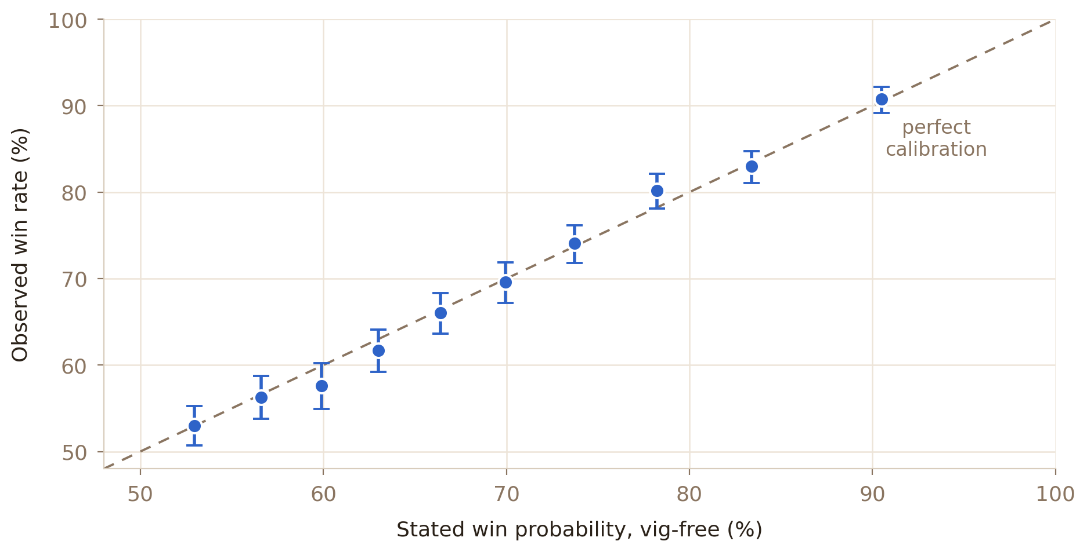
CALIBRATION BY DECILE
Stated probability against what actually happened
Ten deciles of 15,351 games, 1,347 to 1,804 games each, with 95 percent Wilson intervals. The dashed line is perfect calibration.
Notes:
This is the picture behind the number, and the least surprising slide in the deck. That is the point.

Slide 10
THE PART MOST PAPERS SKIP
"Not significant" is not the same as "small"
Failing to reject zero says the data are consistent with zero. It does not say the gap is too small to matter. Those are different claims, so the second one gets its own test.
Two one-sided tests
And the intervals agree on their own
gap is below +2.99
p = 4.7e-08
Primary 95% upper bound
+1.51
gap is above -2.99
p = 2.4e-13
Team bootstrap upper bound
+1.57
Both rejected. The gap is smaller than a bettor needs.
What a bettor needs
+2.99
An 80% minimum detectable effect is not a confidence bound. An earlier draft used it as one; that argument is gone.
Notes:
A reviewer caught this. It was the sharpest statistical point anyone made about the paper.

Slide 11
THE BAR, DERIVED RATHER THAN GUESSED
How big does a gap have to be to be worth money?
expected return = true probability / raw price − 1
Set that to zero and solve. The portfolio breaks even on a gap weighted by 1 / raw probability, not on a plain average.
The paper originally quoted the plain average. The exact answer is two hundredths of a point away.
3.0126 pp
plain average, what the paper quoted
2.9941 pp
exact, what the tests now use
If the whole bias sat in one decile of prices instead of spreading evenly, that decile would need a gap of 27 to 35 points. Nothing close exists here.
Notes:
This is the difference between an economically anchored threshold and an arbitrary one.

Slide 12
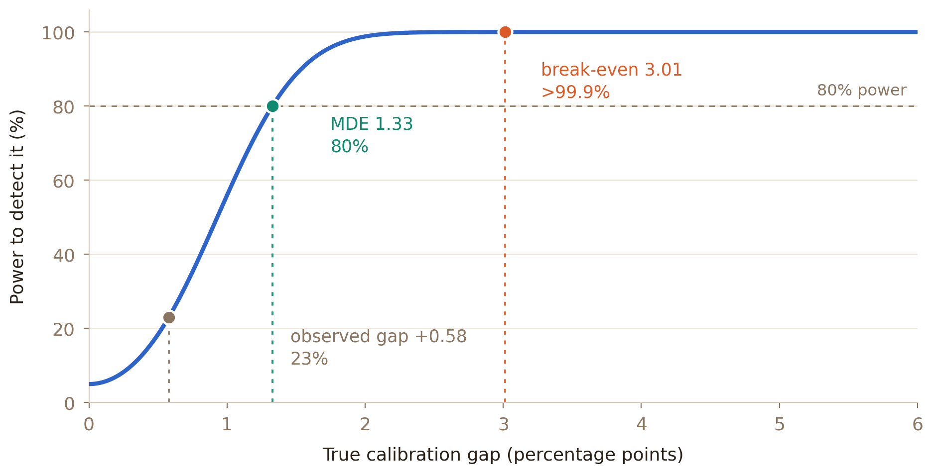
POWER
What size of gap could this design actually catch?
Above 99.9% power at the break-even margin, 80% at 1.33 points, about 11% for the 74-game bucket. No mark is taken from anyone else’s paper.
Notes:
An earlier draft marked 1.7 and 5.1 as the range claimed in prior work. Neither could be traced to a source I cited, so both were removed rather than re-sourced.

Slide 13
So far, an unsurprising null.
Then I changed one line of code.
The bookmaker’s margin has to come out of the price before you can test anything. There is no single correct way to take it out.
Notes:
Most papers pick a rule in one sentence and never come back to it. That sentence turns out to decide the answer.

Slide 14
SAME 6,840 GAMES. ONLY THE RULE CHANGES.
The answer moves, and so does its sign
Vig-removal rule
Gap
p
Break-even
Verdict
None, raw prices
−2.43
<.001
—
margin artifact
Proportional (pre-set)
+0.58
.223
3.01
below the bar
Additive / Shin
−0.55
.231
1.88
below the bar
Constant odds ratio
−0.65
.157
1.78
below the bar
Power
−1.21
.008
1.22
below the bar
Each rule also picks its own games above .70, so an earlier version compared different rules on different samples. Holding the sample fixed is what this table does.
Notes:
Power normalization is significant where the pre-set rule is not. On a fixed sample it still lands below the bar, by one hundredth of a point.

Slide 15
THE FINDING
Three treatments of the same games
−2.43
+0.58
−1.21
raw prices
proportional
power
p < .001
p = .223
p = .008
Whether favorite bias appears at all, how big it is, and which way it points all turn on one modeling step.
Notes:
That dependence, not the null, is what the paper is actually about. It is also why the title changed.

Slide 16
THE SHARPEST SINGLE NUMBER IN THE PAPER
Skip the margin and you measure the margin
−2.43
Test observed win rates against raw implied probabilities and you get a large, highly significant favorite bias.
It is not bettor behavior. It is the bookmaker’s cut, sitting in the numbers, being read as a result.
favorite bias, p < .001, testing against raw prices
Several bucket-test designs still in use skip this step. The sign of the headline finding turns on it.
Notes:
If a paper reports favorite bias close to the overround, check whether they removed the vig at all.

Slide 17
A SMALL THING I DID NOT EXPECT
Shin’s rule and the equal-margin rule are the same rule
Shin (1993) prices against a share of insider money. The equal-margin rule is a mechanical convention with no story behind it. For a two-outcome book they give identical answers, every time.
sum to one + difference held fixed → one possible pair
3.3e-16
2.8e-16
2.8e-16
2.2e-16
difference preserved
closed form
Shin minus additive
sum constraint
Largest error across 15,350 games: 3.3 × 10⁻¹⁶. That is machine precision, not agreement to a few decimals.
Clarke, Kovalchik and Ingram (2017) proved this for two-competitor races. Whelan (2025) gives the closed form for Shin’s insider share.
Notes:
With three or more outcomes they separate. The equivalence is specific to a two-way market.

Slide 18
SIXTEEN LOGGED CORRECTIONS
Things this paper got wrong, on the record
A literature range with no source
An early draft cited favorite bias of 1.7 to 5.1 points. Neither number could be traced to any paper I cited. Both were removed rather than re-sourced.
A power claim doing the wrong job
The minimum detectable effect was being used as if it ruled small effects out. It does not. An equivalence test now carries that claim.
A table comparing different samples
Each vig rule selected its own games, so one comparison mixed the rule with sample composition. Fixing it retracted a claim about power normalization.
All sixteen are in docs/errata.md with the numbers before and after. A result nobody can check is not a result.
Notes:
I would rather show the corrections than have someone find them. This slide is deliberate.

Slide 19
REPRODUCIBILITY
One command rebuilds every number
$ bash run_all.sh
1
verify the data
6
vig rules and dependence
2
build the dataset
7
power curve
3
confirmatory tests
8
Shin proof
4
robustness
9
return simulation
5
figures
10
equivalence and fixed sample
Six minutes, 49 files, from the raw archive. Verification runs first and stops the pipeline if it fails.
Notes:
Data verification runs first on purpose. If the inputs are wrong, nothing after it is worth computing.

Slide 20
WHAT TO TAKE FROM THIS
Two conclusions, one of them useful
For bettors
For researchers
In these archived prices, over this period, under the rule fixed in advance, simply backing favorites or underdogs offered nothing worth having.
That is a narrow statement and it should stay narrow.
The evidence for favorite bias is not robust to how the margin is removed. That dependence is invisible to a single-rule bucket test.
Reporting the sensitivity is not a caveat attached to the result. It is the result.
The title of this paper used to be a question about calibration. The data changed it into a question about method.
Notes:
If a reader remembers one slide, it should be this one.

Slide 21
WHAT THIS CANNOT TELL YOU
Limits, stated plainly
The freeze has no outside timestamp
One consensus line per game
The plan was fixed before I saw outcomes, but the record is in my own files. Pre-specified, not pre-registered.
No line shopping, no book identity, and the timing of each quote is unrecorded. Nothing here speaks to closing lines.
Thirteen clusters is not many
The archive stops in March 2020
Season-level cluster-robust variance needs more groups than this to be trusted, so those rows are sensitivity checks.
Everything predates most of the US legal expansion. No claim is made about what came after.
Every one of these is in the paper. None of them was found by a reviewer first.
Notes:
Every one of these is in the paper. None of them was found by a reviewer first.

Slide 22
Questions? Holes in it?
The whole thing rebuilds from raw data with one command. I would rather it broke now than after someone cites it.
github.com/jacobburdier05/nba-moneyline-calibration
Jacob Burdier · jacobburdier@gmail.com · The Scholars’ Academy, class of 2027
Notes:
Ask for the hole, not the compliment. It is a better question and you get better answers.

