Slide 1
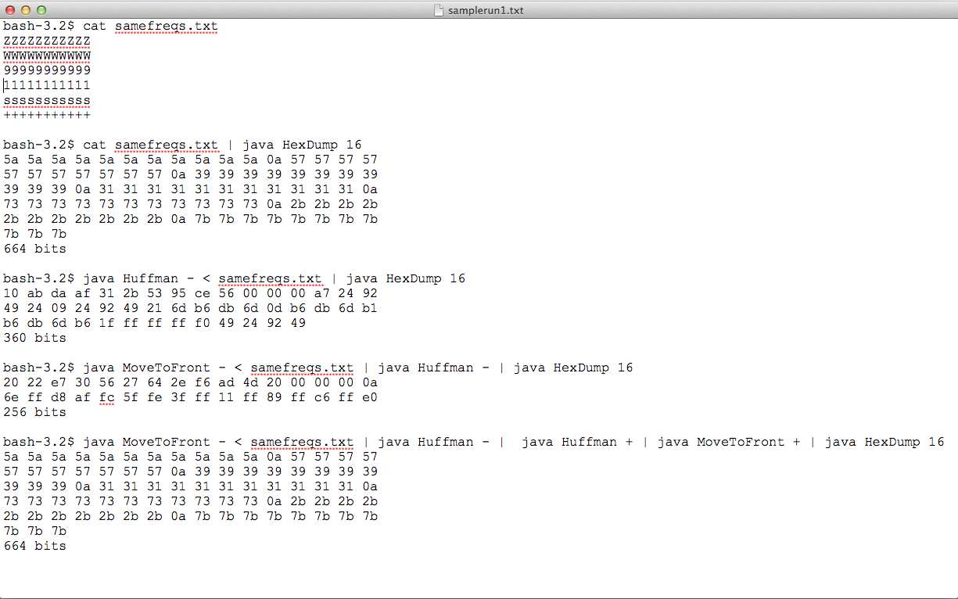
Run on my Mac
Original file
Original file (Hex)
Compressed no preprocessing
Compressed with preprocessing (improvement)
Reverse process to get original file

Slide 2
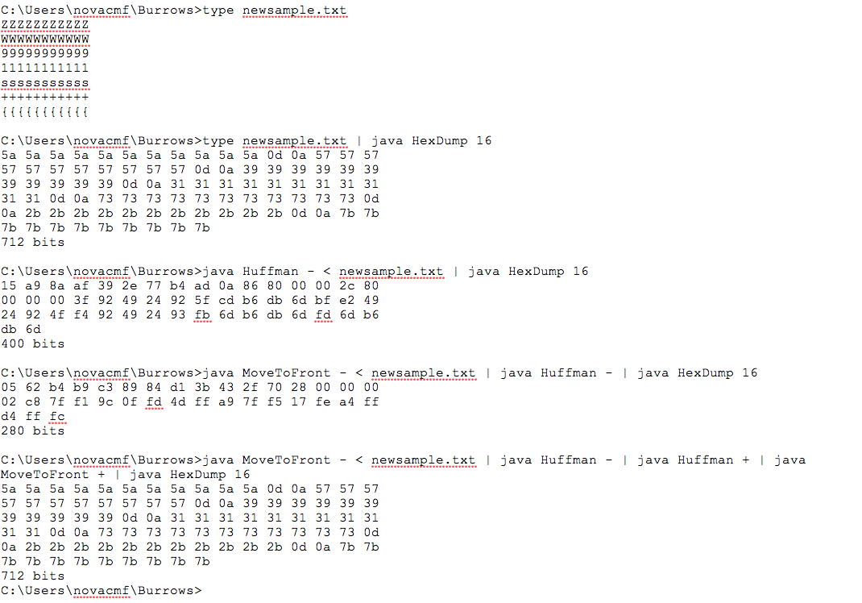
Run on a PC
newsample.txt constructed in NotePad

