Slide 1

A Presentation by:
Jacob Caudle
Andrew Eash
Nathaniel Ritzman

Slide 2
Who We Are
Jacob Caudle - Electrical Engineer - Microcontroller Programming
Andrew Eash - Electrical / Renewable Engineer - Android App Programming
Nathaniel Rizman - Mechanical Engineer - Overall Blimp Design

Slide 3
Introduction
Lead Zeppelin is a company looking to entertain adult hobbyists with a RC blimp. We wanted to apply our skills and knowledge to create a blimp that had the capabilities of Vertical Take-Off and Landing (VTOL). We also wanted to provide the operator with a user friendly interface with simple controls from an Android phone app. Altogether we wanted this design to be a fun, large scale blimp that could be flown in open spaces and easy to operate.

Slide 4
Initial Idea
Design idea 1
Powered by battery
Connect wirelessly with two MSP430s and a radio frequency transmitter
2 continuous motors and 3 servo motors (3rd one to operate a rudder/fin)
One giant 5ft diameter balloon

Slide 5
Final Design
A remote controlled blimp
Powered by battery
Controlled by Bluetooth
2 continuous motors and 2 servos
Assembly of balloons
Controlled by Android phone app

Slide 6
Issues & Solutions
3D print did not turn out for oblique print Not enough balloons for lift Balloons thicker than expected Glue dots not as strong as expected | Rectangular propeller blade protector Added two balloons to increase from 6 to 8 Modified balloon assembly Added more glue dots

Slide 7
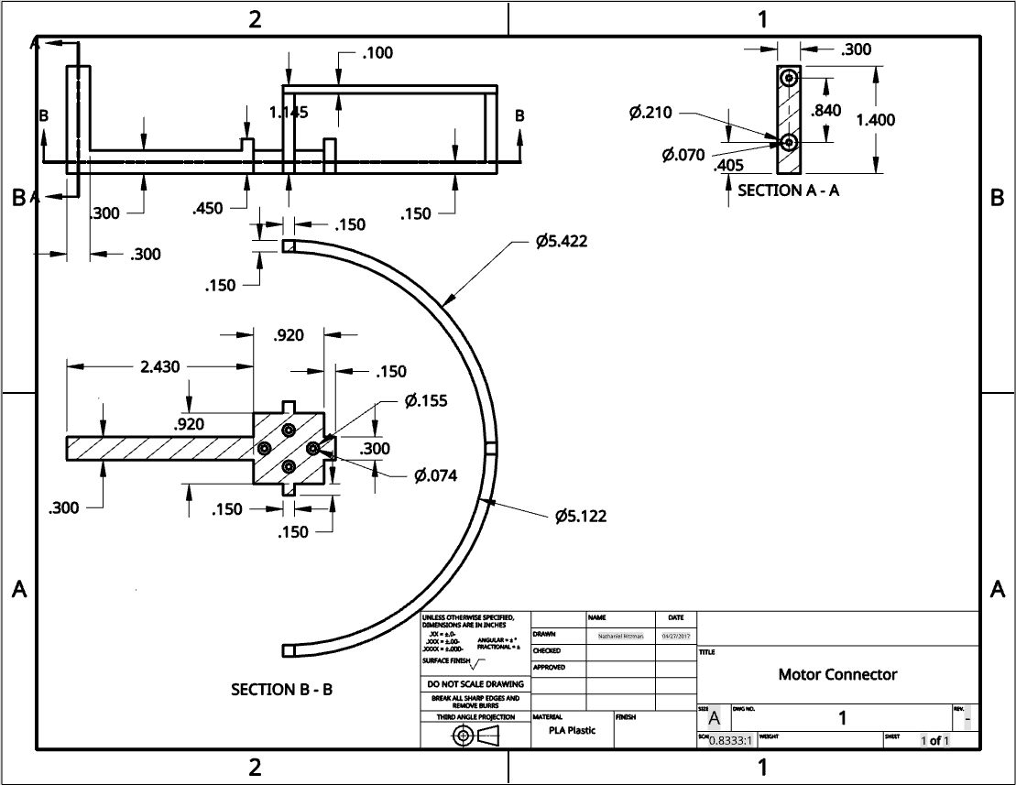

Slide 8
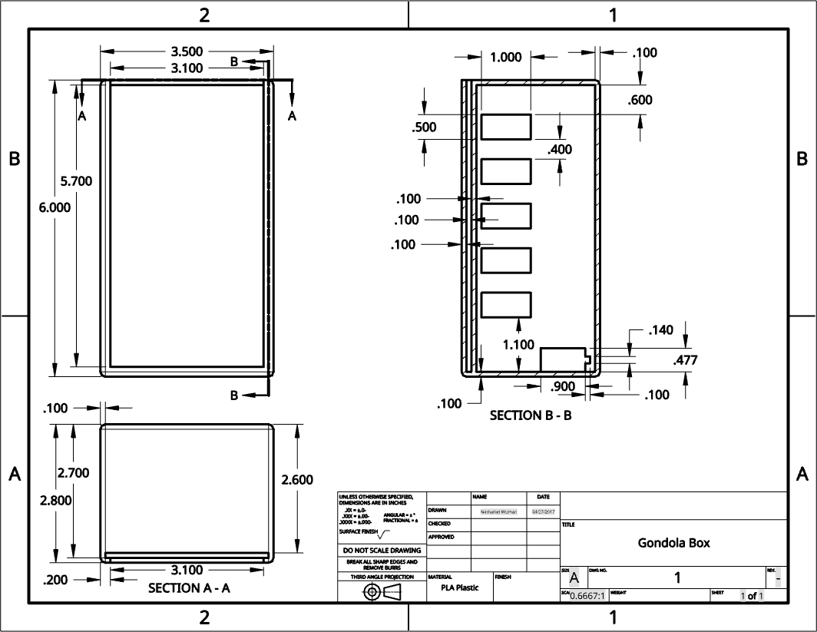

Slide 9
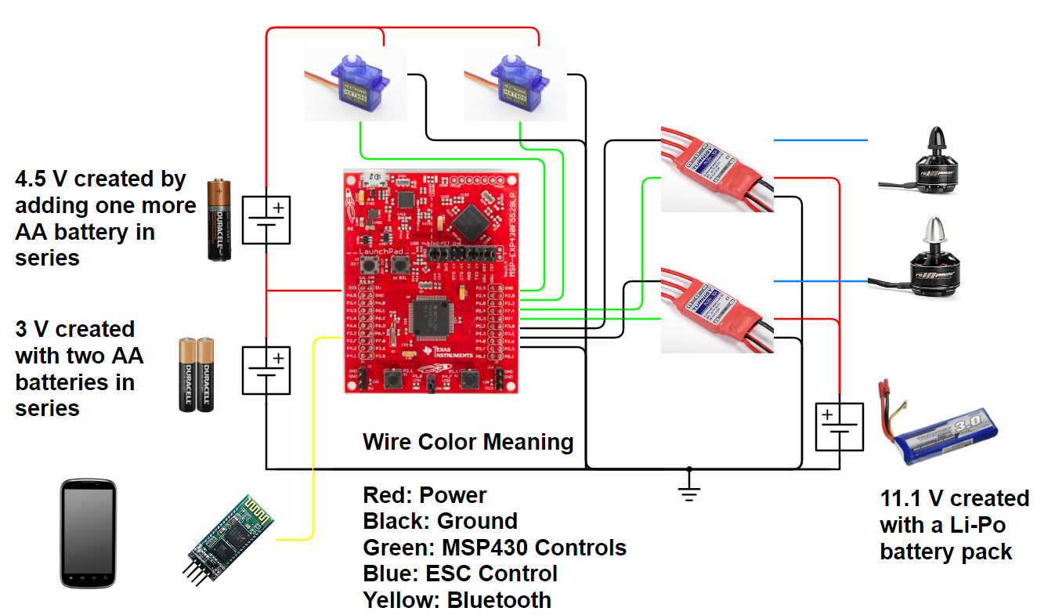
Electrical Schematics
Pin | Connection
3.4 (UCA0RXD) | Bluetooth TX connector
3.3 (UCA0TXD) | Bluetooth RX connector
GND | Bluetooth Ground
2.5 (TA2.2) | Left ESC motor signal wire
GND | Left ESC ground
2.4 (TA2.1) | Right ESC motor signal wire
GND | Right ESC ground
1.5 (TA0.4) | Left servo motor signal wire
GND | Left servo ground
1.4 (TA0.3) | Right servo motor signal wire
GND | Right servo ground

Slide 10
Motor Design
Both the servo and DC motors are controlled by Pulse Width Modulation
Motor states depend on the 3 variables sent by phone app, Pitch, Roll, and Throttle
Servo motors have a 180 degree rotation
DC motors output a max power of 24.4 W at highest speed

Slide 11
How do they communicate?
Serial Universal Asynchronous Receiver/Transmitter (UART) connection via Bluetooth
Phone app gathers data and sends it to the MSP430 via ASCII characters
MSP430 receives data and changes “states” based on the certain characters received
MSP430 sends corresponding signals to the motor output pins

Slide 12
What are they saying?
Motor control based off of 3 variables: Pitch, Roll, and Throttle
The Pitch controls the servos rotating the blimp up or down (A-Z)
The Roll controls the DC motors turning the blimp left or right (a-z)
The Throttle controls the speed of the DC motors (0-9)
Pitch and Roll are calculated by the position of the phone (using the accelerometer)
Throttle is controlled on a sliding bar ranging from 0-100
Variables are constantly updated 10 times per second

Slide 13
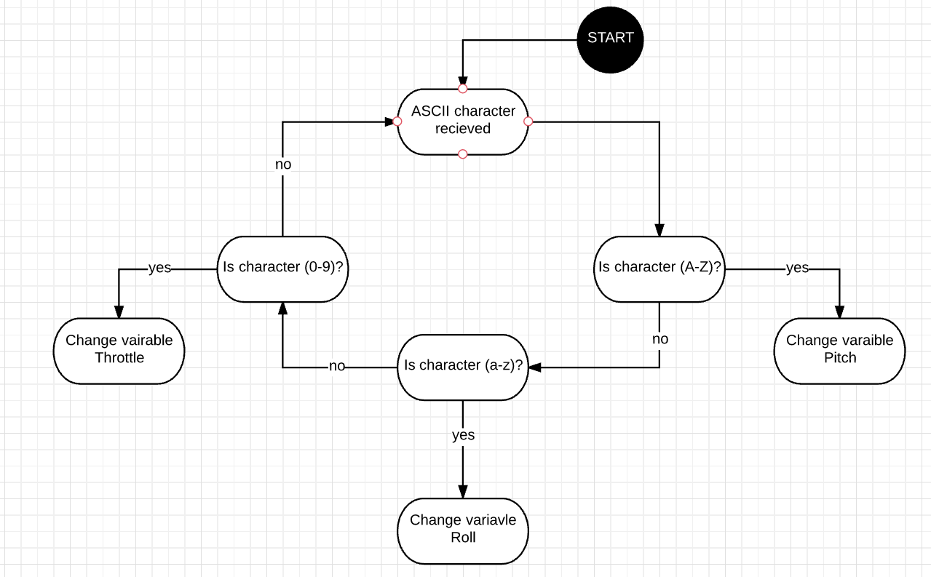

Slide 14
Why Use a Phone App
Cheapest option for this project
Most Americans already own a smartphone
Simplicity with phone app
Cutting edge technology
Allows further development
Updates could be provided with new features

Slide 15
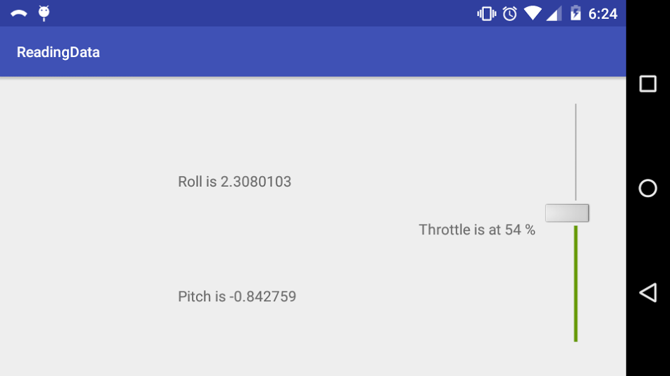

Slide 16
Why Bluetooth?
Device to device connection
Less power usage
Easy setup within app
RF is difficult with phone
Doesn’t use up WiFi channel
Range of 110 meters
Bluetooth has a low power mode

Slide 17
Bluetooth on the App
“DISCOVER” button searches for pairable devices
List of connectable devices
Click on listed “HC-06”
Attempts connection with “HC-06”
If successful, turn data streaming toggle button on
Throttle, roll, and pitch are sent to MSP430

Slide 18
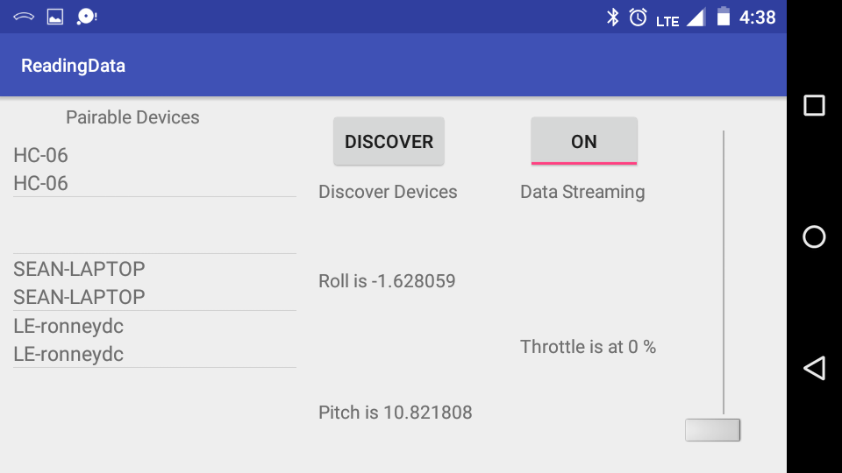

Slide 19
Testing issues
MSP430 default case problem Speed controller was defective App magnetometer did not exist App incorrect UUID for HC-06 | Removed the default case from the MSP430 code Increased PWM value sent to ESC for equal power Removed magnetometer function and only used accelerometer Looked up and altered UUID for serial connection

Slide 20
Testing Results
Blimp can successfully take-off from the ground
Blimp will hover at the in between 3rd and 4th throttle speed
Turning the blimp is difficult, but possible
Balloon can successfully land
First flight time lasted 58 minutes

Slide 21

Packaging
Servos
Speed Controller
Breadboard
Battery Holder
Bluetooth Connector
Motors
Connector Arms
Props
Balloons and Manuals
Wires
Gondola
Battery

Slide 22
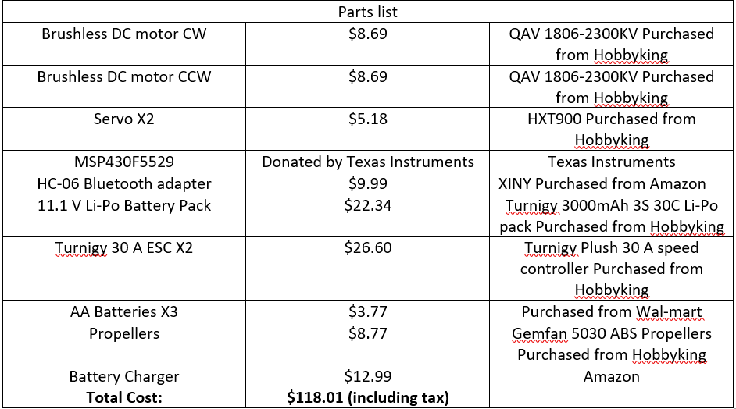
Budget

Slide 23
What we have learned
How to communicate well as a team
Divided up work well
Integrate as early as possible
Make sure to order everything needed
Contact people early on (balloon and helium)

Slide 24
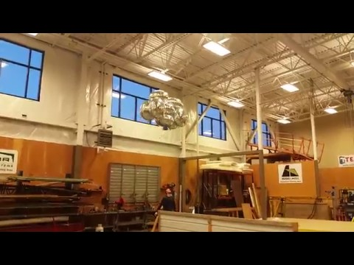
Demonstration

Slide 25
Questions?

