Slide 1
Movie Recommendation System
CS550: Massive Data Mining
By: Anirudh Negi, Jacob Celestine, Meghana Tumkur Narendra

Slide 2

Outline
Objective
Data set description
Approach
Models for Recommendation
Evaluation of Algorithms
Results Analysis
Learnings and Future scope

Slide 3

Objective
The Recommender systems takes much of the cognitive burden off the shoulders of the users by filtering all the available choices and presenting only the information that would more accurately describe the users needs and interests.
We aim to build a rating prediction and movie recommendation system based on ‘MovieLens’ dataset.

Slide 4




Data Set
● Movie review dataset (MovieLens)
○ Movies: 1642
○ Users: 943
○ Ratings: 100k
○ Genres: 20
● Four csv files: movies.csv, ratings.csv, tags.csv and links.csv
● Dataset is split into 80% training and 20% testing based on the User ID.
Notes:
100,000 ratings (1-5) from 943 users on 1682 movies.
* Each user has rated at least 20 movies.
* Simple demographic info for the users

Slide 5
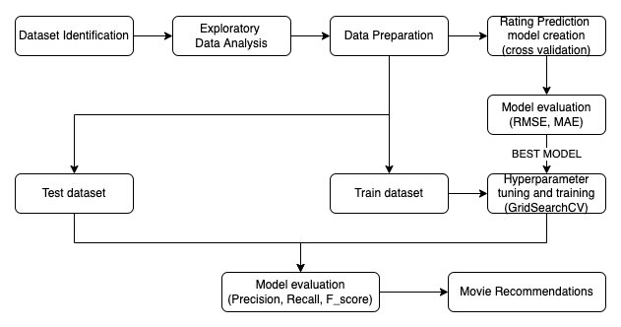
Approach

Slide 6
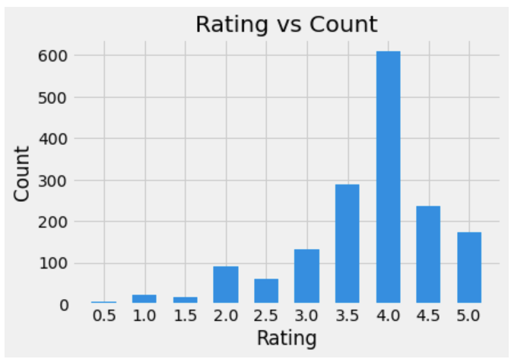
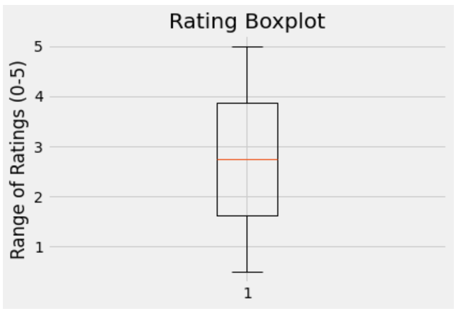
Data Analysis (1/3)

Slide 7
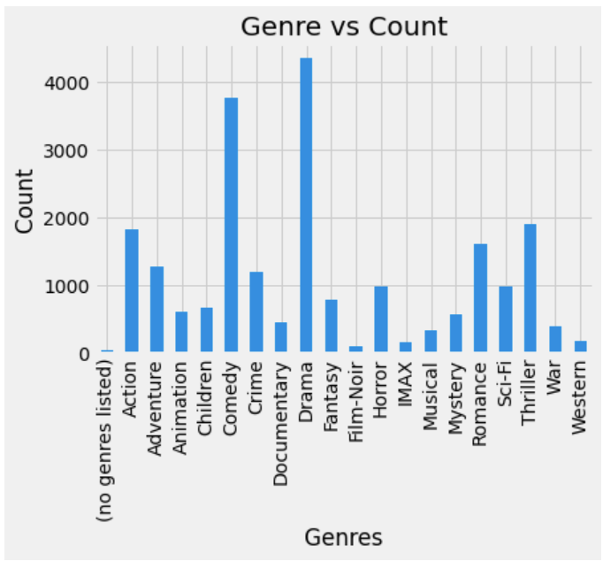
Data Analysis (2/3)

Slide 8
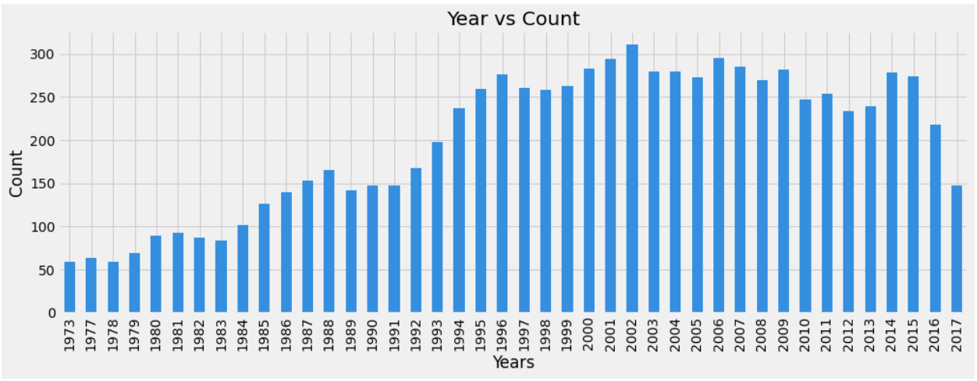
Data Analysis (3/3)

Slide 9
Models for Recommendation
Normal Predictor
Slope One
Co Clustering
K Nearest Neighbors inspired Algorithms
Matrix Factorization - based Algorithms

Slide 10
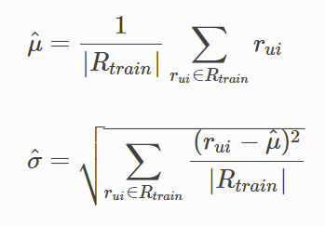
Algorithm: Normal Predictor
Normal Predictor
Algorithm predicting a random rating based on the distribution of the training set, which is assumed to be normal.
Notes:
Remove baseline

Slide 11


Algorithm: Slope One
SlopeOne
Slope One predictors have the form f(x) = x+b, where b is a constant and x is a variable representing rating values. As it compares rating between pairs of items to make its prediction, the idea is to find the best f function that predicts one item’s rating based on other.
Notes:
Remove baseline

Slide 12

Algorithm: CoCluster
CoCluster
A collaborative filtering algorithm based on co-clustering.
Notes:
Remove baseline

Slide 13
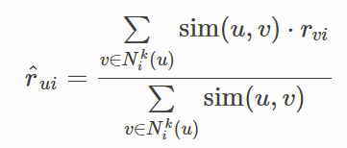
Algorithm: KNN Basic
KNNBasic
A basic collaborative filtering KNN algorithm.

Slide 14
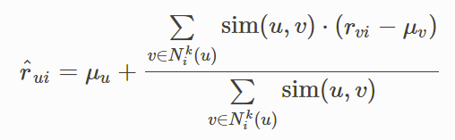
Algorithm: KNN With Means
KNNWithMeans
A basic collaborative filtering algorithm, taking into account the mean ratings of each user.

Slide 15
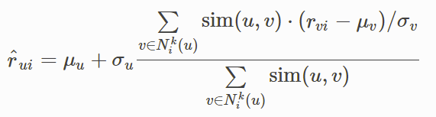
Algorithm: KNN With Z-Score
KNNWithZScore
A basic collaborative filtering algorithm, taking into account the z-score normalization of each user.

Slide 16


Matrix-Factorisation Based Algorithms
SVD
Based on famous SVD algorithm by Simon Funk
SVDpp
An extension to SVD taking into account implicit ratings

Slide 17
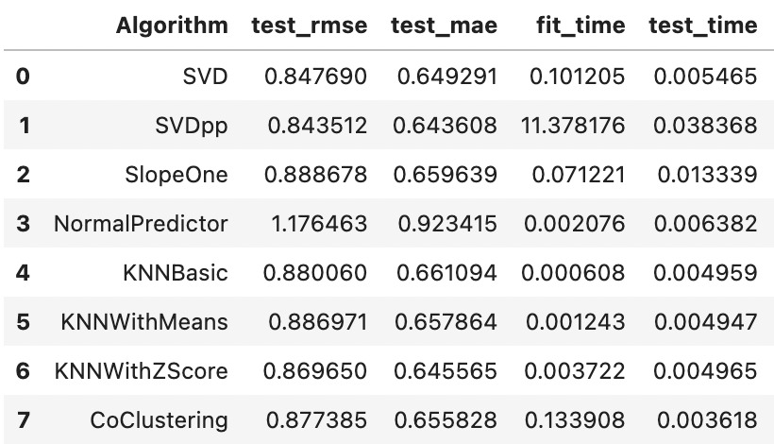
Evaluation of Various Algorithms
Notes:
baseline,KNNbaseline,NMF. Crop till test_time

Slide 18
Which Model is best?
SVDpp is performing best compared to other models.
But when compared with SVD, it takes a lot more time for negligible difference in the RMSE and MAE values.
Thus, we choose SVD to explore further.

Slide 19
Model Improvement (1/2)
Hyperparameter tuning using GridsearchCV for SVD.
○ Number of epochs, number of factors, regularization parameter
Notes:
In almost any Machine Learning project, we train different models on the dataset and select the one with the best performance. However, there is room for improvement as we cannot say for sure that this particular model is best for the problem at hand. Hence, our aim is to improve the model in any way possible. One important factor in the performances of these models are their hyperparameters, once we set appropriate values for these hyperparameters, the performance of a model can improve significantly
GridSearchCV tries all the combinations of the values passed in the dictionary and evaluates the model for each combination using the Cross-Validation method. Hence after using this function we get accuracy/loss for every combination of hyperparameters and we can choose the one with the best performance.

Slide 20
Model Improvement (2/2)
Results obtained for predicting the ratings on test data.
Precision: % of relevant instances among the retrieved instances.
Recall: % of relevant instances that were retrieved.
F-Score: 2 * Precision * Recall / (Precision+Recall)
Precision | 0.8009259259259259
Recall | 0.9141344050269369
F- Score | 0.8537938071953081
Notes:
Precision: 0.8009259259259259
Recall: 0.9141344050269369
F_score: 0.8537938071953081
Add the formulas

Slide 21
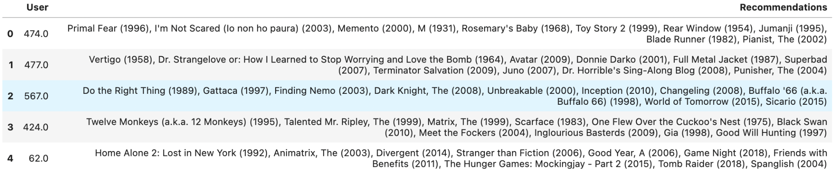
Recommendation Results
Top 10 movie recommendations based on the User_id

Slide 22
Learnings and Future Scope
We experimented with the Movielens 100K data to predict ratings and generate movie recommendations for users.
Models: Normal Predictor, K Nearest Neighbors inspired Algorithms, Matrix Factorization - based Algorithms, Slope One, Co Clustering
Evaluation Metrics used: RMSE, MAE, Precision, Recall and F-score
Increase the dataset size and use deep learning models.

Slide 23
References
Surprise library: https://surprise.readthedocs.io/en/stable/prediction_algorithms_package.html
https://surprise.readthedocs.io/en/stable/knn_inspired.html
https://joss.theoj.org/papers/10.21105/joss.02174
https://github.com/NicolasHug/Surprise/issues/285

Slide 24
Thank you!!

