Slide 1
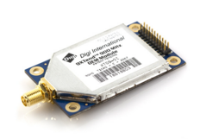
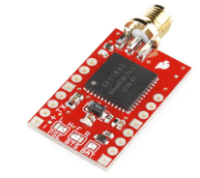
Tracking Bay
Components:
Arduino Mega
XTEND-900 radio transceiver
Venus GPS Module
Radio and GPS Antenna
Battery
Communicates vehicle position data back to ground station in real time.

Slide 2
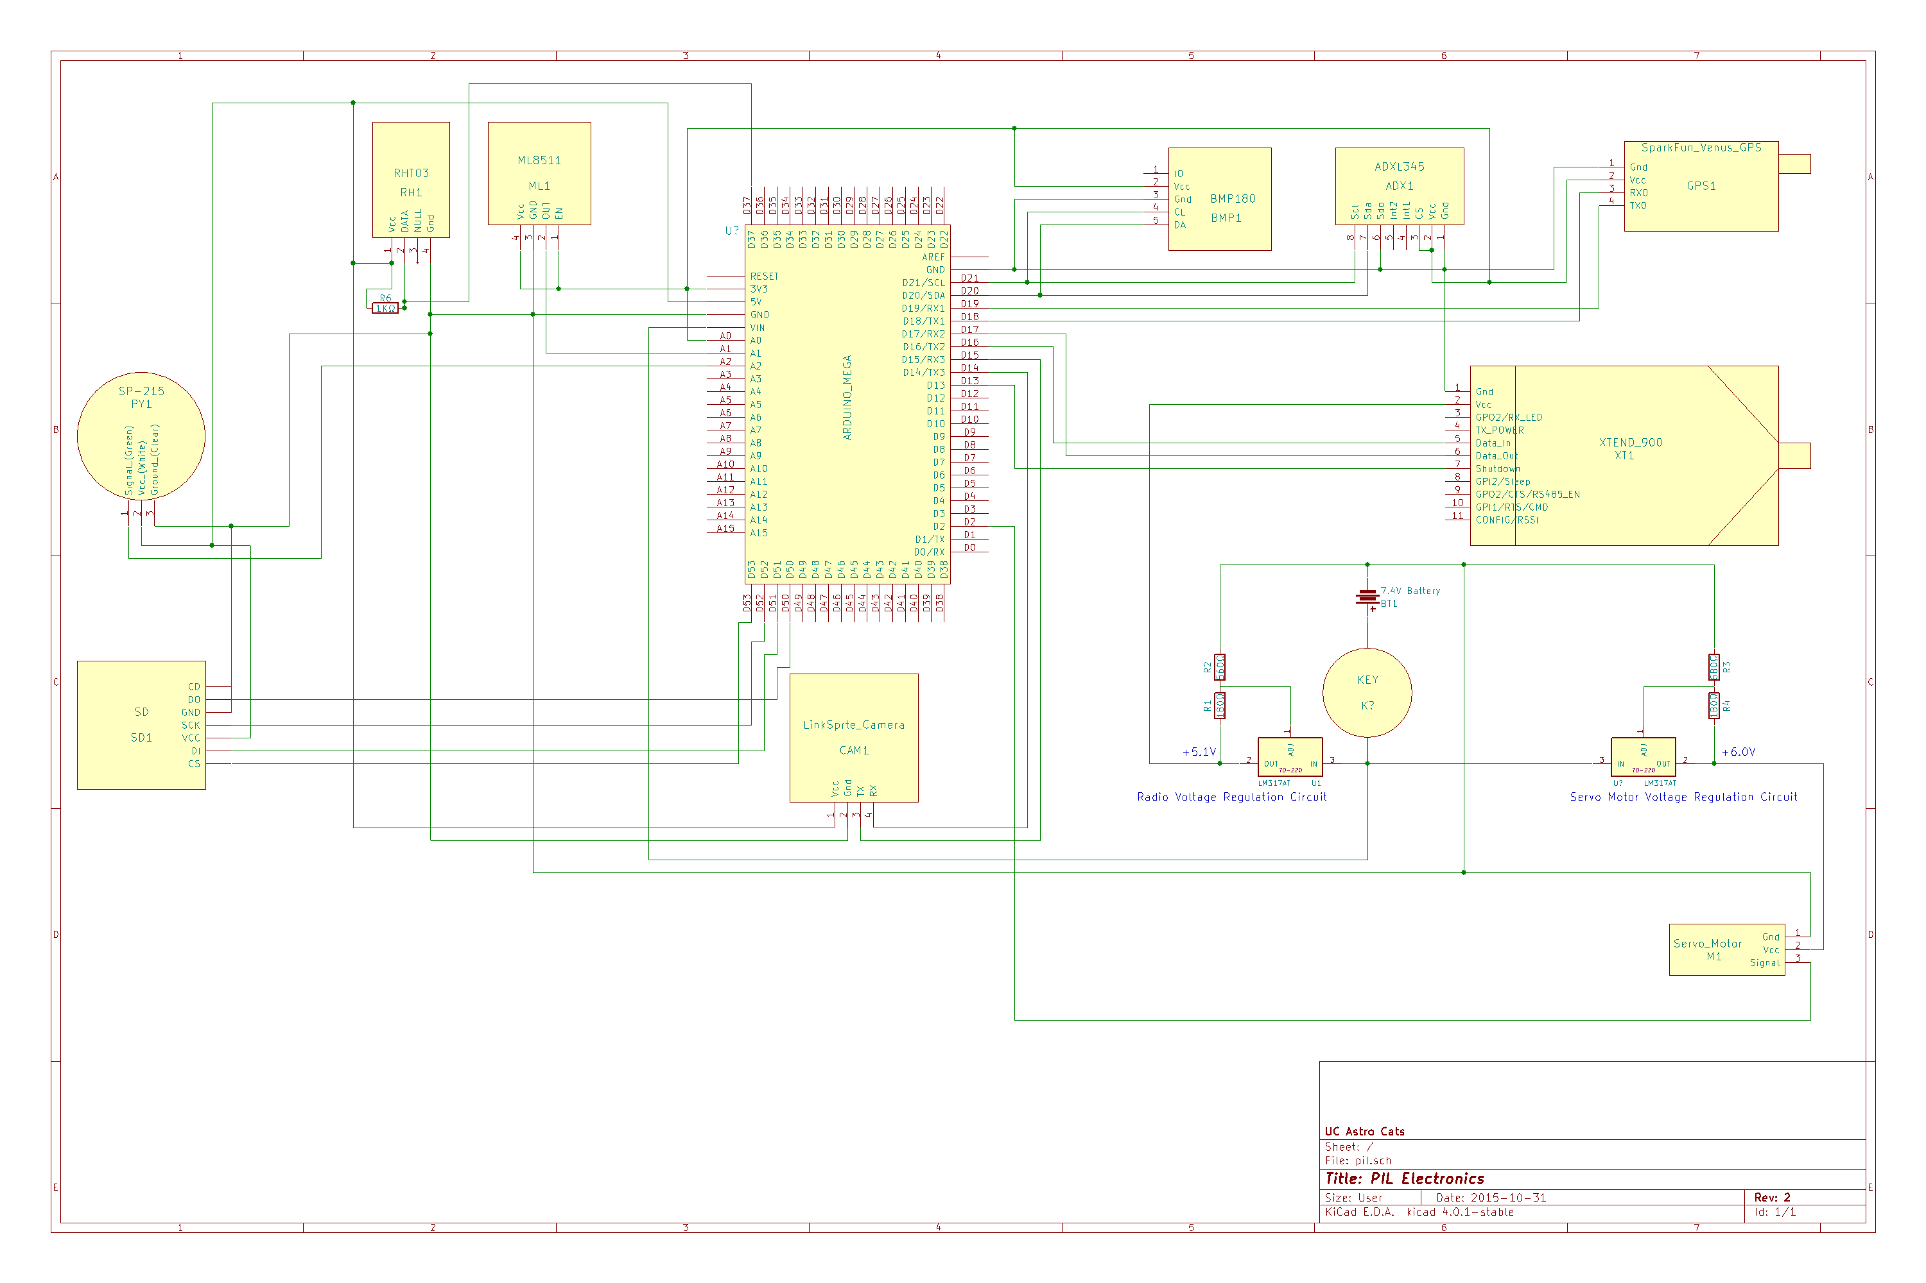
PIL Electronics Schematic

Slide 3
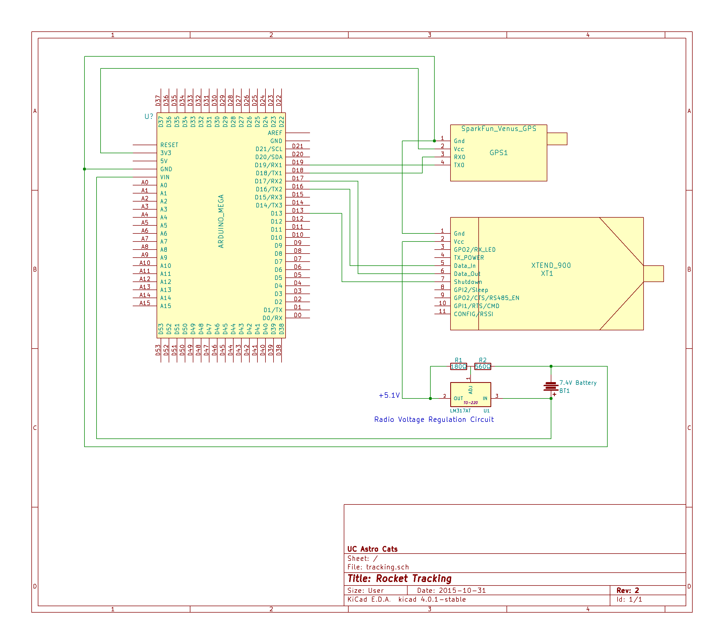
Tracking Bay Electronic Schematic

Slide 4
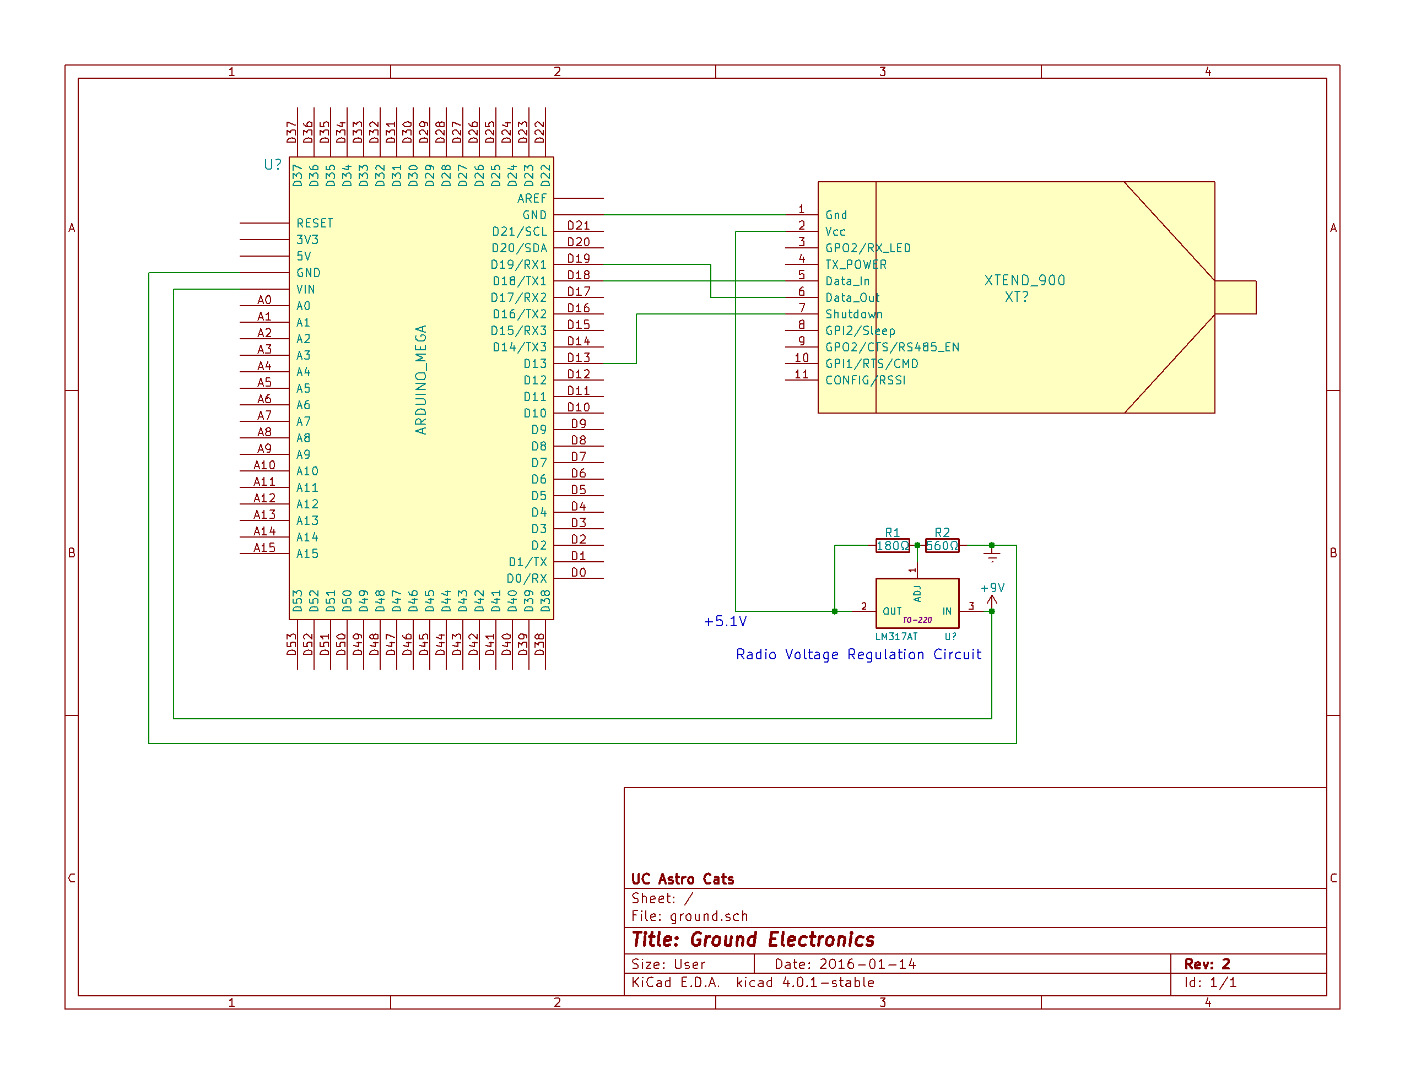
Ground Control Electronic Schematic

Slide 5
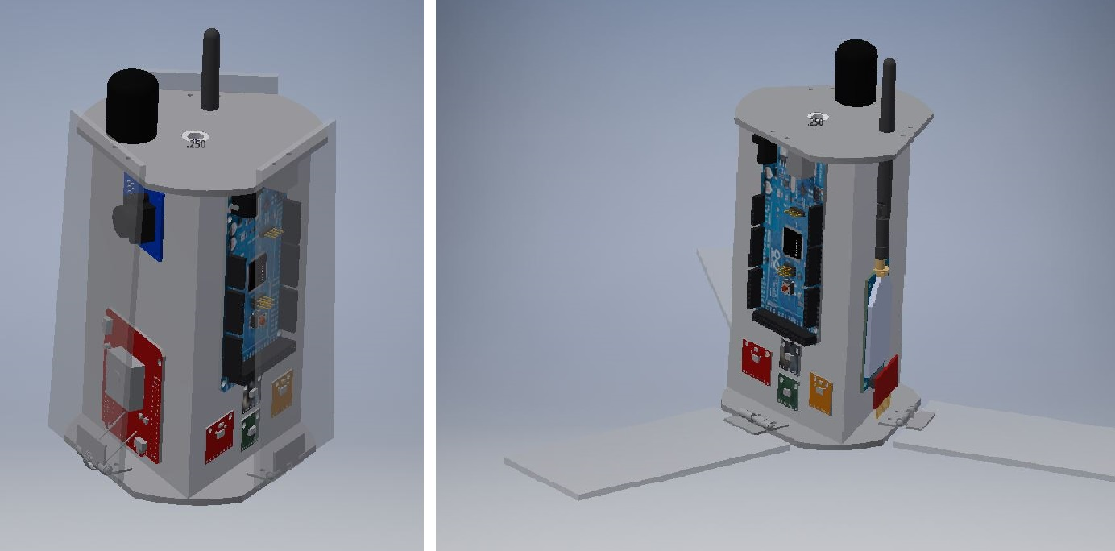
PIL Hardware
Arduino Mega 2650 – Microcontroller
XTEND 900 – 1 Watt 900 MHz radio
SparkFun Venus GPS – GPS Module
RHT03 – Temperature and Humidity sensor
Two used with alternating polling.
BMP180 – Barometric sensor
ML8511 – UV Sensor

Slide 6
PIL Hardware Continued
Apogee Instruments SP-215 – Pyranometer
continuously outputting voltage relating to solar irradiance (W/m²).
ADXL345 – Accelerometer
LS-Y201-2MP - JPEG Color camera
SparkFun microSD Transflash
microSD Breakout board to write data to microSD
Backup data storage in case of radio failure

Slide 7
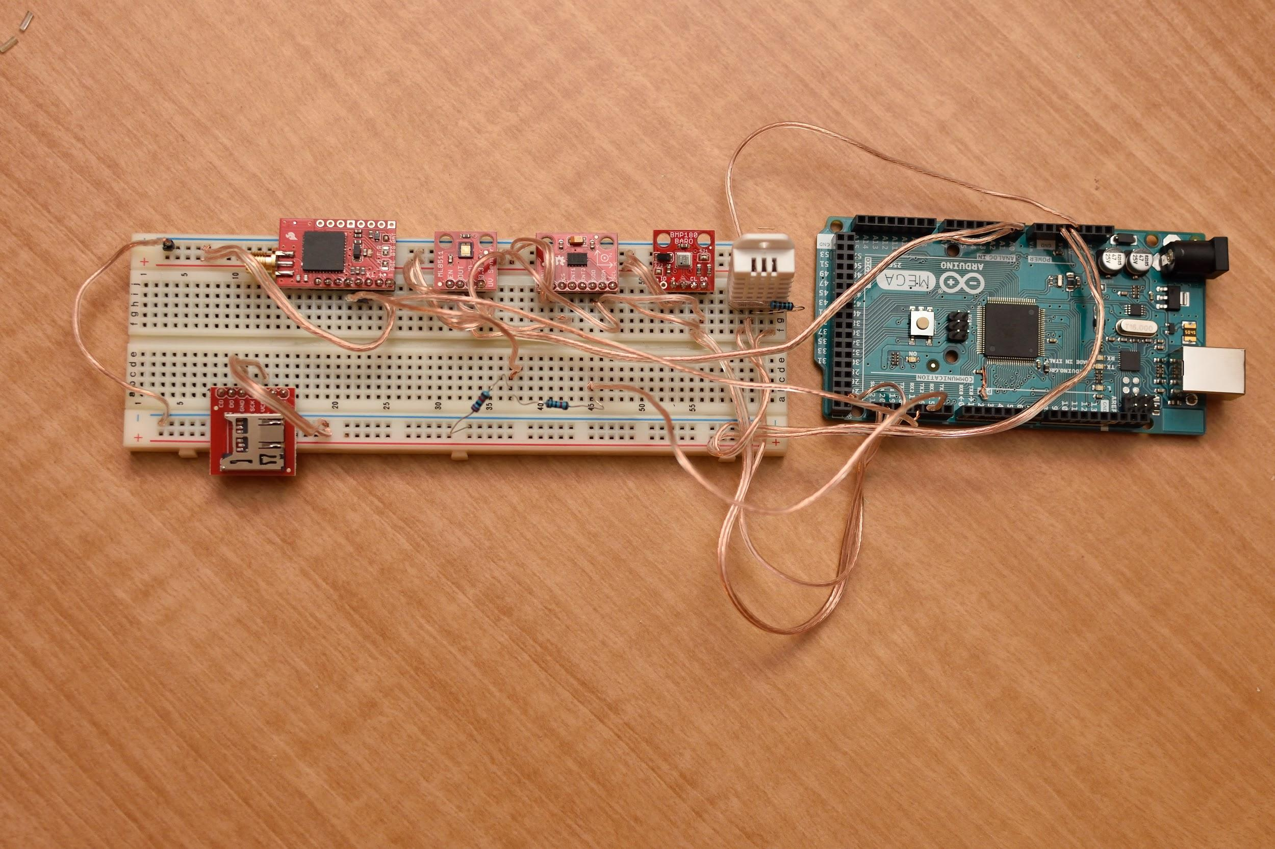
PIL Hardware Prototype

Slide 8
Ground Control Hardware
Arduino Mega 2650
Microcontroller that interfaces the radio transceiver with the PC
Sends incoming radio data from the PIL and Tracking Bay to the PC
Sends outgoing commands to the radio, to transmit to the PIL
XTEND-900 - Radio transceiver
PC - A laptop used to interface with the Arduino
Collect and display gathered data using custom software

Slide 9
Ground Control Software
Arduino will collect data from radio that has been received from PIL and Rocket Tracking Bay, and send it to the PC over serial connection.
PC will utilize custom software that retrieves serial data sent from the Arduino.
Data will be parsed and the user interface display will be updated in real time with new data. Data will be stored on machine running the software.
wxWidgets C++ GUI Library being used for GUI.

Slide 10
Ground Control Software Development
• Able to connect to Arduino using Serial Port.
• User Interface development started.
• Data recording system is implemented.
• Data playback system is implemented.

Slide 11
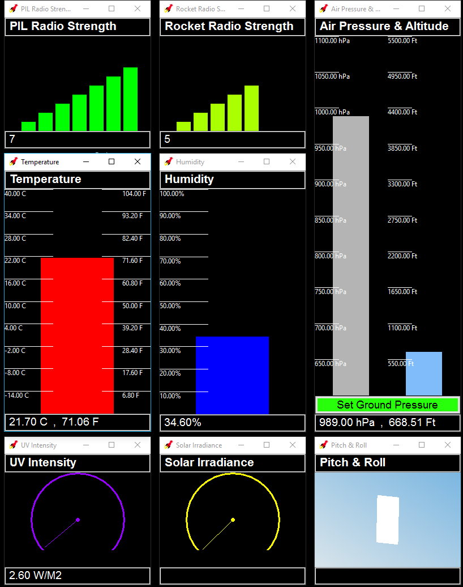
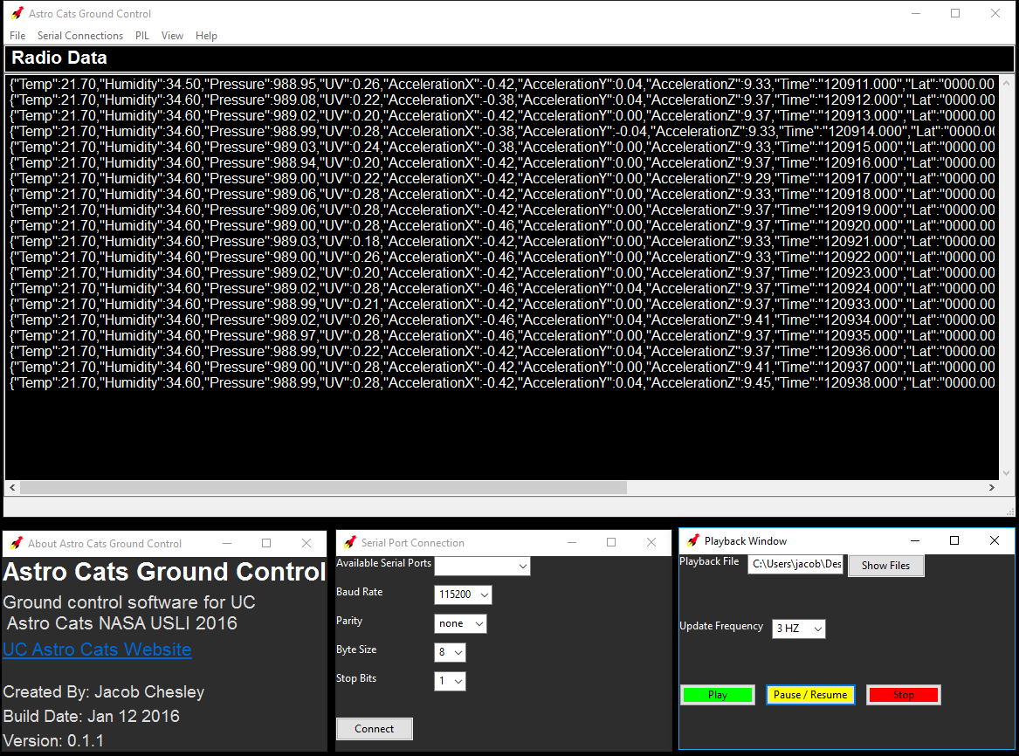
Ground Control Software GUI

Slide 12
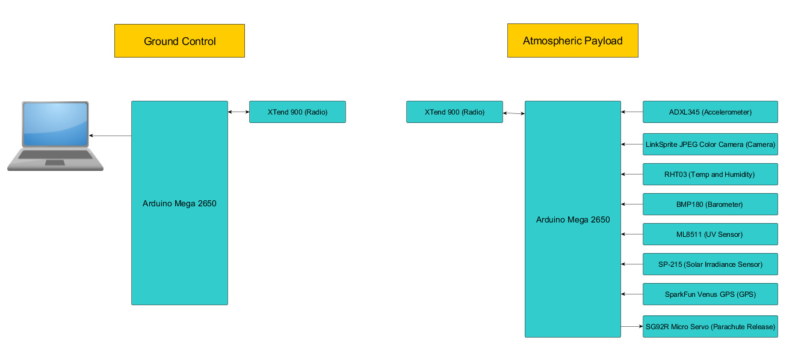
System Integration - PIL & Ground Ops

