Slide 1
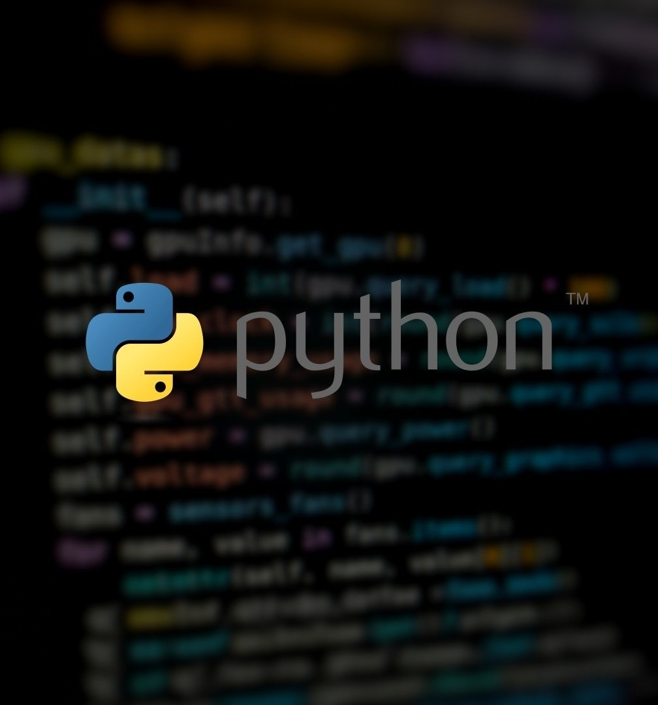
Python Bootcamp
For Beginners
Python foundations, working with tables and visualizations
2025-10-20

Slide 2
Introduction, Discussion &
Setting Up Python

Slide 3

Welcome!
Main goal by the end of the week:
Think computationally: Be confident with Python coding fundamentals
Solve business problems: Learn to break down processes
Automate tasks: Implement these processes as code
Notes:
Open with goals tied to specific accounting scenarios and set the Friday deliverables.*

Slide 4
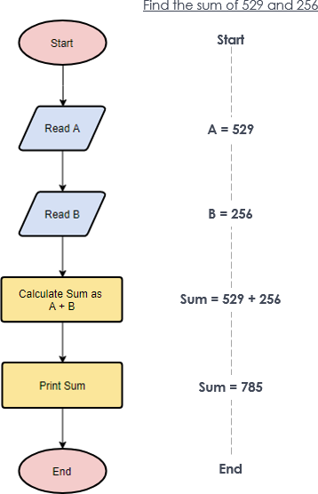
Algorithmic Thinking
How to solve problems
What is an algorithm?
Definition: "A process or set of rules to be followed in calculations or other problem-solving operations, especially by a computer."
Simpler terms: "A step‑by‑step 'how‑to' complete a task."
'Imperative' vs 'declarative' knowledge:
Declarative knowledge is high-level, stating the broader goals/constraints.
Imperative knowledge is the deeper "knowing-how" to perform a task, the set of steps, rules, or procedures to achieve a goal.
When manually performing a task, we don't always consciously consider these imperative aspects.
Now we need to focus on the 'imperative' understanding of tasks: how to automate processes.
Notes:
Demystify 'algorithm' with a 4‑step raffle example and map to a concrete 4–5 step invoice check.*

Slide 5
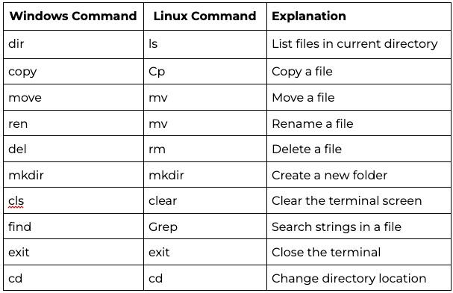
Terminal: Usage Fundamentals
Also known as the 'command-line' or 'shell'
Can use
Terminal in VSCode
PowerShell (A separate application)
Running the Python interpreter:
Type 'python' in the terminal, press 'enter'. It should look like this:
C:\> python
Python 3.x.x (main, Jun . . . , 13:29:14) [MSC v.1932 64 bit (AMD64)] on win32
Type "help", "copyright", "credits" or "license" for more information.
>>>
The python interpreter is now open. Type the following and press 'enter':
print("Hello World!")
Now, we will run this as a script instead of directly in the interpreter:
Create a new text file in VSCode, and save it as "hello_world.py"
Save the above 'print' command in this file.
Run this script by typing the following into the terminal, then press 'enter':
python hello_world.py
Notes:
Anchor new terms: terminal = command window, directory = folder, path = folder address.*

Slide 6
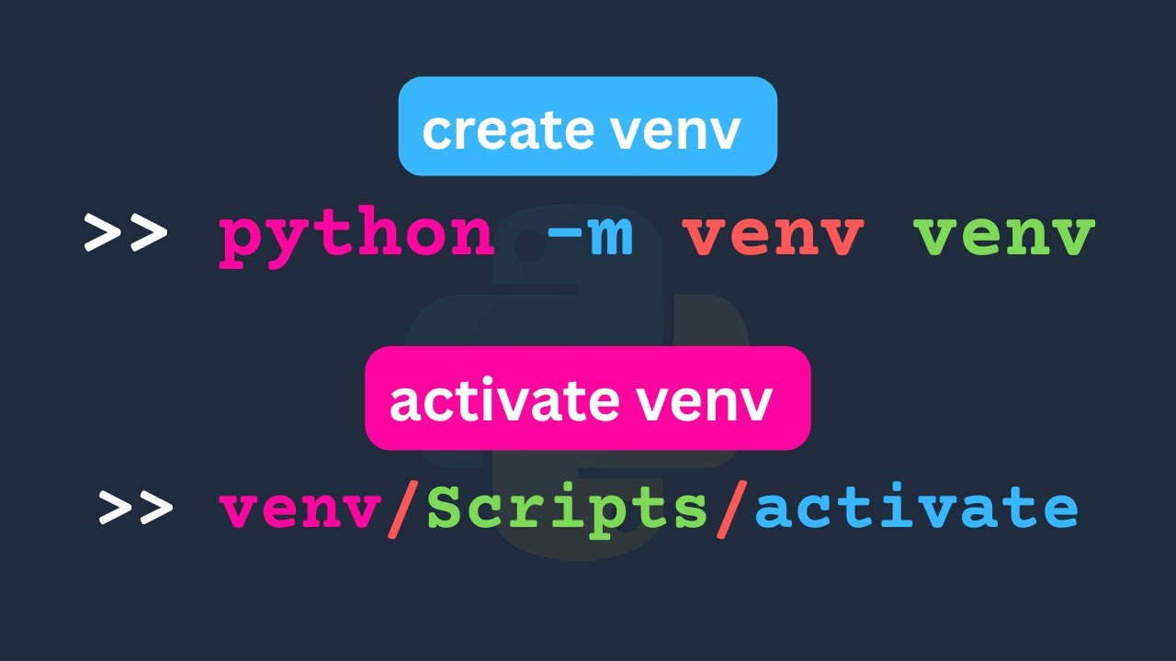
Terminal: Python Virtual Environments (venv)
In Python, we can install various extra packages (shown in next step)
Sometimes we want to have different packages for different projects
Solution: Virtual Environments
Create and Activate a Virtual Environment (venv)
Create a folder for the environment mkdir folder_name
Change working directory (into the folder you created) cd new_folder
Create 'venv' in the folder you created python -m venv .venv
Activate the '.venv' you just created Windows: .venv\Scripts\activate Linux: source .venv/bin/activate (Runs a script that was created in the venv folder)l
Now any packages installed will be tied to this venv when active
To exit the venv, type: deactivate
Notes:
Anchor new terms: terminal = command window, directory = folder, path = folder address.*

Slide 7

Python Package Manager
Using 'pip'
We will use pip to install a package called 'pandas'
Install the package (inside the venv):
python -m pip install pandas
Or even specify the version:
python -m pip install "pandas==2.2.3"
Can uninstall a package:
python -m pip uninstall pandas
Install many packages stored as a list in a 'requirements.txt' file:
python -m pip install -r requirements.txt
(Simply provide a list of all package names in a text file called requirements.txt, one package name per line)
Notes:
Define repository in 1 line: the folder Git tracks; define commit in 1 line: a timestamped snapshot you can roll back to.*

Slide 8
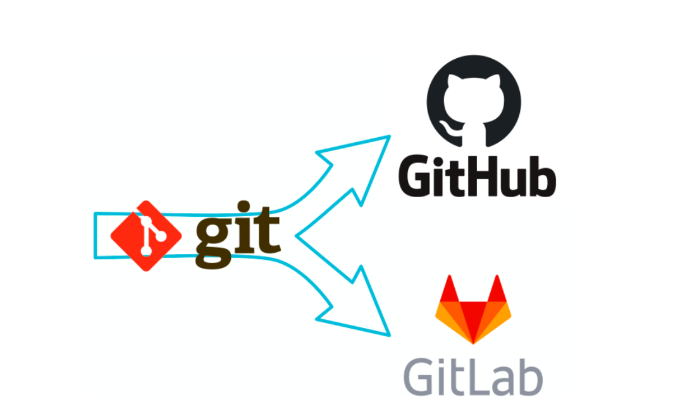
Version Control Basics
Getting started with Git - Advanced usage addressed later on
Based around the concept of a repository ('repo')
Initialise by running:
git init (This creates a hidden .git folder).
Create an empty text file ".gitignore". Add the text ".venv/" (so the 1,000+ venv files aren’t tracked).
Optional: add any other file names/folders you don't want to track to the ".gitignore" file.
Save a snapshot of the repository by running "git add ." (the dot indicates all files)
Run "git commit -m "Initial project setup" " to save the changes
Run "git status" to see current state of repo
Next step: Connect to remote repo
Notes:
Explain .gitignore as a rulebook: it tells Git which files/folders (like .venv) to ignore permanently.*

Slide 9
Fixing and Merging a Problem Repo
1. Restart from scratch by deleting the existing local copy of your git repository (Will not delete your code) rm -Recurse -Force .git
2. Create a ".gitignore" file in the root (top-level) of your folder. Type the following (inside the file) and save it: .venv
3. Similarly, create a ".gitattributes" file in the root (top-level) of your folder. Type the following (inside the file) and save it: .gitignore merge=union
4. Run each of the following in sequence in your terminal: git init git add .gitignore .gitattributes git commit -m "First commit" git branch -M main git remote add origin YOUR-GITHUB-REPO-LINK-HERE git fetch origin git pull origin main --allow-unrelated-histories git add . git commit -m "Merge remote version" git push -u origin
Notes:
Explain .gitignore as a rulebook: it tells Git which files/folders (like .venv) to ignore permanently.*

Slide 10
Data
Types and Fundamentals

Slide 11
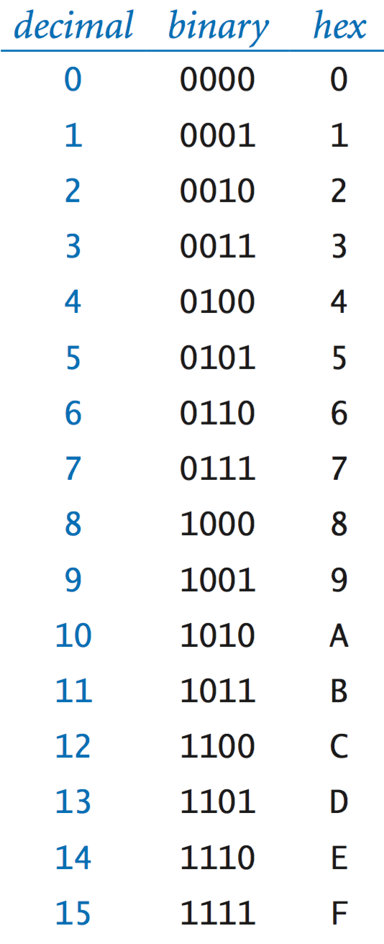
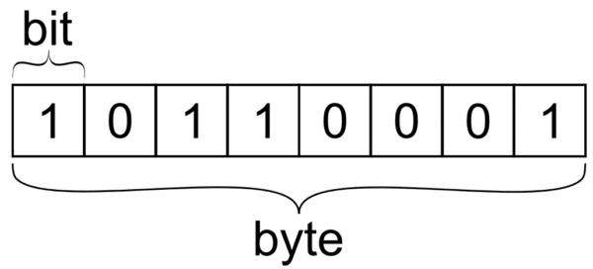
Variables & Data Types: Strings and Numbers
What are variables?
What is their underlying representation?
1's and 0's, bits and bytes
Various Types:
Binary: Boolean True or False
Numbers: integer, float
Strings Declared between single (') or double (") quotes
etc.
Variables are stored as named values
Can use the type() function to check the type
Convert between types using functions like:
string()
list()
int()
float()
etc.
Notes:
Anchor new terms: terminal = command window, directory = folder, path = folder address.*

Slide 12
Variables & Data Types
Binary: Boolean variable1 = True variable2 = False
Numbers:
Integer: int1 = 10 int2 = int(10.0)
Float float1 = 10.0 float2 = float(10)
Use standard operators like: + - / *
Multiple assignment: Separate by commas
x, y, z = 0, 0, 0
Strings
Declared between:
Single (') quotes string1 = 'Hello there!'
Double (") quotes string2 = "Hello there!"
Multiline triple (""") quotes string3 = """Hello there !"""
Can be joined/concatenated:
string1 + string2
separator.join(string1, string2)
Notes:
Anchor new terms: terminal = command window, directory = folder, path = folder address.*

Slide 13
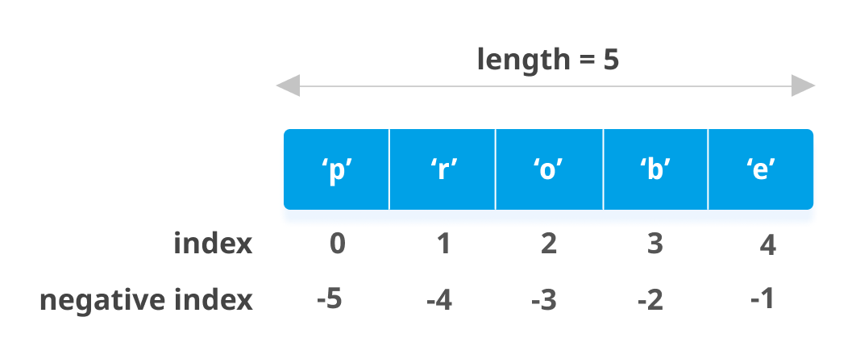
Variables & Data Types: Lists
What is a list?
A collection/array of any item in a particular order
Put anything in it including strings, numbers and other lists
Defined within square brackets, separated items by commas
Can be declared directly, like:
bicycles = ['trek', 'cannondale', 'redline', 'specialized']
Read or access items via a numbered index
Use a number inside square brackets to select index print(bicycles[0]) >>> trek
IMPORTANT: Index Positions Start at 0, Not 1
Access the elements from the end using negative index
E.g. The last item: bicycles[-1] = 'specialized'
Second last item:
bicycles[-2] = 'redline'
List slices: Select only a part of the list two_bicycles = bicycles[0 : 2]
Tip: Strings are actually just lists of characters!
Notes:
Anchor new terms: terminal = command window, directory = folder, path = folder address.*

Slide 14
Control Structures

Slide 15
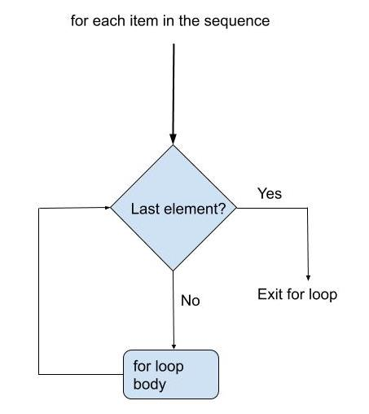
Lists and For-loops
Iterating through lists and more
A step-by-step repeated process
Example:
people = ['alice', 'david', 'carolina']
for person in people:
print(person)
Warnings:
Be very careful about correct indentation
Ensure to use the right syntax (e.g. remember the colon)
Can also iterate through generated numeric values e.g. for value in range(1, 5): print(value)
Lists can be modified, including deleting items, appending items etc.
"List comprehensions" are shorthand for modifying and returning a new list from an existing list e.g. new_list = [x.lower() for x in list_of_strings]
Notes:
Define repository in 1 line: the folder Git tracks; define commit in 1 line: a timestamped snapshot you can roll back to.*

Slide 16
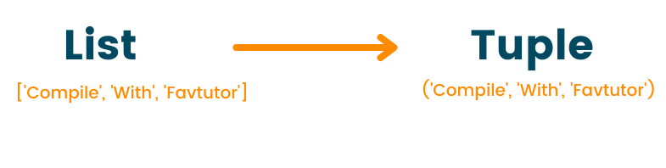
Tuples: Similar to lists
A tuple looks just like a list, except you use parentheses instead of square brackets
So how is it different from a list?
Tuples are immutable
Means that you can overwrite an item but not completely delete it
This is to make sure the size or 'shape' of the tuple doesn't change
NOTE: Tuples are technically defined by the presence of a comma A tuple of one element is thus: new_tuple = (1,)
Notes:
Define repository in 1 line: the folder Git tracks; define commit in 1 line: a timestamped snapshot you can roll back to.*

Slide 17
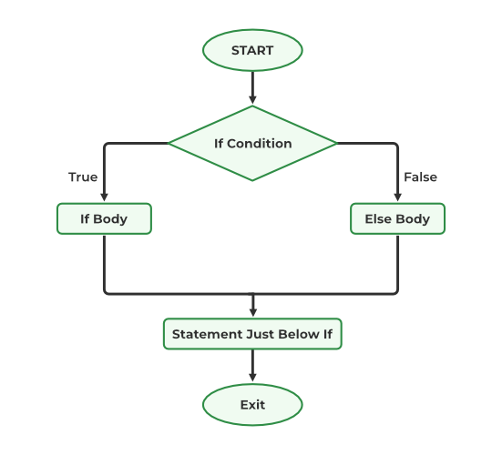
Booleans & If Statements
Conditionals and more
Evaluate Boolean expressions (True/False)
Can use various operators to evaluate these
Greater or less than: <, <=, >, >=
Equal to: == (Not =)
Not equal to: !=
Many other specialised function can exist e.g. The .islower() or .contains() function for strings
Select to execute code based on either being True or False using 'if statements'
Can specify an 'else' which runs if the condition is not matched
if name == 'alice':
print("Hi Alice!") else: print("Hi someone else!")
Notes:
Define repository in 1 line: the folder Git tracks; define commit in 1 line: a timestamped snapshot you can roll back to.*

Slide 18
Functions

Slide 19
Functions: Definition
Reusable blocks of code that perform specific tasks, avoiding repetition by writing code once
Called by using the function name with brackets afterwards like_this()
Inputs: Parameters fed into the brackets
Outputs: Yielded by the return statement (Defaults to None if not provided)
Defining a function:
Define using def keyword
Must be defined before being called (function doesn't exist yet)
Call by using function name with parentheses
Basic function definition:
def function_name(arguments):
"""Optional documentation, i.e. docstring"""
# Function body… result = …
return result
Calling the function:
output_result = function_name(arg_input)
Notes:
Anchor new terms: terminal = command window, directory = folder, path = folder address.*

Slide 20
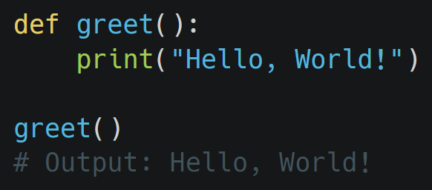
Functions: Usage
Arguments:
Positional arguments:
def function_name(arg1, arg2):
…
Optional "keyword arguments" (with default values) def function_name(optional_arg1 = "toyota"): …
Return value. Simply write return inside function body, followed by the item to return. This will also cause the function to end.
Variable scope, meaning that not all variables are accessible everywhere
Local variables: Only accessible inside function
Global variables: Accessible everywhere
Functions create their own so-called 'namespace'
Tips:
Always remember parentheses when calling
Variables declared within the function aren't accessible outside of the function
For positional arguments order matters. For keyword arguments, it does not.
Keyword arguments must come after the positional arguments
Notes:
Anchor new terms: terminal = command window, directory = folder, path = folder address.*

Slide 21
Functions: Arguments
Can also handle an arbitrary number of arguments.
For positional arguments, place a star * character before the placeholder
For keyword arguments, place two star ** characters before the placeholder
Positional arguments: Input some fixed arguments, and/or arbitrary arguments:
def function_name(arg1, arg2, *other_args):
print(type(other_args))
# Would see that other_args is a list
Keyword (i.e. 'named') arguments: Input some fixed arguments, and/or arbitrary arguments:
def function_name(kw_arg_1='eg1', kw_arg_2='eg2', **other_keyword_args):
print(type(other_args))
# Would see that other_keyword_args is a dictionary …
Can even be used in combination: def function_name(arg1, arg2, *other_args, kw_arg_1='toyota', kw_arg_2='subaru', **other_keyword_args): …
Remember: Positional arguments must come before the keyword arguments.
Notes:
Anchor new terms: terminal = command window, directory = folder, path = folder address.*

Slide 22
Dictionaries

Slide 23
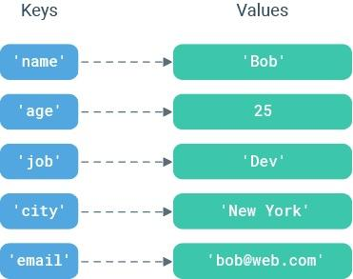
Dictionaries: Definition
A key-value pair as its own data structure
Not simply an ordered list -> Indexed by the 'key'
Allows fast lookup of items
Keys: Must be 'hashable' and 'immutable' i.e. strings, numbers and tuples
Values: Can be practically anything
Any combination of key and value types are valid
Example with string as key, and number as value:
car_sales_1 = {"toyota": 1000, "bmw": 20000}
Example with tuple as key, number as value: car_sales_2 = { ("toyota", "asia"): 15000, ("toyota", "europe"): 20000, ("bmw", "asia"): 50000, ("bmw", "europe"): 25000
}
Note: Dictionaries can be nested (dictionaries as values)
Notes:
Anchor new terms: terminal = command window, directory = folder, path = folder address.*

Slide 24
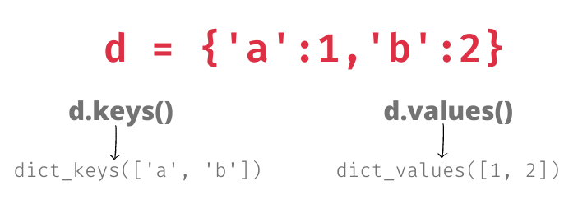
Dictionaries: Usage
Create an empty dictionary two ways:
empty_dict = {}
empty_dict = dict()
Read/access elements (similar to the list syntax) using the key:
e.g. toyota_sales = car_sales_1['toyota'] europe_toyota_sales = car_sales_2[('toyota', 'asia')]
Write or overwrite elements (mutable):
e.g. car_sales_1['suzuki'] = '2000' car_sales_1['toyota'] = '3000'
Can use del to delete an element
Can also read using the .get(key, default) method when presence of key is unknown: Error (key doesn't exist): toyota_sales = car_sales_1['opel'] Works (returns None): toyota_sales = car_sales_1.get('opel') Works (returns 0): toyota_sales = car_sales_1.get('opel', 0)
Can be looped through using:
.keys()
.values()
.items()
Notes:
Anchor new terms: terminal = command window, directory = folder, path = folder address.*

Slide 25
Working With Files

Slide 26
Files: Paths
Path types:
Absolute path; the full path from root
/home/user/documents/data.txt
Relative path; the path from the current working directory. Note: use one dot . to refer to the current directory, and two .. for the parent
./data/file.txt or data/file.txt
Path operations with os and pathlib:
import os
current_dir = os.getcwd() # Get current directory
os.path.exists('file.txt') # Check if exists
os.path.join('folder', 'file.txt') # Build paths safely
Using pathlib (recommended for validation):
from pathlib import Path
path = Path('data/file.txt')
path.exists() # Returns True/False
path.parent # Get parent directory
Notes:
Anchor new terms: terminal = command window, directory = folder, path = folder address.*

Slide 27
Files: Reading
Reading a file:
file = open('data.txt', 'r')
content = file.read() # Reads entire file
file.close() # MUST close file
The with statement (context manager):
Automatically handles file closing
Better cleanup when errors occur (e.g. data corruption less likely)
with open('data.txt', 'r') as file:
content = file.read()
# File automatically closed here
Reading methods:
read() - Entire file as string
readline() - One line at a time
readlines() - All lines as list E.g.
with open('data.txt', 'r') as f:
lines = f.readlines() # Returns list
Notes:
Anchor new terms: terminal = command window, directory = folder, path = folder address.*

Slide 28
Files: Writing
Writing a file (also uses the open() method): with open('output.txt', 'w') as file:
file.write("Hello World\n")
File modes:
'r' - Read only (default)
'w' - Write (overwrites existing)
'a' - Append to end
'x' - Exclusive creation (fails if exists)
Add 'b' to any for binary (i.e. will not automatically encode to text for example): 'rb', 'wb'
Writing methods:
write()
writelines()
with open('log.txt', 'a') as f:
f.write("New log entry\n") # Single string
f.writelines(['Line 1\n', 'Line 2\n']) # List of strings
Notes:
Anchor new terms: terminal = command window, directory = folder, path = folder address.*

Slide 29
Error Handling

Slide 30
Error Handling: Understanding Exceptions
Errors in Python are called 'exceptions'
What are exceptions?
Errors that occur during program execution
Without handling, program crashes completely
Critical for automation reliability
Common exceptions:
FileNotFoundError # File doesn't exist
ValueError # Invalid data type/format
KeyError # Dictionary key missing
IndexError # List index out of range
ZeroDivisionError # Division by zero
Reading error messages:
Read from bottom up
Look for file name and line number
Error type tells you what went wrong

Slide 31
Error Handling: In Your Code
Uses the 'try-except' block concept
Similar syntax to the 'if-else' (though not related)
Try-block: The main code that will run. If an error occurs, will switch to the 'except' block.
Except-block: Will run if there is an error thrown in the try-block.
Finally-block (Optional): Will run in either case at the end.
Helps ensure that your application doesn't crash even in case of an error
Example:
try:
file = open('report.txt')
except FileNotFoundError:
print("File missing")
finally:
file.close() # Always runs
When to handle errors:
File operations (files might not exist)
User input (could be wrong format)
External data (APIs, databases)
Calculations with uncertain inputs
In summary: situations where errors are expected or common

Slide 32
Writing Maintainable Code

Slide 33
Maintainable Code: Code Naming and Style
Naming:
Use descriptive names that explain purpose
Snake_case for variables and functions
CamelCase for classes
CAPITALS for constants
Avoid 'magic numbers', or unlabelled parameters:
Don't do:
total = amount * 1.1 # What is 1.1?
Do:
GST_RATE = 0.1
total = amount * (1 + GST_RATE)
Write in-line comments with a # wherever possible and required
Write doc-strings inside functions to clearly define the purpose of the function (inside triple quotes at the start):
def process_invoice(invoice_data, tax_rate=0.1):
"""Calculate total invoice amount including tax.
Args:
invoice_data: Dict of line items
tax_rate: Tax rate (default 10%)
Returns:
Total amount including tax
"""
# Function implementation
…

Slide 34
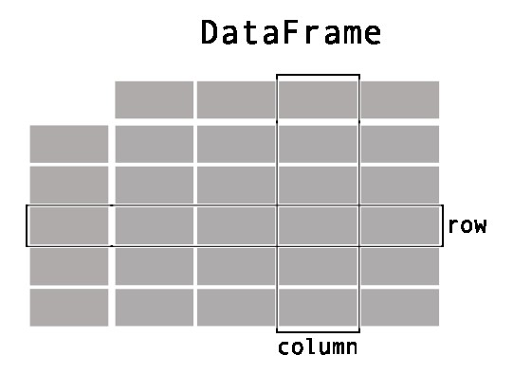
Pandas Introduction
Import it inside your Python script:
import pandas as pd
If it's not installed, run the following in your terminal to install python -m pip install pandas
A table in pandas is called a "Dataframe"
Two common ways to create a Dataframe (table):
Use pd.read_csv(filepath) or pd.read_excel(filepath)
Use the pd.DataFrame constructor with a dictionary
df = pd.DataFrame(
{
"Name": [
"Braund, Mr. Owen Harris",
"Allen, Mr. William Henry",
"Bonnell, Miss. Elizabeth",
],
"Age": [22, 35, 58],
"Sex": ["male", "male", "female"],
}
)

Slide 35
Maintainable Code: Code Naming and Style
Naming:
Use descriptive names that explain purpose
Snake_case for variables and functions
CamelCase for classes
CAPITALS for constants
Avoid 'magic numbers', or unlabelled parameters:
Don't do:
total = amount * 1.1 # What is 1.1?
Do:
GST_RATE = 0.1
total = amount * (1 + GST_RATE)
Write in-line comments with a # wherever possible and required
Write doc-strings inside functions to clearly define the purpose of the function (inside triple quotes at the start):
def process_invoice(invoice_data, tax_rate=0.1):
"""Calculate total invoice amount including tax.
Args:
invoice_data: Dict of line items
tax_rate: Tax rate (default 10%)
Returns:
Total amount including tax
"""
# Function implementation
…

Slide 36

Pandas Data Structures
Two main structures: Series and DataFrame
Series: Single column of data
Like a single spreadsheet column
Has an index (row labels)
sales = pd.Series([100, 150, 200, 175])
DataFrame: Table of data
Multiple columns (each is a Series)
Rows and columns both have labels
THIS IS WHAT YOU'LL USE MOST
df = pd.DataFrame({ 'product': ['A', 'B', 'C'], 'revenue': [1000, 1500, 1200] })

Slide 37
What is a DataFrame?
A 2-dimensional data structure → Like a table or spreadsheet
It can store data of many different types including:
Characters
Integers
Floats
Datetime
Etc.
Each column is a Series
Like key-value concept
'Key' equivalent is rowid
'Value' equivalent to the cell value
Select slices of rows using df[]
Select rows and columns by index using df.iloc[rowNum, colNum]
Select cells by index using df.loc[rowId,colId]

Slide 38
Creating & Importing Data
Create from dictionary:
data = {'name': ['Alice', 'Bob', 'Charlie'], 'sales': [250, 300, 275]} df = pd.DataFrame(data)
Import from CSV:
df = pd.read_csv('sales_data.csv')
Import from Excel:
df = pd.read_excel('quarterly_report.xlsx')
Export back:
df.to_csv('output.csv', index=False) df.to_excel('output.xlsx', index=False)

Slide 39
Exploring DataFrames
View first/last rows:
df.head() # First 5 rows df.head(10) # First 10 rows df.tail() # Last 5 rows
Get summary information:
df.info() # Column types, non-null counts df.describe() # Statistics for numeric columns df.shape # (rows, columns) df.columns # List of column names
Quick preview:
print(df) # Show entire dataframe (if small)
Note: Some items like df.shape are so-called 'properties' on the dataframe. They don't need to be run as a function (i.e. no brackets needed)

Slide 40
Selecting Data
Select single column:
df['revenue'] # Returns a Series df[['revenue']] # Returns a DataFrame
Select multiple columns:
df[['product', 'revenue', 'region']]
Select rows by position (.iloc):
df.iloc[0] # First row df.iloc[0:3] # First three rows df.iloc[0:3, 0:2] # Rows 0-2, Columns 0-1
Select rows by label (.loc):
df.loc[0] # Row with index 0 df.loc[0:2, 'revenue'] # Rows 0-2, revenue column

Slide 41
Filtering Data
Filter with conditions:
df[df['revenue'] > 1000] df[df['region'] == 'North']
Multiple conditions (use & for AND, | for OR):
df[(df['revenue'] > 1000) & (df['region'] == 'North')] df[(df['product'] == 'A') | (df['product'] == 'B')]
IMPORTANT: Each condition must be in parentheses!
Filter by string methods:
df[df['name'].str.contains('Alice')] df[df['product'].str.startswith('P')]

Slide 42
Data Manipulation
Add new column:
df['profit'] = df['revenue'] - df['costs'] df['profit_margin'] = df['profit'] / df['revenue']
Modify existing column:
df['revenue'] = df['revenue'] * 1.1 # 10% increase
Rename columns:
df.rename(columns={'old_name': 'new_name'}, inplace=True)
Delete column:
df.drop('column_name', axis=1, inplace=True)
Delete row:
df.drop(0, axis=0, inplace=True) # Drop row at index 0

Slide 43
Handling Missing Data
Missing data appear as NaN (i.e. a null value)
NaN is related to NumPy → Conceptually equivalent to 'None' values
Detect missing values:
df.isnull() # True/False for each cell df.isnull().sum() # Count of missing per column
Remove missing data:
df.dropna() # Remove any row with missing data df.dropna(subset=['revenue']) # Drop only if revenue missing
Fill missing data:
df.fillna(0) # Replace NaN with 0 df['revenue'].fillna(df['revenue'].mean()) # Fill with average

Slide 44
Basic Operations
Sorting:
df.sort_values('revenue') # Ascending df.sort_values('revenue', ascending=False) # Descending df.sort_values(['region', 'revenue']) # Multiple columns
Basic statistics:
df['revenue'].mean() df['revenue'].sum() df['revenue'].min() df['revenue'].max()
Count occurrences:
df['region'].value_counts() # How many of each value

Slide 45
Grouping and Aggregation
Group by category:
df.groupby('region')['revenue'].sum() df.groupby('product')['sales'].mean()
Multiple aggregations:
df.groupby('region').agg({ 'revenue': 'sum', 'profit': 'mean', 'units': 'count' })
Group by multiple columns:
df.groupby(['region', 'product'])['revenue'].sum()
VERY POWERFUL for business analysis!

Slide 46
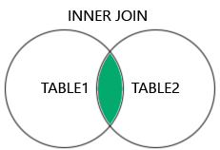
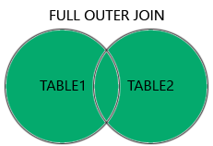
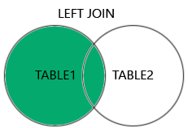
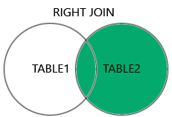
Combining DataFrames
Concatenate (stack vertically or horizontally):
pd.concat([df1, df2]) # Stack rows pd.concat([df1, df2], axis=1) # Stack columns
Merge (Equivalent to join operations):
pd.merge(sales_df, customer_df, on='customer_id') pd.merge(df1, df2, on='id', how='left') # Left join
Useful for combining data from multiple sources
(More on merge/join on the next slide)

Slide 47
Combining DataFrames
Four kinds of merge/join operations:
Inner join. Returns only matching values in both tables
Left join. Returns:
All from the left table
Matched from the right table
Right join. Returns:
All from the right table
Matched records from the left table
Full join: Returns all records, regardless of match in either left or right table
Merge on multiple columns:
pd.merge(df1, df2, on=['region', 'product'], how='outer')
Merge with different column names:
pd.merge(df1, df2, left_on='cust_id', right_on='customer_id')
Suffix for duplicate column names:
pd.merge(df1, df2, on='id', suffixes=('_old', '_new'))

Slide 48
Pivot Tables
Create Excel-style pivot tables
Summarize data with rows, columns, and values
Ideal for preparing data for reporting
Basic pivot:
pivot = df.pivot_table( values='revenue', index='region', columns='product', aggfunc='sum' )
Multiple aggregations:
pivot = df.pivot_table( values='revenue', index='region', columns='quarter', aggfunc=['sum', 'mean', 'count'] )
Fill missing values:
pivot = df.pivot_table(..., fill_value=0)

Slide 49
Reshaping: Melt (Wide to Long)
Melt converts wide format to long format
Wide format: Multiple columns for categories
Long format: Single column for categories, another for values
Example - Wide format:
Product Q1_Sales Q2_Sales Q3_Sales A 100 150 200 B 120 140 180
Convert to long:
df_long = pd.melt(df, id_vars=['Product'], value_vars=['Q1_Sales', 'Q2_Sales', 'Q3_Sales'], var_name='Quarter', value_name='Sales' )
Useful for plotting and certain analyses

Slide 50
Reshaping: Stack & Unstack
Multi-index data: Like nested indexes
Stack: Convert columns to rows (creates multi-index)
df.stack() # Columns become inner index level
Unstack: Convert rows to columns (opposite of stack)
df.unstack() # Inner index level becomes columns
Useful for:
Reorganizing multi-level indexed data
Preparing data for specific analysis formats
Can specify level to stack/unstack:
df.unstack(level=0)

Slide 51
DateTime Handling
Convert strings to datetime:
df['date'] = pd.to_datetime(df['date']) df['date'] = pd.to_datetime(df['date'], format='%Y-%m-%d')
Extract date components:
df['year'] = df['date'].dt.year df['month'] = df['date'].dt.month df['day_name'] = df['date'].dt.day_name() # Monday, Tuesday... df['quarter'] = df['date'].dt.quarter
Date arithmetic:
df['days_since'] = (pd.Timestamp.now() - df['date']).dt.days
Set datetime as index for time series:
df.set_index('date', inplace=True)

Slide 52
Time Series Operations
Requires datetime index (see previous slide)
Useful for sales trends, seasonal analysis, etc.
Resampling - aggregate by time period:
df.resample('M').sum() # Monthly totals df.resample('Q').mean() # Quarterly averages df.resample('W').count() # Weekly counts
Rolling windows - moving averages:
df['revenue'].rolling(window=7).mean() # 7-day moving avg df['sales'].rolling(window=30).sum() # 30-day rolling sum
Date-based selection:
df['2024'] # All data from 2024 df['2024-Q1'] # Q1 2024 only df['2024-01':'2024-03'] # January to March

Slide 53
Apply & Lambda Functions
Apply custom functions to rows or columns
Apply to column (operates on each value):
df['revenue'].apply(lambda x: x * 1.1) # 10% increase df['name'].apply(len) # Length of each name
Apply to entire row:
df.apply(lambda row: row['revenue'] - row['cost'], axis=1)
Define custom function:
def categorize_revenue(value): if value > 1000: return 'High' elif value > 500: return 'Medium' else: return 'Low' df['category'] = df['revenue'].apply(categorize_revenue)
More flexible than simple operations
Can do complex logic row-by-row

Slide 54

Introduction to NumPy
What is NumPy?
Numerical Python library
Foundation for scientific computing in Python
Much of Pandas is built on top of Numpy
Why Numpy?
Fast mathematical operations on arrays
Much faster than Python lists
Handles large datasets efficiently
When you see dtype in pandas, that's numpy
Import convention:
import numpy as np

Slide 55
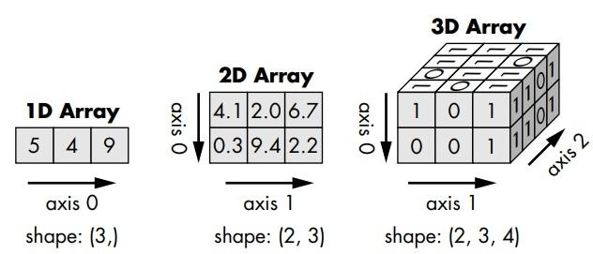
Numpy Arrays
Array: Collection of values, all of the same type
Similar to, but different from lists:
All elements must be same type (e.g., all numbers)
Much faster for math operations
Fixed size (can't append easily)
Can be converted to lists and vice versa
Creating arrays:
arr = np.array([1, 2, 3, 4, 5]) zeros = np.zeros(10) # Array of 10 zeros ones = np.ones(5) # Array of 5 ones range_arr = np.arange(0, 10, 2) # [0, 2, 4, 6, 8]
Multi-dimensional arrays possible (i.e. matrices)
Used in more advanced analytics and data science

Slide 56
Array Operations and Statistics
Numpy is much faster than 'regular' python for mathematical operations
Mathematical operations apply to ALL elements:
arr = np.array([1, 2, 3, 4]) arr * 2 # [2, 4, 6, 8] arr + 10 # [11, 12, 13, 14] arr ** 2 # [1, 4, 9, 16]
Operations between arrays:
arr1 = np.array([1, 2, 3]) arr2 = np.array([4, 5, 6]) arr1 + arr2 # [5, 7, 9] arr1 * arr2 # [4, 10, 18]
Common statistical functions:
arr = np.array([10, 20, 30, 40, 50]) arr.mean() # 30.0 arr.sum() # 150 arr.min() # 10 arr.max() # 50 arr.std() # Standard deviation np.median(arr) # 30.0
Works on entire array or specific axis (for 2D)

Slide 57
Array Indexing
Access elements (like lists):
arr = np.array([10, 20, 30, 40, 50]) arr[0] # 10 (first element) arr[-1] # 50 (last element) arr[1:4] # [20, 30, 40] (slicing)
Boolean indexing (like pandas filtering):
arr[arr > 25] # [30, 40, 50] arr[arr % 2 == 0] # Even numbers only
Very similar to pandas, just without column names

Slide 58
Pandas + Numpy
Pandas uses numpy "under the hood"
Access underlying numpy array:
df['revenue'].values # Returns numpy array
Apply numpy functions to pandas:
np.sqrt(df['revenue']) np.log(df['sales']) df['revenue'].apply(np.mean) # Though pandas has .mean()
When to use each:
Pandas: Working with tables, labeled data, mixed types
Numpy: Pure numerical computation, array math
Together: Best of both worlds!
Most business analysis stays in pandas
Numpy helps when you need speed or advanced math

Slide 59
Visualisation

Slide 60
Matplotlib: Foundation Plotting Library
Installation & Import:
Customization:
Terminal: pip install matplotlib
plt.xlabel()
plt.ylabel()
plt.title()
plt.legend()
plt.grid(True)
plt.plot(x, y, color='blue', linestyle='--', marker='o')
Python: import matplotlib.pyplot as plt
Basic Plots:
plt.plot(x, y) # Line plot
plt.scatter(x, y) # Scatter plot
plt.bar(categories, values) # Bar chart
plt.show()
plt.savefig('plot.png')
df.plot(x='date', y='revenue')
Multiple Plots:
fig, axes = plt.subplots(2, 2)
plt.plot(x, y, color='blue', linestyle='--', marker='o')

Slide 61
Seaborn: Simpler Statistical Visualization
Installation & Import:
Categorical & Correlation:
Terminal: pip install seaborn
sns.barplot(data=df, x='region', y='revenue')
sns.countplot(data=df, x='category')
sns.heatmap(df.corr(), annot=True)
Python: import seaborn as sns
What is Seaborn?
Built on matplotlib but simpler.
Has better defaults, less code, and works with DataFrames.
Used directly alongside matplotlib.
Styling:
sns.set_theme()
sns.set_style('darkgrid')
Distribution & Relationship Plots:
Integration with Matplotlib:
First: sns.plot(...) #seaborn
then: plt.title(...) #matplotlib
then: plt.savefig(...) #matplotlib
sns.histplot(data=df, x='revenue')
sns.boxplot(data=df, x='region', y='sales')

Slide 62
Plotly: Interactive Visualizations
Installation & Import:
Automatic Features:
Terminal: pip install plotly
Hover tooltips, zoom/pan, toggle legend, export button
Python: import plotly.express as px
Why Plotly?
Customization:
Interactive plots with hover, zoom, pan - great for dashboards
fig.update_layout(title='Performance')
px.scatter(..., color='region', size='revenue')
Basic Plots:
fig = px.line(df, x='date', y='revenue')
fig = px.scatter(df, x='price', y='sales')
fig.show()
Save as Interactive HTML Page:
fig.write_html('dashboard.html')

