Slide 1
Introduction to C#
You had me at “Hello World” Hands on Lab
Jacob Colón

Slide 2

Jacob Colón
Sophomore
North Andover High School
Essex County Soccer Referee
Taekwondo Black Belt
Ping Pong enthusiast
C#

Slide 3
Todays Topics
.Net Framework
Compiling
Variables/Data Types
Conditional Logic
Looping Logic
Branching Logic

Slide 4
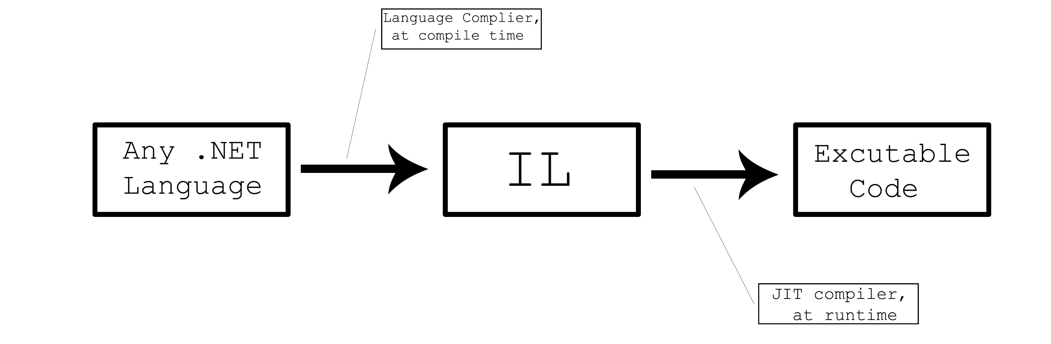
Compiler Timeline

Slide 5
.NET Framework
VB.NET
C#
Java.NET
C++.NET
…
Visual Studio.NET
Common Language Specification
ASP.NET
Windows Forms
.NET Framework Base Classes
Common Language Runtime
Windows

Slide 6
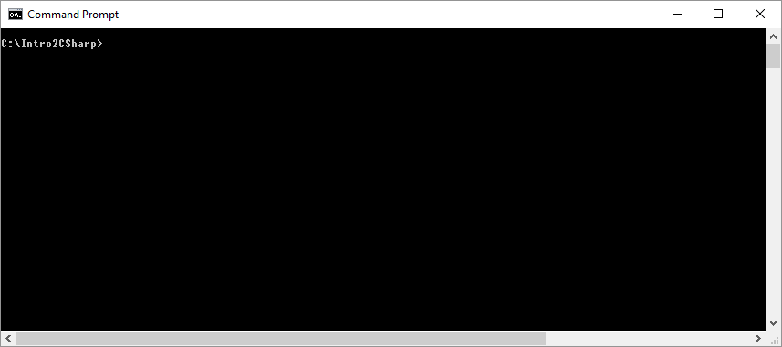
Compiling
C# compiler help use the following:
csc /?
Compile HelloWorld use the following:
csc HelloWorld.cs

Slide 7
Demo - Hello World
using System;
namespace IntroToCSharp
{
class HelloWorld
{
static void Main(string[] args)
{
Console.WriteLine("Hello World");
}
}
}

Slide 8
Memory
Computers talk in 1s and 0s
A bit is either a 1 or a 0
8 bits is one byte
1024 bytes is one Megabyte
1024 Megabytes in one Gigabyte

Slide 9
Variables
A memory location referred to by a name. The data stored in this memory location can be change during the execution of the application.
There are different types of variables used to store different types of data.
For example:
If the application was required to store the number ‘5’. It would do so with an integer type. Integer types take up 4 bytes of memory

Slide 10
Data Types
Type | Category | Size (bytes) | Description | Example
Boolean | Boolean | 1 | True/False | true or false
String | string |  | character array | Hello World
Date | Dates |  | 1/1/1 to 12/31/9999 | 10/28/2018
Integer | Integers | 4 | +/- 2,147,483,648 | 7
Decimal | Floating-points | 12 | +/- 1E-29 to +/- 7.9 E28 with 28 to 29 significant figures | 10.99

Slide 11
Variables
using System;
namespace IntroToCSharp
{
class HelloVariables
{
static void Main(string[] args)
{
string greeting = "Hello Variables";
Console.WriteLine(greeting);
}
}
}

Slide 12
Accepting Input
static void Main(string[] args)
{
Console.WriteLine("What is your name?");
string name = Console.ReadLine();
Console.WriteLine("Hello " + name + "!");
}

Slide 13
Arrays
string[] fruits = {"apples", "bananas", "pears", "oranges"};
Console.WriteLine(“My favorite fruit is " + fruits[2] + ".");

Slide 14
Passing an argument to your program
static void Main(string[] args)
{
Console.WriteLine("Hello " + args[0] + "!");
}

Slide 15
Conditional Logic – If Then
int i = 5;
if(i < 4)
{
Console.WriteLine("Hello if");
}
else
{
Console.WriteLine(“Hello else");
}

Slide 16
Conditional Logic – Switch Statement
Console.WriteLine(“Pick a number 1 or 2.");
int number = Int32.Parse(Console.ReadLine());
switch (number)
{
case 1:
Console.WriteLine("Your number is 1");
break;
case 2:
Console.WriteLine("Your number is 2");
break;
default:
Console.WriteLine("I said pick either 1 or 2.");
break;
}

Slide 17
Looping Logic – While Loop
int i = 0;
while(i < 5)
{
Console.WriteLine("Hello While");
i++;
}

Slide 18
Looping Logic – For Loop
string greeting = "Hello ForLoop";
int loopCount = 5;
for(int i = 0; i < loopCount; i++)
{
Console.WriteLine(greeting);
}

Slide 19
Branching Logic- Subroutine
static void Main(string[] args)
{
SubroutineSample();
}
static void SubroutineSample()
{
Console.WriteLine("Hello Subroutine");
}

Slide 20
Branching Logic - Function
static void Main(string[] args)
{
string greeting = FuntionSample();
Console.WriteLine(greeting);
}
static string FuntionSample()
{
return "Hello Funtion";
}

Slide 21












THANK YOU TO OUR SPONSORS!

Slide 22
References
C# Tutorial
https://www.tutorialspoint.com/csharp/index.htm
Introduction to C#
https://docs.microsoft.com/en-us/dotnet/csharp/tutorials/intro-to-csharp/
Visual Studio Community Edition
https://visualstudio.microsoft.com/downloads/
.NET In-Browser
https://www.microsoft.com/net/learn/dotnet/in-browser-tutorial/3
PowerPoint Slides / Code
www.github.com/jacobcolon/IntroToCSharp

