Slide 1
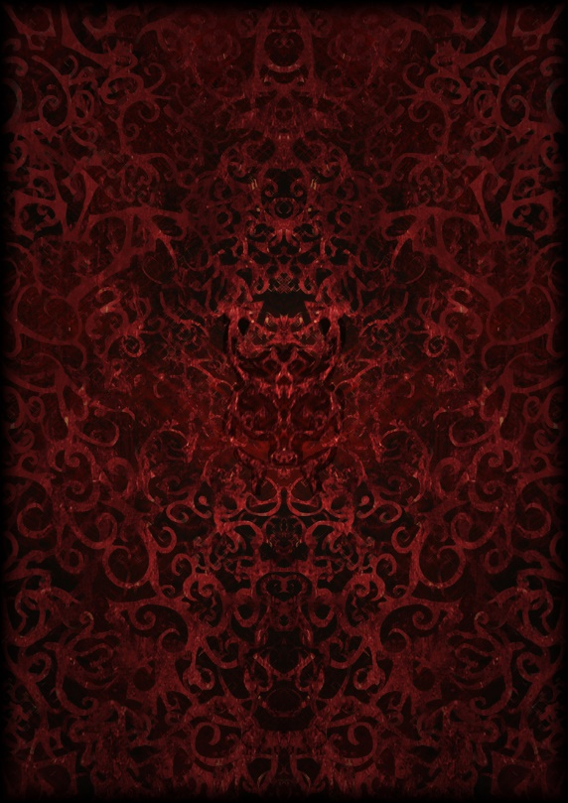
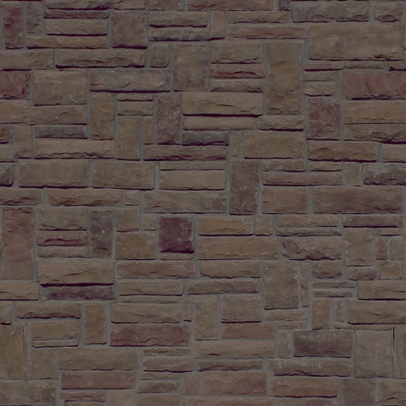
Terr-Out
MAJORE GAMES
April 15 2014
Game 610

Slide 2
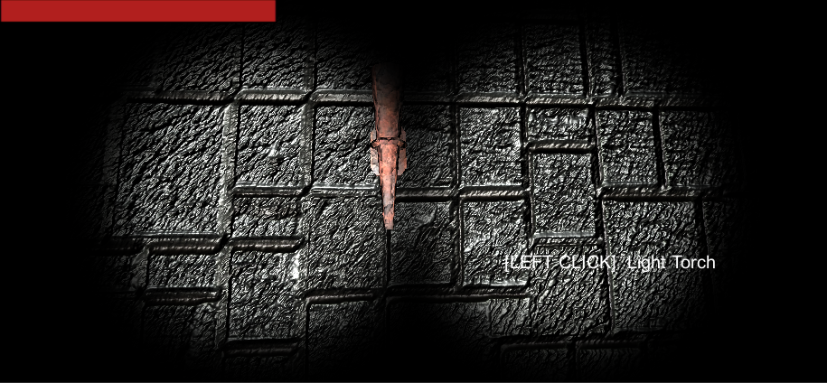
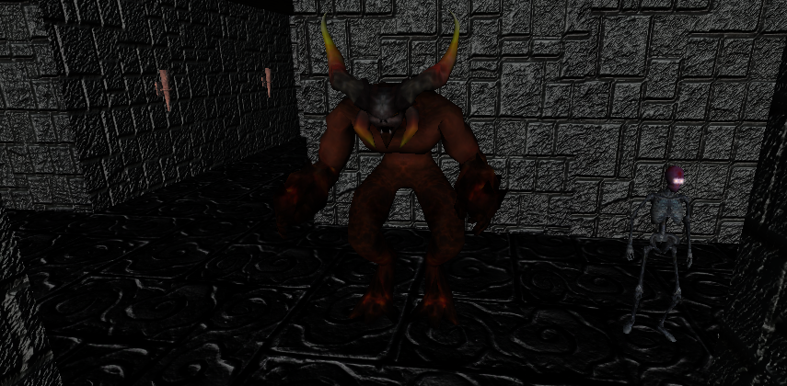
Here is our first Person Perspective with a hp gauge and notifiers for clicking torches
Here is our enemy he’s pretty scary looking. And big too, and there is the player , the skeleton.
The Story:
You are a skeleton , Lost in a labyrinth, You must find your way out of the maze and run from the monster that hides in its depths.
The Characters:
Skeleton, The player. You are just a skeleton nothing more nothing less, try to escape!
Monster, The Monster. He’s pretty tough, runs the labyrinth and stalks his prey. Watch out for his hearing, He hears everything in the maze.

Slide 3
The Controls:
The Gamepad and keyboard are supported , W A S D on the keyboard to move your character , The mouse to move your camera , and same for the left and right joystick on the controller. To run press left shift or b , to active items press mouse left click or x and to jump press space or b on the keyboard or gamepad.
Objective:
The Objective of Terr-Out is to dodge traps , run from the Monster who finds you either sight or sound, and get to the exit of the Maze!
Mechanics:
Torches are used as a away to find where you have been , you press the mouse click or x on a torch , it lights
The torch and use to make sure you arn’t going the around in circles.
Enemy AI , the Enemy monster Finds points in the labyrinth and goes to them , aswell hears you! When you make a sound or chat the monster hears It and finds that point.
Randomly Generated Maze , the maze is generated randomly to insure a scary and constant running experience.

Slide 4
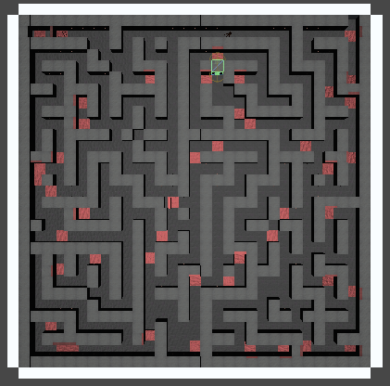
Mechanics Continued:
Traps and Triggers , Randomly generated in the Maze are Traps and triggers , one Trigger is good , it’s the White Block that is the end of the tunnel. And lastly are the bad ones , Traps . Traps are the ones randomly generated through out the maze. They are ment to harm you and stop you from leaving. There are 2 types of traps one is the wall traps that when triggered press a wall to the other side of the hallway. And the other are floor spikes , which deal a constant amount a damage when triggered.
Technology Used:
Unity 3d 4.3 and github, address https://github.com/jacobdeichert/HorrorGame.git
Heres the Map of the Maze.
Red spots are triggers for wall or floor spikes.
And that space that connects right to a white piece , that’s the end of the level

