Slide 1
COME HOME TO CLEAN · INLAND EMPIRE
What I set up for
my own business
Five simple things that bring in more calls. Took me less than a week.
Jacob · SAX — Never miss another customer
Notes:
Hand them the iPad or turn it toward them. Say: "Here's exactly what I did for Come Home to Clean. Takes about two minutes."

Slide 2
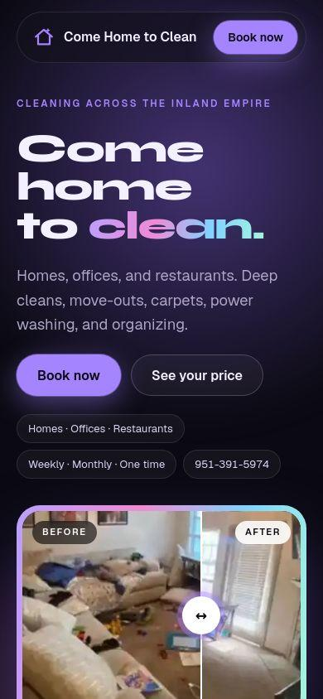
1 · A WEBSITE THAT BRINGS IN LEADS
People see my work and contact me right away
A big “Book now” button at the top
Before and after photos of real jobs
A form that sends new leads straight to me
Notes:
Open the real site on your phone too if they want to tap around: come-home-to-clean.ullbek.site. Say: "Most service businesses either have no site, or one nobody can figure out how to contact them from."

Slide 3
2 · FACEBOOK AUTO-REPLY
Every message gets an answer in seconds
[Your screenshot here]
A screenshot of your auto-reply answering a real message
Even when I’m in the middle of a job. People who message a business usually move on if nobody answers.
Notes:
Send Claude a screenshot of your Facebook auto-reply working, and it will be added here.

Slide 4
3 · THE BRING-BACK TEXT
The text I send
Hi [Name], it’s Jacob from Come Home to Clean! The holidays are coming up fast, and I’m booking pre-Thanksgiving deep cleans now. I only have a few spots left. Want me to save one for you?
Old customers are the easiest jobs to book
I send this one person at a time, with their name. No ads, no cost.
Notes:
Say: "This one text cost me nothing. Every business has a list of old customers they never reach out to."

Slide 5
Right after the job
Thanks for having us today, [Name]! If you’re happy with how it turned out, would you leave us a quick Google review? It really helps a small local business. [review link]
4 · REVIEWS AND REFERRALS
Happy customers bring the next ones
A week later
Two short texts after every job. A phone shortcut types them for me in seconds.
Know anyone who could use a deep clean? Send them my way. When they book, you get a free add-on on your next clean.
Notes:
Say: "Most owners never ask for reviews because it feels awkward. This makes it automatic."

Slide 6
5 · POSTED PRICES, PINNED TO MY PAGE
Customers see my prices before they ask, so less haggling
Regular clean
Deep clean
Move-out
Organizing
from $110
from $175
from $200
from $195
Carpet washing
Power washing
Office cleaning
Restaurant kitchen
from $110
from $125
from $175
from $400
Notes:
Show them the real pinned post on your Facebook page too. Say: "Price is the number one question. Posting it up front saves me hours of back-and-forth."

Slide 7
MY RESULTS SO FAR
From one text to my old customers
[__]
[__]
[__]
texts sent
replies
jobs booked
Notes:
Fill these in with your real numbers after the holiday text goes out. Until then, skip this slide.

Slide 8
FOR YOUR BUSINESS
I’ll set up the same thing for you
Never Miss a Lead
Win Back Old Customers
Get More Reviews
$400 + $50/mo
$150 + $30/mo
$150 + $30/mo
Auto-reply, booking form, lead tracker
Ready-to-send bring-back text
Review & referral texts after every job
Know Your Price in Seconds
Get Found Online
Lead Generation Page
$200 + $20/mo
$800 + $50/mo
$300 + $40/mo
Instant price calculator / quote tool
Full website build + widgets
Local leads, one-tap call/text
Sunday Auto-Update (add-on)
One-Scan QR Code
Price Menu Graphic (add-on)
$40/mo
$125 + $25/mo
$60 one time
Weekly lead refresh
Reviews, booking & social in one scan
Starting-at price list, pinned to Facebook
$2,000 + $260/mo
The Everything Bundle
All 8 services together (QR Code included free)
Founding prices for my first 3 businesses · Jacob · 951-418-0216 · jacobdemitrow@gmail.com
Notes:
Say the price, then ask: "Want me to get started?" Then stop talking.

