Slide 1
Boggle
Design Documentation: Author: Jacob Hurst Date: 10/12/17

Slide 2
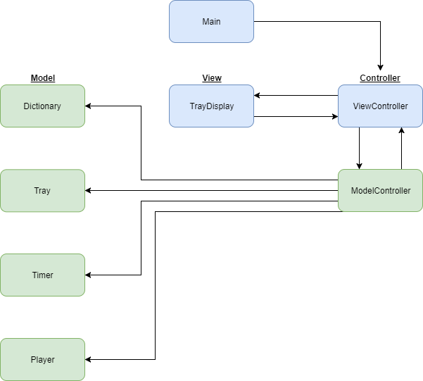
Program Overview:

Slide 3
Main:
Main.java
N/A
+ start() : + main() :
The main entry point for the program. Instantiates ViewController and sets up the primary stage.

Slide 4
ViewController:
ViewController.java
- end : Stage - Root : BorderPane - optionBox : VBox - timebox : HBox - timeField : TextField - newGame4x4/5x5 : Button - game/timer/score/word : Label - correct/incorrect/end : AudioClip
+ Initialize() : Parent + handle(ActionEvent) : void + handleWord(String) : void - startGame(int) : void - startTimer() : void - play() : void - update() : void - endgame()
ViewController handles the frame of the game.
ViewController starts a game with given dimensions and duration and instantiates the ModelController and TrayDisplay.
During the game, ViewController passes words to be checked by ModelController.
When the timer expires it disables the view and presents an end game dialog.

Slide 5
TrayDisplay:
TrayDisplay.java
- layers : StackPane - gtx : GraphicsContext - letters : Button[][] - dragging : boolean - dimensions/prefSize/x/y : int - Initial/Selected/file/word:String
+ TrayDisplay(ViewController, int, char[][]) : Constructor + getTray() : StackPane + currentWord() : String - setButton(Button, char) : Button - dragStarted(MouseEvent) : void - draggedOver(MouseEvent) : void - dragEnded(MouseEvent) : void - format(int) : void - disable(Node) : void - enable() : void
TrayDisplay builds the tray with and updates the look of the tray during the game.
The letters are stylized with css & use custom images for enabled/disabled.
The tray is represented with a StackPane containing a Canvas and a GridPane. The Canvas is used to draw lines between letters during drags & the GridPane is used to contain the letters on the tray and handle mouse interactions.

Slide 6
ModelController:
ModelController.java
- dictionary : Dictionary - tray : Tray - player : Player - possible : ArrayList<String> - possibleScore : int
+ ModelController(int) : Constructor + handleWord(String) : boolean + getCorrect : ArrayList<String> + getPossible : ArrayList<String> + getPossibleScore : int + getScore : int + getTray() : char[][]
ModelController instantiates the dictionary, tray, and player and then constructs a list of all possible words in the dictionary & tray.
As the game progresses, ModelController receives words from ViewController and adds them to the correct lists, checks for repeats, and allocates points earned.

Slide 7
Dictionary:
Dictionary.java
- dictionary : ArrayList<String>
+ Dictionary(String) : Constructor + getDictionary() : ArrayList<String> + getBoneyardSize() :int - write(String) : void
Dictionary takes a String file name & reads in a given file line by line, adding each line to it’s ArrayList<String>.

Slide 8
Player:
Player.java
- guesses : ArrayList<String> - incorrect : ArrayList<String> - correct : ArrayList<String> - score : int
+ Player(String) : Constructor + setCorrect(String) : void + setIncorrect(String) : void + addPoints(int) : void + getGuesses() : ArrayList<String> + getCorrect() : ArrayList<String> + getScore() : int
Player stores the current player guesses (incorrect, correct, total) and current player score.

Slide 9
Timer:
Timer.java
- timer : Timeline - timeString : String - time : int - minutes : int - seconds : int
+ Timer(int) : Constructor + play(Label): void - converter(int) : void - format(Label) : void
Timer handles the timing & time label of the Boggle game.
The constructor takes an int value of the total time (in seconds).
play is started from ViewController and updates the timer Label as the game progresses.
converter converts the total time into minutes and seconds.
format formats the current time into a string view on the label.

Slide 10
Tray:
Tray generates the tray given it’s
dimensions.
Initialize is used by the constructor to
build the tray. Initialize goes through
the tray placing characters from
random indexes of the alphabet (updating the counts of letters used). If a ‘q’ is placed, populateAdjacent is
called.
populateAdjacent fills the neighboring cells of the ‘q’ character with an increased probability for ‘u’ (17/25 using other getRandom method) until either a ‘u’ is placed or there are no more neighbors to populate.
Search searches the tray for the first
character of a given word, then calls
the recursiveSearch to traverse from that cell for the given word. If recursiveSearch finds the word, the points earned for that word are set using calculatePoints, points are returned from search
(default points = 0).
Tray.java
- tray : char[][] - visited : char[][] - dimensions : int - letterCount : int[] - alphabet : String - random : Random - n : int
+ Tray(int) : Constructor + getTray() : char[][] + search(String) : int + calculatePoints(String) : int - initialize(int) : void - populateAdjacent(int, int) : void - setVisited(char) : void - recursiveSearch(String, int, int) : boolean - getRandom(int) : int - getRandom(int, int) : int

