Slide 1
SmartRail
Design Documentation: Author: Jacob Hurst & Jaehee Shin Date: 11/16/17

Slide 2
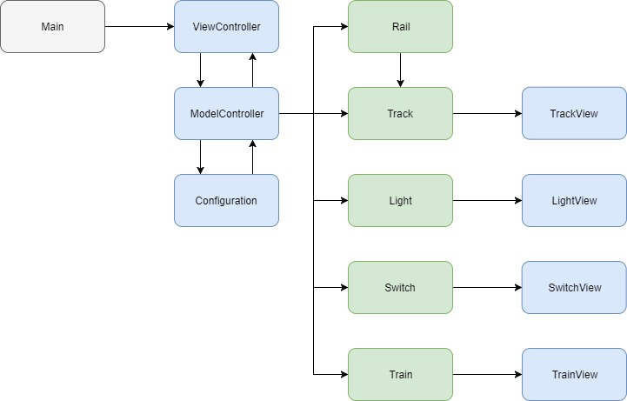
Program Overview:

Slide 3
Main:
Main.java
N/A
+ main() :
The main entry point for the program. Launches the
ViewController.

Slide 4
ViewController:
View Controller initializes the main frame (initially empty) and presents a setup dialog box. From this dialog box, the user can choose to select from 4 pre-loaded configurations, or to build a custom configuration using the builder.
Once a configuration is loaded, the user must then start the simulation.
Upon starting the simulation a timer, pause/resume buttons, text presenting active train count, & text presenting simulation information are all displayed.
From there, the user just needs to set train’s on tracks and provide destinations using the trains prompt.

Slide 5
ModelController:
ModelController instantiates Configuration with the file or configuration provided by ViewController.
From there, ModelController initializes all of the threads based on Configuration’s build. In doing this, ModelController also connects the switches and adds 1 un-active train to each rail.
When a train is started, ModelController increases the active count of trains and handles station statuses.

Slide 6
Configuration:
Configuration can take either an InputStream or an array representation of the desired configuration and will build from there.
Configuration checks for conditions involving lack of stations by labeling empty station name fields as “NO STATION”.
When a configuration is loaded from a file, configuration adds that file to a static ArrayList of configurations so as to not have to constantly rebuild configurations.

Slide 7
Rail:
Rail is primarily used to maintain the collection of tracks that make up a row.
When created, rail also set’s the neighboring connections between tracks.

Slide 8
Track:
Track extends Thread and gets extended by Light & Switch.
Track provides a generic run method to be shared among the three track components (itself, lights, switches).
Components of the rail only have knowledge of their immediate neighbors, the train currently occupying them (if any), and the current lock-holder (“ “ for no lock).
PathFinder uses a depth-first search to check for a destination.
SecurePath secures the locks for that path if a path is found.

Slide 9
Light:
Light extends track & provides additional light functionalities.
Lights can be either red or green. Upon initialization, these colors are set randomly.
The only scenarios in which light statuses get changed is when neighboring switches (if any) request a change to red or green.

Slide 10
Switch:
Switch extends Track & provides additional switching functionalities.
Upon creation, switches connect to themselves and their left/right neighbors. When a connection is set, that switch connects to the track either above or below them and forgets their connection to themselves.

Slide 11
Train:
Train extends Thread & acts as an individual agent on it’s starting track.
A trains starting track is determined when a station is clicked on and a path to the user entered destination is found (but not secured).
From there, the train will wait for the path to be secured and then begin traversing the path when it receives the “secured” message.
While traversing the path, the train will make sure that it’s next track has not received any changes by asking if the track is ready & will only move when it receives the “available” message.
When a train leaves a track it sends an “unlock” message that unlocks the track and sets its current train reference to null.

Slide 12
TrackView:
TrackView is the view component of the generic tracks.
Text above the track shows the current lock-holder.
ImageView is used to represent the track.
TrackView also handles the endpoints that may hold a station by adding EventListeners to the station names.

Slide 13
LightView:
LightView is the view component of the lights.
Text above the light shows the current lock-holder.
ImageView is used to represent the light and it’s status (red, green, or off).

Slide 14
SwitchView:
SwitchView is the view component of the switches.
Text above the switch shows the current lock-holder.
ImageView is used to represent the switch.

Slide 15
TrainView:
TrainView is the view component of the trains.
ImageView is used to represent the train with different colors for each train.
TrainView also handles the starting of trains by providing a destination prompt when a station is clicked.

