Slide 1
Domain Specific AI
SD 18
Jacob Duba, Conor O’Shea, Carter Cutsforth, Diego Perez, and Keenan Jacobs

Slide 2
Improving Code Search
Problem
“I know what I want the code to do, but don’t know the specific keywords”
Natural language keyword search is an unsolved problem
Now, LMs embedded in programming environments (eg. Cursor) need to search a local codebase for more context.
Solution
UniXcoder, an embedding model, scores 70% on the CosQA benchmark.
Add more compute
Take top 10 results from UniXcoder, and rank them using a language model.

Slide 3
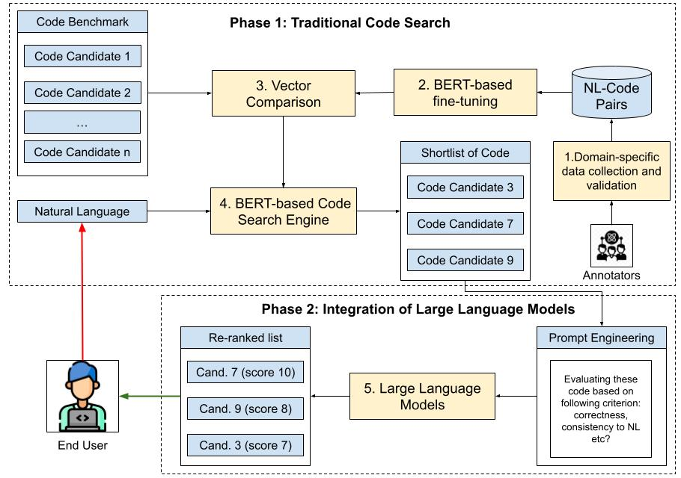
Overview of Design and Implementation
Vector comparison done more efficiently
Dataset moved to SQLite, loads much faster
Generate embeddings using GPU versus CPU (~3x speed up)
Switched out external API calls to on-prem LLM to rank results
Faster
Significantly cheaper, which is useful for benchmarking
New web search UI improves accessibility
In process of benchmarking UniXCoder results
Vs
Reranked results

Slide 4
Vector Search Performance Improvements
Design and implementation
Speed up queries by moving away from json.
Localize the model
Take advantage of hardware acceleration.
Obstacles
Access to remote machine hasn’t gone as planned
Cuda vs mps development (thank you PyTorch)
Remaining work
Better use of the GPUs.

Slide 5
Performance results (generating 10,000 embeddings)
Before:
Data.json = 248MB
Embeddings generated in ~97 min
After:
embeddings.db = 47.7MB
Embeddings generated in 20:55 min

Slide 6
Performance results (nl search and LLM ranking)
Ran 100 times, through its “dataset” of 10,000 embeddings
Before:
Average of 9.27s
After:
Average of 4.69s

Slide 7
Accelerating LLM Calls (Carter)
Design and implementation
Obstacles:
Slow Api Call Speeds (35+ seconds)
Network Connectivity Problems (drops)
Rate Limits

Slide 8

Accelerating LLM Calls
Solution: Local Hosting
Notes:
Ollama is a open source tool that allows you to run and make calls to a locally hosted llm, variety of models are available
Easy to implement with as it works with a variety of libraries including the open ai library we used,
Just need to download and run locally

Slide 9
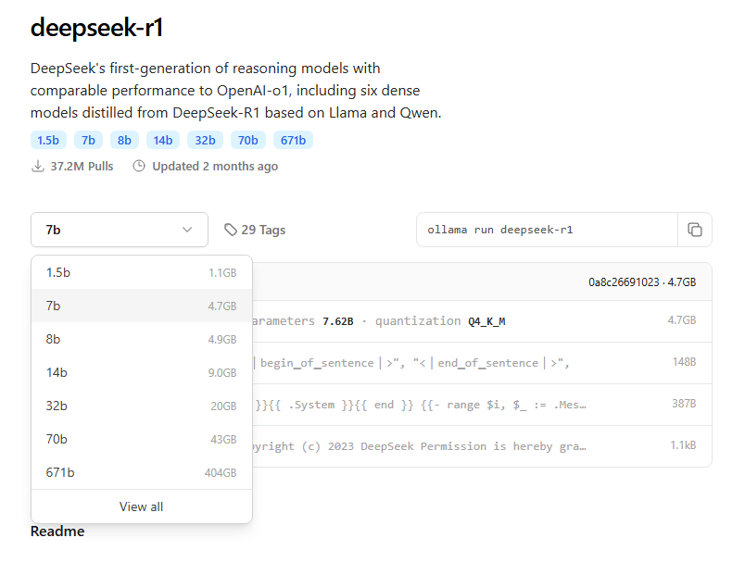
Accelerating LLM Calls
avg 40% increase in call speed!
Notes:
4 models tested with
Llama2-not very useful was mostly more speed to determine functionality
Deepseek14b which worked decently but was inaccurate at time
Deepseek32b which was difficult to run as it required a lot of hardware to run (quite slow)
Deepseek-coder-v2 was much better with code specific problems but still had the issue of giving innaccuracies

Slide 10
Accelerating LLM Calls
Challenges:
Speed vs Accuracy
Model Hallucinations
Hardware Limits
How to Overcome:
Using better models
Better Prompting
Lab Computer
Notes:
As the models I tested got my complex the answer back speed can increase dramatically as it takes in more information to create a response, this leads to a noticeable tradeoff between accurate ratings and the speed at which these ratings are generated
The Models also tend to hallucinate a lot, what I mean by this is that after being given a prompt models will try to respond in the way in which they were programmed rather than following the directions given in the prompt.
Say I ask a model to only give a number, with the hallucinations they will try to instead generate an entire paragraph explaining there reasoning for there number choice which increases overhead and slows down the processing speed.
Finally there are just the general model limitations that we have as we cannot use any gigantic models as the hardware needed to process them is much more than we could affordably acquire for this project.

Slide 11
Benchmarking Against UniXcoder (Conor)
Design and Implementation
Rework of accuracy assessment
Feed LLM the top 10 most accurate in order to get new best
Match with corresponding URLs
Must determine best code segment to give LLM
Average(1/rank)

Slide 12
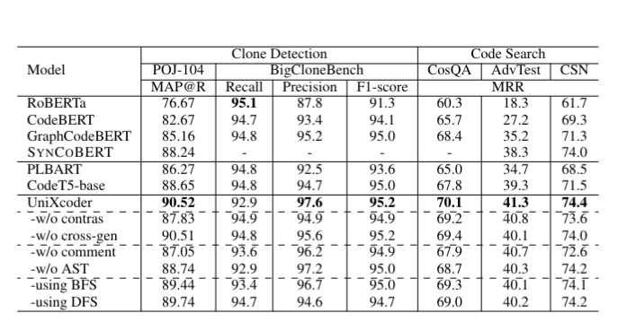
Benchmarking Against UniXcoder (Conor)

Slide 13
Benchmarking Against UniXcoder (Conor)
Obstacles
Confusion over what accuracy we should be checking
What code should the LLM receive?
Interacting with entire benchmarks that are not ours
Have to learn the pre-existing code and how to adapt it

Slide 14
Benchmarking Against UniXcoder (Conor)
Remaining Work and Current Progress
Finish our benchmarking
Should see improvements from base UniXcoder search
Benchmark with the different provided datasets
Benchmark with different LLMs as well

Slide 15
Frontend: Design and Implementation (Keenan)
Built with Flask and HTML/CSS/JS
Clean, minimalist UI
Users enter a code prompt and receive relevant snippets
Displays both pre-ranking (vector similarity) and post-ranking (LLM-evaluated) results
Supports:
Copy-to-clipboard button
Loading animation
Responsive layout

Slide 16
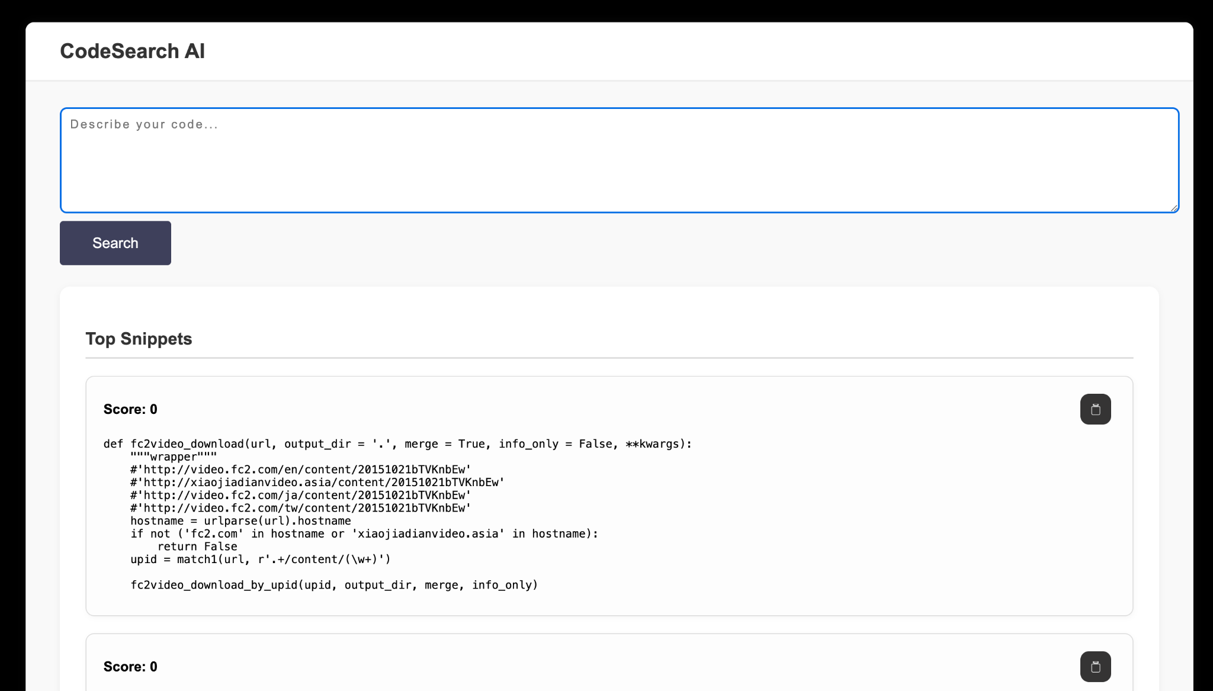
Frontend: Design Principles
Minimal distractions: black background with white content container
Mobile-friendly and accessible
Snippet display designed for quick readability
Interactive elements:
Search bar with hover styling
Visual feedback during loading and copying

Slide 17
Frontend: Obstacles
Not too many
Learning Flask for the first time
Learned how Flask looks for templates/ and static/ directories by default
Improved directory structure to keep frontend code modular

Slide 18
Frontend: What’s Left
Side-by-side layout for pre/post rankings (currently vertical)
Consider syntax highlighting with a library like highlight.js
More UI polish: transitions, score color-coding, mobile tweaks
Possibly integrate Dr. Phan’s dataset instead of CodeSearchNet

Slide 19
Timeline
LLM’s integration
Develop a GUI
Benchmarking
Prompt Engineering Creation
Dataset Collection and Curation
Download data set and set up a code search using UniXcoder
Improve Robustness
Demo 1
Spring Break
Demo 2
Final Project
Notes:
Dataset selection and curation
Next round: collect your favourite code repositories and perform the code search on it.
Along with it are other small improvements to other areas of the program and adding more benchmarking

Slide 20
Demo
Notes:
Conor

Slide 21


