Slide 1
Domain Specific AI
SD 18
Jacob Duba, Conor O’Shea, Carter Cutsforth, Diego Perez, and Keenan Jacobs

Slide 2
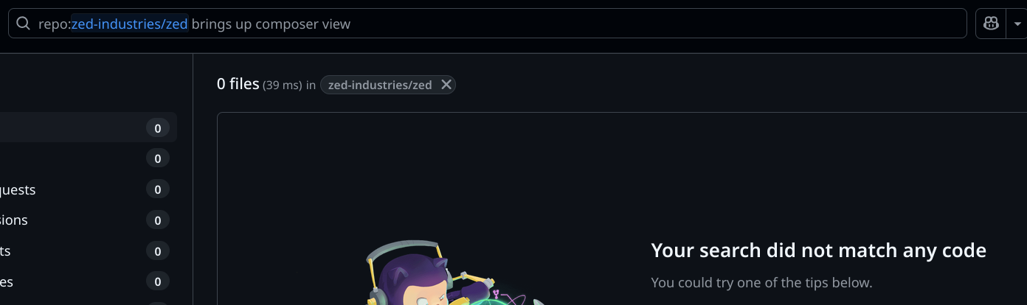
Understanding the Problem
Large Language Models need good data to give good results
Needs to be Concise and efficient
Related to the problem being solved
Preferably well documented for users
Can’t search codebases using English
Notes:
LLMs like chat GPT, Llama, and Deepseek need good data in order to give a satisfactory result to its users’
What I mean by good data is,
concise and effective in solving the problem posed by a user
It needs to answer there problem posed by the user
Issue is that for specific domains like High performance computing and more specialized problems there is limited data for the LLMs to use
Good news is we can make that data and some already exists
Bad news is that theres a lot of data and not all of it is useful for a specific problem

Slide 3
Problem
Code snippets are different than English (natural language)
Can’t train an LLM for your own codebase (expensive)
How do we talk with our codebases without training an LLM on it?
Notes:
The problem were aiming to solve is how do we give an LLM good data while remaining inexpensive
Code snippets are a challenge to explain to an LLM to retrieve
LLMs also require a ton of computation when training itself on large datasets which can be costly
If we can give an llm highly specialized snippets to solve user questions it would be able to better answer domain specific problems that LLMs tend to struggle with allowing users to better understand there down codebases.

Slide 4
Our Project
Natural language search for code snippets
Notes:
Our solution to the problem of giving LLMs good data is to utilize a code search algorithm to provide
quality examples to be looked over by an LLM which then provides users with a ranked list of the most useful domain specific solutions

Slide 5
Benefits of a solution
Domain specific problems get better answers
Large enterprises can’t use ChatGPT for help on internal codebases with domain specific information.
LLMs are not effective for domain specific or proprietary code
Traditional code search is not good with natural language.
Notes:
If we can give an LLM better suited data for answering a question this would mean we can get better solutions to domain specific querys
This can be useful in a number of ways and is highly applicable
Companies can use there own data for problem solving internal issues
Finding better solutions to a specific user problems can become much easier
Cuts costs on LLMs searching over a large dataset to solve a problem

Slide 6
Challenges and Design Decisions
Notes:
Jacob

Slide 7
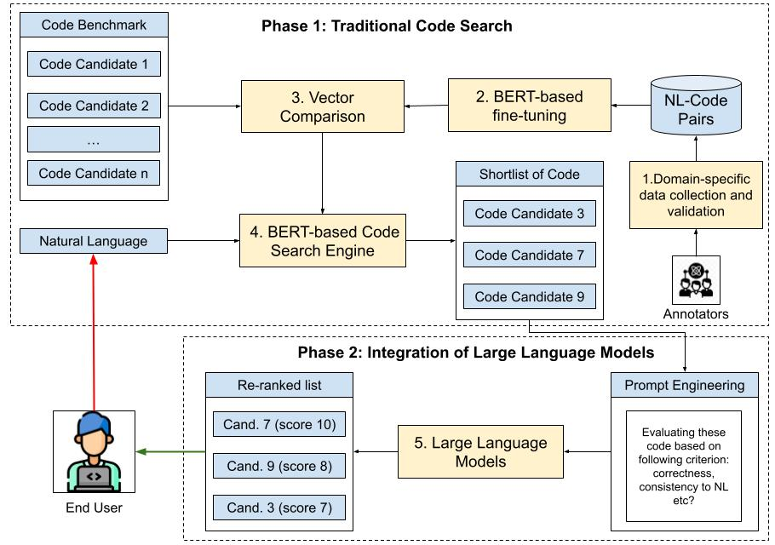
Key Design & Development Challenges
Challenge: many code snippets in dataset, but
LLMs are EXPENSIVE
O(n^2) runtime
Solution: vector search
Dot Product is cheap
Use LLMs to rank top results

Slide 8
Key Design & Development Challenges
Challenge: Dot product is similarity…
BUT we want NL to Code
Users would have to type out similar code which ruins the point
Solution: dataset stores pairs of code comments and code.
Creating embeddings of natural language code comments
Embedding for search string
Compare dot product on the comment embedding and search string embedding, return code snippets

Slide 9
Current Progress & Roadblocks
Notes:
Diego

Slide 10
Current Progress
CodeSearchNet loaded
Embeddings created
Vector Similarity Search
LLM ranks results
Notes:
Diego

Slide 11
Current areas of Improvement
MVP DONE
SLOW JSON LOADING
API Calls for LLM are very slow
APIs sometimes drop for one reason or another
Notes:
Diego

Slide 12
Next Steps & Timeline
Notes:
Keenan

Slide 13
What’s Left to Do?
Improve Speed
Changing datasets to high performance computing datasets
Ensure API stability and consistency
Could experiment with different LLMs
Using a more powerful machine to run code faster
User Interface
Notes:
Improve Speed - API calls take an extremely long time and we are wondering if we can make it faster on our end
Changing datasets to high performance computing datasets- We were using json before, should be changed to some other data type
Ensure API stability and consistency - Some api calls get dropped and we just have to retry them, so maybe we need to figure out a more consistent and stable way to make these calls without them being dropped
Could experiment with different LLMs - We are currently using deepseek’s free llm but we could experiment with different ones
Using a more powerful machine to run the AI - We are looking at more powerful hardware that is set up and we are working towards using it to run our code
User Interface - Everything is still command line so we will work on making a nice looking user interface

Slide 14
User Interface
Score: 9
def get_vid_from_url(self, url):
"""Extracts video ID from live.qq.com.
"""
hit = re.search(r'live.qq.com/(\d+)', url)
if hit is not None:
return hit.group(1)
hit = re.search(r'live.qq.com/directory/match/(\d+)', url)
if hit is not None:
return self.get_room_id_from_url(hit.group(1))
html = get_content(url)
room_id = match1(html, r'room_id\":(\d+)')
if room_id is None:
log.wtf('Unknown page {}'.format(url))
return room_id
Type code you want
Send
Score: 7
def veoh_download(url, output_dir = '.', merge = False, info_only = False, **kwargs):
'''Get item_id'''
if re.match(r'http://www.veoh.com/watch/\w+', url):
item_id = match1(url, r'http://www.veoh.com/watch/(\w+)')
Notes:
Very primitive rough idea of what the user interface should look like at a very basic level

Slide 15
Timeline
LLM’s integration
Develop a GUI
Prompt Engineering Creation
Dataset Collection and Curation
Download data set and set up a code search using UniXcoder
Improve Robustness
Demo 1
Spring Break
Demo 2
Final Project
Notes:
Downloaded codesearchnet data set from Hugging face
Made it into usable data that we could start working on
Set up a code search module using UniXcoder
Fine-tuning UniXcoder.
Performed Vector Comparison.
Created a terminal application with Natural Language Query as input
Prompt Engineering Creation
Design a prompt for reranking the candidate codes from traditional code search.
LLM’s integration
Write a script to get the output from prompts you made in previous steps.
Develop a GUI for traditional code search
Allow users to input query and output list of code.
Dataset selection and curation
Next round: collect your favourite code repositories and perform the code search on it.

Slide 16
Development Process & Tools
Notes:
Conor

Slide 17
Tools and Practices Used
Programming languages & frameworks
Python
UniXCoder
DeepSeek through OpenRouter
Development methodologies
Weekly meetings where we give updates and mark issues on Gitlab
Code reviews and approvals needed for merge requests
Tested on our local machines
Moving to dedicated hardware soon
References
Our client Dr. Phan has a paper, “Leveraging statistical machine translation for code search”
https://dl.acm.org/doi/10.1145/3661167.3661233
Notes:
For programming languages we are using python. UniXcoder is our tool to handle emeddings for vector search. We embed all of the comment strings and compare them to the user request. For our current LLM we are using OpenRouter to make requests to a DeepSeek LLM.
For our development methodologies we do weekly meetings with our client Dr. Phan where we give him updates on our progress and mark the issues that need to be done for our next meeting. Through gitlab we do code reviews and as a safety measure we require approvals for our merge requests. We are currently testing on our local machines, but in the future we will move to dedicated hardware which will allow us to perform more powerful searches on larger datasets.
And finally out client Dr. Phan has a paper with Dr. Ali Jannesari where he has documented previous progress in this area.

Slide 18
Live Demo
Notes:
Conor

