Slide 1
Domain Specific Code Search with LLMs as a Ranker

Slide 2
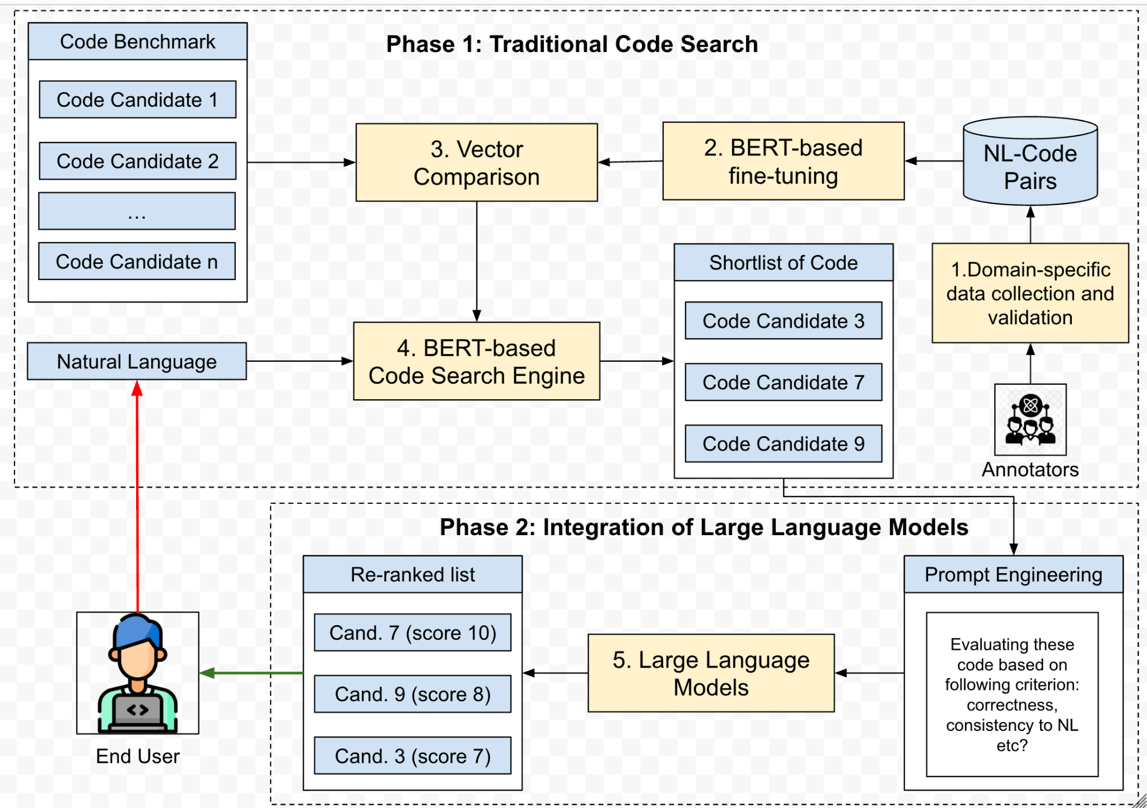
Content

Slide 3
Progress
https://docs.google.com/document/d/17U0fFrk5Tyt0uFu4Cvmb9vM-o1UC_RVhbxGo5dVfFF4/edit?tab=t.0
Downloaded and iterate through the dataset (https://git.las.iastate.edu/SeniorDesignComS/2025s/402c/sd18_domain-specific-ai_1/-/issues/1)
Create embeddings for the dataset, save to local file (https://git.las.iastate.edu/SeniorDesignComS/2025s/402c/sd18_domain-specific-ai_1/-/issues/2)
Beside Repository: https://github.com/pdhung3012/DomainSpecificAI_CS

Slide 4
Progress
https://docs.google.com/document/d/17U0fFrk5Tyt0uFu4Cvmb9vM-o1UC_RVhbxGo5dVfFF4/edit?tab=t.0
Downloaded and iterate through the dataset (https://git.las.iastate.edu/SeniorDesignComS/2025s/402c/sd18_domain-specific-ai_1/-/issues/1)
Create embeddings for the dataset, save to local file (https://git.las.iastate.edu/SeniorDesignComS/2025s/402c/sd18_domain-specific-ai_1/-/issues/2)
Beside Repository: https://github.com/pdhung3012/DomainSpecificAI_CS

Slide 5
In progress
https://docs.google.com/document/d/17U0fFrk5Tyt0uFu4Cvmb9vM-o1UC_RVhbxGo5dVfFF4/edit?tab=t.0
Implement vector similarity search (https://git.las.iastate.edu/SeniorDesignComS/2025s/402c/sd18_domain-specific-ai_1/-/issues/3)
Develop the LLM reranking systems (https://git.las.iastate.edu/SeniorDesignComS/2025s/402c/sd18_domain-specific-ai_1/-/issues/4)

Slide 6
Open Ideas
Code Search over HPC tasks:
CUDA dataset: https://github.com/tehranixyz/CodeRosetta/blob/main/src/dataset/dataset_cpp_cuda.py

