Slide 1
Better Tower Defense
Jacob Dufault
Sponsor: Dr. Bernhard

Slide 2
Milestone 2 Progress
Locomotion (navigating between two nodes on a graph, not finding the nodes to navigate)
Effects
Tower placement

Slide 3
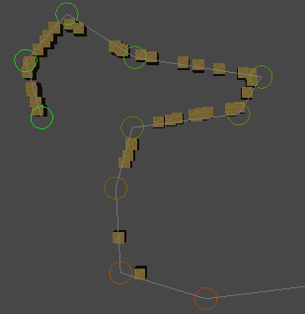
Locomotion
Current implementation works well and is fast
Approach distance: how far away from the node until we have “passed it”
Algorithm:
Calculate normalized direction vector from current position to next node
Update position by dir*speed
Check to see if we are close enough to the next node to move to the next one
Easily extendable for boids-like approach; direction vector is the applied force

Slide 4
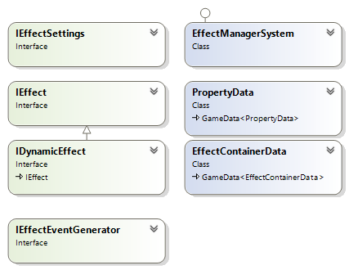
Effects
Interdependent effects are really two problems:
Effects change the properties of a unit (health, armor, etc)
Combinations of effects trigger interesting events
Effects are applied to a set of properties, make changes
Effect event generators scan through the list of active effects and react to any interesting combinations
Keep it DRY with interface based tagging

Slide 5
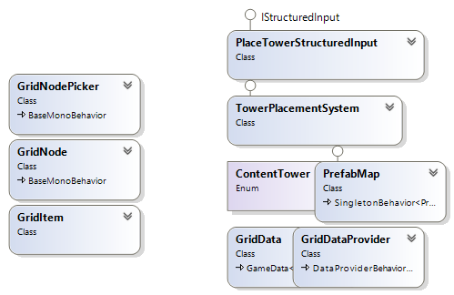
Tower placement
Towers placed only on grid nodes
Not really a classic grid; instead there are regions of the map which have a grid
Use structured input system for correct
network sync behavior

Slide 6
Plan for Next Milestone
Implement resource system
Extends building placement system
Per player resources
Define relationships among buildings and how resources are gathered
Implement power system
Builds on the effect system
Effects that are placed at a specific location
Implement level types
Primarily controls how units are spawned
Extends spawning system

Slide 7
Demo & Questions
Thanks!

Slide 8
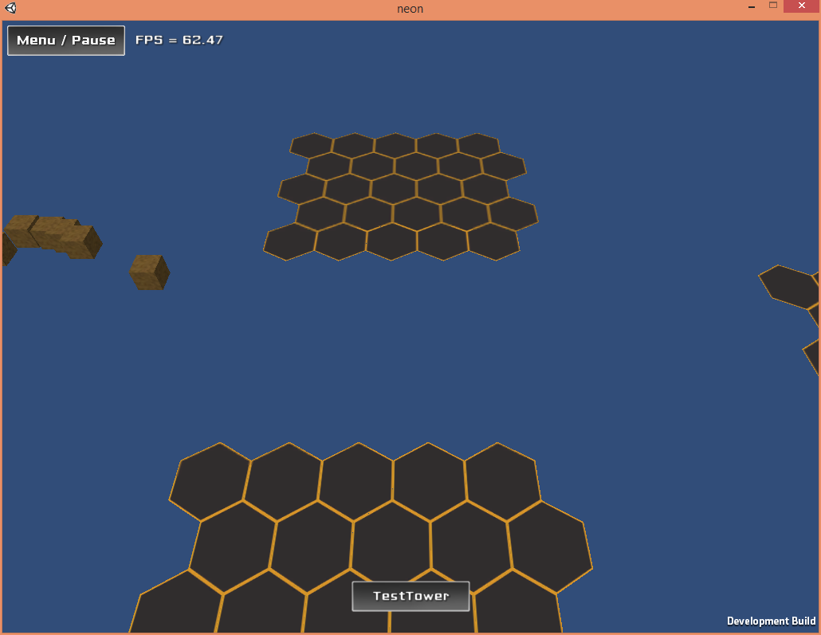
Demo Screenshots

Slide 9
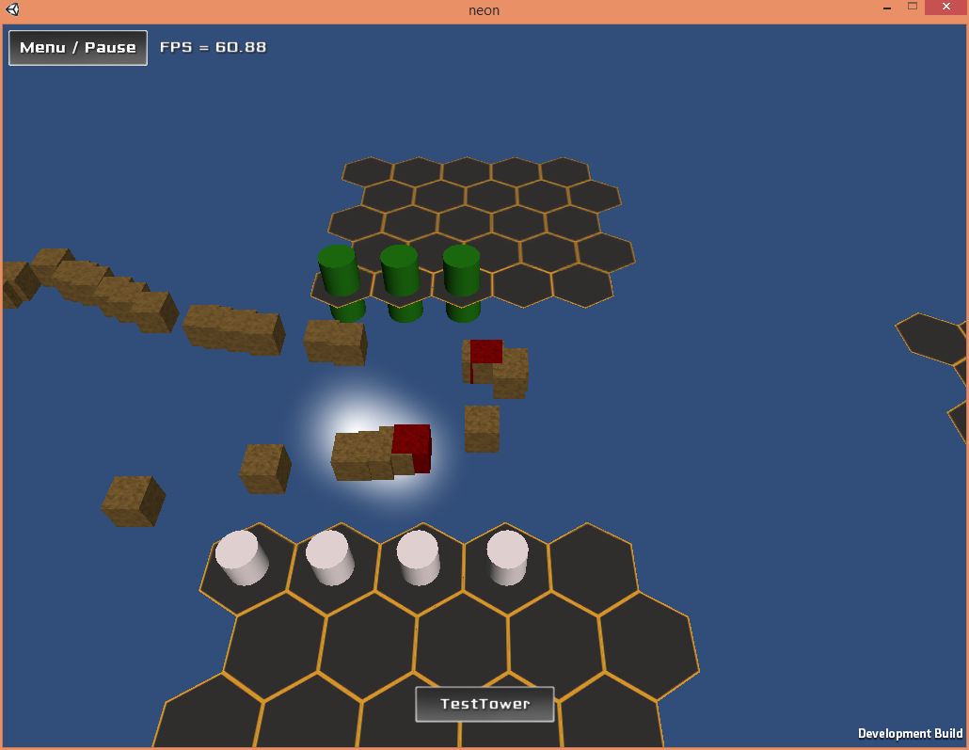
Demo Screenshots

Slide 10
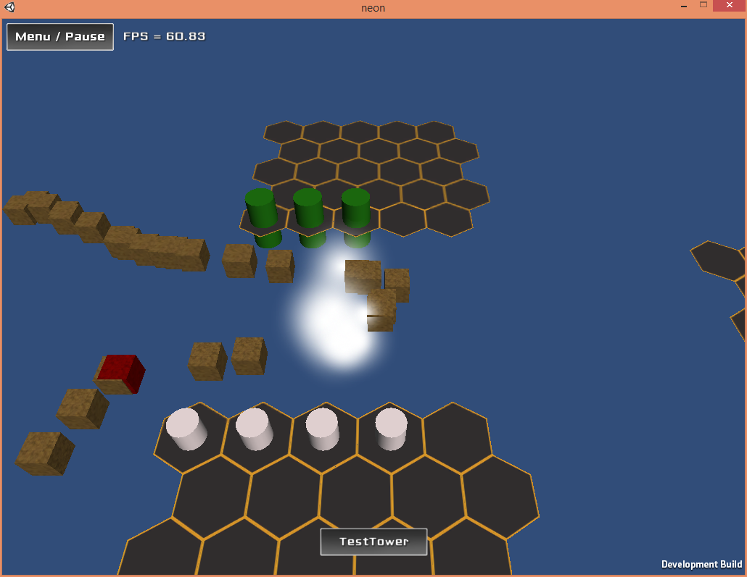
Demo Screenshots

Slide 11
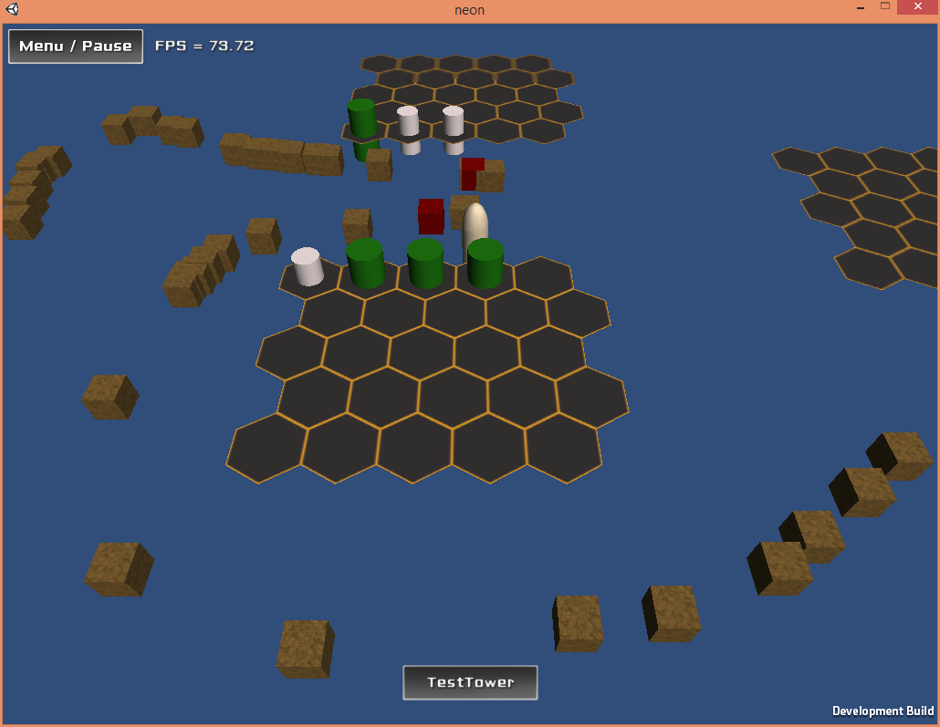
Demo Screenshots

