Slide 1
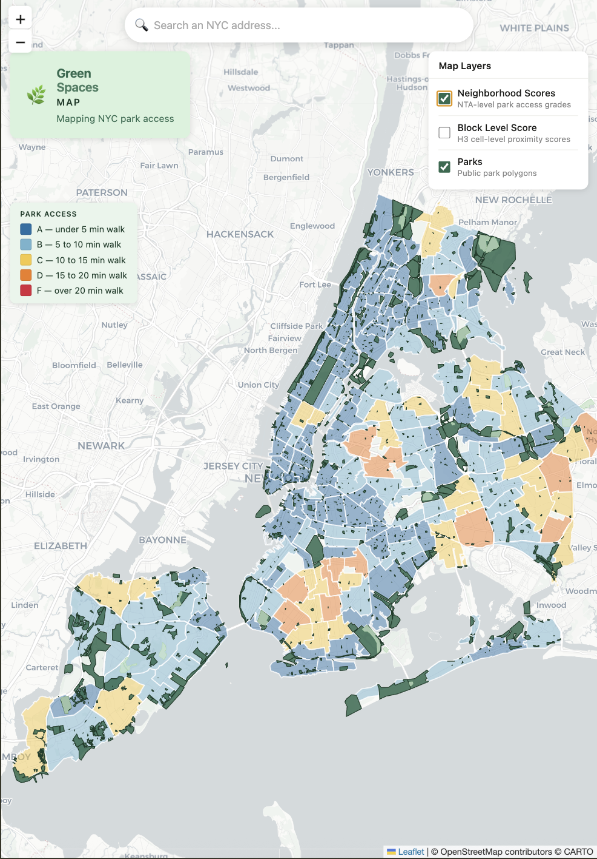
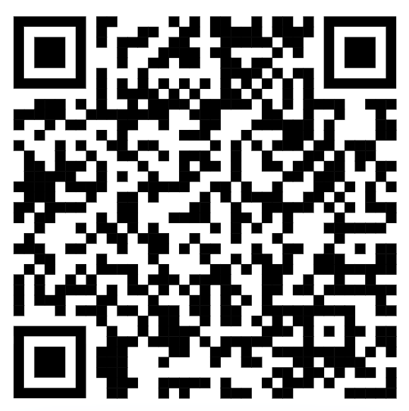
🌿
GreenSpaces
Map
Mapping NYC Park Access
NYC Open Data Week 2026 • March 25
Little Red School House, 272 6th Ave
Jacob Farkas

Slide 2
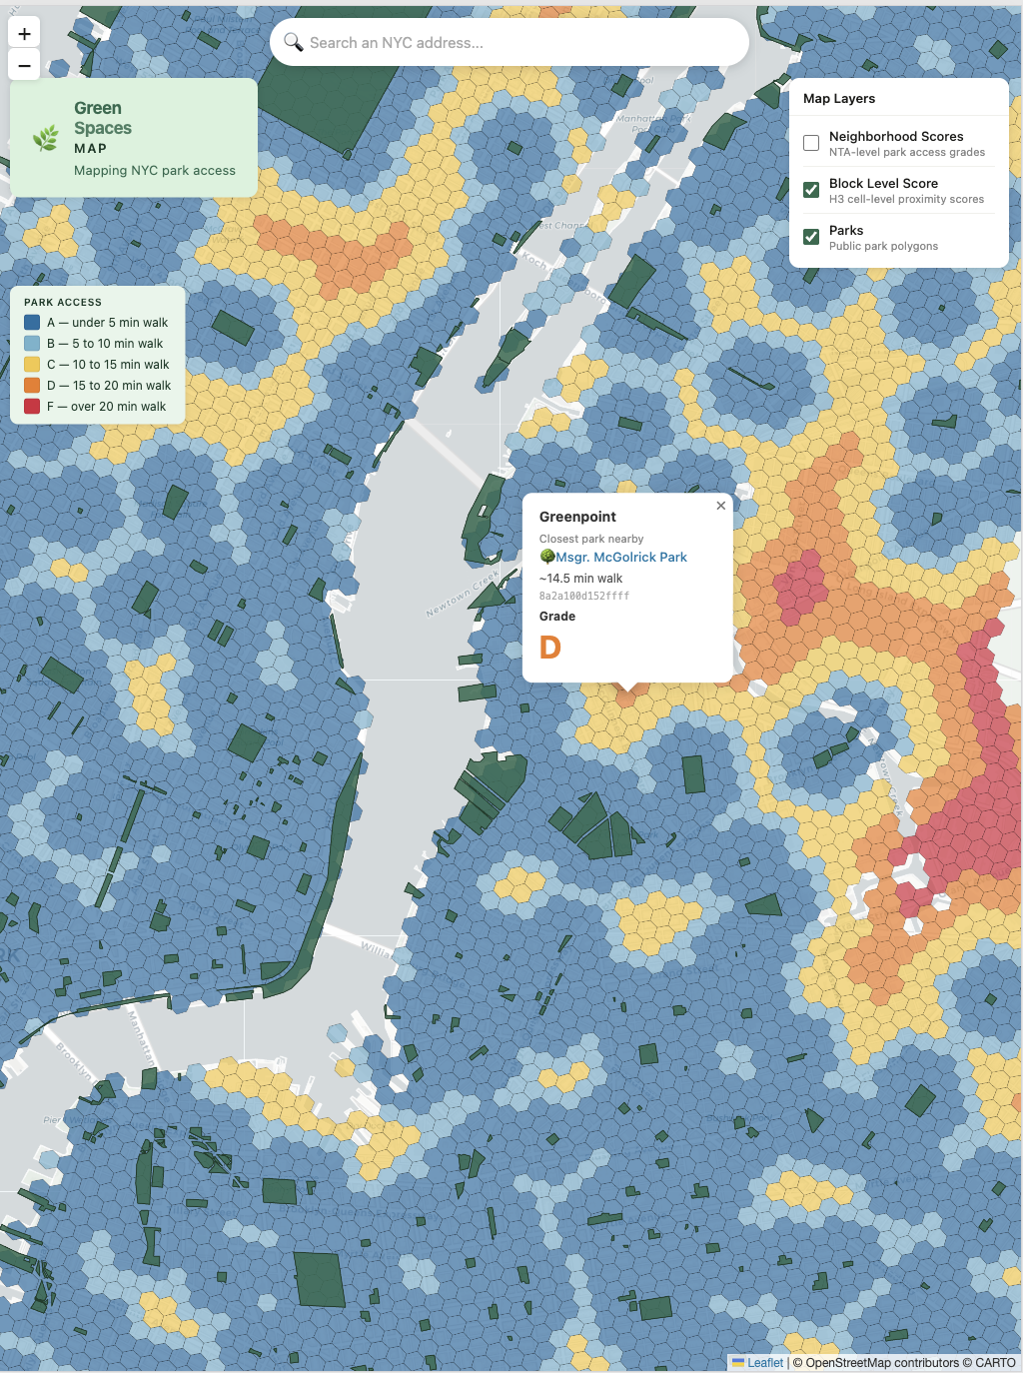
THE QUESTION
Access to Parks and Greenspaces in NYC
New York City has over 1,700 spaces designated as parks.
But a concrete playground with a swing set is not the same as a park with trees, grass, and open space.
And a park two miles away with no transit connection is hard to get to.
Given where you live — how long does it actually take to reach a green space?

Slide 3
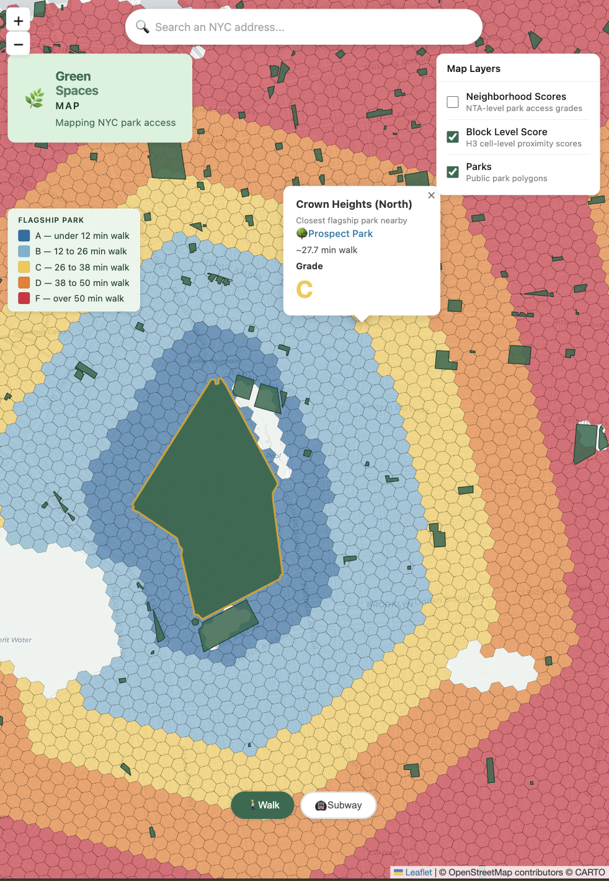
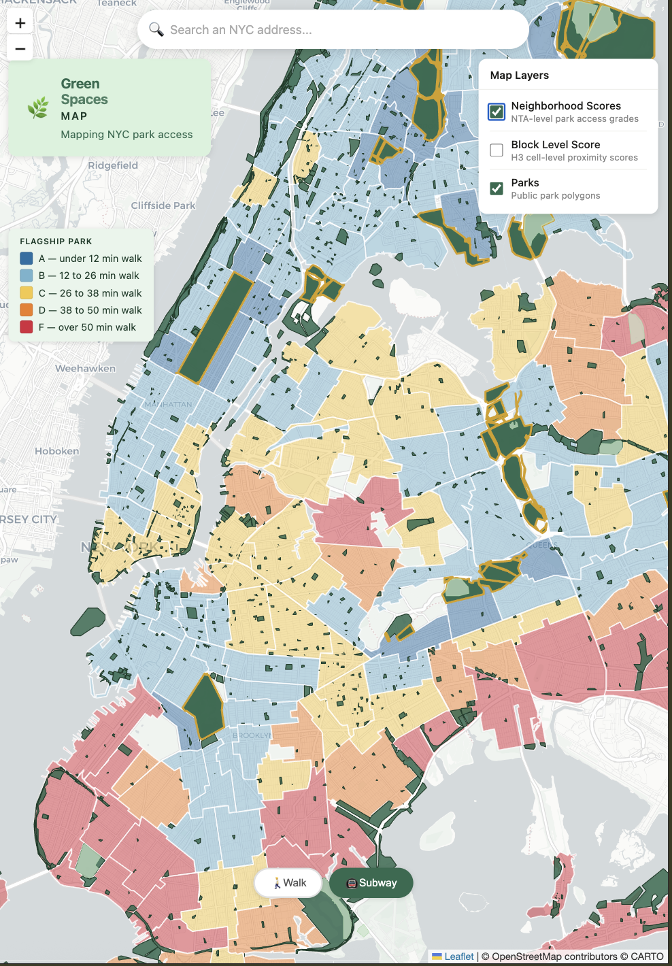
THE TOOL
What this map does
Block-level reporting
Every cell is roughly one short city block
Neighborhood Grades
Every cell is roughly one short city block
Qualified Green Spaces
Tree inventory filters out small playgrounds, courts, paved spaces
Walking + Transit scoring
Combined modes for flagship parks
Address search
Search any NYC address, get your personal score instantly
Mobile-first
Designed and tested on iPhone and Android
Open source
All public data, all reproducible, zero paid APIs

Slide 4
Part 1
The Journey
How this was built

Slide 5
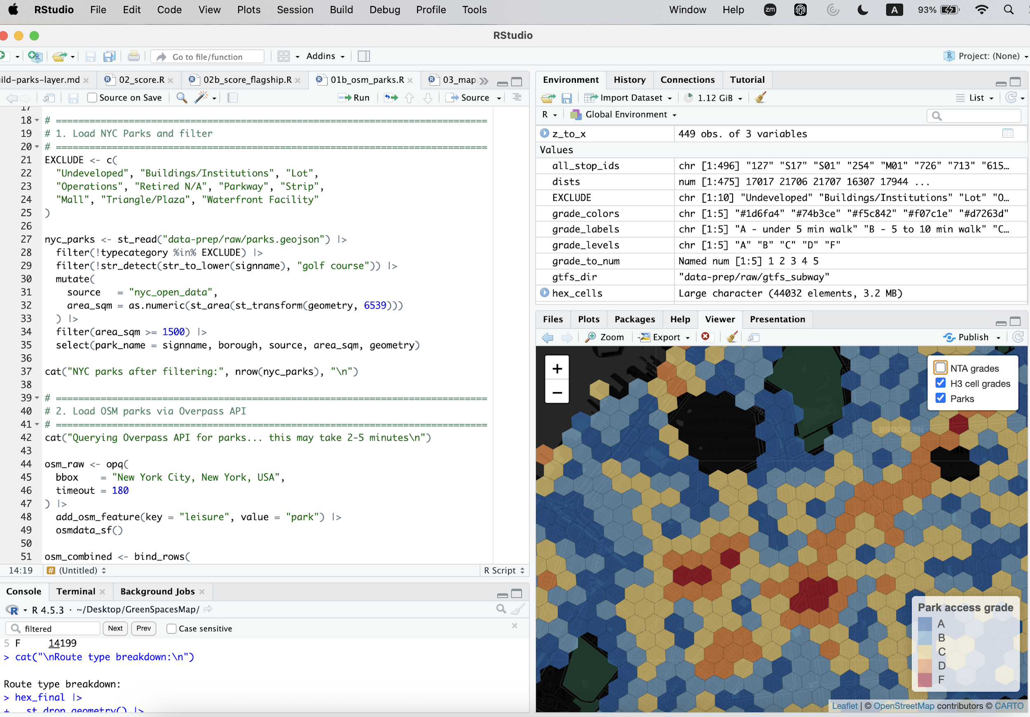
THE JOURNEY — DATA PROBLEM
What actually counts as a park?
NYC Open Data lists 2,000+ parks.
Rappaport Playground has 18 mapped trees. Passannante Ballfield is 6 acres of asphalt. Both are tagged as parks.
We used NYC's own Forestry Tree Points dataset to filter:
≥ 10 trees
OR ≥ 40,000 m²
inside the polygon
large natural areas
Data wrangling using R Studio
Result: 1,295 qualifying parks from 1,657 candidates

Slide 6
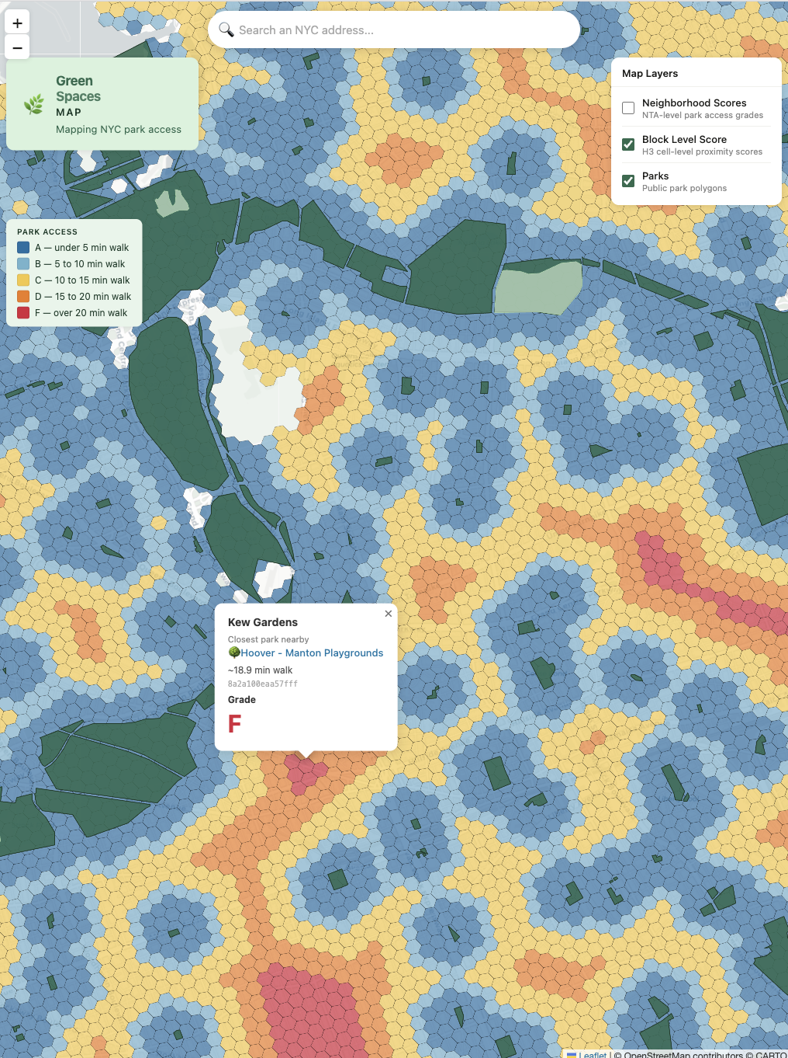
THE JOURNEY — SPATIAL PROBLEM
How do you score every city block?
The H3 hexagonal grid at resolution 10 divides NYC into ~47,000 cells — each roughly one short city block.
Each cell is scored by estimated walk time to the nearest qualifying green space.
walk_minutes =
(hops × 131 + 79) × 1.4 / 5000 × 60
1.4× circuity factor accounts for street grid vs straight line

Slide 7
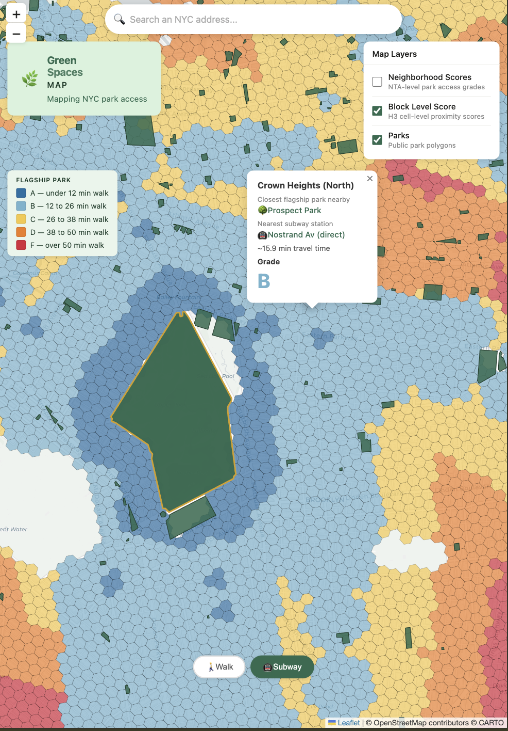
THE JOURNEY — TRANSIT PROBLEM
Walking can get you to your local parks.
The Subway unlocks the bigger ones.
Most folks don’t take the subway to a playground.
Flagship parks, on the other hand, are different. For the 15 NYC Flagship Parks, designated as such by NYC Parks, we built a walking+transit score using walking estimates + MTA GTFS timetable data.
🚶
🚇
🌳
→
→
Walk to station
Subway ride
Walk to park
H3 hop model
Median GTFS time
5 min fixed
Subways only for now • Direct rides or 1-transfer routing for now

Slide 8
Part 2
The Maps
What the data shows

Slide 9
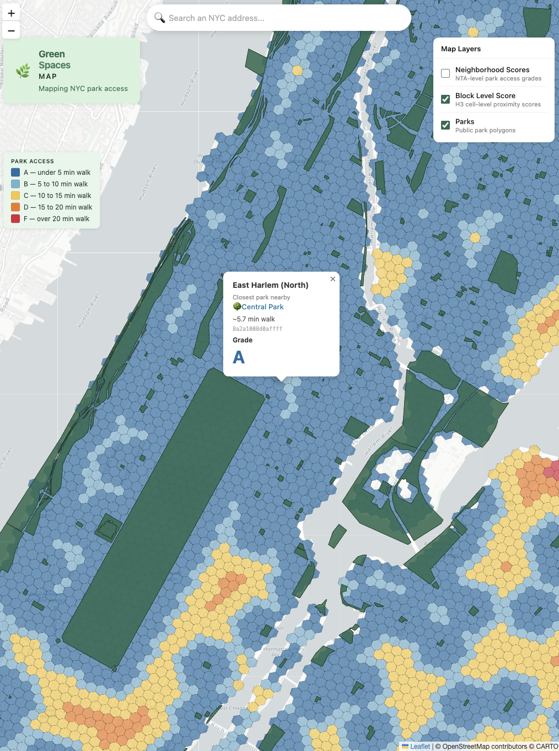
MAP 1 — NEIGHBORHOOD PARKS
Walk score:
87% of NYC scores A or B
A
Under 5 min
B
5–10 min
C
10–15 min
D
15–20 min
F
Over 20 min
87% of NYC cells score A or B

Slide 10
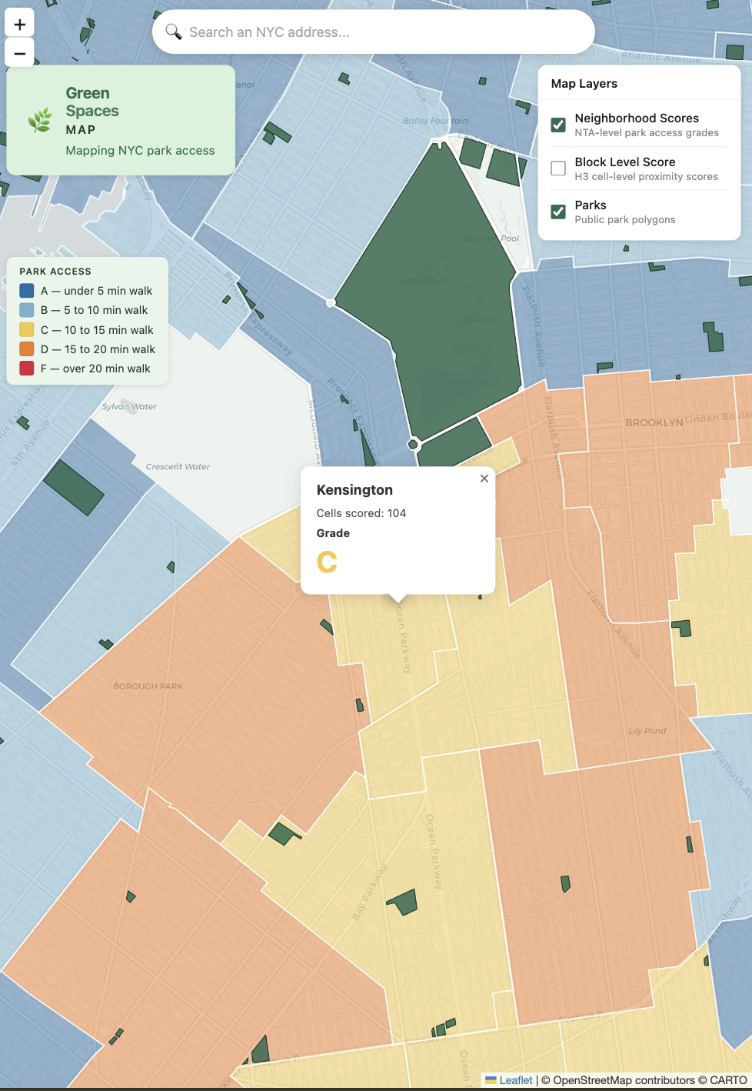
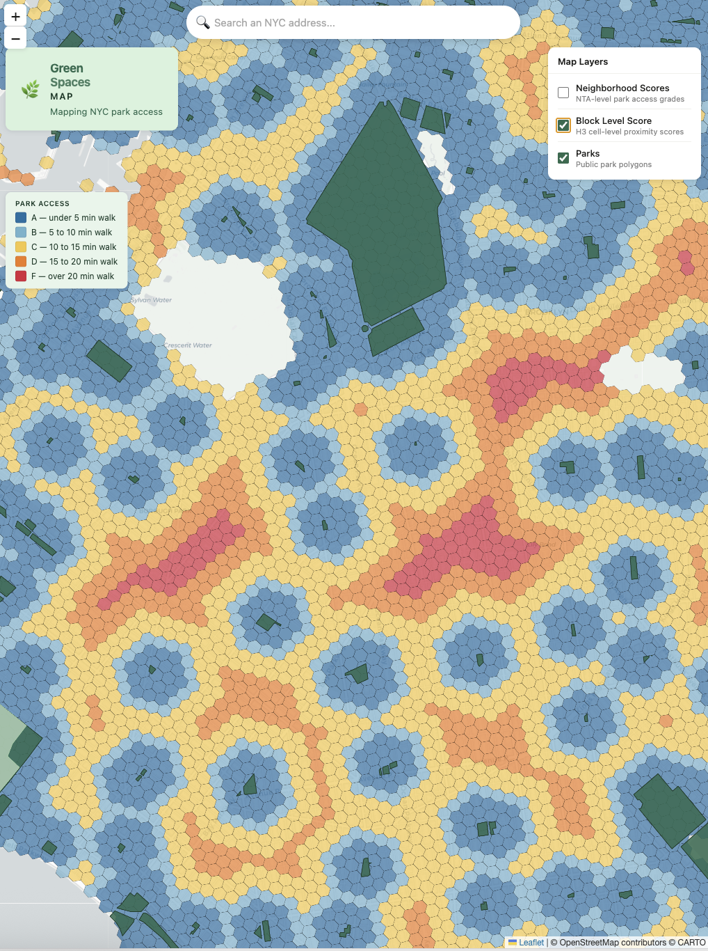
MAP 1 — NEIGHBORHOOD SCORES
Neighborhood grade = % of blocks with good access
A
≥ 80% of cells score A or B
B
≥ 60% of cells score A or B
C
≥ 40% of cells score A or B
D
≥ 20% of cells score A or B
F
< 20% of cells score A or B

Slide 11
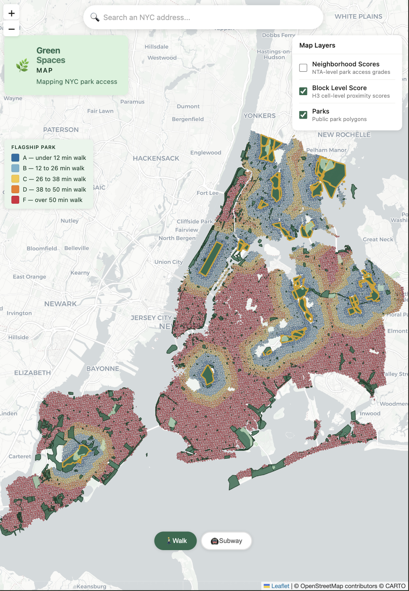
MAP 2 — FLAGSHIP PARKS
Flagship walk — 46% of NYC can't reach a major park
NYC Parks' 15 official Flagship Parks — the destination parks worth a longer trip.
A
Under 12 min
B
12–26 min
C
26–38 min
D
38–50 min
F
Over 50 min
46% of NYC cells score F for flagship walk access

Slide 12
MAP 2 — FLAGSHIP PARKS — SUBWAY MODE
Subway alone cuts number of F scores from 46% to 32%
46%
→
32%
Cells scoring an F — calculating walk only
Cells scoring an F — calculating walk+ subway
Subway and other forms of transit help improve access Likely far more than our app currently shows. No bus scoring yet, single transfer rides on subway only.

Slide 13
WALK VS SUBWAY — CROWN HEIGHTS
Same neighborhood. Different story.
Walk to Prospect Park — 27.7 min — Grade C
Subway via Nostrand Av (direct) — 15.9 min — Grade B

Slide 14
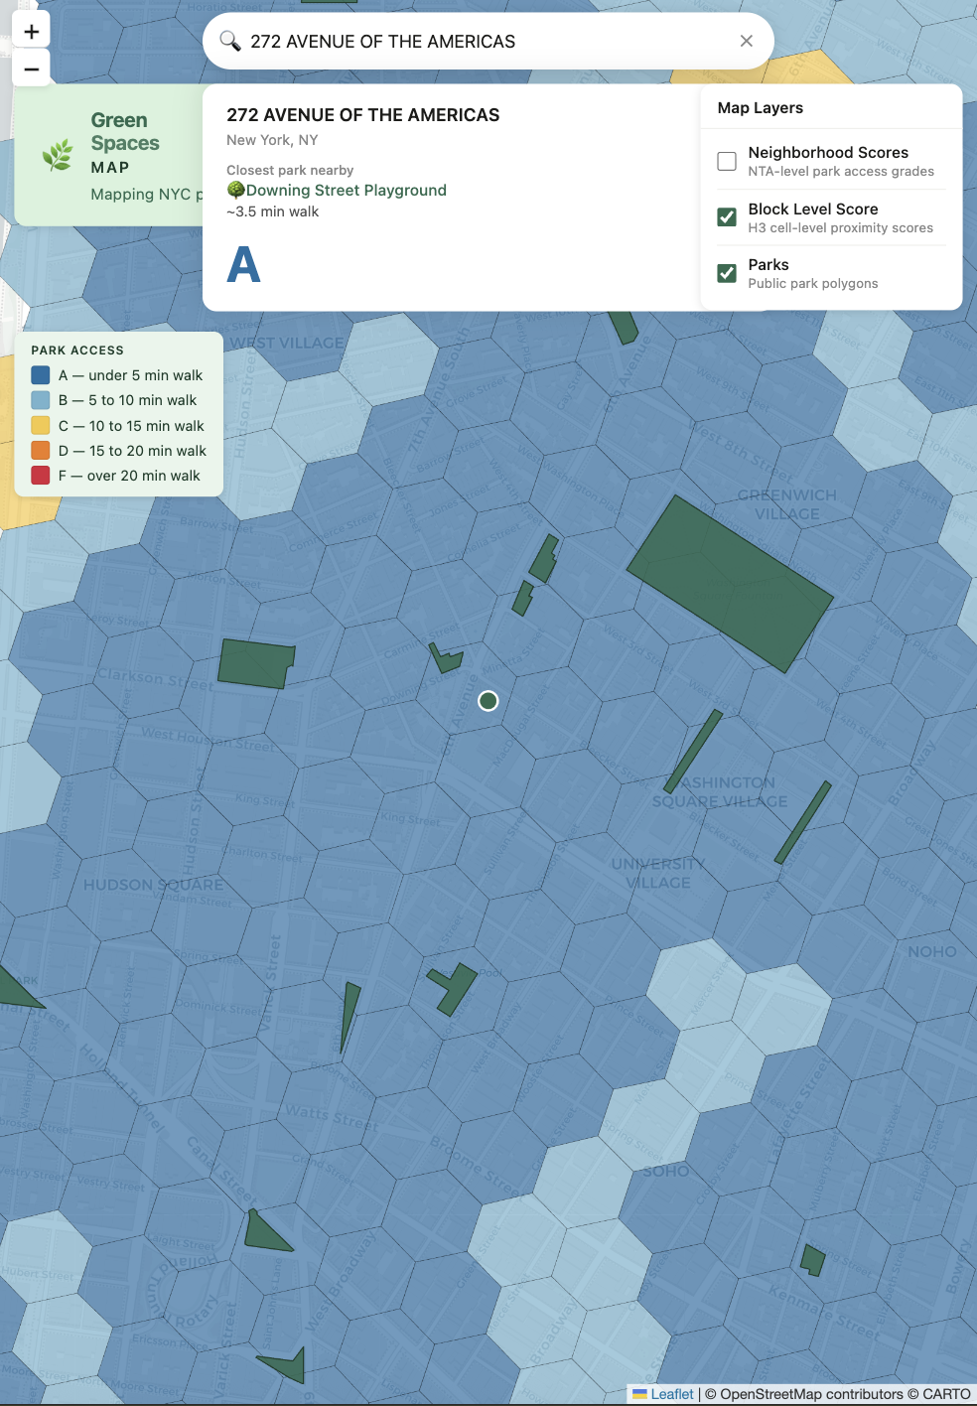
THE TOOL — ADDRESS SEARCH
Search your address. Get your score.
272 Avenue of the Americas
(This venue — LREI)
Nearest park:
Downing Street Playground
~3.5 min walk
Grade: A

Slide 15
Part 3
What's Next
And where you come in

Slide 16
WHAT'S NEXT
The roadmap
🚌
Bus scoring
📊
Advocacy for Park Access
Routing and scheduling info, stop info for MTA buses
Identify areas that could benefit from better access as well as developing more parks.
⭐
Hybrid score
🗺️
Pedestrian routing
Buses, subways, multi-modal transfers, as well as including routes that are 100% accessible
Augment hop approximation with street routing

Slide 17
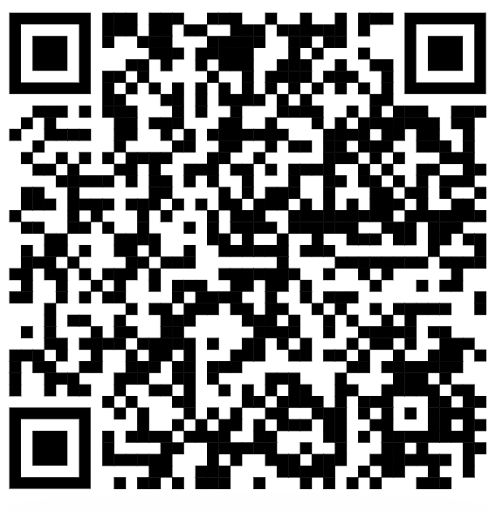
Let’s collaborate!
Everything is open source. All public data. Zero paid APIs.
🚌
🗺️
📊
🎨
Transit routing
Pedestrian routing
Advocacy
Design and Tech
Bus routes, multi-transfer subway
Identify safe and accessible features
Use this data to help advocate for better park access
Help add features to the app
Github Repo https://jacobfarkas.github.io/GreenSpacesMap
Website https://jacobfarkas.github.io/GreenSpacesMap

