Slide 1
Agile Delivery 1

Slide 2
Planning
For our first sprint, we want our to-do list to have the basic features expected from such an app like, readability, the ability to update a task, and deletion.
Implementing a database connection early would also help implement and test our code as it develops.

Slide 3
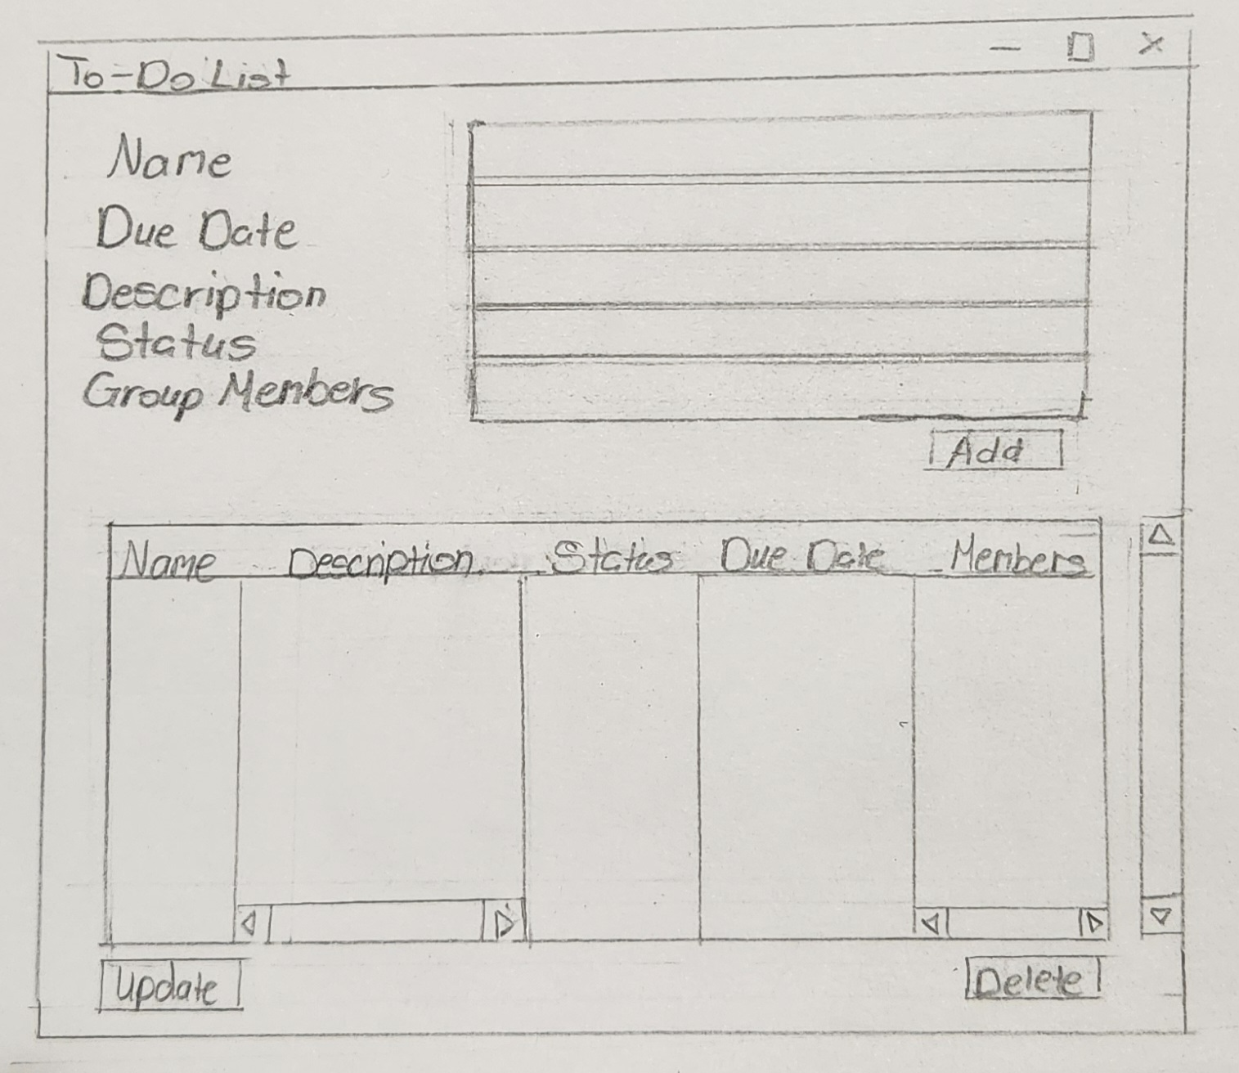
Design
Our interface will consist of:
Various fields to concerning tasks on the to-do list
Buttons to create, modify, and delete
An overview of all tasks on the to-do list

Slide 4
Development
We started with creating a template of our UI for the to-do list.
Our highest priority objective for this sprint was ensuring the creation of a proper connection to our database.
From this we were successfully able to receive and modify the table on the database.
Some issues we encountered were:
Overlapping one of our variables with a with reserved keyword
Spacing and indentation issues

Slide 5
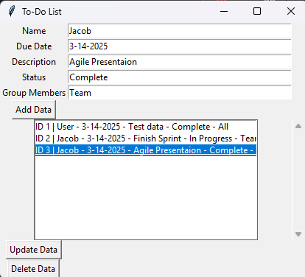
Testing
From our development, we created an application that takes the text from our text fields and can create and modify tasks in the database.

