Slide 1

COVID-19
Forecasting Strategy
Jacob Gipson
Triston Hudgins
DS6373_Time_Series_Project-FINAL.mp4

Slide 2
The Data
The University of Oxford has maintained a dataset that contains various daily metrics related to COVID-19
The daily range is from 2/24/2020 to 3/5/2022
The data contains 67 variables that describe various attributes of cases and deaths that include:
Cases per day
Deaths per day
Vaccination Trends
Geographical Details
This study will focus on cases and death rates in the United States
Question of Interest: Is there a model that can forecast COVID deaths?
This question can be critical to readiness and response to the pandemic and accurate modeling can optimize supply and personnel efforts.

Slide 3
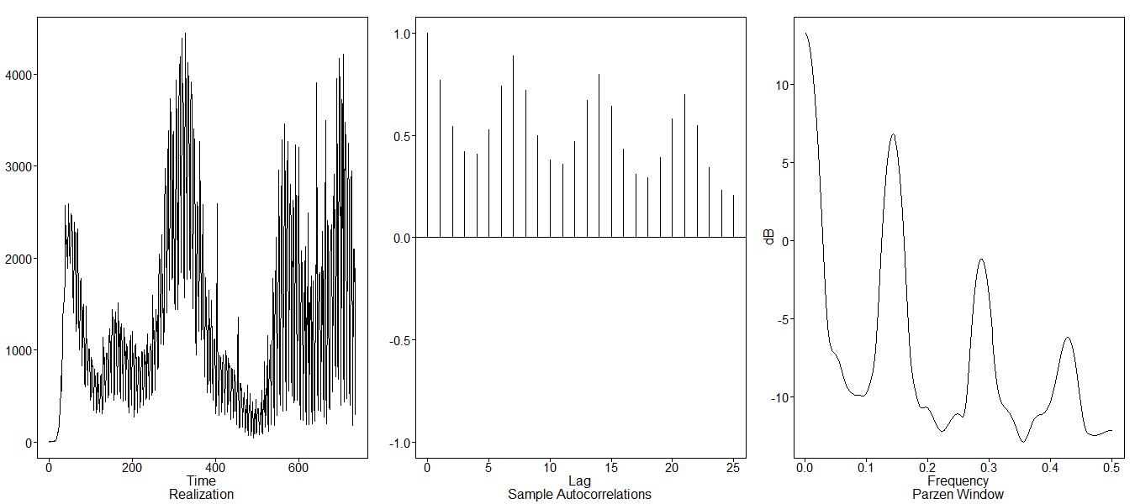
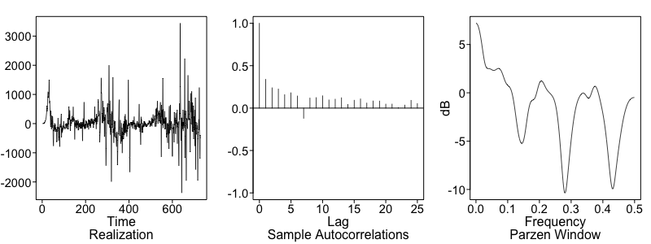
COVID Deaths per Day
Realization | Transformation
Slowly dampening autocorrelations indicate wandering behavior along with the sharp peak at 0 on the spectral density plot Peaks in the ACF plot indicate the possibility of an s=7 seasonal component which aligns with the peak at 0.14 on the spectral density plot | After taking out the s = 7 seasonal component, a constant mean and relatively constant variance is observed The ACF seems to be damping Spectral density plot shows a peak at 0, indicating an AR component with troughs indicating a MA component

Slide 4

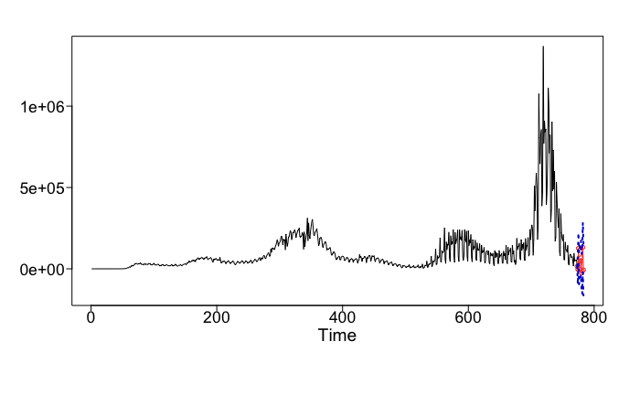
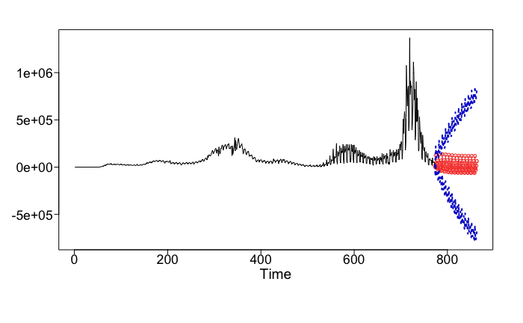
ARUMA (2,0,8) Model with s = 7
 | ARUMA (2,0,8)
AIC | 11.79
10 Day ASE | 190,285
90 Day ASE | 474,667
10-Day Rolling RMSE | 387
90 Day Rolling RMSE | 905
Short-Term Forecast – 10 Days
Long-Term Forecast – 90 Days
Failed to reject the Ljung-Box test with K = 24 and 48 with p-values of 0.36 and 0.20, respectively

Slide 5
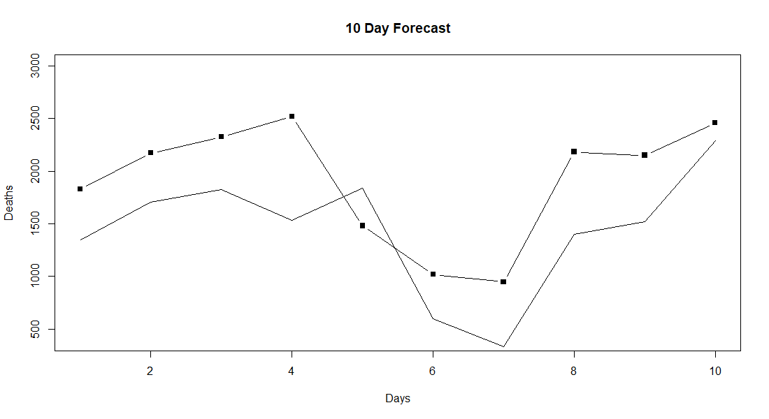
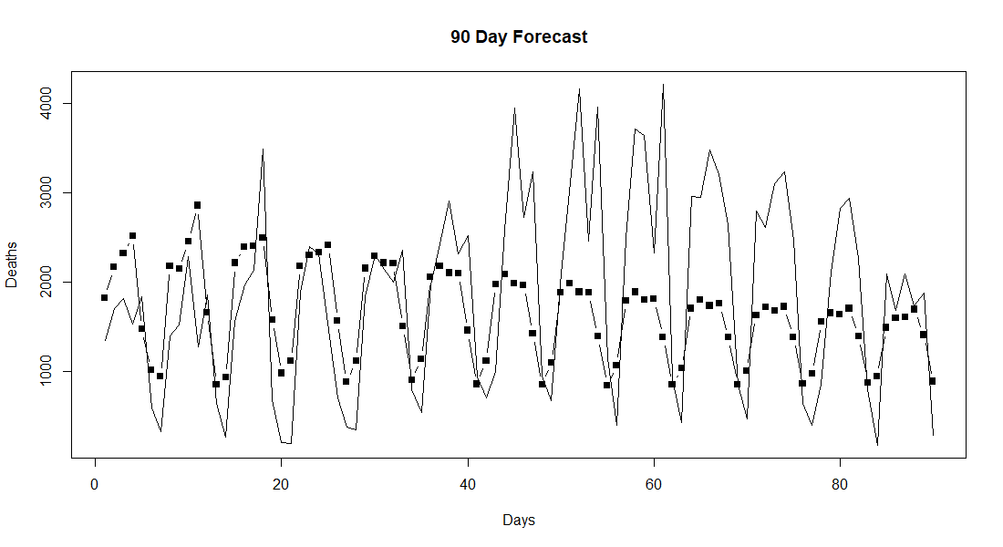
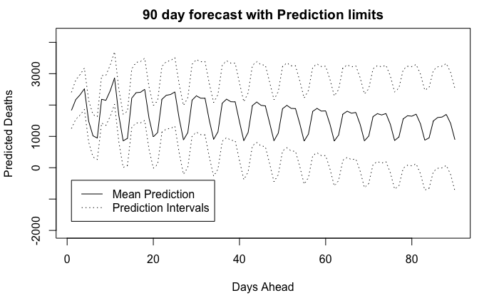
Vector Autoregressive (VAR) Model
ccf plot and varselect indicated the best lag effect to model was lag 16
AIC | 24,238.29
10 Day ASE | 338,780.2
90 Day ASE | 880,543.7

Slide 6
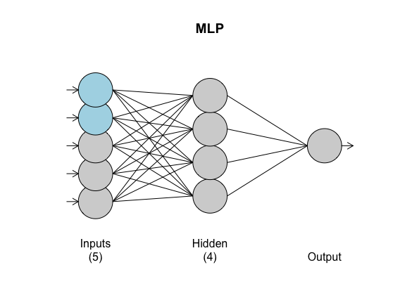
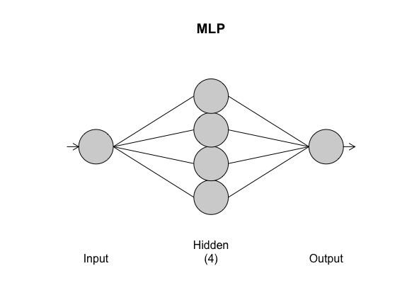
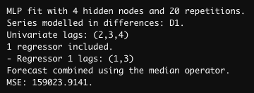

Neural Network - MLP Model
10-day Forecast
90-day Forecast

Slide 7
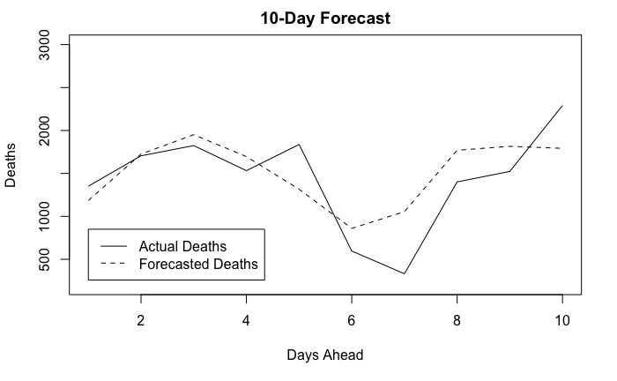
Neural Network - MLP Model – 10 Day Forecast
10 Day ASE = 140,566

Slide 8
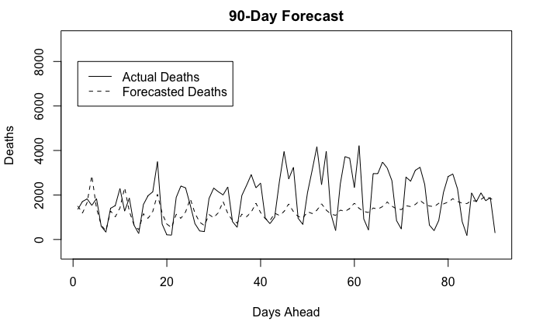
Neural Network - MLP Model
90 Day ASE = 1,295,712

Slide 9
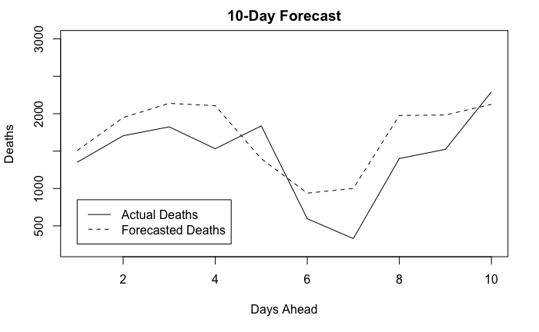

MLP + VAR Ensemble Model
10 Day ASE = 184,123
90 Day ASE = 426,045

Slide 10
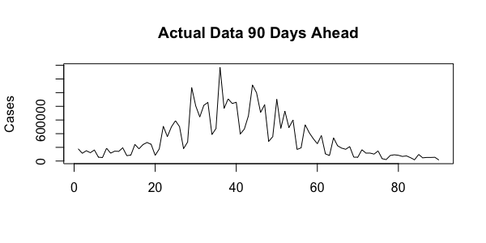
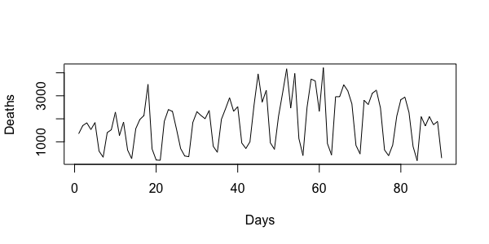
Model Recommendation
 | ARUMA (2,0,8) | VAR | MLP | Ensemble
AIC | 11.79 | 24,238.29 | n/a | n/a
10 Day ASE | 190,285 | 338,780.2 | 140,566 | 184,123
90 Day ASE | 474,667 | 880,543.7 | 1,295,712 | 426,045
The MLP model had the lowest ASE for the short-term forecast by ASE
The ensemble model had the best long-term forecast by ASE
All models were less accurate in the long term. After 25 days (roughly a month), the models failed to detect major spikes.
Given the known lag between deaths and cases, modeling death rate is most accurate within a 16-day window. The short-term MLP model should give the most accurate forecast by ASE and is the most confident prediction method.

Slide 11
Questions?
Jacob Gipson – gipsonj@mail.smu.edu
Triston Hudgins – thudgins@smu.edu

