Slide 1
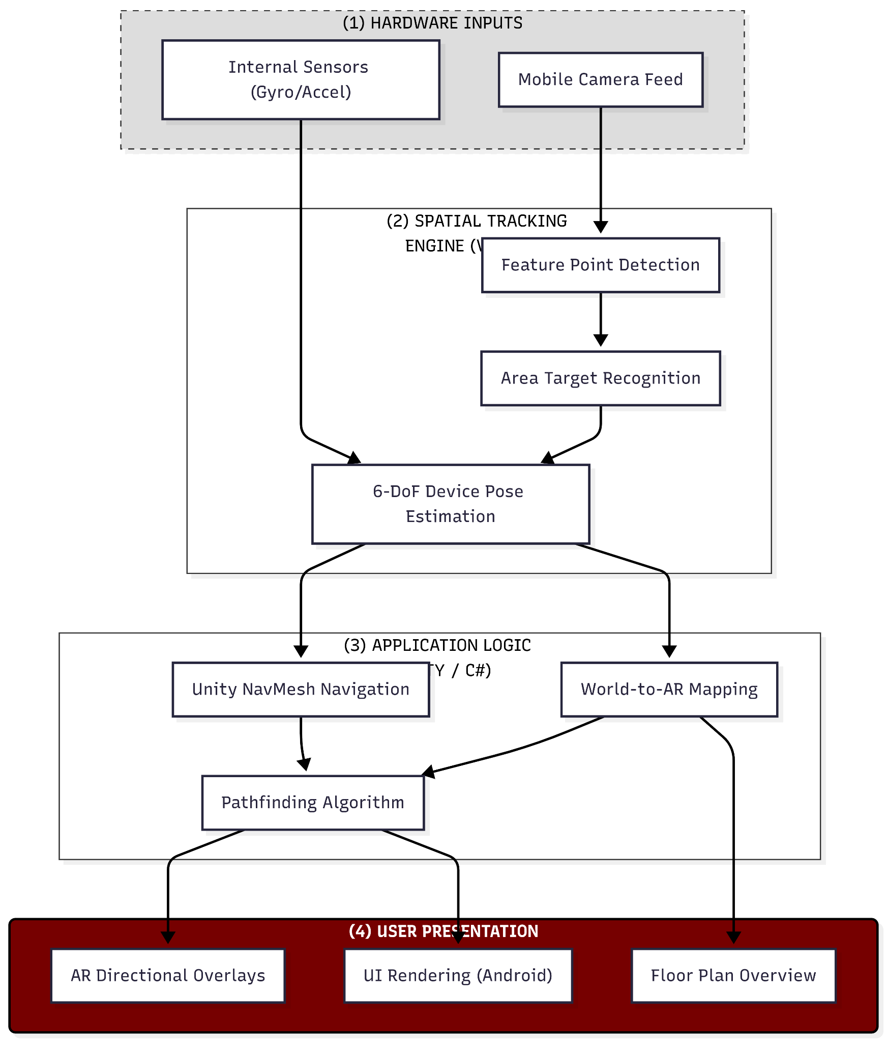
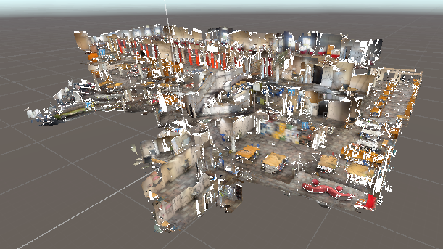



FIT AR Navigation App (FITARNA)
Vincenzo Barager, Dathan Dixon, Jacob Hall-Burns , Ethan Wadley
Faculty Advisor: Eraldo Ribeiro, Dept. of Computer Science, Florida Institute of Technology
Motivation
System Architecture
Navigation Complexity: Large-scale academic facilities like the Evans Library present significant wayfinding challenges for new students and visitors.
GPS Limitations: Standard satellite-based navigation fails indoors due to signal attenuation and lack of floor-level granularity.
The Solution: FITARNA leverages Augmented Reality to provide intuitive, real-time visual guidance, bridging the gap between digital maps and the physical environment.
Project Goals
High-Precision Localization: Achieve sub-meter indoor positioning accuracy without the use of GPS by leveraging AR spatial mapping.
Intuitive AR Wayfinding: Develop a seamless navigation experience using real-time 3D directional overlays.
Dynamic Point-of-Interest System: Implement a searchable database of campus locations, such as specific library wings, study rooms, and help desks.
Implementation and Approach
Environment Mapping: Conducted extensive spatial scans of the Evans Library using Vuforia Area Targets to create a high-fidelity digital twin for persistent tracking.
Hybrid AR Framework: Integrated Unity’s AR Foundation with the Vuforia Engine to leverage cross-platform ARCore/ARKit features while maintaining superior object and area recognition.
Pathfinding Logic: Implemented a custom NavMesh within Unity to calculate real-time, shortest-path routes between navigational waypoints.
Spatial UI Overlay: Developed a user interface that projects 3D directional markers and "breadcrumbs" onto the physical world, ensuring intuitive wayfinding in a complex indoor environment.
Software Stack

