Slide 1
SAFETY
WAYPOINT GENERATION
MPC
PLANT
VISIBILITY
ENVIRONMENT

Slide 2
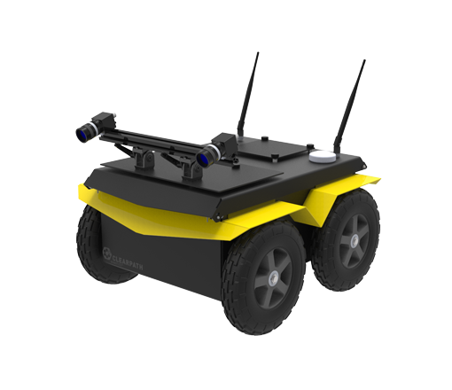






SAFETY
$$|\overline{d}|$$
WAYPOINT GENERATION
$$w$$
MPC
$$u$$
PLANT
VISIBILITY
$$Λ$$
$$p(d)$$
$$y$$
CORNER
MAP
ENVIRONMENT

Slide 3
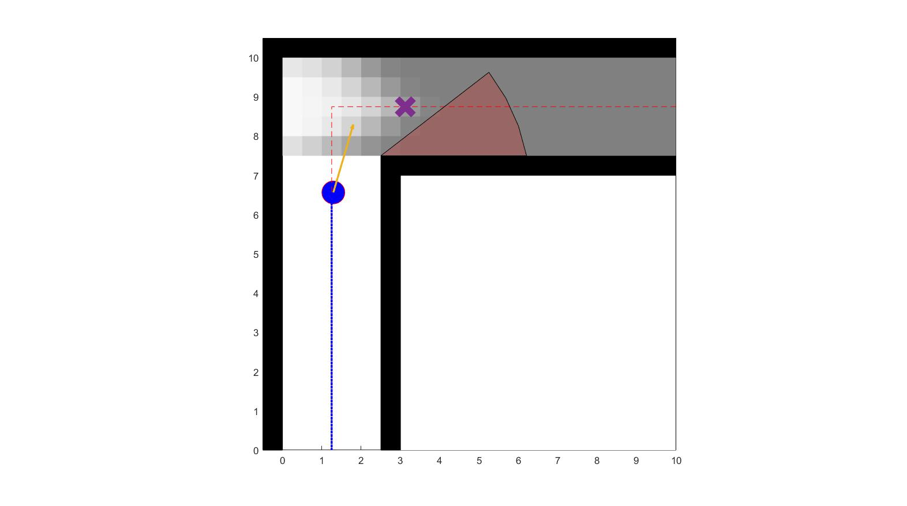

$$\overline{d}$$

Slide 4
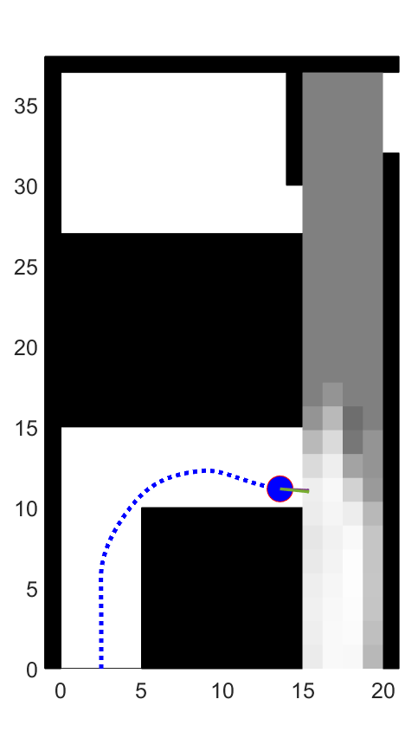
Stock Room
Main Hallway

