Slide 1

Ethical Considerations for Terrestrial Aboveground Biomass Modeling
Earth and Environment Data Science & Society
Jake Howell
Notes:
Good morning, Today I will be presenting my proposal on Modeling Factors Associated with a Wildland Firefighters Assessment of Structure Defensibility
I want to thank my Committee Members
Chair: Phil Dennison and Committee members: Mickey Campbell and Matthew Thompson

Slide 2
Forests are Carbon Sinks
Forested environments cover 30% of the planet and contain 80% of the earth’s biomass (IPCC, 2006)
Forest biomass is a proxy for carbon sequestration
Biomass the mass of organic matter contained within plant material
How do we measure biomass?
Fine-scale: Measure trees in field plots
Time consuming and costly
Requires measuring structural attributes from individual trees
Broad-scale: Use remote sensing data
We can map forested environments at scale, but we can’t directly measure biomass

Slide 3
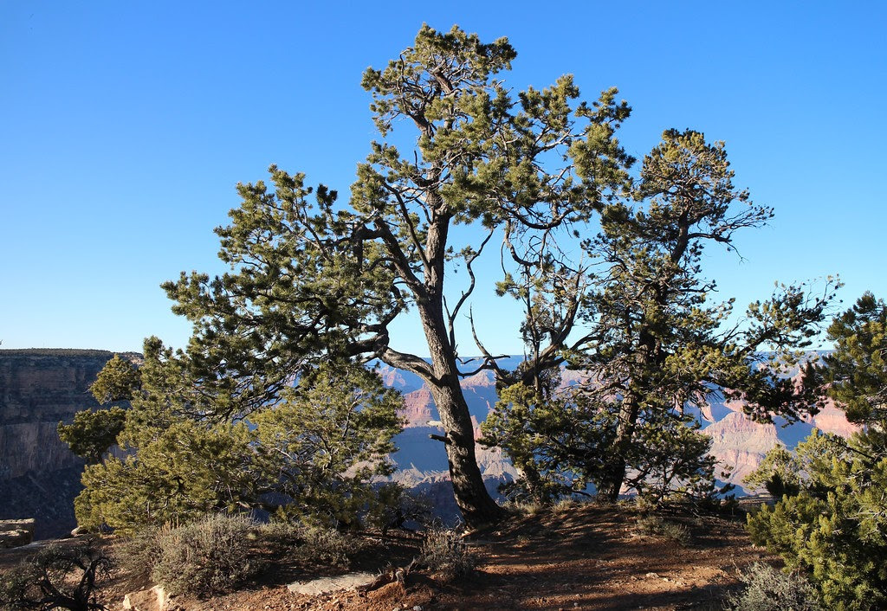
Research Objectives
Pair field measurements and remotely sensed data to model individual tree-level biomass in the largest dryland ecosystem in the USA
Compare model performances between best-case scenario remotely sensed data (lidar) & emerging methods
Produce scalable & defensible biomass maps across southwestern USA’s most prominent ecosystem

Slide 4
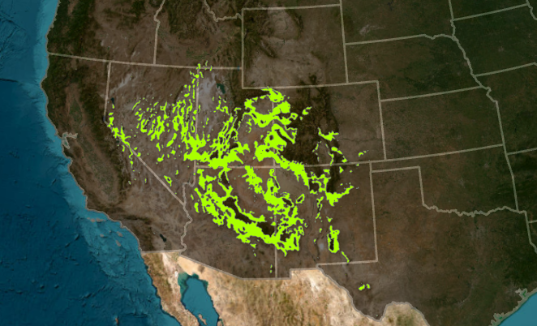
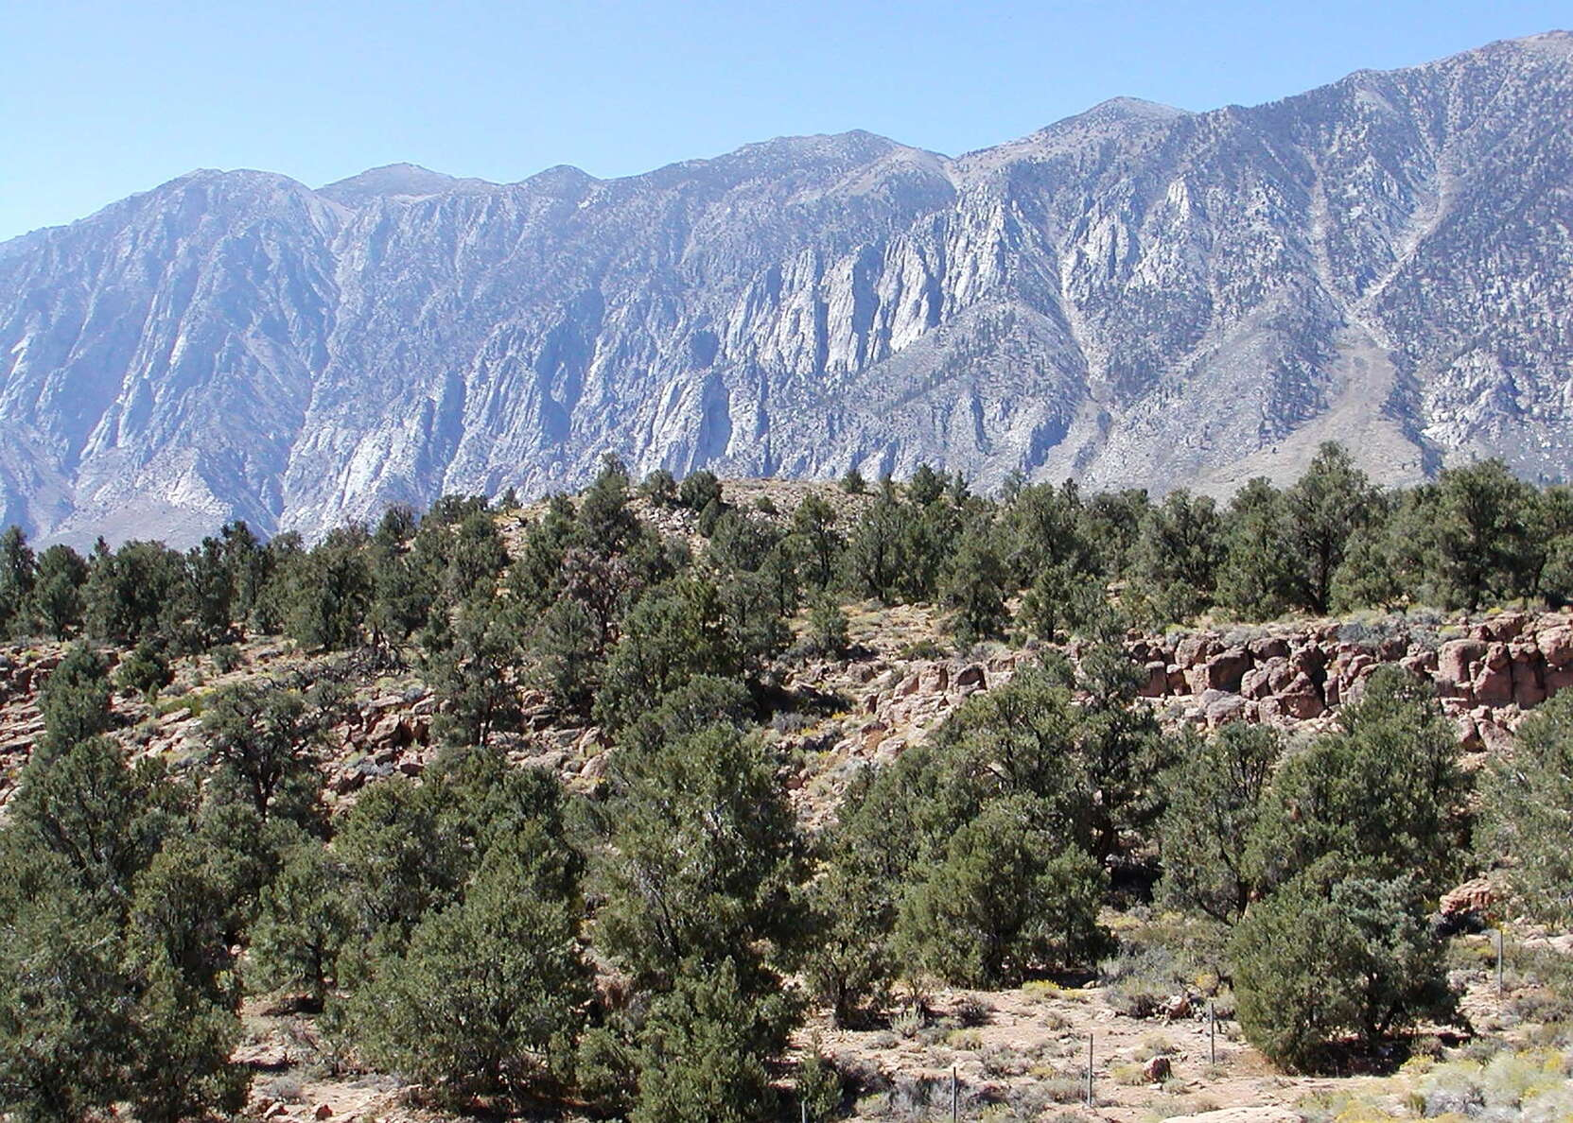
Study Area
Pinyon-Juniper (PJ) Woodlands are the largest dryland ecosystem in the USA
Span ten western states and cover 36 million acres of land (Shaw et al., 2005)
Undergoing unprecedented rates of tree mortality/die off (Breshears et al., 2005)
Drought
Beetle kill
Invasive Encroachment

Slide 5
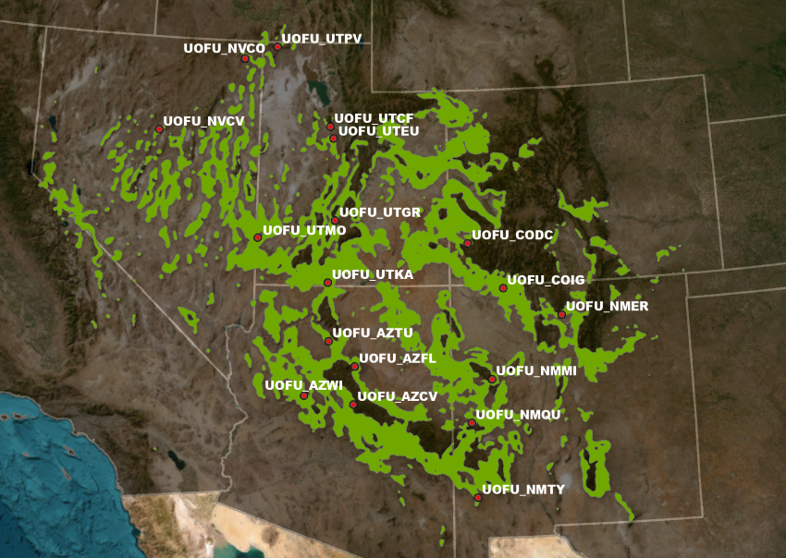
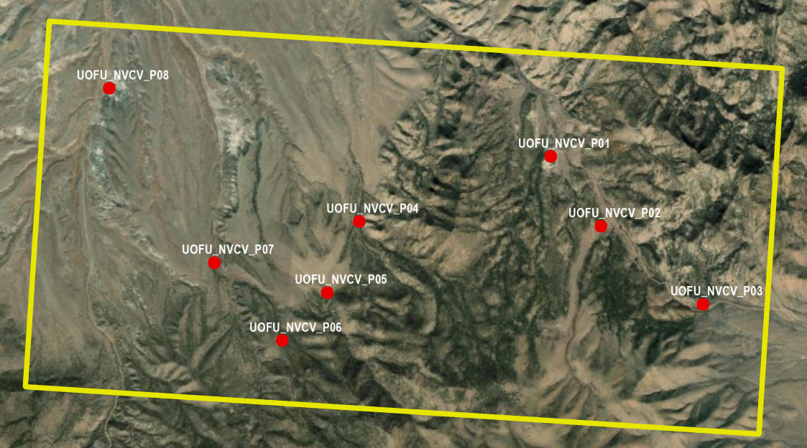
PJ Field Campaign
Selected 18 PJ-dominated sites throughout five southwestern states.
Collected 7-13 plots per site, with a total of 180 being collected.

Slide 6
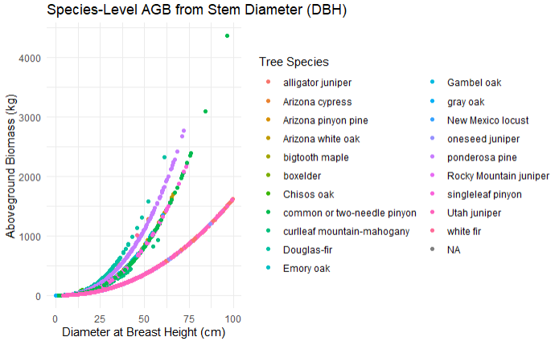
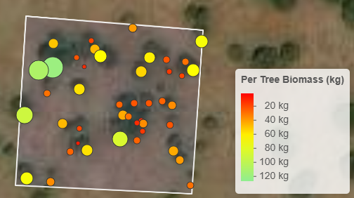
Field Plot Measurements
GPS points of plot boundaries (30 x 30-meter squares)
Individual tree measurements
Species
Stem Diameter
Compute AGB for each individual tree and summarize the per-plot AGB

Slide 7
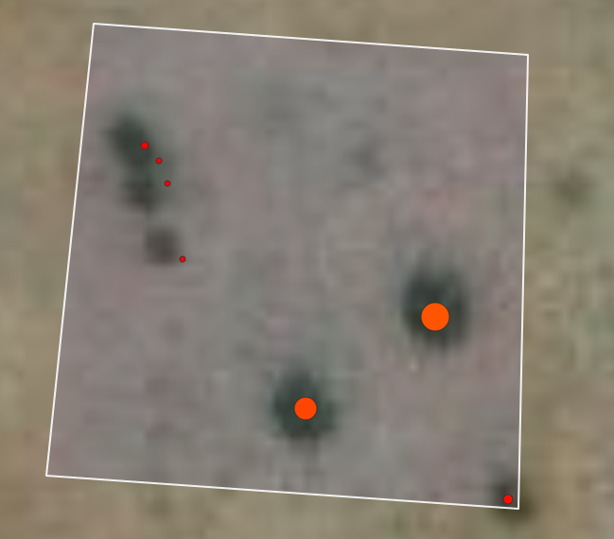

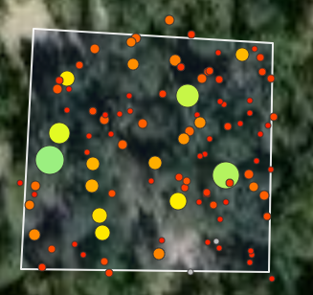

Field Data Results
Lowest Plot Biomass: 364 kg
For each of the 180 field plots:
We know each tree's location and biomass
We know the summed plot level biomass
How do we use these field data results to make landscape-scale biomass estimates?
Highest Plot Biomass: 13,969 kg

Slide 8
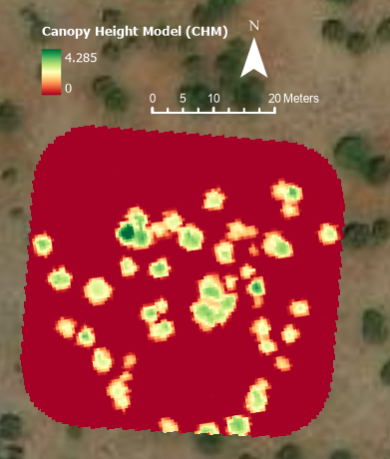
Remotely Sensed Data
Primary data source:
Canopy Height Models (CHM)
Digital Surface Model (DSM) – Digital Terrain Model (DTM)
Pixels represent the height (m) above the bare-earth surface
Great for determining the position of trees

Slide 9
What is Aboveground Biomass?
Aboveground Biomass (AGB) is the mass of organic matter contained within plant material above the ground surface
Indicator of vegetation health and condition, but also carbon sequestration
This can be measured for individual trees in the field
Time consuming and costly
Requires measuring structural attributes from individual trees

Slide 10
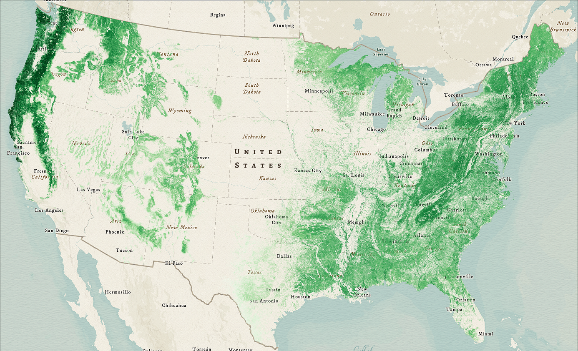
Mapping Aboveground Biomass
There have been many efforts to map AGB at scale
USFS FIA BIGMAP project
NASA Carbon Monitoring
These efforts typically map AGB at the individual pixel level

Slide 11
Pinyon-Juniper Woodlands
As this name suggests, this ecosystem largely comprises of Pinyon and Juniper trees
Common species types include:
Utah Juniper (Juniperus osteosperma)
One-seed Juniper (Juniperus monosperma)
Single-leaf Pinyon (Pinus monophyla)
Two-needle/Colorado Pinyon (Pinus Edulis)

Slide 12
Remotely Sensed Data
Primary data source: Canopy Height Models (CHM)
Pixels represent the height (m) above the ground

Slide 13
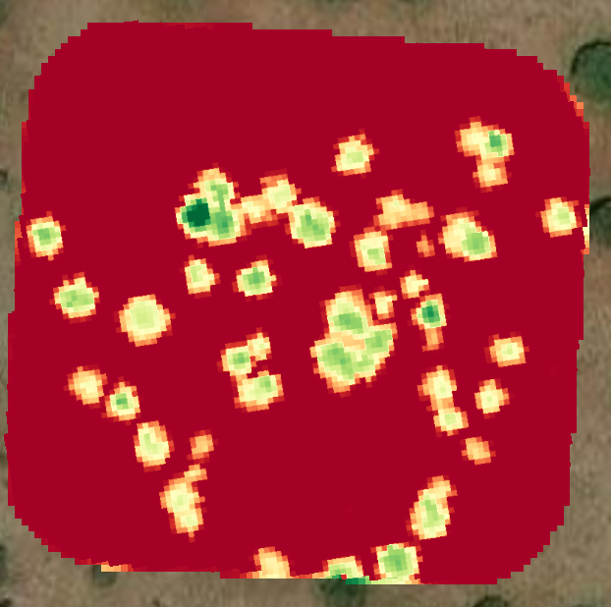
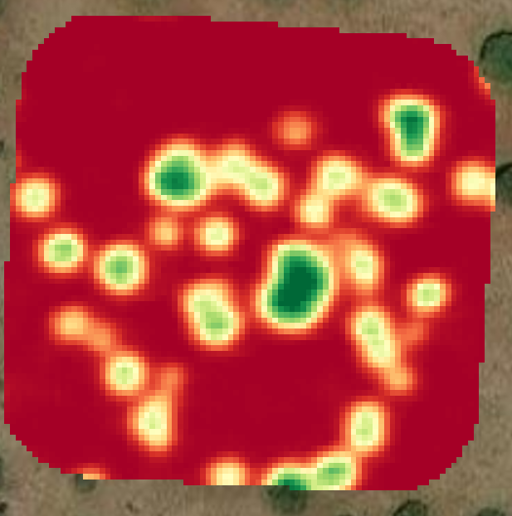
Remotely Sensed Data
Lidar-Derived Canopy Height Models
NAIP-Derived Canopy Height Models

Slide 14
Individual Tree Detection

Slide 15
Individual Tree Detection

Slide 16
Thank You for Your Time
Any Question?
Notes:
Thank for your time I will be happy to answer any questions at this time

Slide 17
References

