Slide 1
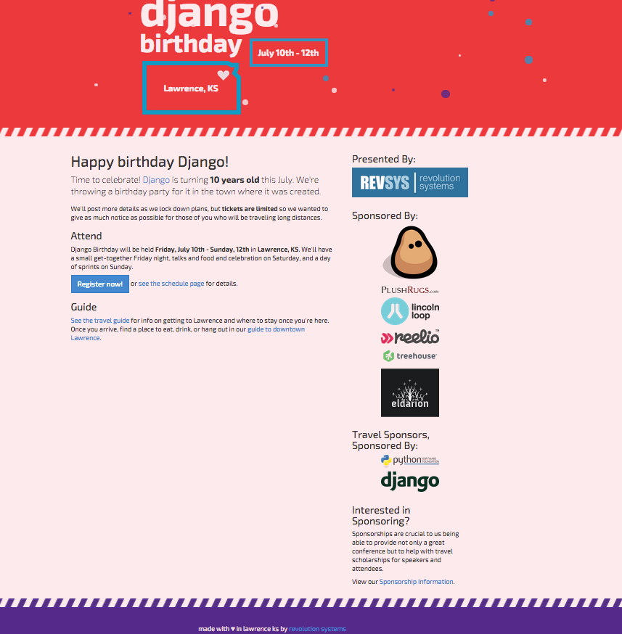
Block Party: July 11 @ 6pm
@ Sandbar (8th St between Mass and New Hampshire)
Sprints: July 12 @ 10am
@ Carnegie Building (200 West 9th St)
@djangobirthday & #djbday

Slide 2


Slide 3


Slide 4


Slide 5


Slide 6


Slide 7


Slide 8


Slide 9


Slide 10


Slide 11


