Slide 1

Dagsseminar 16/12-19

Slide 2
Bakgrunn
Labarbeid - prosedyrer
Statistikk - opplæring
Andre oppgaver - standardisering
Notes:
Unngå at gruppemedlemmer finner «sin måte» å gjennomføre en gitt oppgave på -

Slide 3
Standardisering
Best practice i alle faser av et forskningsprosjek
Tidlig involvering og kunnskapsoverføring til nye gruppemedlemmer
Effektiv kompetanseheving og videreføring av kunnskap i forskningsgruppa
Tidsbesparende for alle
Notes:
Mindre «silojobbing»

Slide 4
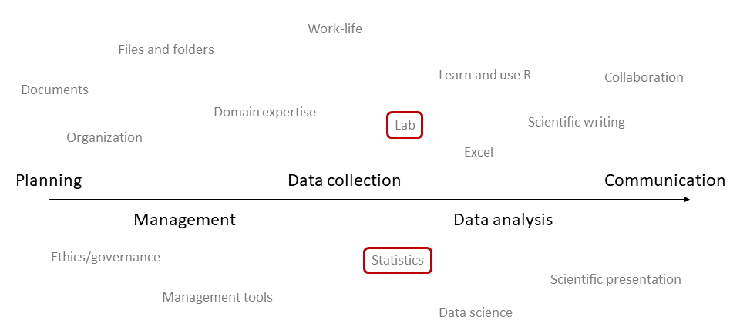

Slide 5
Bruke lipidklasser som eksempel - standardisere
Samle artikler publisert på lipidklasser (Holven/Ulven grp)
Synliggjøre studier «in pipeline» på lipidklasser
Lage standard tekst til artikler:
Metodeavsnitt
Statistikk

Slide 6
Mål for dagen
Innføring: Nightingale-excelfila → forestplots
Hva er et forestplot?
Hva må til for å lage det?
Generelt om data visualisering
Data analyse pipeline
Innføring i R

Slide 7
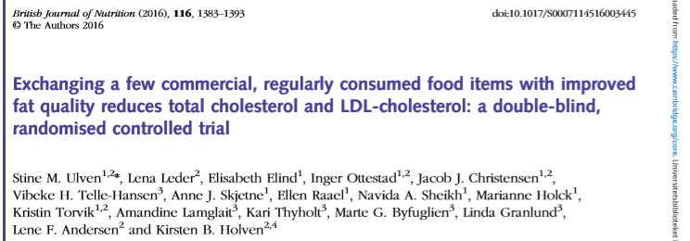
Background: The healthy Nordic diet has shown health beneﬁcial effects among subjects at risk of CVD. However, the extent of food changes needed to
achieve these effects is less explored.
Aim: effects of exchanging commercially available, regularly consumed key food items* with improved fat quality on total cholesterol, LDL-cholesterol and inﬂammatory markers.
Participants: 99 moderately hypercholesterolaemic, non-statin-treated adults (25–70 yrs) completed
Methods: 8 wk double-blinded RCT.
Two arms: experimental diet group (Ex-diet group) and control diet group (C-diet group).
Results: Reduction in tot-C and LDL-C with 9% and 11% (P<0·001), respectively.
*replacing SFA with mostly n-6 PUFA (food items used: e.g. spread on bread, fat for cooking, cheese, bread and cereals)
Notes:
No difference in change in plasma levels of inﬂammatory markers

Slide 8
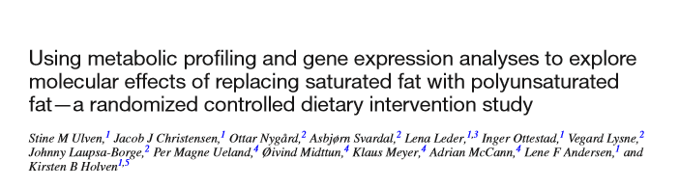
Background: Beyond changes in LDL-C we lack a complete understanding of the physiologic alterations that occur when improving dietary fat quality
Aim: to gain knowledge of metabolic alterations when SFAs were replaced with PUFAs
Methods: We performed comprehensive metabolic profiling with NMR, MS and PBMC gene expression
Results: A large number of lipoprotein subclasses, myristoylcarnitine and palmitoylcarnitine, and kynurenine were reduced, and bile acids, proprotein convertase subtilisin/kexin type 9, acetate, and acetoacetate were increased.
The mRNA levels of LXRA and LDLR were increased, in addition to several liver X receptor α target genes and genes involved in inflammation, whereas the mRNA levels of UCP2 and PPARD were decreased in peripheral blood mononuclear cells after replacing SFAs with PUFAs.
Conclusion: metabolomics in RCT has the potential to extend our knowledge of the effects of dietary fat on CVD risk.
Notes:
No difference in change in plasma levels of inﬂammatory markers

Slide 11
Background: The healthy Nordic diet has shown health beneﬁcial effects among subjects at risk of CVD. However, the extent of food changes needed to
achieve these effects is less explored.
Aim: effects of exchanging commercially available, regularly consumed key food items* with improved fat quality on total cholesterol, LDL-cholesterol and inﬂammatory markers.
Participants: 99 moderately hypercholesterolaemic, non-statin-treated adults (25–70 yrs) completed
Methods: 8 wk double-blinded RCT.
Two arms: experimental diet group (Ex-diet group) and control diet group (C-diet group).
Results: Reduction in tot-C and LDL-C with 9% and 11% (P<0·001), respectively.
*replacing SFA with mostly n-6 PUFA (food items used: e.g. spread on bread, fat for cooking, cheese, bread and cereals)
Notes:
No difference in change in plasma levels of inﬂammatory markers

Slide 12
Karakteristikk
Kjønn
Røyking
BMI
Blodtrykk
Lipider
Glukose, HbA1c
ASAT, ALAT
Kreatinin
CRP
Fettsyrer
Kostdata (kostdagbok)
Compliance (kosthold)

Slide 13
Background: Beyond changes in LDL-C we lack a complete understanding of the physiologic alterations that occur when improving dietary fat quality
Aim: to gain knowledge of metabolic alterations when SFAs were replaced with PUFAs
Methods: We performed comprehensive metabolic profiling with NMR, MS and PBMC gene expression
Results: A large number of lipoprotein subclasses, myristoylcarnitine and palmitoylcarnitine, and kynurenine were reduced, and bile acids, proprotein convertase subtilisin/kexin type 9, acetate, and acetoacetate were increased.
The mRNA levels of LXRA and LDLR were increased, in addition to several liver X receptor α target genes and genes involved in inflammation, whereas the mRNA levels of UCP2 and PPARD were decreased in peripheral blood mononuclear cells after replacing SFAs with PUFAs.
Conclusion: metabolomics in RCT has the potential to extend our knowledge of the effects of dietary fat on CVD risk.
Notes:
No difference in change in plasma levels of inﬂammatory markers

