Slide 1
AXM0F243-Multisense BME680 only consumption characterization
Florian Grante
Thursday, June 27, 2019

Slide 2
Radiolab project
Constant configuration
FSK
868.3 MHz
Dual Ended PA.
RX for slave is always on.
Modification of the main to an application (next slide).

Slide 3
Application
Read and transmit BME680 values every X secs . (Values are wrong for now, still working on it ATM but current consumption should not change).
BMA400 is disabled and not powered.
Deep Sleep between all these events.

Slide 4

Receiver side
Connected to PC with AXDBG.
Sending received data through UART and reading it with HTERM
UART Initialization is done and slave is ready to receive data
BMA400 Events
BME680 Event

Slide 5
Tested configuration
3 different settings : Data rate, TX output power and Duty cycle
TOTAL : 72 configurations have been tested
Data Rate (kbps) | TX Power (dBm) | Duty cycle (seconds)
5 | 0 | 5
10 | 5 | 10
20 | 15 | 30
50 |  | 60
100
125

Slide 6
Testing protocol
Flashing AXM0F243-Multisense with a specific configuration.
Powering the board with the NUCLEO LPM01A to measure the current.
Waiting 2 duty cycles to start measurement to have permanent status.
Measure current during 15 duty cycles.
Taking average current of this 15 duty cycles to estimate lifetime.
Screenshot one waking up event / reading BME680 / Transmission

Slide 7
Results
Excel reporting data about each configuration (Can’t insert an excel with relative path here, so you have to open it on you own way)
Be sure to let the excel inside the folder
EXCEL will propose you to enable macro (disable by default) with this message box :
CLICK on Enable Content if you want every feature of this excel report

Slide 8
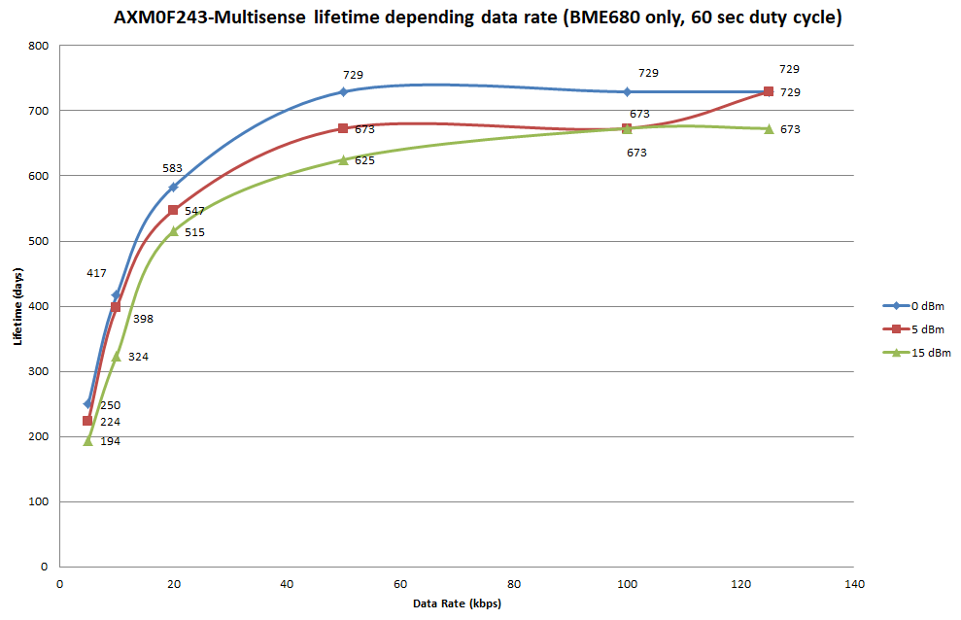
Results
After 20 kbps, we can chose any TX Power we want, we will have good lifetime

Slide 9
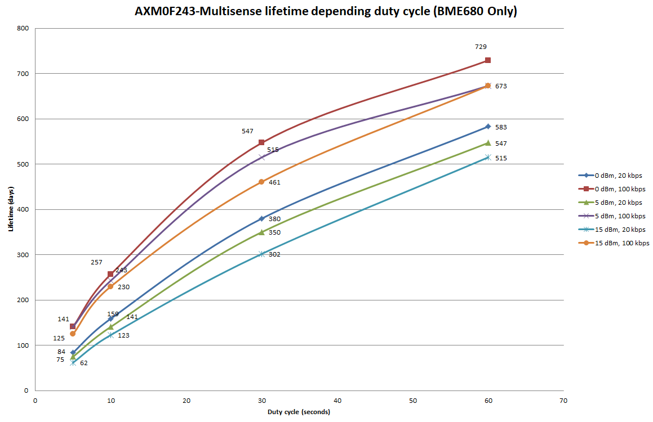
Results
We can notice two groups of curves depending data rate
→ Data rate is more decisive than TX power in lifetime.

Slide 10
Trying to improve lifetime
30 sec duty cycle but sending the all data only every hour
Sending one frame of almost 1600 bits every hour
Reading Temp, pressure and humidity every 30 sec and stock it.
Testing it with this current settings :
20 kbps
0 dBm
30 sec duty cycle
Other are the same (see slide 2)
From our test on the Excel, the lifetime is 380 days, let’s see with this protocol.

Slide 11
Trying to improve lifetime
Deep Sleep :
6µA average current
Reading event :
5157 µA average current
29 ms duration
Transmission event :
9275 µA average current
204 ms duration

Slide 12
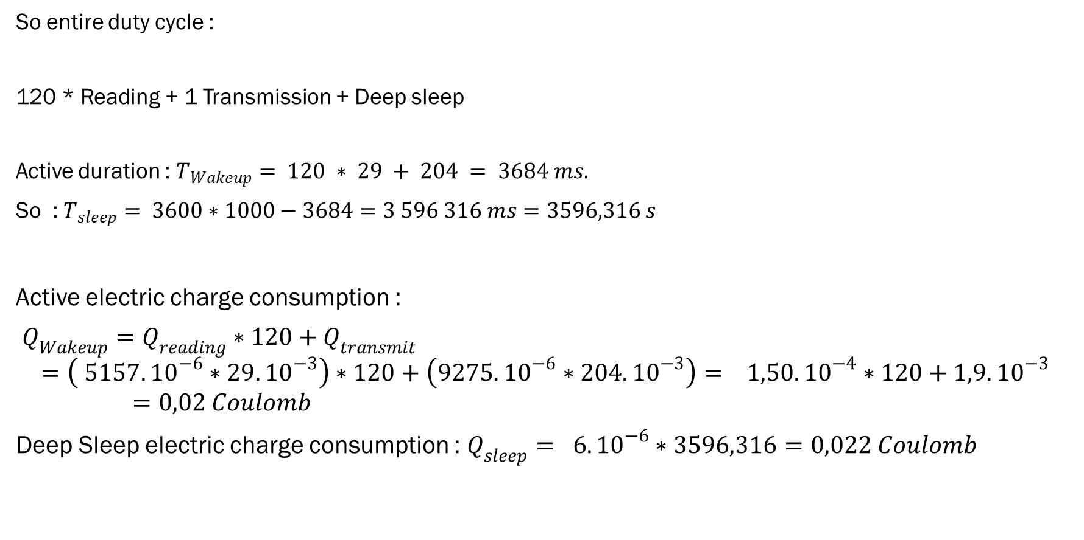
Trying to improve lifetime
So entire duty cycle :
120 * Reading + 1 Transmission + Deep sleep
Active duration : $T_{Wakeup}= 120 ∗ 29 + 204 = 3684 ms.$
So : $T_{sleep}= 3600∗1000−3684=3 596 316 ms=3596,316 s$
Active electric charge consumption :
$Q_{Wakeup}=Q_{reading}∗120+Q_{transmit}$
$$=\left( 5157. {10}^{−6}∗29.{10}^{−3}\right)∗120+\left(9275.{10}^{−6}∗204.{10}^{−3}\right)= 1,50.{10}^{−4}∗120+1,9.{10}^{−3}=0,02 Coulomb$$
Deep Sleep electric charge consumption : $Q_{sleep}= 6.{10}^{−6}∗3596,316=0,022 Coulomb$

Slide 13
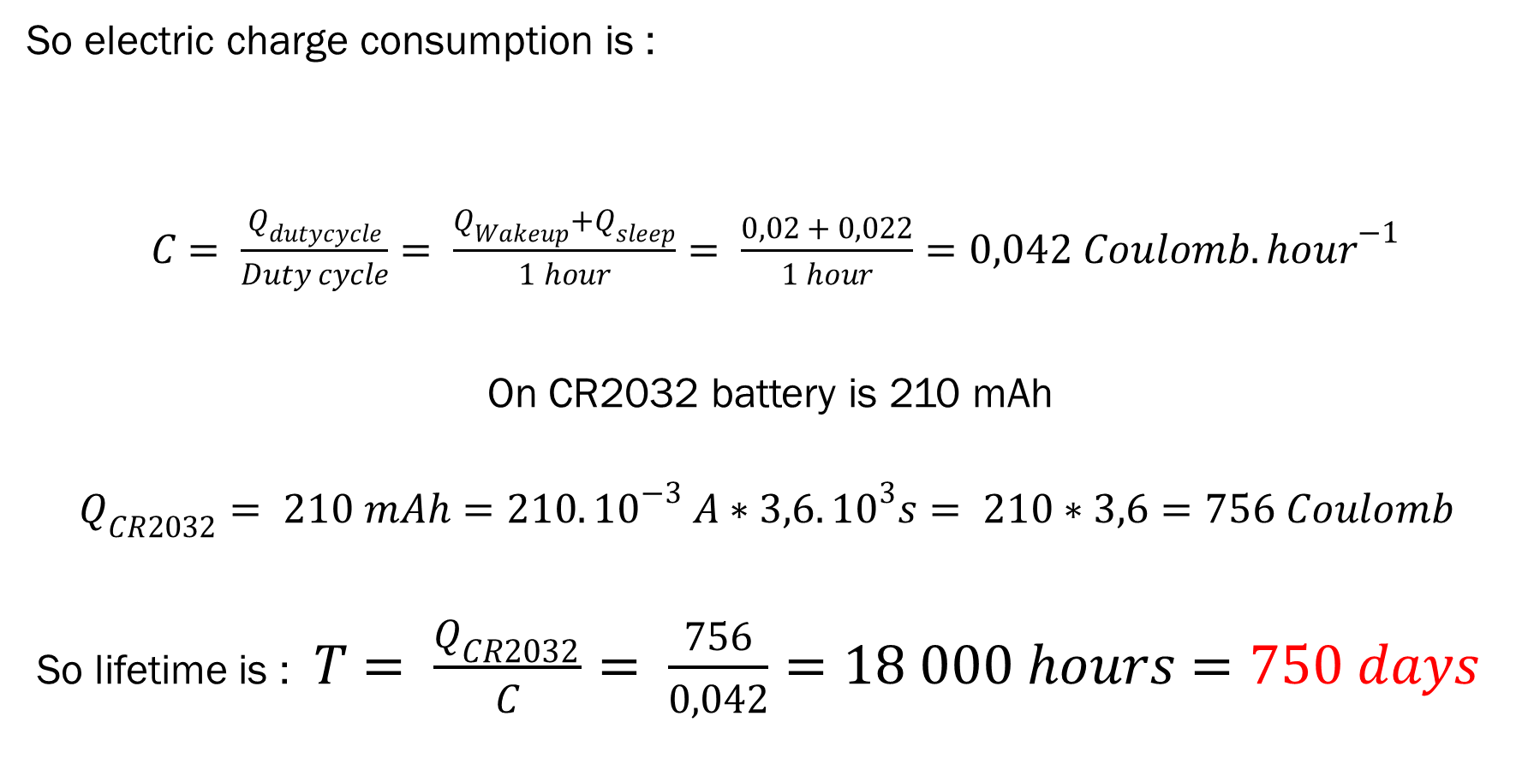
Trying to improve lifetime
So electric charge consumption is :
$C= \frac{Q_{dutycycle}}{Duty cycle}= \frac{Q_{Wakeup}+Q_{sleep}}{1 hour}= \frac{0,02 + 0,022}{1 hour}=0,042 Coulomb.{hour}^{−1}$
On CR2032 battery is 210 mAh
$$Q_{CR2032}= 210 mAh=210.{10}^{−3} A∗3,6.{10}^{3}s= 210∗3,6=756 Coulomb$$
So lifetime is : $T= \frac{Q_{CR2032}}{C}= \frac{756}{0,042}=18 000 hours=750 days$

Slide 14
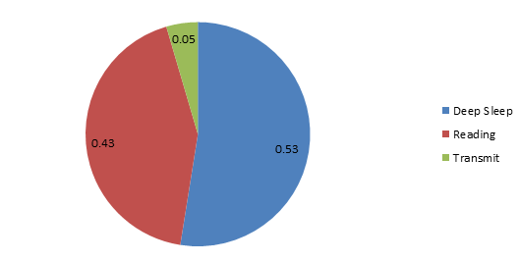
Trying to improve lifetime
We got 750 days instead of 380 days
Proportion of the consumption in %
Transmission is only 5%

