Slide 1
Jacob Kaplan
Department of Criminology
University of Pennsylvania
Notes:
Introduce talk then talk about background.

Slide 2
Broad research interests with data focus
Research Topics
Crime Prevention Through Environmental Design (CPTED)
Domestic Violence
Police and incarceration

Slide 3
Broad research interests with data focus
Research Topics
Crime Prevention Through Environmental Design (CPTED)
Domestic Violence
Police and incarceration
Data Focus
Clean and combine public data
Make data accessible to the public
Notes:
Data for public, MEDIA, POLICY MAKERS

Slide 4
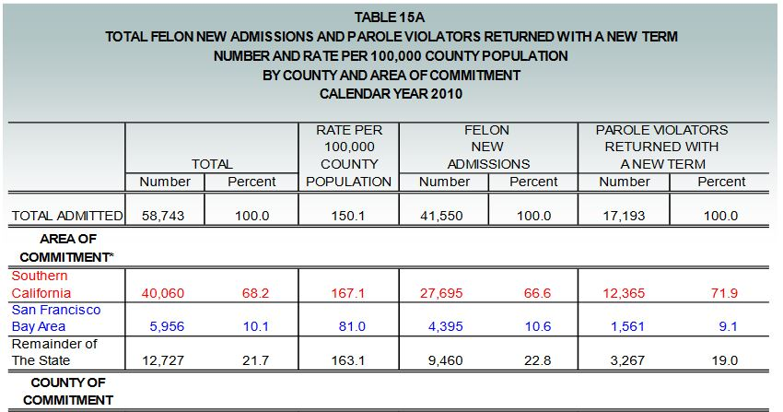
Making crime data more accessible
Common problems with crime data
Each year in a separate file
Hard to access format
fixed-width text
Data in a PDF file
Data vs Information

Slide 5
Making crime data more accessible
Common problems with crime data
Each year in a separate file
Hard to access format
fixed-width text
Data in a PDF file
Data vs Information
My contributions
Clean and combine all UCR data
R package: asciiSetupReader
Scrape data from PDFs
Crimedatatool.com: Data dashboard
Publish data on openICSPR

Slide 6
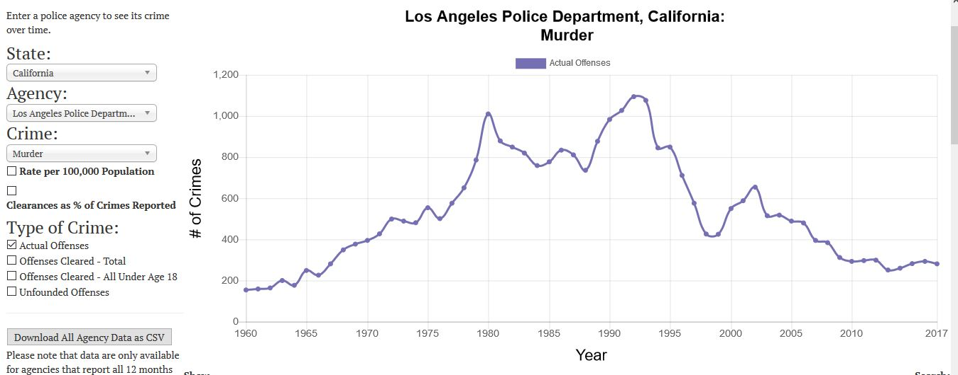
Crimedatatool.com lets users easily visualize data
UCR
Crimes
Arrests
Police
Alcohol Consumption
CDC Cause-of-Death
Border Patrol
Prisons
National Prisoner Statistics
National Corrections Reporting Program
Notes:
Data that is on crimedatatool.com

Slide 7
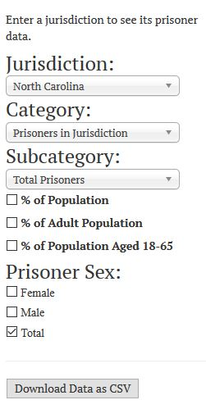
Users can select what data to graph
Notes:
What choices user can make

Slide 8
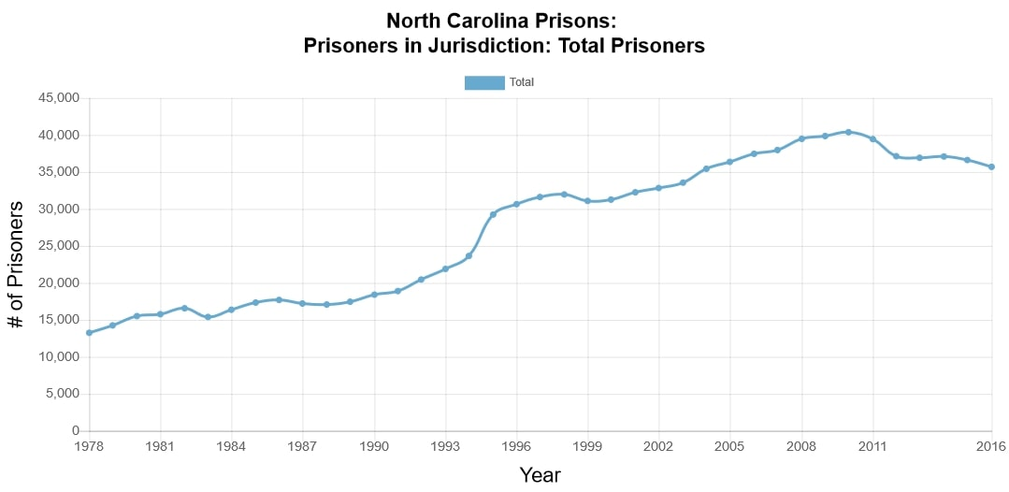
Notes:
Example of default result

Slide 9
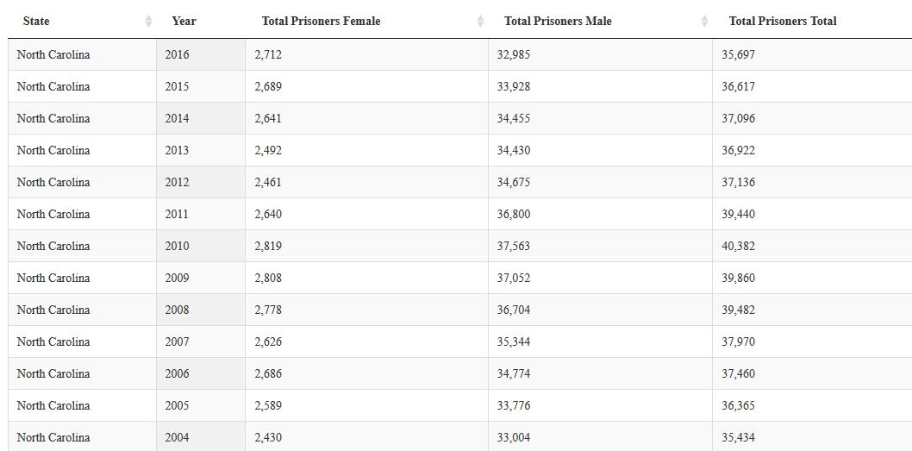
Notes:
Example of default result

Slide 10
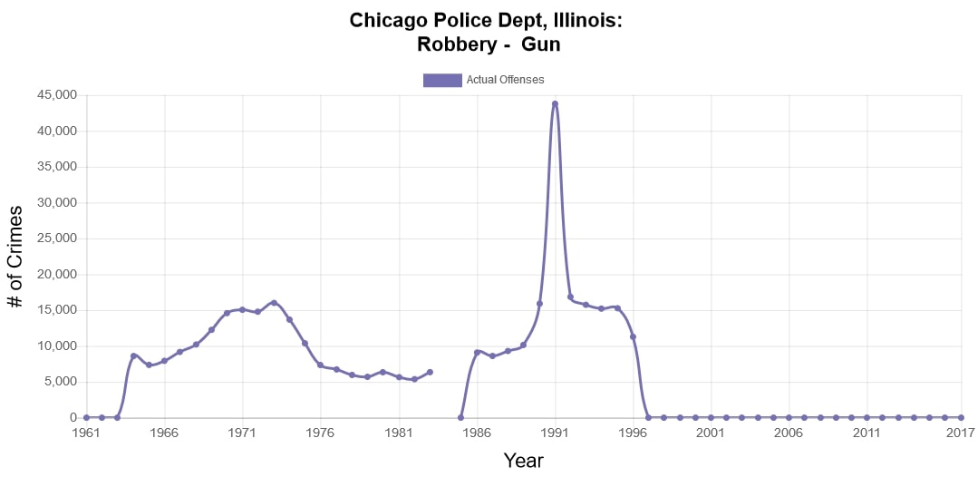
Data dashboards are a useful tool during research
Understand data’s capabilities
See trends in data
Can quickly discover problems
Notes:
Explain that these dashboards tools are useful during the research process. Not just for displaying finished products.

Slide 11
Jacob Kaplan
Department of Criminology
University of Pennsylvania
Notes:
Introduce talk then talk about background.

