Slide 1
More Cops,
Fewer Prisoners?
Jacob Kaplan and Aaron Chalfin
Department of Criminology
University of Pennsylvania
Notes:
In the last 30 years we’ve hired police and incarceration rates have skyrocket. There’s discussion that we’ve spent too much on prisons AND on police - more police lead to more arrests to more prisoners. There have been discussions (Chief Bill Bratton) that police may deter crime and cause lower incarceration rates.

Slide 2
Broad research interests with data focus
Research topics
Crime Prevention Through Environmental Design (CPTED)
Domestic Violence
Police and incarceration

Slide 3
Broad research interests with data focus
Research topics
Crime Prevention Through Environmental Design (CPTED)
Domestic Violence
Police and incarceration
Data focus
Clean and combine public data
Make data accessible to the public

Slide 4
Broad research interests with data focus
Research Topics
Crime Prevention Through Environmental Design (CPTED)
Domestic Violence
Police and incarceration
Data Focus
Clean and combine public data
Make data accessible to the public

Slide 5
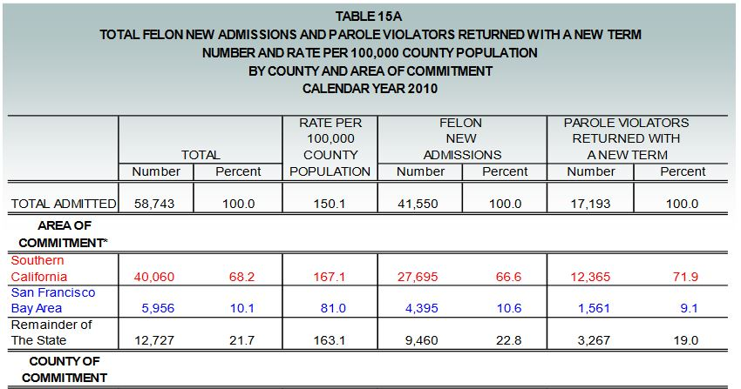
Making crime data more accessible
Common problems with crime data
Each year in a separate file
Hard to access format
fixed-width text
Data in a PDF file

Slide 6
Making crime data more accessible
Common problems with crime data
Each year in a separate file
Hard to access format
fixed-width text
Data in a PDF file
My contributions
Clean and combine all UCR data
R package: asciiSetupReader
Scrape data from PDFs
Crimedatatool.com: Data dashboard

Slide 7
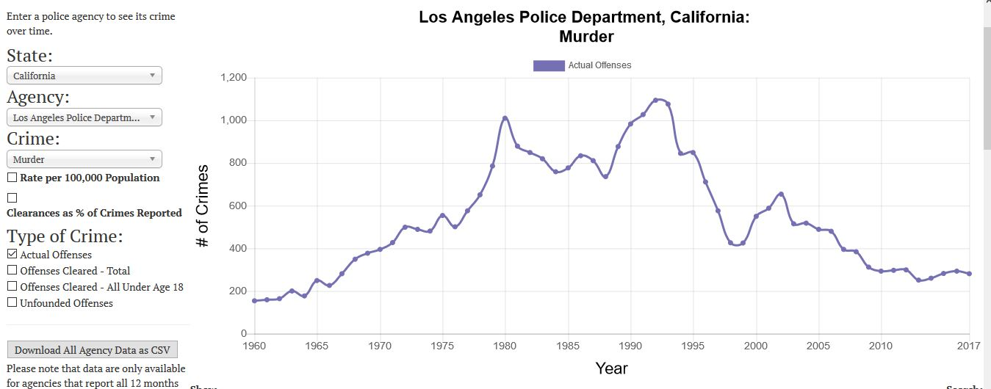
Crimedatatool.com lets users easily visualize data
UCR
Crimes
Arrests
Police
Alcohol Consumption
CDC Cause-of-Death
Prisons
National Prisoner Statistics
National Corrections Reporting Program
Notes:
Data that is on crimedatatool.com

Slide 8
Crimedatatool.com lets users easily visualize data
UCR
Crimes
Arrests
Police
Alcohol Consumption
CDC Cause-of-Death
Prisons
National Prisoner Statistics
National Corrections Reporting Program
Notes:
Show example of prison page

Slide 9
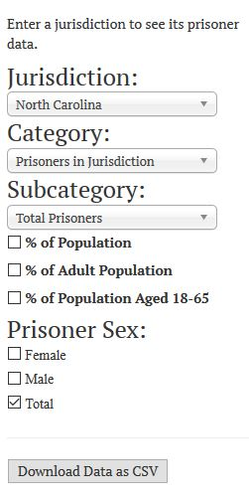
Users can select what data to graph
Notes:
What choices user can make

Slide 10
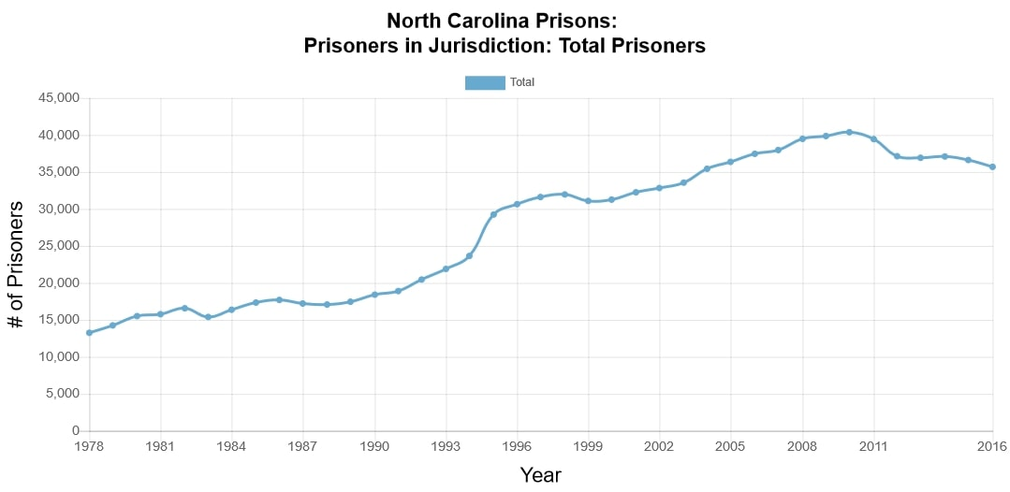
Notes:
Example of default result

Slide 11
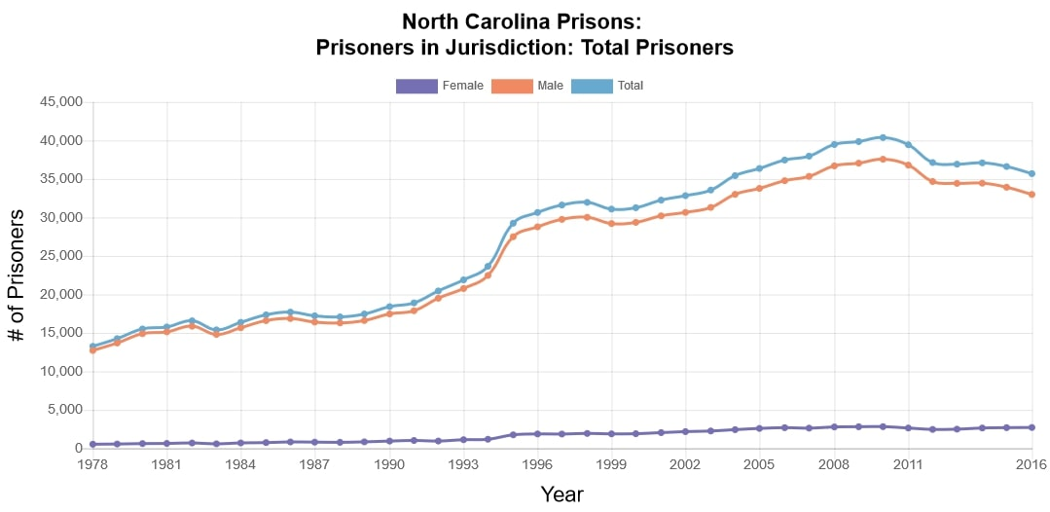
Notes:
Sex options

Slide 12
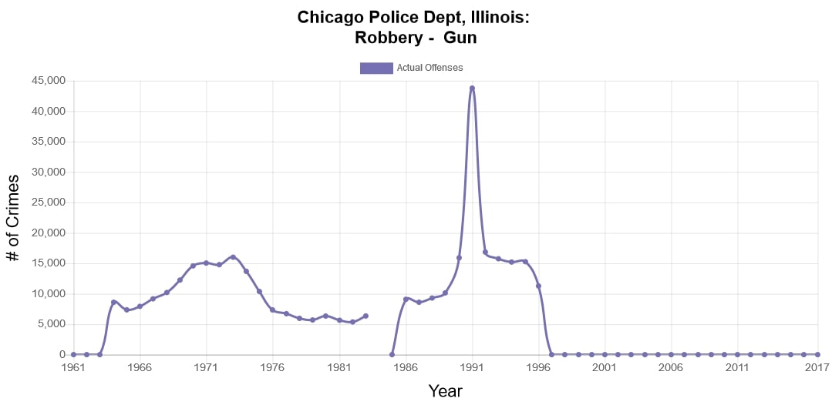
Interactive graphs are a useful tool during research
Understand data’s capabilities
See trends in data
Can quickly discover problems
Notes:
Explain that these dashboards tools are useful during the research process. Not just for displaying finished products.

Slide 13
More Cops,
Fewer Prisoners?
Jacob Kaplan and Aaron Chalfin
Department of Criminology
University of Pennsylvania
Notes:
Now to focus on research paper
In the last 30 years we’ve hired police and incarceration rates have skyrocket. There’s discussion that we’ve spent too much on prisons AND on police - more police lead to more arrests to more prisoners. They have been discussions (Chief Bill Bratton) that police may deter crime and cause lower incarceration rates.

Slide 14
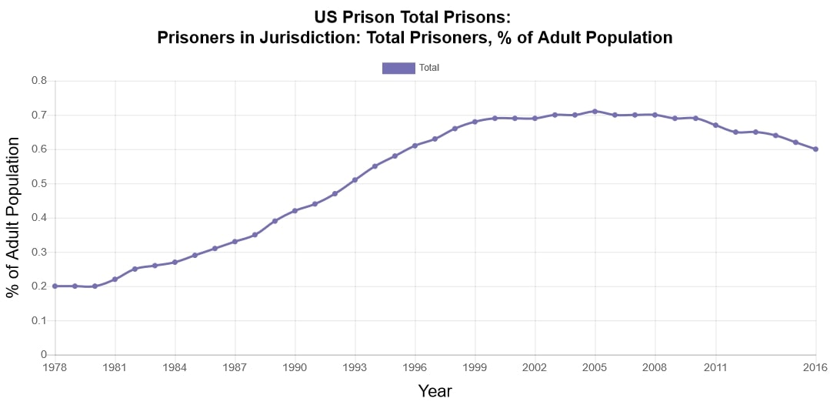

Slide 15
Competing Stories
Police arrest people. Some arrested people end up in prison.
Policing increases incarceration?
Notes:
Bratton - NYPD Commssioner

Slide 16
Competing Stories
Police arrest people. Some arrested people end up in prison.
Policing increases incarceration?
Police deter crime, fewer people to go to prison?
Former NYPD Commissioner Bill Bratton
Policing decreases incarceration?
Notes:
Bratton - NYPD Commssioner

Slide 17
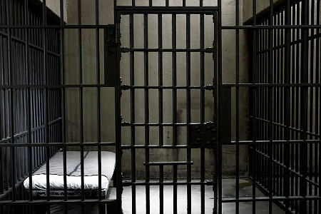
Police can affect crime in two ways
Incapacitation
Incarceration
Costly
Collateral consequences

Slide 18
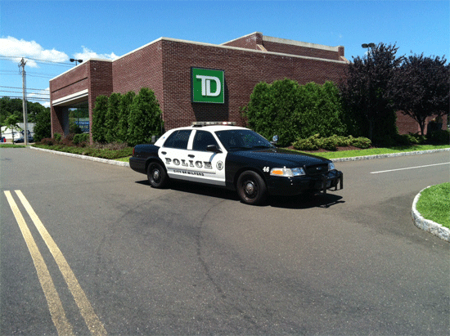
Police can affect crime in two ways
Incapacitation
Incarceration
Costly
Collateral consequences
Deterrence
Incarceration
Cheap
Prevent crime

Slide 19
More police, less crime
Studies find that a 10% increase in police manpower is related to
4-10% decrease in violent crimes
2-5% decrease in property crimes
See:
McCrary (2002), Klick and Tabarrok (2005), Evans and Owens (2006), Lin (2009), Chalfin and McCrary (2017)

Slide 20
What happens to state prison admissions when more resources are allocated to law enforcement?

Slide 21
Preview of findings
Little evidence that police increase incarceration
Likely due to deterrence of crimes
Police very unlikely to have been a driver of mass incarceration
If anything, perhaps a small moderating effect

Slide 22
The average officer makes relatively few arrests
 | Total Per Year | Per Officer
# of Police Officers | 774,740
# of Arrests | 11,001,461
# of Index Violent Arrests | 502,174
# of Index Property Arrests | 1,508,597
# of Prison Admissions | 572,292
Notes:
Typical cop only makes an arrest every month. 2014-2015 average data

Slide 23
The average officer makes relatively few arrests
 | Total Per Year | Per Officer
# of Police Officers | 774,740 | 1
# of Arrests | 11,001,461 | 14.2
# of Index Violent Arrests | 502,174 | 0.6
# of Index Property Arrests | 1,508,597 | 1.9
# of Prison Admissions | 572,292 | 0.7
Notes:
Typical cop only makes an arrest every month. 2014-2015 average data

Slide 24
The average officer makes relatively few arrests
 | Total Per Year | Per Officer
# of Police Officers | 774,740 | 1
# of Arrests | 11,001,461 | 14.2
# of Index Violent Arrests | 502,174 | 0.6
# of Index Property Arrests | 1,508,597 | 1.9
# of Prison Admissions | 572,292 | 0.7
Notes:
Typical cop only makes an arrest every month. 2014-2015 average data

Slide 25
Few arrested people end up in prison
Most Serious Crime | # of Defendants | Defendants Convicted | Defendants Sent to Prison
Murder | 100
Rape | 100
Robbery | 100
Notes:
Data is from the Bureau of Justice Statistics’ 2006 Felony Sentences in State Courts report. Convicted is for a felony

Slide 26
Few arrested people end up in prison
Most Serious Crime | # of Defendants | Defendants Convicted | Defendants Sent to Prison
Murder | 100 | 81
Rape | 100 | 50
Robbery | 100 | 64
Notes:
Data is from the Bureau of Justice Statistics’ 2006 Felony Sentences in State Courts report. Convicted is for a felony

Slide 27
Few arrested people end up in prison
Most Serious Crime | # of Defendants | Defendants Convicted | Defendants Sent to Prison
Murder | 100 | 81 | 75
Rape | 100 | 50 | 36
Robbery | 100 | 64 | 45
Notes:
Data is from the Bureau of Justice Statistics’ 2006 Felony Sentences in State Courts report. Convicted is for a felony

Slide 28
We measure growth in police spending on prison admissions
State-year units
41 states
Years 1997-2015
Spending measured in payroll for officer salary

Slide 29
Endogeneity and aggregation bias are concerns
Police-crime endogeneity?
We use spending on firefighters as an instrumental variable
OLS models produce similar results
Aggregation bias?
We re-estimate model using county-level prison admissions in California (1997-2010)
Notes:
Say why we didn’t use COPS grants. Firefighter spending is correlated with police spending. OLS estimates are similar, endogeneity could be issue at the city-level, at the state-level is it less of an issue - still an issue.

Slide 30
Prisoner Data - BJS National Prisoner Statistics Program
State-year number of new admissions to prison
New Court Commitment
Parole Violator - New Sentence
Other Conditional Release - New Sentence

Slide 31
Public Expenditures - Annual Survey of Public Employment and Payroll (ASPEP)
Collects jurisdictions’ spending on payroll for various sectors.
Fire Protection - Firefighters
Police Protection - Officers
Total budget
Adjusted to 2015 dollars

Slide 32
Crime and Arrest Data - Uniform Crime Reporting (UCR) Program
Crime Data
State-level crime data with missing data interpolated by FBI
Index Crimes
Murder, rape, robbery, aggravated assault, burglary, motor vehicle theft, larceny/theft
Arrest Data
Index Crimes + Drug Sales

Slide 33
Census Data
Population
% Male
% Non-Hispanic Black
% Hispanic
% Foreign born
% Aged 15-24
% <High School Diploma (age 25+)
% of Population Employed
Unemployment Rate (age 16+)
% of People in Poverty
State Governor Data
Binary: Republican Governor or not

Slide 34
Effect of $10,000 additional dollars on police payroll - National data (2SLS Results)
 | Index Crimes | Index Crimes Arrests | Expected Prison Spells | Actual Prison Spells
𝛽 | -0.555 | -0.100 | -0.073 | -0.010
Se(𝛽) | 0.210 | 0.082 | 0.053 | 0.019
[CI] | [-0.996, -0.144] | [-0.262, 0.061] | [-0.178, 0.031] | [-0.048, 0.028]
Effect per officer [CI] | -7.2 [-12.95, -1.87] | -1.3 [-3.41, 0.79] | -1.0 [-2.31, 0.40] | -0.1 [-0.62, 0.36]
mean(y) | 170,304 | 38,049 | 22,694 | 8,959
Notes:
Chalfin and McCrary study for officer cost

Slide 35
Effect of $10,000 additional dollars on police payroll - National data (2SLS Results)
 | Index Crimes | Index Crimes Arrests | Expected Prison Spells | Actual Prison Spells
𝛽 | -0.555 | -0.100 | -0.073 | -0.010
Se(𝛽) | 0.210 | 0.082 | 0.053 | 0.019
[CI] | [-0.996, -0.144] | [-0.262, 0.061] | [-0.178, 0.031] | [-0.048, 0.028]
Effect per officer [CI] | -7.2 [-12.95, -1.87] | -1.3 [-3.41, 0.79] | -1.0 [-2.31, 0.40] | -0.1 [-0.62, 0.36]
mean(y) | 170,304 | 38,049 | 22,694 | 8,959

Slide 36
Effect of $10,000 additional dollars on police payroll - National data (2SLS Results)
 | Index Crimes | Index Crimes Arrests | Expected Prison Spells | Actual Prison Spells
𝛽 | -0.555 | -0.100 | -0.073 | -0.010
Se(𝛽) | 0.210 | 0.082 | 0.053 | 0.019
[CI] | [-0.996, -0.144] | [-0.262, 0.061] | [-0.178, 0.031] | [-0.048, 0.028]
Effect per officer [CI] | -7.2 [-12.95, -1.87] | -1.3 [-3.41, 0.79] | -1.0 [-2.31, 0.40] | -0.1 [-0.62, 0.36]
mean(y) | 170,304 | 38,049 | 22,694 | 8,959

Slide 37
Effect of $10,000 additional dollars on police payroll - National data (2SLS Results)
 | Index Crimes | Index Crimes Arrests | Expected Prison Spells | Actual Prison Spells
𝛽 | -0.555 | -0.100 | -0.073 | -0.010
Se(𝛽) | 0.210 | 0.082 | 0.053 | 0.019
[CI] | [-0.996, -0.144] | [-0.262, 0.061] | [-0.178, 0.031] | [-0.048, 0.028]
Effect per officer [CI] | -7.2 [-12.95, -1.87] | -1.3 [-3.41, 0.79] | -1.0 [-2.31, 0.40] | -0.1 [-0.62, 0.36]
mean(y) | 170,304 | 38,049 | 22,694 | 8,959
Notes:
Talk about confidence interval. Standard error is bigger than we want.

Slide 38
More cops, fewer prisoners?
Little evidence that police increase incarceration
Police very unlikely to have been a driver of mass incarceration
If anything, perhaps a small moderating effect
Only looks at prisons
Notes:
Still thinking about what a jail paper would look like

Slide 39
Relevance to RTI
Cleans and combines several complex datasets
Makes complicated data easily available
U.S. Census ASPEP data
Makes public dashboard to show data

Slide 40
More Cops,
Fewer Prisoners?
Jacob Kaplan and Aaron Chalfin
Department of Criminology
University of Pennsylvania

Slide 41
Effect of $10,000 additional dollars on police payroll - California counties (2SLS Results)
 | Index Crimes | Index Crimes Arrests | Expected Prison Spells | Actual Prison Spells
𝛽 | -0.260 | -0.133 | -0.091 | -0.038
Se(𝛽) | 0.163 | 0.101 | 0.071 | 0.031
[CI] | [-0.581, 0.060] | [-0.331, 0.065] | [-0.229, 0.048] | [-0.098, 0.023]
Effect per officer [CI] | -3.4 [-7.56, 0.78] | -1.7 [-4.30, 0.85] | -1.2 [-2.98, 0.62] | -0.5 [-1.27, 0.30]

Slide 42
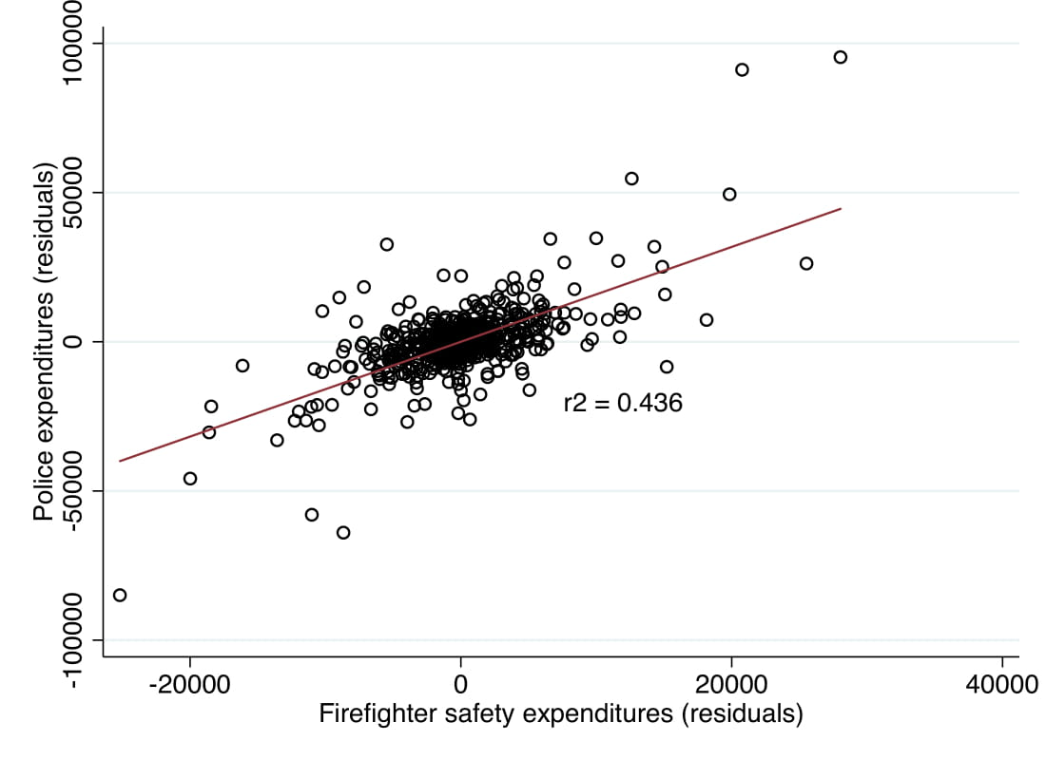
First Stage Relationship Between Police and Firefighter Expenditures
Notes:
The T -ratio is 3.7 and hence the first stage F-statistic is 13.7 which compares favorably to the Stock-Yogo threshold for the effective sample size of an instrumental variables model with a single instrument and a single endogenous regressor (Stock & Yogo, 2005).

