Slide 1
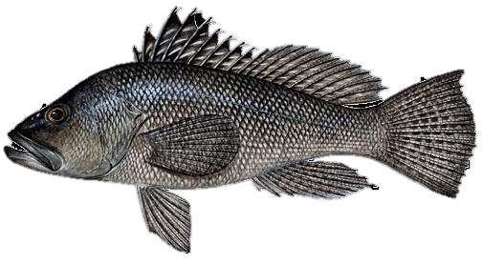
How Regulations Effect the Recreational Harvest of Black Sea Bass
By Nathan Shivers and Jacob Kasper
dnr.Maryland.gov

Slide 2

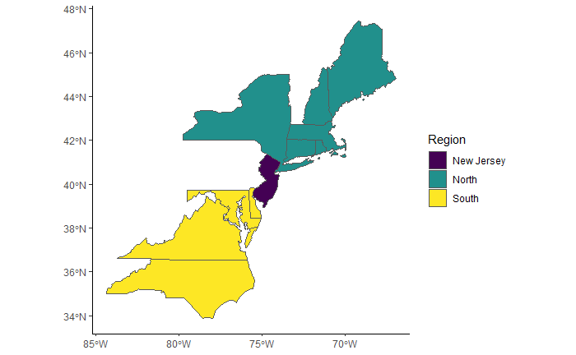
North Atlantic Black Sea Bass
Defined as all Black Sea Bass north of Cape Hatteras, North Carolina
Important recreational fishery for northern states
Managed by the Atlantic States Marine Fisheries Commission
Regulated coastwide till 2010 then regulated by state
Harvest is allocated into three regions based on stock distribution

Slide 3

Issue with Harvest
Year | 2006 | 2007 | 2008 | 2009 | 2010 | 2011 | 2012 | 2013 | 2014 | 2015 | 2016
Coastwide Harvest (mil. lb) | 1.78 | 2.18 | 2.03 | 2.56 | 3.19 | 1.17 | 3.19 | 2.46 | 3.66 | 3.79 | 5.19
Coastwide RHL (mil. lb) | 3.99 | 2.47 | 2.11 | 1.14 | 1.83 | 1.78 | 1.32 | 2.26 | 2.26 | 2.33 | 2.82
Percent of RHL harvested | 45% | 88% | 96% | 225% | 174% | 66% | 242% | 109% | 162% | 163% | 184%

Slide 4
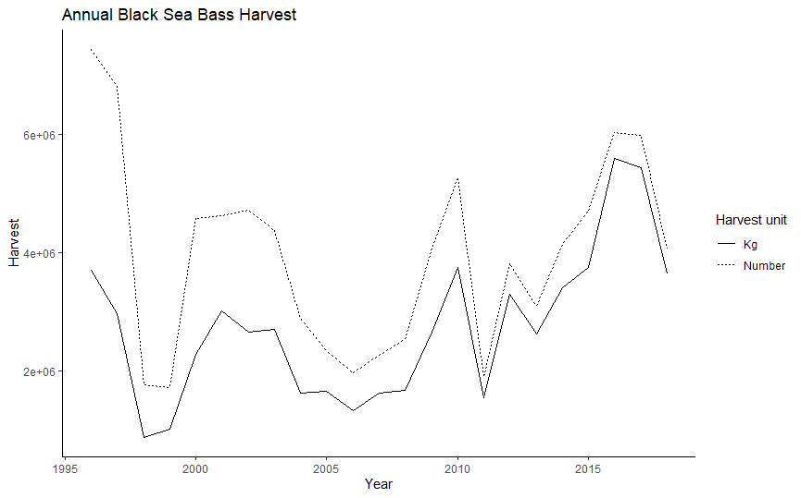
Harvest through the Years

Slide 5
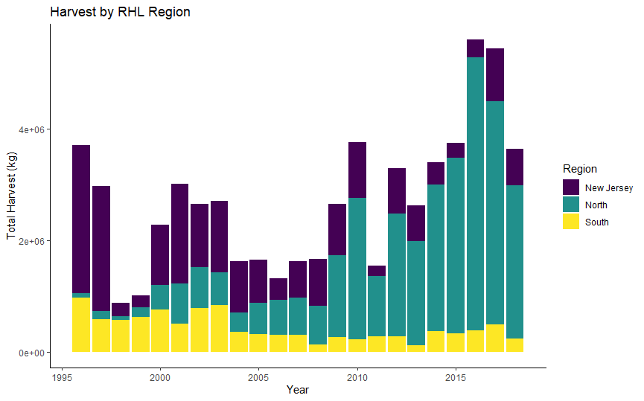
Harvest by RHL Regions

Slide 6
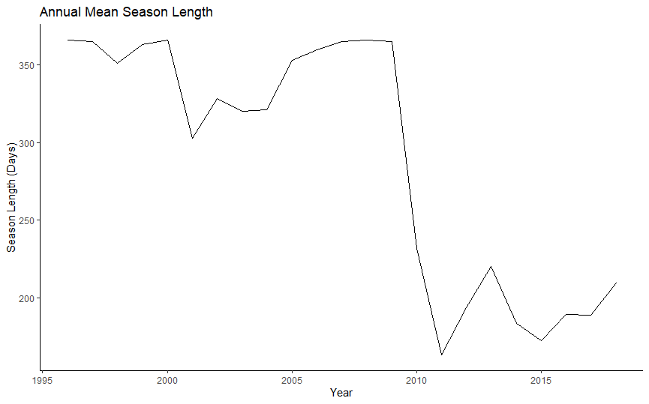
Regulation History

Slide 7
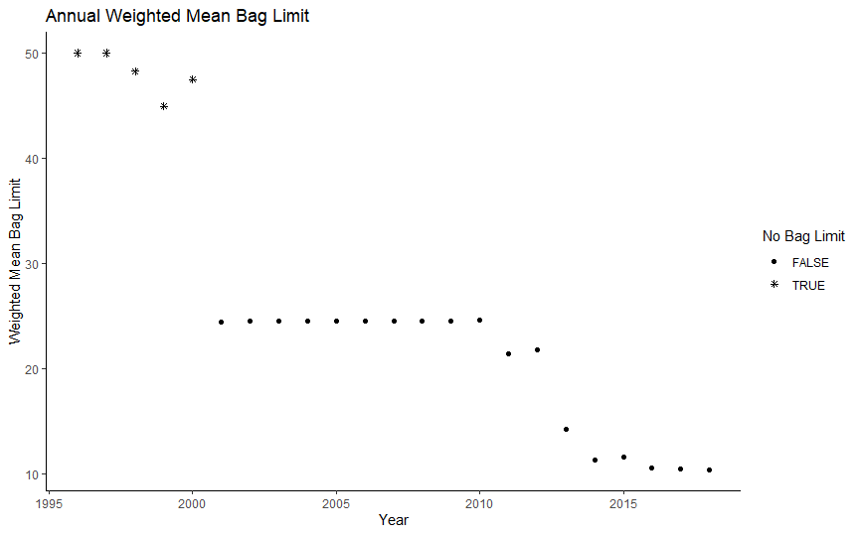
Regulation History

Slide 8
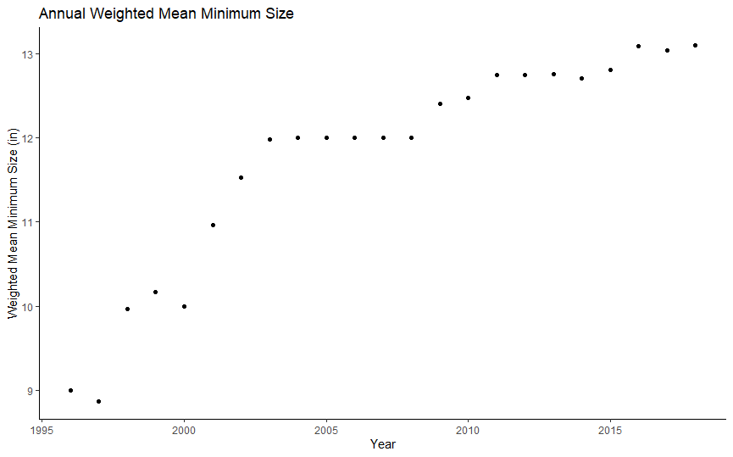
Regulation History

Slide 9
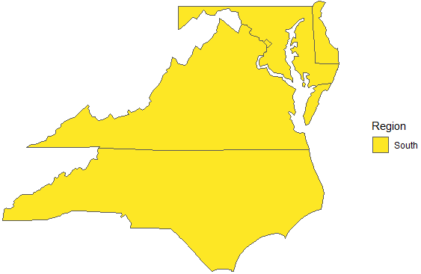
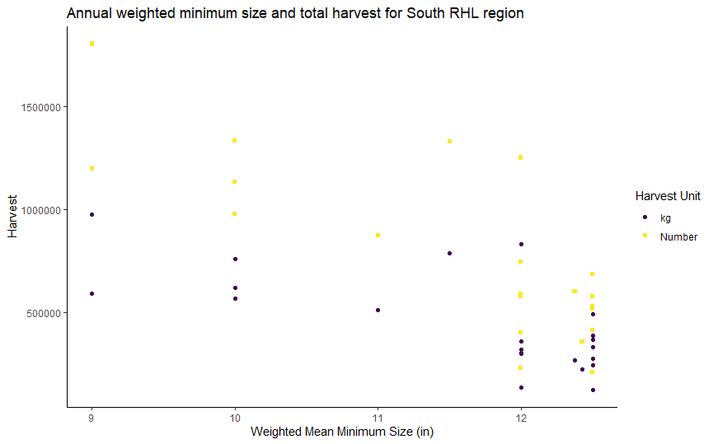
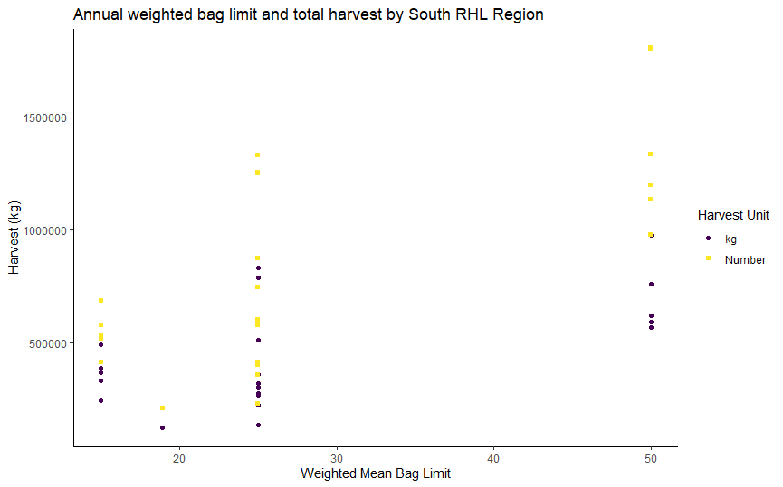
South RHL Region

Slide 10
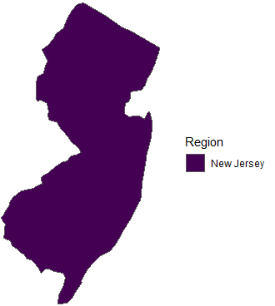
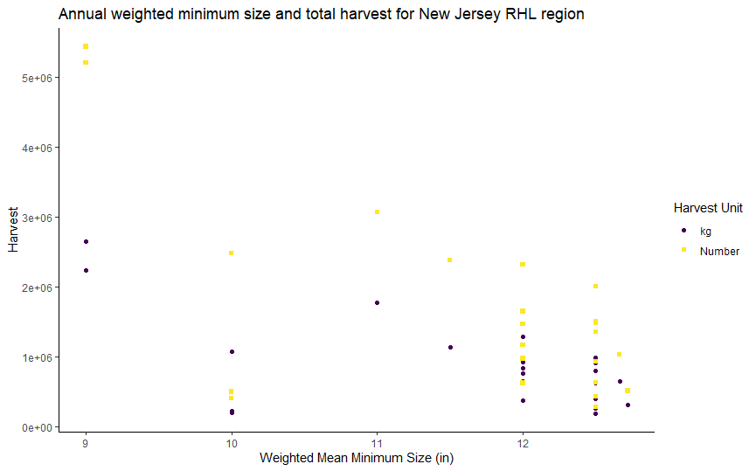
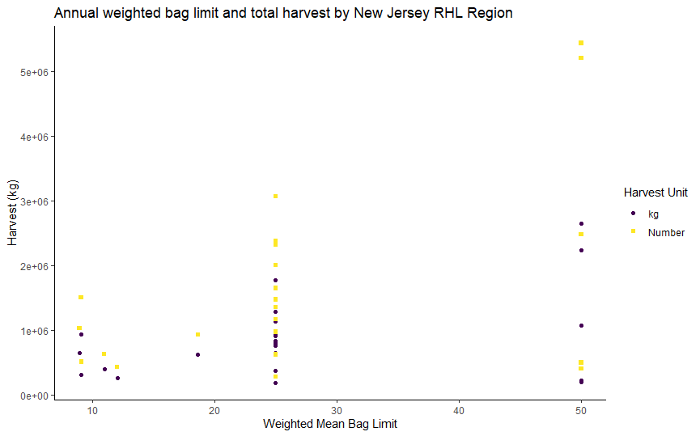
New Jersey RHL Region

Slide 11
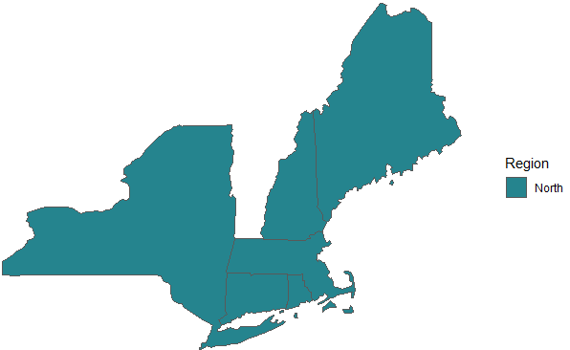
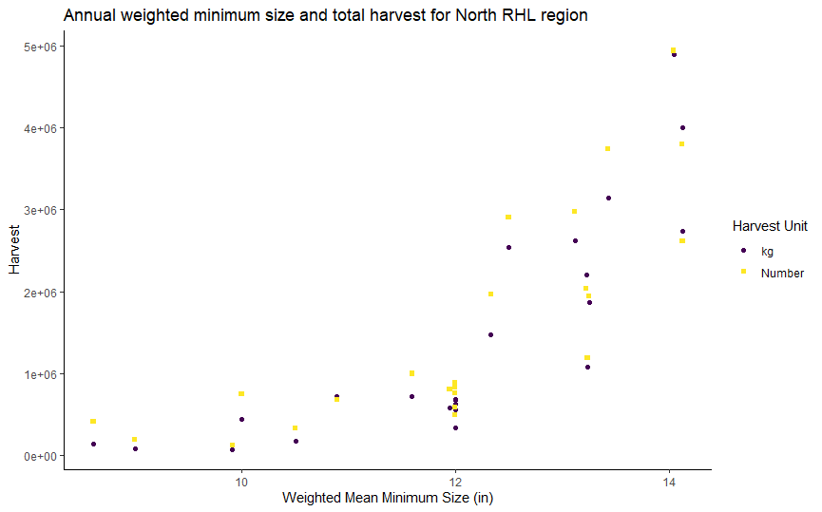
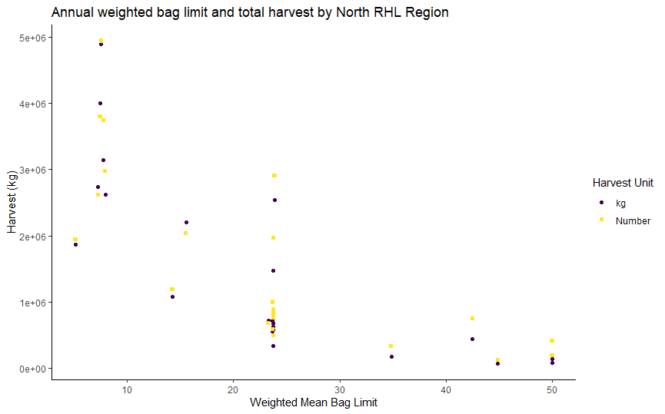
North RHL Region

Slide 12
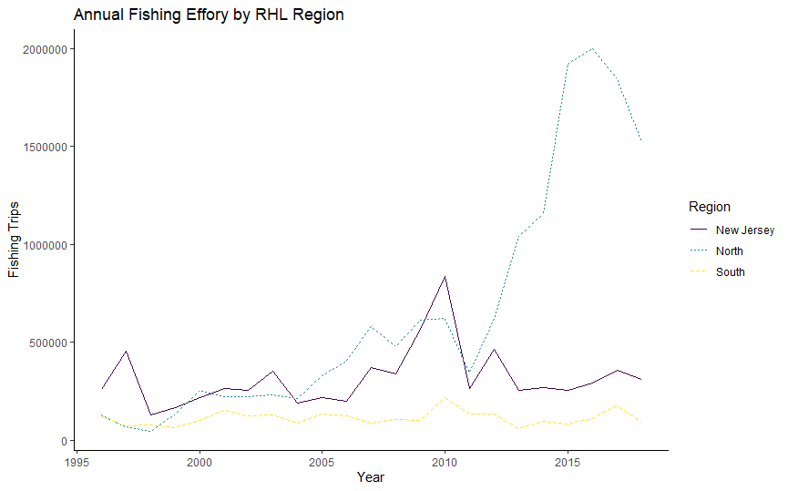
Fishing Effort

Slide 13
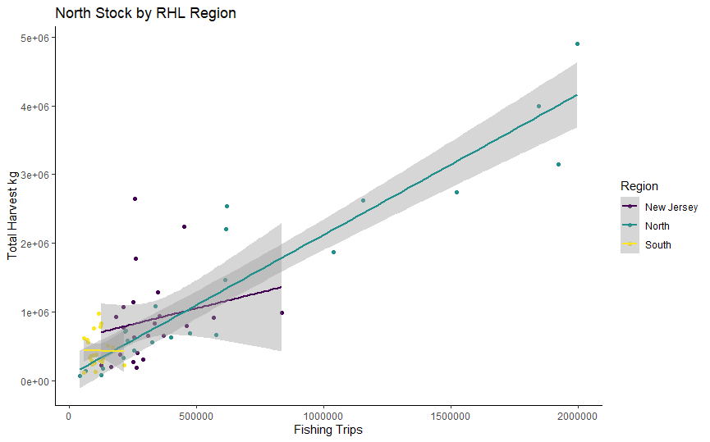
Impact of Fishing Effort

Slide 14
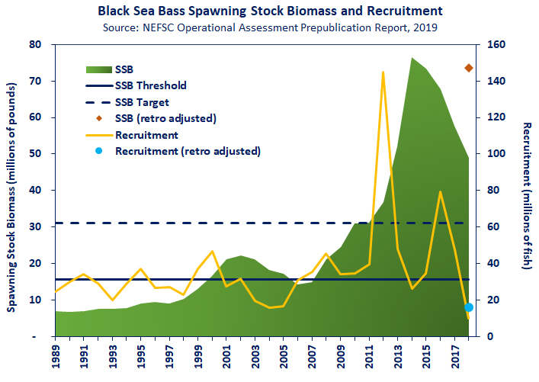
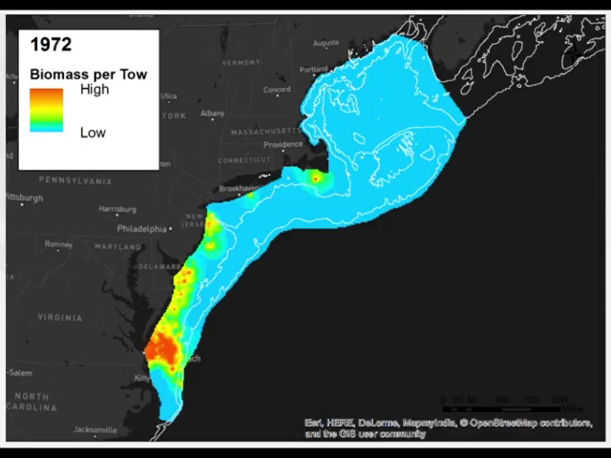
North RHL Region
Change in Biomass
Change in Distribution
ASMFC
Rutgers Ocean Adapt

Slide 15
Conclusion
For the South and New Jersey regions, restrictive regulations were correlated with decreased harvest
In the North region, restrictive regulations were correlated with increased harvest
The increase in the North region could be explained by increases in fishing effort and biomass and changes in distribution
Fishing effort was directly correlated with harvest in the North and New Jersey regions
Black Sea Bass are one of the “winners” in climate change

Slide 16
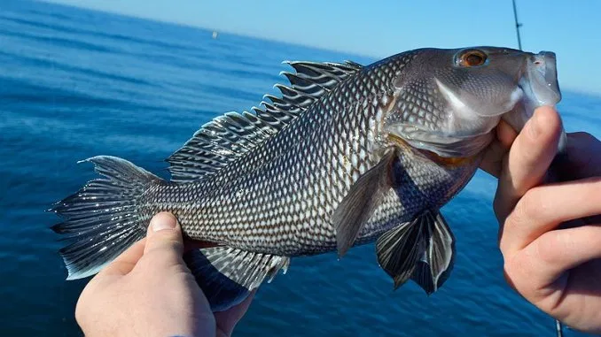
Questions?
Carolinasportsman.com

