Slide 1
Current Atlantis Ecosystem Model for the California Current:
Model calibration and quasi-validation
(Three steps toward improving model performance)
Isaac Kaplan
Notes:
Intro to Altantis: what it is, where it comes from,
the underlying equations and data necessary to paramterize them
And some generic examples from the Cal Current model, which was the precursor to the model Ivonne will discuss

Slide 2
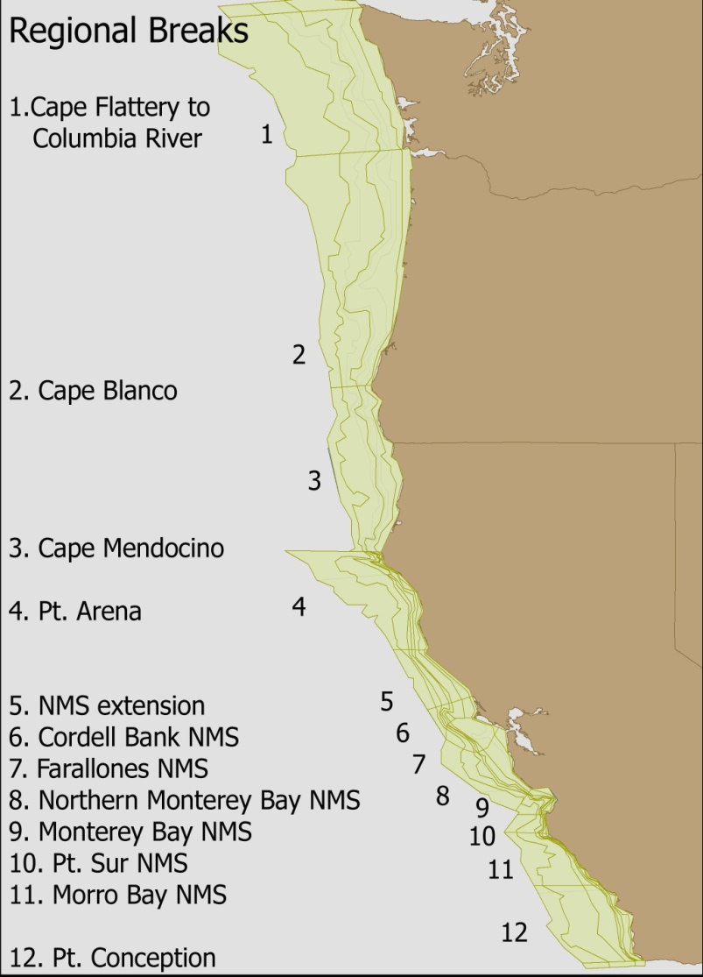
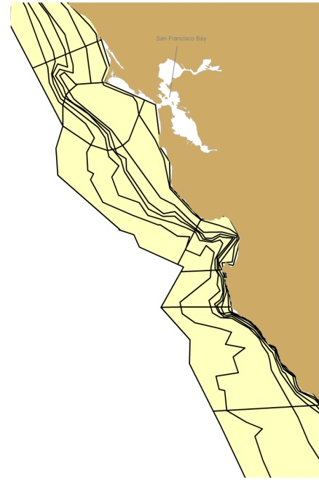
Geography
82 polygons

Slide 3
Model Calibration and Fits to History
    Phase I: Unfished scenarios

Slide 4
Model Calibration and Fits to History
    Phase I: Unfished scenarios
    Phase 2: Sensitivity to fixed fishing mortalities, estimates of MSY and FMSY

Slide 5
Model Calibration and Fits to History
    Phase I: Unfished scenarios
    Phase 2: Sensitivity to fixed fishing mortalities, estimates of MSY and FMSY
    Phase 3: Comparison to historical trends

Slide 6
Model Calibration and Fits to History
    Goal is for the calibrated model productivity to be biologically plausible, as evidenced by tests of no fishing, simple forced F, and historical fishing
    Calibration of recruitment and consumption parameters primarily; also interaction coefficients between predator and prey, and additional mortality terms

Slide 7
Phase I: Unfished scenarios in Horne et al. (2010) Figure 3
Primary goal is to avoid extinction of groups!
Unfished, quasi-equilibrium abundance can be compared to estimates of unfished biomass (B0) from assessments (scaled up to the functional group level if necessary)
No need to ‘tune’ to assessment B0, but can be compared and used to identify major model deficiencies

Slide 8
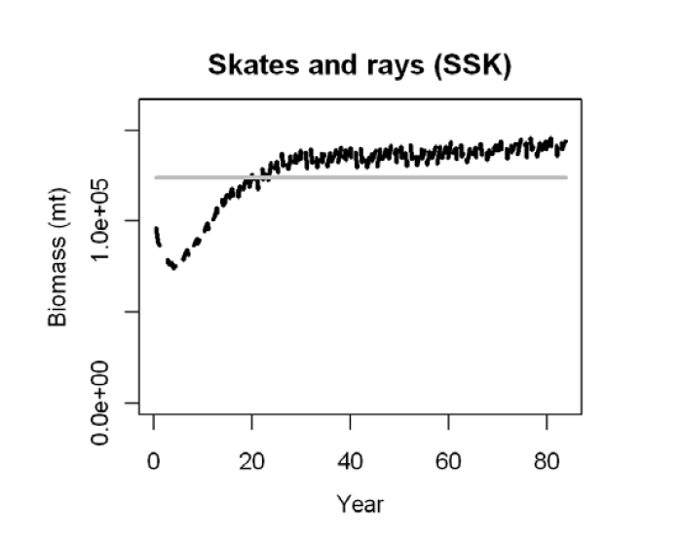
Unfished scenarios: Horne et al. (2010) Figure 3
19 of 22 groups qualitatively match Bo estimates
Three groups clearly differ, likely due to lack of predation in model, or long recovery times (toothed whales, baleen whales, yelloweye+cowcod)

Slide 9
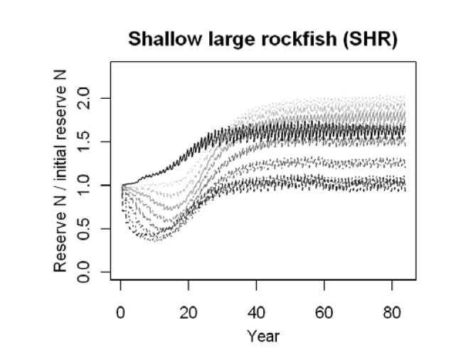
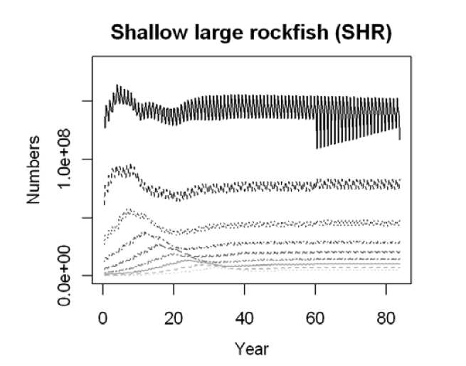
Unfished scenarios
Vertebrate biomass is product of:
Numbers at age
Weights-at-age (plotted relative to initial)
Youngest (dark) to oldest (light)

Slide 10
Vertebrates, Goals of Calibration for unfished scenario
Numbers at age
  Expect stable age structure
  Persistence of all age classes
  Some mortality with age
Weights-at-age
  Expect fluctuations depending on time-varying consumption
  Target: 0.8-1.2 initial weight-at-age
  Tolerance: 0.5-1.5 considered acceptable

Slide 11
Phase 2 Calibration
    Sensitivity to fixed fishing mortalities, estimates of MSY and FMSY
      Kaplan et al. (2013 Env. Conservation)
        MSY, Bo, and Fmsy as compared to assessments

Slide 12
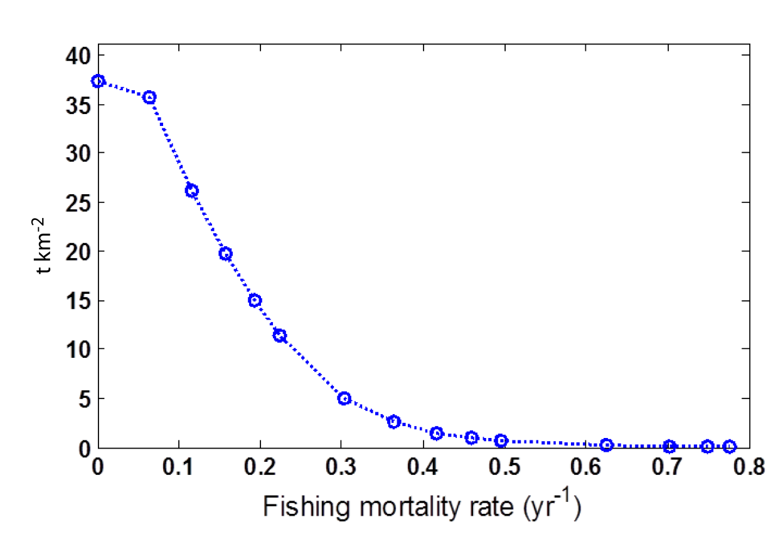
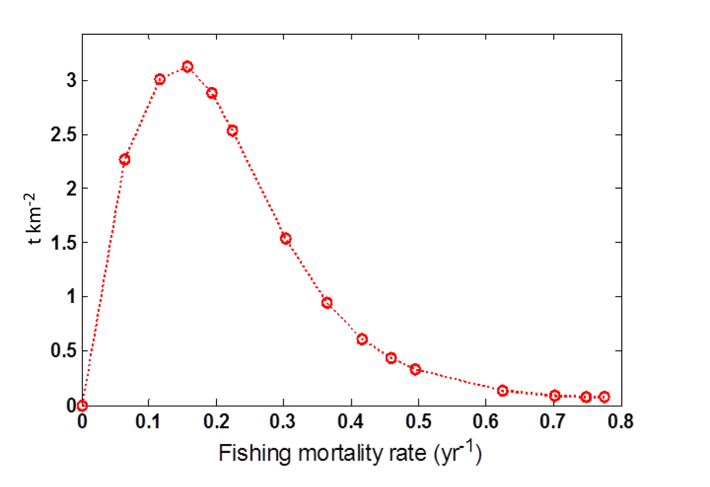
Forage Fish (sardine, anchovy, herring, saury)
Biomass vs. F
Assessment sardine max biomass = 16 t/km2
Catch vs. F
Harvest fraction=0.15
Notes:
Emphasize that this has also been done for Eco Model Marshall et al. paper. This productivity will emphasze rectivity and sensitivity of the stocks to perturbations, including fishing (for intance in Indiseas).
Forage fish (small planktivores) in Atlantis-CCAM and sardine (a single species group) in Ecosim-NCC could sustain more moderate levels of fishing mortality, as compared to Ecosim-NCC. In Ecosim-NCC, the sardine reference points were F_{MSY} = 0.18, F₀ = 0.45, F₂₀ = 0.26, F₄₀ = 0.17, F₇₅ = 0.05 (Figures S2.7,S2.8). In Atlantis-CCAM, fishing forage fish (e.g. small planktivores) suggests F_{MSY} = 0.16. F_{0,} F₄₀, and F₇₅ were 0.78, 0.19, and 0.12, respectively (Figures S2.9, S2.10). MSY in Atlantis-CCAM was 3.12 t km^{–2}. B₁₀₀ was estimated to be 37.4 t km^{–2}, approximately equal to our biomass estimate for 2007, and one third lower than the B₁₀₀ estimate from Ecosim-NCC.
Forage fish in Atlantis-CCAM and sardines in Ecosim-NCC generally matched the recent stock assessment’s values of F_{MSY} and B₁₀₀ or peak biomass, and therefore stock productivity; whereas the aggregate forage fish group in Ecosim-NCC was more productive as measured by F_{MSY} and MSY. Atlantis-CCAM forage fish and sardines in Ecosim-NCC were consistent with the harvest fraction (F_{MSY}) of 0.15 assumed by fisheries managers (Hill et al. 2008). B₁₀₀ (i.e. biomass at year 50) for forage fish in both models is broadly consistent with the stock assessment for sardines. More specifically, Hill et al. (2008) estimated peak sardine biomass to have been 1.6 million t, much of which would be in waters south of our model domain. Assuming half the biomass was in our model domain would give an average density of 8 t km^{–2} for this species alone, and the functional group might have B₁₀₀ several times this amount. The higher productivity of the aggregate forage fish group in Ecosim-NCC was based on heavier weighting of high turnover species such as sandlance, as well as juveniles of sardine and anchovies (Field 2004). Appropriate weighting of species and life stages within this functional group is uncertain without coast-wide surveys of forage groups.

Slide 13
Phase 2 Calibration
    Sensitivity to fixed fishing mortalities, estimates of MSY and FMSY
        Simultaneous depletion of all stocks
        Qualitative comparisons of biomass response vs. F= Mliterature

Slide 14
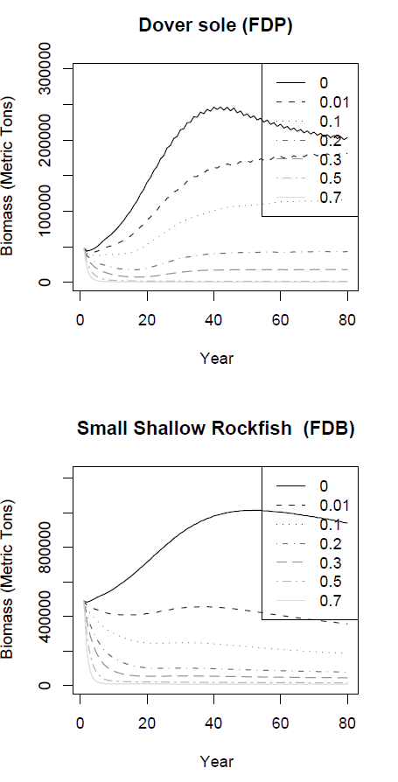

M=0.09
M=0.06
M=0.17
M=0.07

Slide 15
Phase 2 Calibration: Sustainable Fishing Mortality and Productivity
Rockfish F sustainable at ≈0.05
Flatfish F sustainable at ≈0.1
16 of 24 stocks had Fmsy substantially less than literature estimate of M

Slide 16
Phase 3 Calibration:
    Comparison to historical trends (Horne et al. 2010, Figure 8)
      Qualitative comparison to assessment output, 1950-2007, 18 groups
      Single species assessments scaled up to functional group level when needed
      Could focus on fits to survey data in the future
      These are NOT true fits to ‘data’

Slide 17
Qualitative Characterization of Historical Comparisons
Magnitude and trends similar
Magnitudes differ, trends similar (e.g. problem scaling from species to functional group)
Magnitude and trend similar for part of time series
Substantial difference between Atlantis and historical time series

Slide 18
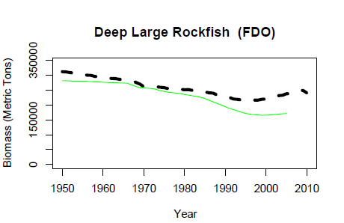
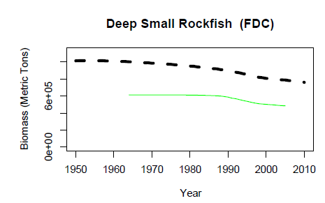
Magnitude and trends similar
Magnitudes differ, trends similar (e.g. problem scaling from species to functional group)

Slide 19
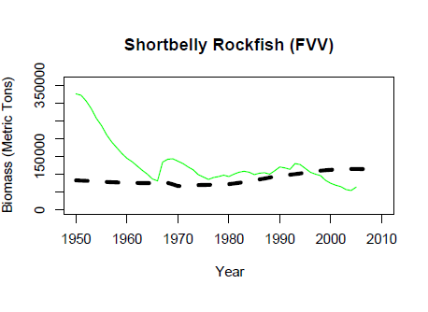
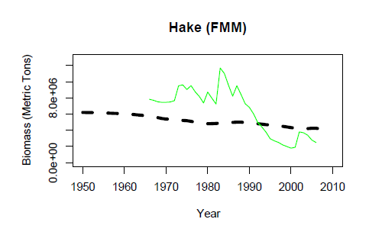
Magnitude and trend similar for part of time series
Substantial difference between Atlantis and historical time series

Slide 20
Qualitative Characterization of Historical Comparisons
Magnitude and trends similar (4)
Magnitudes differ, trends similar (e.g. problem scaling from species to functional group) (4)
Magnitude and trend similar for part of time series (6)
Substantial difference between Atlantis and historical time series (4 = sardine, mackerel, hake, and lingcod)

Slide 21


