Slide 1
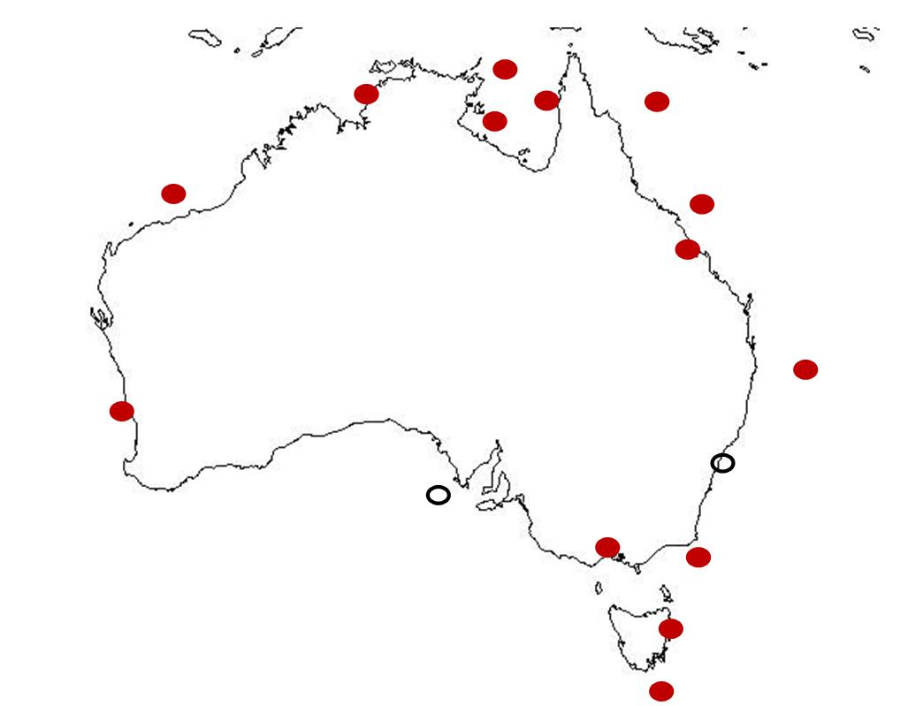
Australian Ecopath with Ecosim models workshop
2nd – 4th September 2008

Slide 2
Background
Workshop sponsored by ARC Discovery Grant DP0879365 “Integrating climate and ecosystem models to predict climate change impacts on Australian marine systems”
  Richardson: Climate impacts
  Hobday: Fisheries and climate impacts
  Okey: Ecopath
  Matear: NPZ
  Fulton: Ecosystem models
  Possingham: Modelling
Ecopath and climate change (Chris Brown)

Slide 3
Why are we here?
Expand our Ecopath knowledge
Enhance, refine, extend our own Ecopath models
Forge links between Ecopath users in Australia
Assess strengths and potential weaknesses of our own models
Meet and interact with Villy Christensen!
Develop ways of integrating climate change into Ecopath
Develop methods for comparing Ecopath models
Lay foundation for future collaboration
Answer cutting-edge research questions
Comparing effects of fishing across models
Comparative publication of changes in primary production on Australian marine ecosystems
Outline future publications

Slide 4
Specific research questions
Methodology: How can we best link global climate model output to ecosystem models?
  How can we best integrate climate change (changes in temperature and productivity) into Ecopath?
Simulation: What will be the impact of climate change on the biodiversity and economic sustainability of Australia’s marine ecosystems?
  Will changes in primary production influence marine ecosystems in predictable ways?
  What functional groups may be most affected?
  Are there different but understandable changes by:
    Neritic vs oceanic
    Tropical vs temperate
    Diverse vs simple
    Heavily exploited vs lightly exploited
Application/Adaptation: How can we foster resilience in marine ecosystems?
  Can we increase ecosystem resilience to climate change by changing harvesting strategies?

Slide 5
Overview of Australian Ecopath with Ecosim models
CJ Brown
2nd September 2008

Slide 6
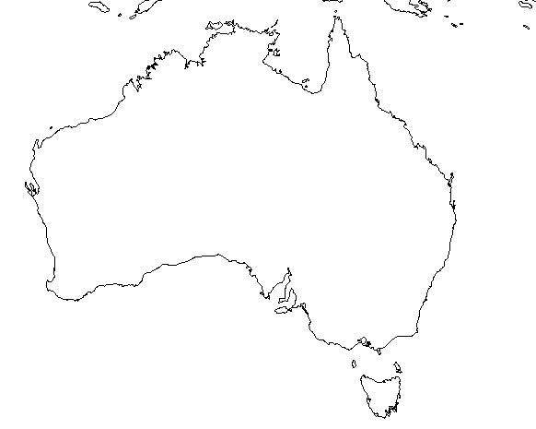
Ecopath model domains

Slide 7
Abbrev. | Model | Local data rating | No. Living Groups | Vuln. Fitting
GCAlb | Gulf Albatross Bay | 4.3 | 92
GCIUU | Gulf IUU | 4.52 | 79
Jur | Jurien Bay (WA) | 8.3 | 72
SEF | South East Fishery | 6.2 | 55
SEF1914F | South East Fishery 1914 full | 5.17 | 55
GCBnth | Gulf Benthic | 6.26 | 51
ETBF | Eastern Tuna and Billfish Fishery | 6.4 | 43
NWS | North West Shelf | 3.27 | 36
PPB | Port Phillip Bay | 4.87 | 33
GBR | GBR | 0.75 | 30
Tas | Tasmania | 4 | 27
NGBR | Northern GBR | 4.93 | 25
STSM | Southern Tasmania Seamounts | ??? | 24
SEF1915 | South East Fishery 1915 | 0.81 | 20
Dar | Darwin Harbour | 1.72 | 20
GBRCst | Coastal GBR | 0.18 | 18

Slide 8
Principal components analysis of system statistics
Classified each Ecopath model based on its system statistics.
Used mainly the biological indices
Usage of fishery value in the models variable

Slide 9
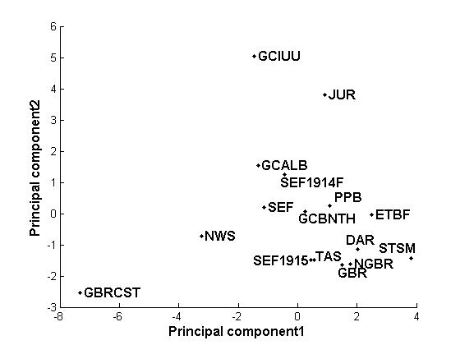
Principal components analysis of Ecopath system statistics
Larger systems Explains 22%
Lower production systems Explains 38%

Slide 10
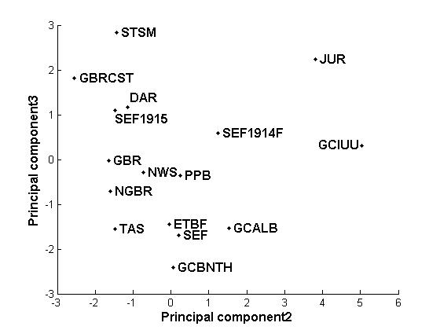
Principal components analysis of Ecopath system statistics
Increasing maturity (B/T & PP/B)?
Explains 12%
Larger systems (higher consumption, respiration, biomass, througput, no. groups) Explains 22%

Slide 11
Summary PCA
PC4 (not shown) related to amount and trophic level of fishery catches. Explained 10%
Very few group by ecosystem type
Designer effects significant?

Slide 12
Model stability
Ecological theory predicts that more diverse ecosystems with greater connectance will be more resilient to change.
Designer effects in models may outweigh ‘real’ resilience responses
We need to understand the relative stability of the models if we are going to compare their responses to climate trends.

Slide 13
Model stability
Connectance strength in Ecopath models can be defined by the amount of prey consumed by a predator.
In a study of Ecopath with Ecosim models Pinnegar et al. (2005) found that:
  Removing weak links from models, whilst keeping the number of groups the same, leads to greater instability
  Removing weak links by aggregating groups in the models increases stability

Slide 14
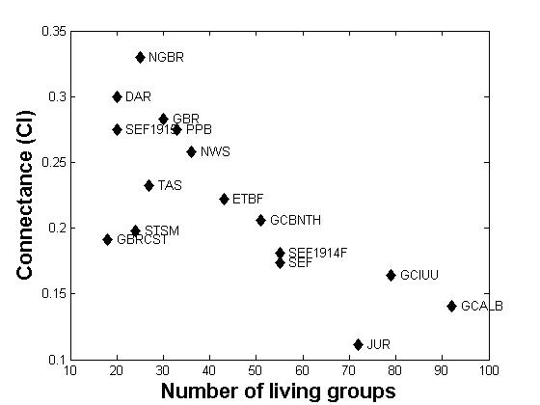
Model stability
More stable
Pinnegar et al. 2005 found that models with higher connectance and fewer groups were more stable to perturbations.

Slide 15
Model stability
Stability analyses:
  5 years with fishing increased 1.5 times
  5 years with primary producers reduced to 80% of initial production
  Standardised vulnerability parameters for all models.
Response variables
  Average deviance of all groups’ biomass trends from an unperturbed simulation.
  Time for biomass trends to recover to within 5% of an unperturbed simulation.

Slide 16
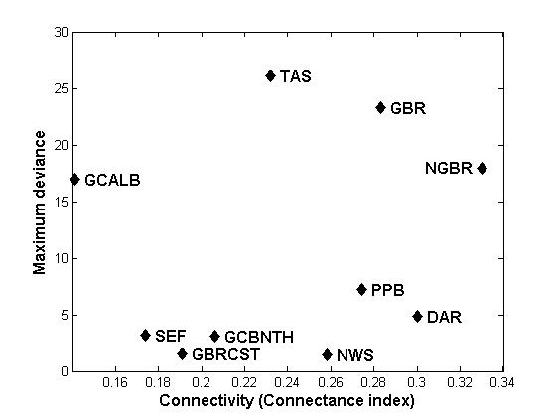
Model stability
Figure: Maximum deviance of summed biomass trends (standardised by number of groups) after increasing fishing 1.5 times for 5 years, plotted against the number of groups in each Ecopath model. All vulnerabilities = 2.

Slide 17
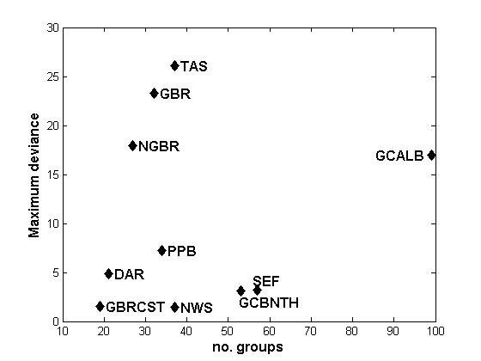
Model stability
Figure: Maximum deviance of summed biomass trends (standardised by number of groups) after increasing fishing 1.5 times for 5 years, plotted against the number of groups in each Ecopath model. All vulnerabilities = 2.

Slide 18
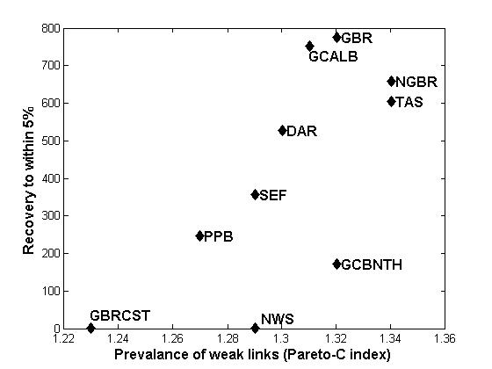
Model stability
(months)
More stable
Figure: Recovery time to unperturbed state after increasing fishing 1.5 times for 5 years, plotted against the prevalence of weak links in each Ecopath model. All vulnerabilities = 2.

Slide 19
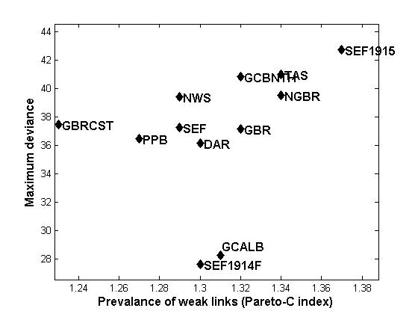
Model stability
More stable
Figure: Maximum deviance of summed biomass trends (standardised by number of groups) after decreasing primary production to 80% for 5 years, plotted against the prevalence of weak links in each Ecopath model. All vulnerabilities = 2.

Slide 20
Discussion points
How do we compare models with vulnerability fitting to models without fitting?
Designing sensitivity analyses for different vulnerability settings
Standardising value and other economic indicators

Slide 21
Addressing uncertainty
Climate uncertainty
Biological response to climate change
Ecosystem model uncertainty
Economic and fishery uncertainty
Width of the uncertainty envelope

Slide 22
Principal Components Analysis of System Statistics
PCA coefficients for system statistics
no living groups | -0.04 | 0.42 | -0.17
fit t | 0.05 | 0.30 | -0.31
sum of all consumption t/km²/year | -0.06 | 0.41 | 0.00
sum of all exports t/km²/year | -0.35 | -0.17 | 0.03
sum of all respiratory flows t/km²/year | -0.02 | 0.42 | 0.05
sum of all flows into detritus t/km²/year | -0.35 | 0.04 | -0.06
total system throughput t/km²/year | -0.33 | 0.20 | 0.00
sum of all production t/km²/year | -0.37 | 0.03 | 0.00
mean trophic level of the catch | -0.07 | 0.12 | -0.36
gross efficiency (catch/net p.p.) | 0.09 | -0.16 | -0.18
input total net primary production | 0.00 | 0.00 | 0.00
calculated total net primary production t/km²/year | -0.37 | -0.08 | 0.00
unaccounted primary production | 0.00 | 0.00 | 0.00
total primary production/total respiration | -0.32 | -0.19 | 0.11
net system production t/km²/year | -0.33 | -0.18 | 0.06
total primary production/total biomass | -0.15 | -0.08 | -0.45
total biomass/total throughput | 0.17 | 0.03 | 0.50
total biomass (excluding detritus) t/km² | -0.12 | 0.25 | 0.39
total catches t/km²/year | 0.05 | -0.15 | -0.20
connectance index | 0.11 | -0.32 | -0.07
system omnivory index | 0.25 | -0.01 | -0.20
Table: Coefficients for PCA of system statistics on 12 Ecopath models. Greater absolute numbers mean that system statistic has a higher influence on the PC

