Slide 1
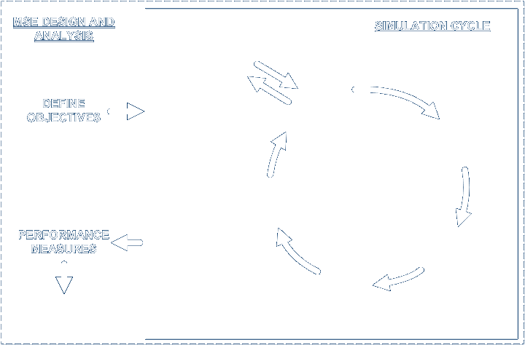













BUILDING Atlantis
Beth Fulton
CSIRO Marine and Atmospheric Research

Slide 2
Atlantis – MSE framework

Slide 3
Build Atlantis - code
  All components described elsewhere slotted together ► Atlantis
    physics = atphysics.lib
    ecological = atecology.lib
    assessment = atassess.lib
    fisheries and management = atmanage.lib
    socioeconomics = atecon.lib
    main loop = atlantismain.exe

Slide 4
Build Atlantis - files
  Parameter files follow similar grouping
    physics = physics.prm and force.prm (+ ts files)
    ecological = biology.prm
    assessment = assess.prm
    fisheries and management = harvest.prm
    socioeconomics = econ.prm
    run definition = run.prm
    initial conditions = in.nc

Slide 5
Build Atlantis - output
  Structuring of output also matches these divisions somewhat
    physics = out.nc
    ecological = out.nc, outTOT.nc, outPROD.nc, biol.txt, YOY.txt
    assessment = indicator files (long list grouped by indicator type)
    fisheries and management = outF.nc, outFTOT.nc, catch.txt, effort.txt, catch_per_fishery.txt
    socioeconomics = econ.txt

