Slide 1
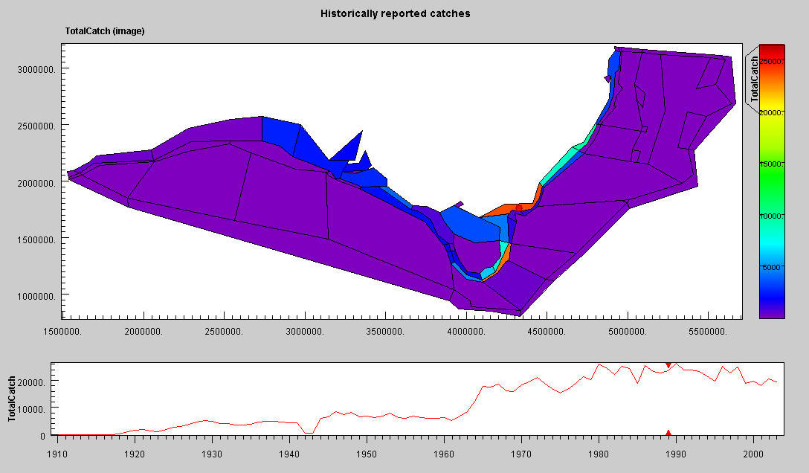


Atlantis OUTPUT
Beth Fulton
CSIRO Marine and Atmospheric Research

Slide 2
Outputs
  Olive – netcdf
  Excel – txt files and “templates”
  What to expect
  What to use when (state variables vs indicators)

