Slide 1
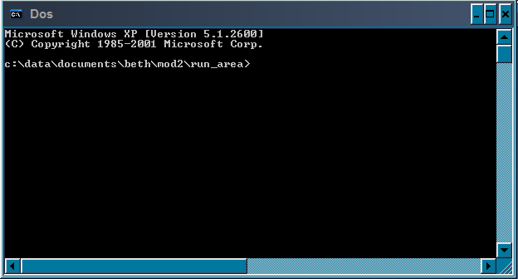


RUNNING
Atlantis
Beth Fulton
CSIRO Marine and Atmospheric Research

Slide 2
Run files
  Bat file
  > atlantis -i inams71_2000.nc 0 -o ams71_2000_FCoutput.nc -r ams71_run_2000.prm -f ams71_force_catch2000test.prm -p ams71_physics.prm -b ams71_biol_2000.prm -h ams71_harvest_hist_fishing.prm -a ams71_assess.prm -e ams71_economics.prm
  Parameter files
  Input files
  Forcing files
  BGM file
  DOS version
  FP time trace version

