Slide 1
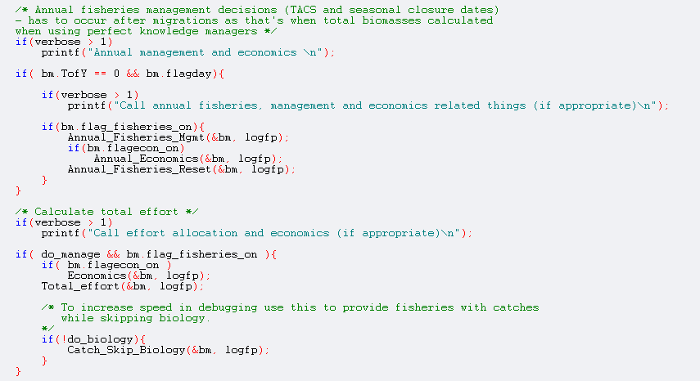


ATLANTIS CODE
Beth Fulton
CSIRO Marine and Atmospheric Research

Slide 2
Main
Setup (Initialisation)
Record state
Time check
Assessment
Fleet dynamics
Biology
Physics

Slide 3
Main
Setup (Initialisation)
Read in run configuration
Read in run parameters
Read in geometry
Read in physical properties
Read in initial conditions
Create arrays
Create output files
Read in parameters
Set up parameter arrays
Initialise fisheries and biological groups

Slide 4
Main
Record state
Output physical characteristics
Output biological variables
Output fisheries statistics

Slide 5
Main
Record state
Time check
Time of Year
Time of Day
Activity states
Parameter corrections

Slide 6
Main
Record state
Time check
Assessment
Data collection
Data handling (e.g. aging)
Stock assessments
Calculate ecological indicators

Slide 7
Main
Record state
Time check
Assessment
Fleet dynamics
Annual fisheries management
CPUE updating
Effort allocation

Slide 8
Main
Record state
Time check
Assessment
Fleet dynamics
Biology
Light levels calculated
Oxygen levels calculated
Migrations
Biological processes
Nutrient cycling
Growth
Mortality
Fishing
Reproduction

Slide 9
Main
Record state
Time check
Assessment
Fleet dynamics
Biology
Physics
Exchanges
Sources
Sinks
Gas exchange
Sediment processes
Bioirrigation
Bioturbation
Resuspension
Settling
Decay
Burial
Advection-diffusion
Horizontal
Vertical

Slide 10
Main
Time of Year
Output physical
characteristics
Time of Day
Output biological
variables
Record state
Time check
Activity states
Output fisheries
statistics
Parameter
corrections
Data collection
Annual management
Data handling
Fleet dynamics
and socioeconomics
Assessment
CPUE updating
Assessment
Economic response
Calculate indicators
Effort allocation
Biophysics
(Light and Oxygen)
Biology
Exchanges
Physics
Movement
Sediment processes
Biological processes
End
Transport
Reproduction

Slide 11
Main
Record state
Time check
Assessment
Fleet dynamics
Biology
Physics
End

