Slide 1
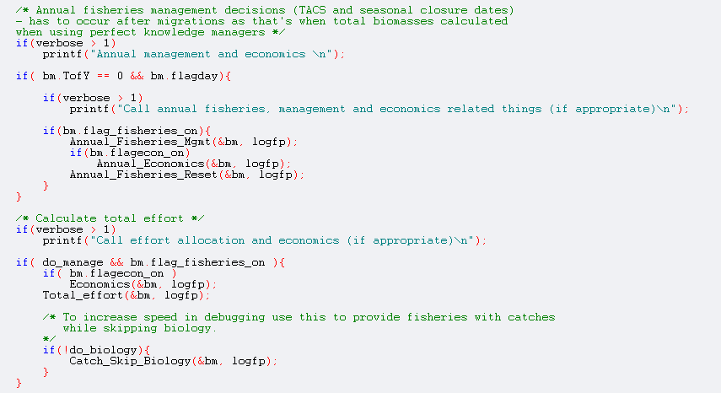
ATLANTIS CODE
Isaac Kaplan
Beth Fulton

Slide 2
Obtaining the code
Talk to Beth Fulton
Consider when you need it – it’s improving daily
Not truly open source (due to CSIRO requirements), but available from Beth, and contributed to by user community

Slide 3
Main
Setup (Initialisation)
Record state
Time check
Assessment
Fleet dynamics
Biology
Physics

Slide 4
Main
Setup (Initialisation)
Read in run configuration
Read in run parameters
Read in geometry
Read in physical properties
Read in initial conditions
Create arrays
Create output files
Read in parameters
Set up parameter arrays
Initialise fisheries and biological groups

Slide 5
Main
Record state
Output physical characteristics
Output biological variables
Output fisheries statistics

Slide 6
Main
Record state
Time check
Time of Year
Time of Day
Activity states
Parameter corrections

Slide 7
Main
Record state
Time check
Assessment
Data collection
Data handling (e.g. aging)
Stock assessments
Calculate ecological indicators

Slide 8
Main
Record state
Time check
Assessment
Fleet dynamics
Annual fisheries management
CPUE updating
Effort allocation

Slide 9
Main
Record state
Time check
Assessment
Fleet dynamics
Biology
Light levels calculated
Oxygen levels calculated
Migrations
Biological processes
Nutrient cycling
Growth
Mortality
Fishing
Reproduction

Slide 10
Main
Record state
Time check
Assessment
Fleet dynamics
Biology
Physics
Exchanges
Sources
Sinks
Gas exchange
Sediment processes
Bioirrigation
Bioturbation
Resuspension
Settling
Decay
Burial
Advection-diffusion
Horizontal
Vertical

Slide 11
Main
Record state
Time check
Assessment
Fleet dynamics
Biology
Physics
End

Slide 12
Key Modules in the C code
I’ll demo on Microsoft Visual C++ .net, but it’s generic – ie. will work with gcc on Ubuntu.
Main : atmain
Ecology: atecology
Assessent/monitoring: atassess
Economics (for fleet dynamics): ateconomics
Oceanography: atphysics

Slide 13
Key functions in the C code
Atmain.c
Atecology → Atvertprocesses.c → Vertebrate_Reproduction() , line 1653
Atecology → atprocess.c → Eat(), line 405
Atecology→atmovement.c, Total_Verts_and_Migration(), line 898
  One option for fleet dynamics:
Ateconomic → Ateconeffort.c, AllocateFinalEffort(), line1771
One option for management:
Atmanage→atmanage.c , VisitCouncil(), line 1901

Slide 14
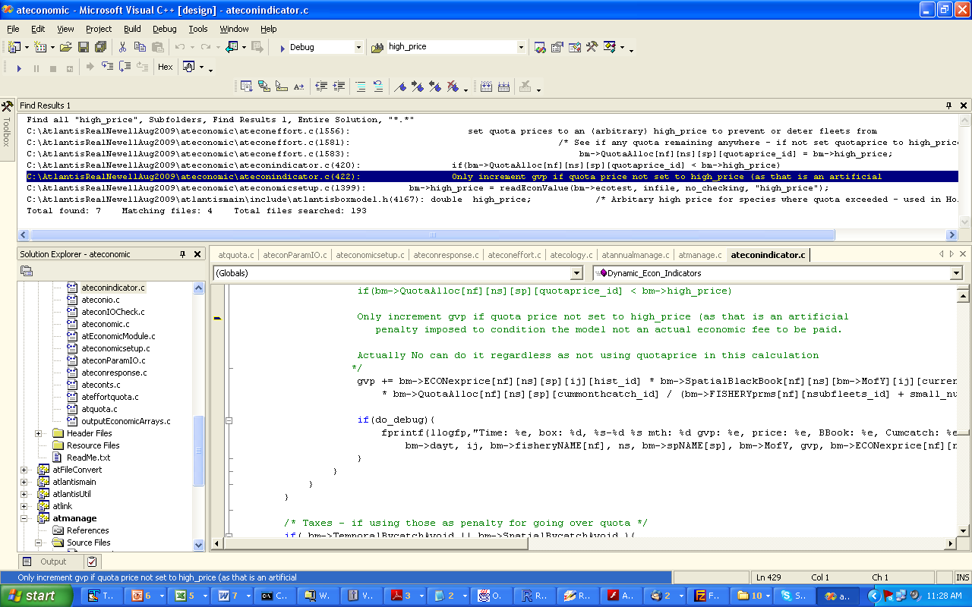
Tips
Stop runs by deleting “delete_to_halt_run” file. This cleanly writes output files.
Use the built in VisualC++ debugger, but also check intermediate output with printfs:

Slide 15
END

Slide 16
Main
Time of Year
Output physical
characteristics
Time of Day
Output biological
variables
Record state
Time check
Activity states
Output fisheries
statistics
Parameter
corrections
Data collection
Annual management
Data handling
Fleet dynamics
and socioeconomics
Assessment
CPUE updating
Assessment
Economic response
Calculate indicators
Effort allocation
Biophysics
(Light and Oxygen)
Biology
Exchanges
Physics
Movement
Sediment processes
Biological processes
End
Transport
Reproduction

