Slide 1
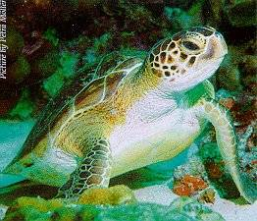


VERTEBRATES
Beth Fulton
CSIRO Marine and Atmospheric Research

Slide 2
Atlantis – vertebrates
Nutrients
Detritus
Prey availability
Disease/Oxygen limitation
Vertebrate
Structure Reserve
Gape limitation
Prey A
Pred A
Prey B
Pred B
Reproduction
Prey C
Pred C
  Follow size and condition of average individual (& number of them) per age phase
    track distribution of age classes per phase

Slide 3
Atlantis – vertebrates
  oxygen deficient, starvation or quadratic
  Basic form:
  Senescence and disease considered
  Age structured (age phases; distribution within phases)
    computationally efficient
    allows ontogenetic shifts, recovery delay, overfishing effects
  Gape limited & can starve (condition impacts survival and reproduction)

Slide 4
Gape Limitation
  Prey must “fit in mouth” to be available for consumption
    invertebrates assumed to “always fit”

Slide 5
Partition Growth
  Partition growth between structure and reserve

Slide 6
Starvation
  In addition to mortality types described for invertebrates

Slide 7
Movement
  Density & food dependent
  Sedentary
  Forced (linear interpolation of quarterly distributions)
  Weighting for seasonal migrations (can migrate in/out of model domain)
  Smooth and interpolate old to new based on cruising speed
  Vertical movements & migrations out/in

Slide 8
Reproduction
  Stock-recruitment relationships
  Live birth and maternal care
  Young of year recruits, but no explicit larval phase (miss predator-prey switch unless use plankton-based recruitment)

Slide 9
Spawn
  Condition dependent

Slide 10
Beverton-Holt & Ricker
  Can scale based on environmental conditions (e.g. temperature, winds, salinity)

Slide 11
Pupping & Calving
  Forcing with timeseries is also an option

Slide 12
Plankton-based
  Stochastic too – or stochastic component of the other relationships

