Slide 1
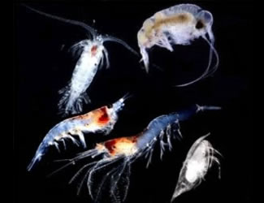


BIOMASS POOLS
Beth Fulton
CSIRO Marine and Atmospheric Research

Slide 2
Atlantis – invertebrates
Nutrients
Detritus
Prey availability
Disease/Oxygen limitation
Prey A
Invertebrate
Prey B
Prey C
Pred A
Pred B
Pred C

Slide 3
Invertebrates
  oxygen deficient or quadratic
  Basic form:
  Age structure and migration explicit for some groups
  Community structure & resource partitioning
  Definition of groups must be done carefully
    physically isolated, under differential pressure but cold re-seed in model (e.g. shallow and deep)

Slide 4
Diet Connections
  Maximum potential availability
    realised reduced by actual availability and gape limitation
    ontogenetic definitions
      juvenile – juvenile
      juvenile – adult
      adult – juvenile
      adult - adult

Slide 5
Diet Connections

Slide 6
Feeding
  Functional feeding responses
  Holling I

Slide 7
Feeding
  Holling II

Slide 8
Feeding
  Holling III

Slide 9
Feeding
  Min-max

Slide 10
Feeding
  Sized-base type III

Slide 11
Feeding
  Ratio dependent

Slide 12
Growth & Limitation
  Growth = total consumption * assimilation
  Spatial limitation

Slide 13
Mortality
  In addition to explicit predation
    implicit predators
    disease and senescence
    oxygen effects
    and fishing mortality (see fisheries equations)

Slide 14
O₂ Mortality
  Couple of formulations typical
  though to complicated combinations of lethal and limiting O₂ levels

Slide 15
Waste production

Slide 16
Age Structure & Reproduction
  Optional Juvenile and adult phases
    multiple cohorts per phase possible
  Assumed once reproduce then die
    typically used for prawns and cephalopods (would need modification other groups maybe)
  All same range as for vertebrates (see vertebrate discussion)

Slide 17
Epibenthos
  Spatial limitation
  Oxygen effects more likely
  Biogenic habitat

Slide 18
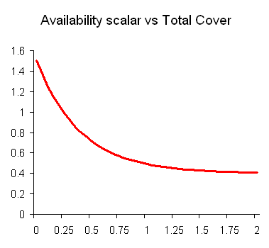
Biogenic habitat
  Habitat dependent = availability scaled
    sufficient (worth having, probably not worth further elaboration EwE style)
    no age structure (under development)

