Slide 1
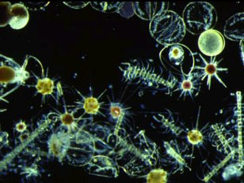


PRIMARY PRODUCTION
Beth Fulton
CSIRO Marine and Atmospheric Research

Slide 2
Primary producers
Detritus
Nutrients
Disease & Lysis/Stress/Fouling
Primary Producer
Light
Space
Pred A
Pred B
Pred C

Slide 3
Atlantis – primary producers
G
  Basic form:
    α = limitation terms
    many different options (e,g, for α_{nut} have monod, leibig, power curve)
    light adaptation
    space limitation for benthic groups
    mortality = lysis
    predation imposed by consumers

Slide 4
Light (I)
  Important production limitation factor
  Absorbed and scattered by dissolved and suspended material ►attenuation
  Where extinction coefficient K_{d} is given by
Water-body dependent (coastal vs oceanic)
Basic coefficient
Phytoplankton
Detritus

Slide 5
Light
  Light at layer midpoint

Slide 6
Light Limitation (h_{I})
  Three options:
  Michaelis-Menten
  Adaptation

Slide 7
Light Limitation
  Steel formulation

Slide 8
Light Adaptation
  where

Slide 9
Nutrient Limitation
  External nutrient concentration dependent
  Monod (Michaelis-Menten most limiting)
  Multiplicative

Slide 10
Nutrient Limitation
  WQI
  Leibig

Slide 11
Nutrient Limitation
  Internal cell concentration cases (not in Atlantis now)
    examples

Slide 12
Uptake

Slide 13
Space Limitation
  Allows for mixed community (overlap)
  Preemption under development (prototypes being played with)

Slide 14
Primary Production
  Growth term (G):

Slide 15
Mortality
  Lysis
  Non-predation mortality
  Additional sources of non-predation mortality
  X = DIN for seagrass; stress for macroalgae

