Slide 1
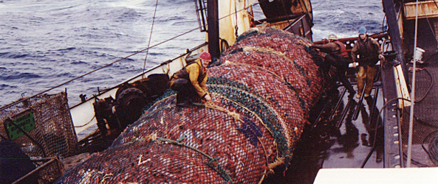


FISHERIES AND MANAGEMENT
Beth Fulton
CSIRO Marine and Atmospheric Research

Slide 2
Atlantis – fisheries
Carrion
Vertebrate
Catch
Catchability
Escape
Availability
Selectivity

Slide 3
Atlantis – fisheries
  Target species, byproduct, bycatch
  Vertical distribution
  Sub-grid scale access (proportional access; habitat dependent access; Ellis statistical model; simple homogenous access)
  Availability (accessible area overlap with group distribution)
  Catchability (constant; size/age based)
  Selectivity (constant; curve)

Slide 4
Applying Fishing Pressure
  Historical time series of catch or effort = forcing
    applied proportional to global distribution of biomass of group in model
    spatially allocated (“borrow” from neighbouring cells)
  Apply F rate
  Dynamic causal model

Slide 5
Availability
  Homogeneous
  Patchiness – following Ellis and Pantus model form

Slide 6
Catchability
  Spatial mismatch
  Spawning closures or “goes off bite”
  Changes through time

Slide 7
Selectivity
  Constant
  Knife-edged
  Logistic
  Normal
  Lognormal
  Gamma
  Bimodal
  Can vary through time
  Swept area also included and can change through time

Slide 8
Escapement & Discarding
  Escapement
    proportion of “encountered” not hauled catch
  Discarding
    constant proportion
    size-based (minimum or maximum preferred size)
    forced (time series)
    dependent on (forced) catch of other groups
    illegal retention possible

Slide 9
Effort models
  Constant level
  Quarterly distributions (interpolate between them)
  Allocated proportional to current CPUE distribution
  Forced time series

Slide 10
Effort models
  Dynamic (socio-econ yet another variant)
    aggregate fleet model
    ports, costs, exploratory fishing, tries for optimal cpue

Slide 11
Effort models
  Recreational
  where
  Aspects can change through time
  Interactions of fisheries with groups (i.e. catch as food source)
  Displacement to nearest “best return” accessible box

Slide 12
Management levers
  Fisheries management drivers (scenario or dynamic)
    trigger points (allowances for mixed-species fisheries; harvest strategies)
    quotas (TAC, ITQ analogue being added)
    seasonal access
    zoning (different fleet access, MPA, seasonal)
    days at sea (being added)
    gear (bycatch mitigation, gear limitation)
    size limits
    changing gear
    changing practices
  Other human impacts = scenario only

