Slide 1
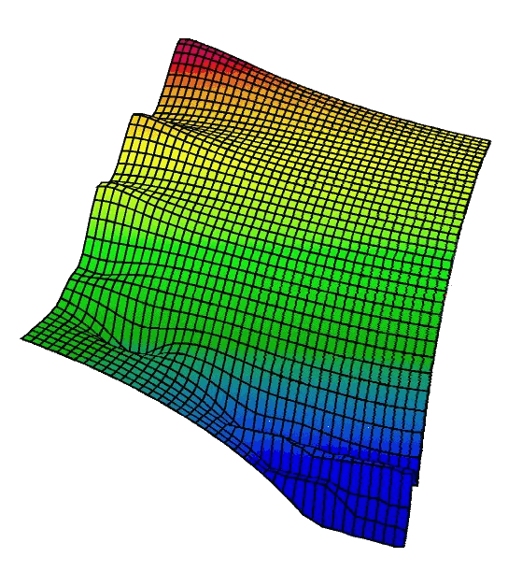
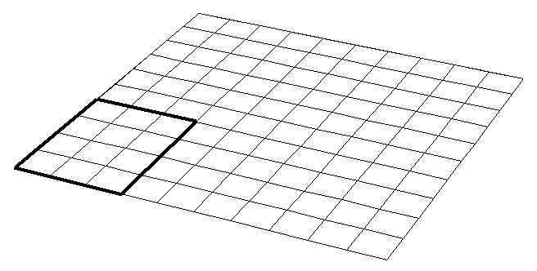


Resolution
continuous
gridded
regional
global
City A
City B
Beth Fulton
CSIRO Marine and Atmospheric Research

Slide 2
Definition
  Complexity vs complicatedness
    complicatedness = number of equations or lines of code
    complexity = two meanings
      detail and degree of intricacy of output
      sophistication of formulation (≠ extra code, could be less, richer dynamic representation)
    related (but not linearly so)
    often confused (intermingled intentionally) or confusing (mixed use of the terms)

Slide 3
Complexity
  Costanza and Sklar indices used as basis
  Complexity
  C_{i} = complexity of node i
  N_{i} = number of divisions in node i
  k_{i} = scaling factor for node i
  (k_{dt} = 5000, k_{space} = 1000, k_{foodweb} = 50, k_{size-age} = 30, k_{process} = 20)
  S_{p} = average of C_{dt} and C_{space}
  S_{c} = average of C_{size-age}, C_{foodweb} and C_{process}

Slide 4
Performance
  Performance
  where

Slide 5
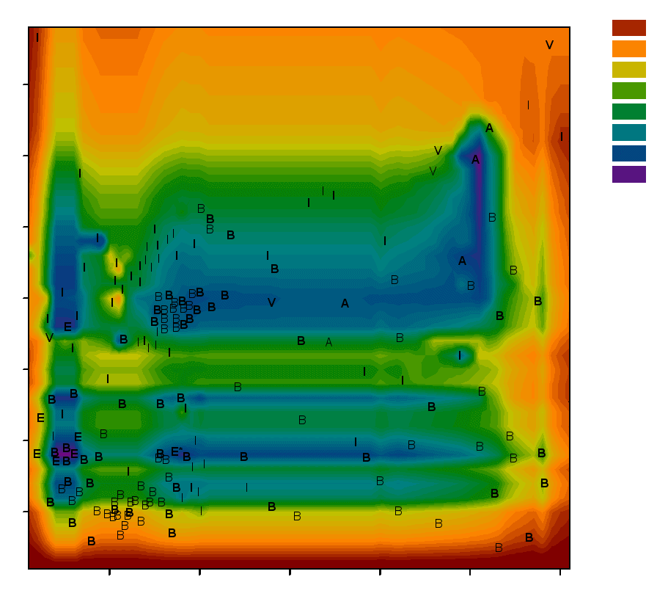
Performance Spectra
Performance Key Model Key
0.1 A – ATLANTIS
0.2 B – BM2
0.68
0.60
0.52
0.44
0.36
0.28
0.20
0.3 E – ECOPATH / ECOSIM
0.4 E* – ECOSPACE
0.5 I – IGBEM
0.6 V – INVITRO
0.7
BOLD = sit on the surface of the spectrum in 3D space
NORMAL = sit below the bounding surface
0.8
Structural complexity (Sc)
Age-structured models
Biomass pool models
0.12 0.24 0.36 0.48 0.60 0.72
Spatio-temporal complexity (Sp)

Slide 6
Why a Hump?
  More detail can be prescriptive not predictive
    hard-wired responses and flexibility lost
    info-content of data low, so large models with lots of noisy data vs slim-line model with few precise data
    trade-off detail vs parameterisation
params and interpret easier
Performance
critical scales and processes lost
start
Detail

Slide 7
Critical Length Scales
Whales
100000000
1000000
10000
100
1
0.01
0.0001
0.000001
Tuna
Ocean basins Thermohaline circulation
Clupeoids
Gyres
Zooplankton
Ocean depth
Phytoplankton
Eddies
Fronts
Length scale (m)
Mixed layer depth
Diffusion
Physical phenomena
Bacteria
Biota
Hour Day Month Year Decade Century Millennium

Slide 8
Scales
  Fish
  Mean depth of ocean
  Largest whale
  Zooplankton
  Phytoplankton
  Mixed-layer depth
  Internal Rossby radius
  Bacteria
  Diffusion limitation
  Ocean Basin
  10⁻⁶
  10⁻⁴
  10⁻²
  10⁰
  10²
  10⁴
  10⁶
  10⁸
  10¹⁰
  1 μm
  1.0 cm
  1.0 m
  1.0 km
  1000.0 km

Slide 9
Dimensions
  One-dim
  Zero-dim
  Two-dim
  Three-dim

Slide 10
Spatial complexity
  Potentially great effect on model predictions
  Homogeneous or heterogeneous

Slide 11
Homogeneous
  Regular grid (square, hexagon etc)
    best at fine to medium scale
    easiest to conceptualise (but can be inefficient)
    mesh of grids at different scales (or telescoping) and interpolating between them (“species specific” reference scales)

Slide 12
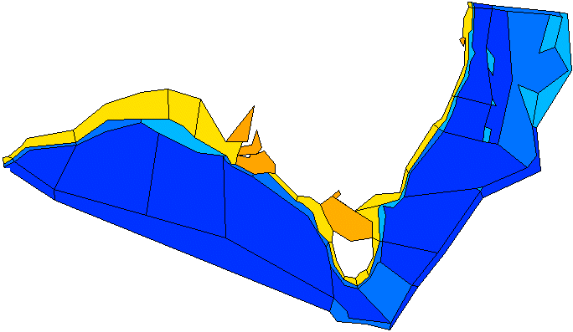
Heterogeneous
  Polygonal geometry
    polygon size dependent on scale of physical (and ecological) processes (e.g. bioregionalisation)
    slow change = large cells, rapid change = small cells
    not so easier to declare but may be more meaningful and efficient
  Same issues vertically as horizontally

Slide 13
Space
  Models ~ observations
    space scale used = important to results
    theoretical ecology done on simplified representations (e.g. 1D)
    space is a critical resource
    direct and indirect effects of removal without compensatory re-formulation
      implicit trophic splitting
      sub-grid scale inclusions

Slide 14
Spatial Cell Count
  Spatial Resolution
  High Lower
  lower variance (through time and space)
  less heterogeneous environment and fewer refugia
  increased self-simplification of trophic web (extinction and exclusion)
  increased boundary condition effects
  increasing altered predictions of response to perturbation (e.g. no effect or even opposite effects)

Slide 15
Model structure – Temporal
  Same issues of getting scale right as for spatial
  Multiple means of representation
    homogeneous (lock-step)

Slide 16
Model structure – Temporal
  Same issues of getting scale right as for spatial
  Multiple means of representation
    homogeneous (lock-step)
    adaptive (and variable speed splitting)

Slide 17
Model structure – Temporal
  Same issues of getting scale right as for spatial
  Multiple means of representation
    homogeneous (lock-step)
    adaptive (and variable speed splitting)
    asynchronous (fine steps where needed, not lock-step, need scheduler)

Slide 18
Time
  Time-step size can be critical
    need not be homogeneous or lock-step
    numerical stability
    process scale
    computational efficiency and magnitude of output
    sampling problem too

Slide 19
Sampling Frequency
  Sampling
  Annual Daily
Noise
Missing info
Fortnightly

Slide 20
Chemical Conservation
  Conservation of currency important
    without currency can lack bounding and get “unreal” results (case in past theoretical ecology)
  Biogeochemical important if primary production = foci and most effected by non-trophic components
    e.g. Tett and Wilson (2000) advise never model plankton without biogeochemistry AND ecology
  EwE successes show mass balance maybe ok

Slide 21
Redfield at work
  Redfield ratio representation
    empirical ratio
    assumes flux macronutrients in fixed ratio (observed ratio fairly constant globally)
    method = ok mesotrophic – eutrophic
    oligtrophic system (or period) requires droop uptake (internal cell content = bound and excess of non-gounding element allowed to create reserve for lean time)

Slide 22
Biology
  No set of “basic equations” for biology (unlike hydrodynamics)
  Complication = integrating across many characteristic scales
    processes
    groups
    interactions

Slide 23
Physiology and Ecology
  Physiological detail usually not necessary (can be a problem) in ecosystem models at regional+ levels
    simpler models (generalised equations not physiological detail) sufficient to guide management
    general matches reality as well as detailed model (neither consistently better than the other)
    simpler not as “robust” (require more tuning site-to-site)
    more “transparent” (for cause of dynamics or errors)

Slide 24
Physiology and Ecology
  Simpler models sufficient to guide management
    bonus = require 30% less code (and maintenance), 50% less parameters, 60% more computationally efficient
    qualitative use on (never “quote” output as accurate prediction and train audience not to expect it)

Slide 25
Trophic Issues
  Need webs not chains
  Functional groups ok (rigorous classification now possible)
    regular coloration
X

Slide 26
Trophic Issues

Slide 27
Trophic Issues

Slide 28
Trophic Issues
  Aggregate (lump) or omit (chop)
    lump then chop
    webs reduced to <25% original detail misleading (e.g. recover more quickly)
    avoid reduction to point where cannibalism >10%
    do not aggregate predator and prey
    do not aggregate if rate constants >3x different

Slide 29
Trophic Issues
  Ontogenetic shifts means need age structure
  Be aware / careful of web skew (Pinnegar et al 2005)
    “typical” fish-centric with aggregated basal groups = resilient to perturbation
  Be alert to “keystone” groups
    if present get step-function in performance rather than “hump”

Slide 30
Formulations – d.e. and stats
  Major division in formulations = equation vs decision tree
  Equation models
    statistical models (applied statistics, regression, GLM / GAM models or AI / neural nets (black-box))
    classical equations (d.e.’s (dx/dt), difference equations)
    forcing functions

Slide 31
Formulations
  Specific formulations
    alternative used has implications for findings (theoretically)
    in practice web constrained into area where all similar

Slide 32
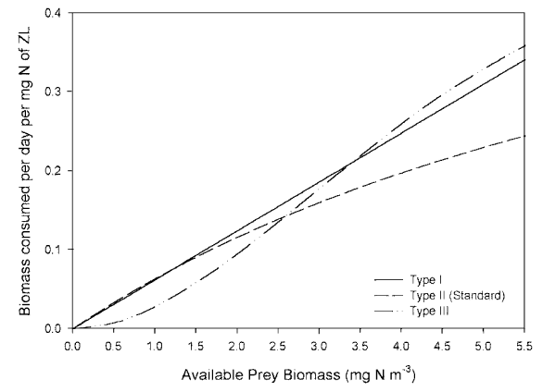
Buffering Prevents Simple Clarity
III
I
II

Slide 33
Formulations
  Specific grazing (etc) formulations
    alternative used has implications for findings (theoretically)
    in practice web constrained into area where all similar
    non-linear necessary (linear wrong when system perturbed)
    without data to distinguish careful (thoughtful) use of any form = ok
    need to justify use of more complex representations (especially if only after “ball-park” results)

Slide 34
Other Thing To Remember
  Use simplified models to build up an understanding of complex models
    but un- (or less) simplified form required for final management guidance
  If important system component poorly known use empirical model or forcing rather than omitting
  Think carefully how model closed (e.g. quadratic mortality)

Slide 35
Size-based Models
  MSFOR vs BSS (Duplisea and Bravington 1999)
  MSFOR = multispecies length-cohort model
  BSS = binned biomasses based on size (assume eat windowed band of smaller size)
  Led to same management conclusions
  Both need some modification to bring out most important non-linear responses (e.g. feeding relationships)

Slide 36
Biogeochemical vs ECOSIM
Fished
Discarded
Adults and juveniles split
Notes:
As another part of my thesis I also built an ECOSIM model based mostly on infor from the PPBES reports
- lighter groups in biogeochemical web = static groups that impose pressure on the system, but aren’t dynamically apart of it (no population dynamics of their own, no fishing pressure on them, just simple additional mortality term on fish groups)
- as typical of most ECOSIM models (which are fisheries oriented) the detail lies in the higher trophic levels and the lower levels are omitted or pooled, while this level of aggregation of species in the ECOPATH model does not match that in the biogeochemical models, it is felt that it was better suited to, and more typical of, what is usually found in ECOPATH models. Moreover some of the group splitting was necessary to avoid high levels of cannibalism, though this is not possible for the zooplankton or piscivore groups due to a lack of relevant information (I used the PPBES Technical report series)
- balancing was required, as was adjustment of biomass estimates based on trawl surveys (to represent vunerabiltyt etc). All parameter values did remain within the ranges given in the PPBES technical reports, but many were moved from the centre to one end or the other of the quoted ranges. The biomass of the deposit feeders proves to be a critical value in the model, but this is also one of the most uncertain.
- facilitation relationship between seagrass and juvenile king george whiting

Slide 37
Differences
ECOSIM
wet weight
interannual forcing
forage arena
simple PP
no sed chem
dynamic top predators
juv + adult fish
discards + bycatch
variable recruitment (self seeding stock)
nonspatial
BM2
N, Si
tidal+ forcing
type II feeding
Leibig PP
dynamic sed chem
static top predators (dynamic optional)
9 age classes
discards only
constant recruitment (external seed)
spatial
IGBEM
C, N, P, Si
tidal+ forcing
type II, type III feeding
adaptive PP
empirical sed chem
static top predators
9 age classes
discards only
constant recruitment (external seed)
spatial
Notes:
Quick look at differences
Don’t try and take it just realise that there are differences between them (ones in yellow are the most important)
- maybe more differences than you’d like up front, but they were built with different goals in mind originally
An ecospace model was created and played with, but the fishing policy analysis is most easily done with ECOSIM so the ECOSPACE model wasn’t used for the stuff I’ll be discussing here.

Slide 38
Production
ECOSIM
r . B / (1 + B . h)
Formulation detail for higher trophic more “even” between models
BM2
μ . min(DIN / (k_{DIN} + DIN), Si / (k_{si} + Si)) . min(1,IRR / k_{irr}) . B
IGBEM
μ . δ_{nut}. min(1,IRR / k_{irradjusted}) . B_{C}
where δ_{nut} = min (min (min(1,max(0,X)),min(1,max(0,Y))), min(1, Si / 2 . k_{si}))
where X = (B_{C} - β_{CNlow}) / (β_{CNint} - β_{CNlow}) and Y = (B_{C} - β_{CPlow}) / (β_{CPint} - β_{CPlow})
Notes:
Don’t try and take this in its just a flash up example of the difference in formulation detail for the lower trophic levels. However at the highest levels, especially those where split pools (juvenile and adults) are included in ECOSIM, the detail can swing back more the other way. At these levels all the models include age structure, explicit recruitment and split food intake into portions allocated to growth and reproduction, though the exact method of doing this does vary between models

Slide 39
Lessons
Problem: biogeochemical calibrated vs ECOSIM balance
  biomass values differ
  NOT critical but something to keep in mind in the future
Qualitative agreement (even when conditions change), but some details differ (due to assumptions and spatial structure)
Development history important
  ECOSIM damps fishery effects
  ECOSIM enhances nutrient effects
Notes:
There were a number of management and ecological findings that fell out of this work and I mentioned them in my previous talk. Model comparison wise we found that:
In hindsight a potentially confounding issue arises from the fact the nutrient models (IGBEM and BM2) are calibrated, while the ECOPATH model undergoes balancing. The nutrient models are calibrated by setting their parameters (growth, mortality etc) based on the species composition of PPB and then minor adjustments are made to these so that the biomass levels output are reasonable reflections of those reported in the PPBES technical reports. While the biomasses from the technical reports are also used in the ECOPATH model they undergo some significant changes during balancing. Thus the biomass values in the final version of the ECOPATH model no longer match those used to calibrate the nutrient models. (While not cripplingly important for all groups in the model, it became obvious that in an ideal situation more tuning would have been beneficial in spots and these will be identified in the following discussion.)
The history of each model’s development is quite telling and the nutrient models may have benefited from more tuning. In spite of this a number of general conclusions can be drawn:
- the ECOSIM model is not as buffered against nutrient related changes as the nutrient models are, but it is more buffered against changes in the fisheries
- the spatial structure of the nutrient models also allow for the expression of some more complex model behaviour
- in general the behaviour of the low to middle trophic groups in the nutrient models is probably more realistic than that in ECOSIM, but the higher trophic groups react more sensibly in ECOSIM than the nutrient models. This is probably another consequence of their respective focus and development histories.
With regard to the differences between the models we found
- qualitative agreement with change
- details can differ (but that was true of IGBEM vs BM2 etc too)… maybe groups with slow dynamics respond a little fast though
- history of development important…. So ECOSIM buffered against F impacts and my stuff from eutrophication stuff….

Slide 40
Spoilt for choice
  What do you use when?
  Large-scale (broad-brush) biomass change = BSS
  Trophic considerations and fisheries = foremost concern = EwE
  Multiple scales over large areas and primarily fisheries (with twists) = ATLANTIS
  Well defined issues at multiple scales, or very fine scale interactions = INVITRO

Slide 41
Model parameterisation
  Data usually from where-ever you can get it!
    specific surveys (industry independent)
    industry records
    observer reports
    local expert info
    similar systems / species elsewhere around the nation (or world)
    educated guesses
    see what needed to fit
  Create pedigrees and tune accordingly

Slide 42
Interpretation
  Not always easy
    may need to build up from simply models or do lots of tracking to figure out dynamics
    potentially right for wrong reason
    not a lost cause though (with experience you can get a feel for these models)

Slide 43
Non-linearities
  Hystersis
  Other examples:
    community composition
    regime shifts
    complex cascades
    spatial release
    many indirect effects
    “counter-intuitive” (release fishing but population abundance ↓)
    predator-prey reversal
  DIN in water column
  Nutrient loading

Slide 44
Emergence
  Controversial
    e.g. definition (and does it really exist)
    is it just we didn’t expect model behaviour (or didn’t understand implications of formulations)?
  Best examples = simple formulation ⇨ complex behaviour
    e.g. unforced regime shifts or self organisation

Slide 45
Summary
  Use multiple approaches
    history of model / modeller can be influential (so more opinions the better
  Focus on questions and critical processes and pick model accordingly
  “Attack problems at appropriate scales, with appropriate theories and methods. A universal scale is NOT useful”
  Rudolph Marcus

