Slide 1
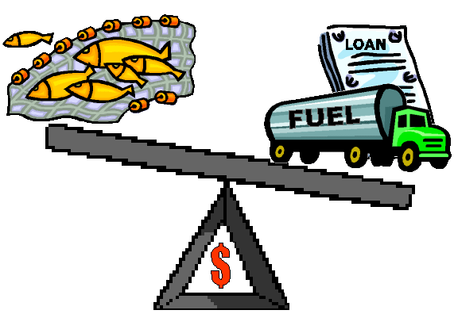


SOCIOECONOMICS
Beth Fulton
CSIRO Marine and Atmospheric Research

Slide 2
Allocation
  Socio-economic drivers
    class categorisation (motivation, flexibility – e.g. vessel size, number crew, size, fuel expenditure, gear, held quota, efficiency etc)
    market, investment, trading, planning sub-models
    not optimisation but “moving equilibrium”
    social and economic factors directing hierarchy of “annual plan” / seasonal / daily trip decisions

Slide 3
Economic Indicators
  Types of sub-models:
    functional forms converts this info into realised effort distribution & parameter modifiers (fed back to existing harvest model)
    dynamic sub-models
    e.g. costs

Slide 4
Economic Drivers
  Socio-economic sub-models (being added)
    max(CPUE-cost)
    simple economic indicators (scenario sketching or forcing)
    optimal motivation (jobs vs vessel size/power vs return vs capacity vs MEY)
    explicit economic drivers of fleet structure and effort distribution (forced or dynamic)
    full model with interplay between sectors/industries, with port size related to catch landed there
    predictive market models
    social network (“friendship”) networks (for quota trading etc)

Slide 5
Price Models
  Market models
    multiple markets
    home-port based preference for proportional sale through market
    autoregressive price models estimated from 5 years of price data (each market done separately)
  Fuel model done similarly

Slide 6
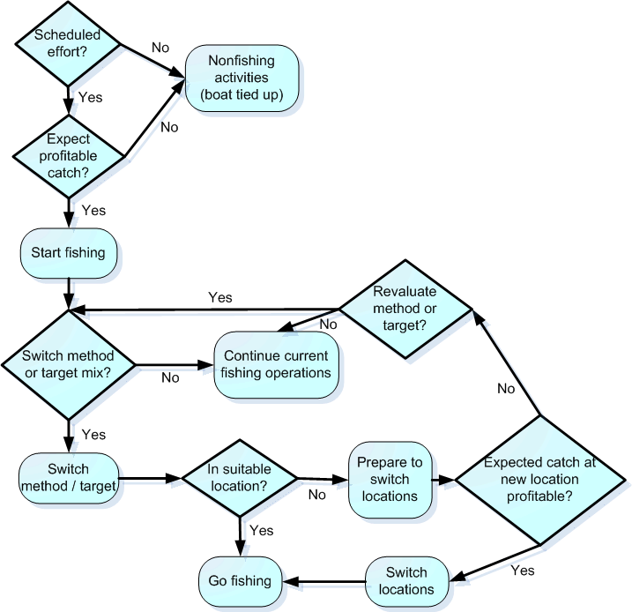
Effort Allocation
  Use Black book (of previous catches)
    to decide where to fish
    to base expectations on
  Will this cover overall effort shifts?
    increase / decrease effort because….

Slide 7
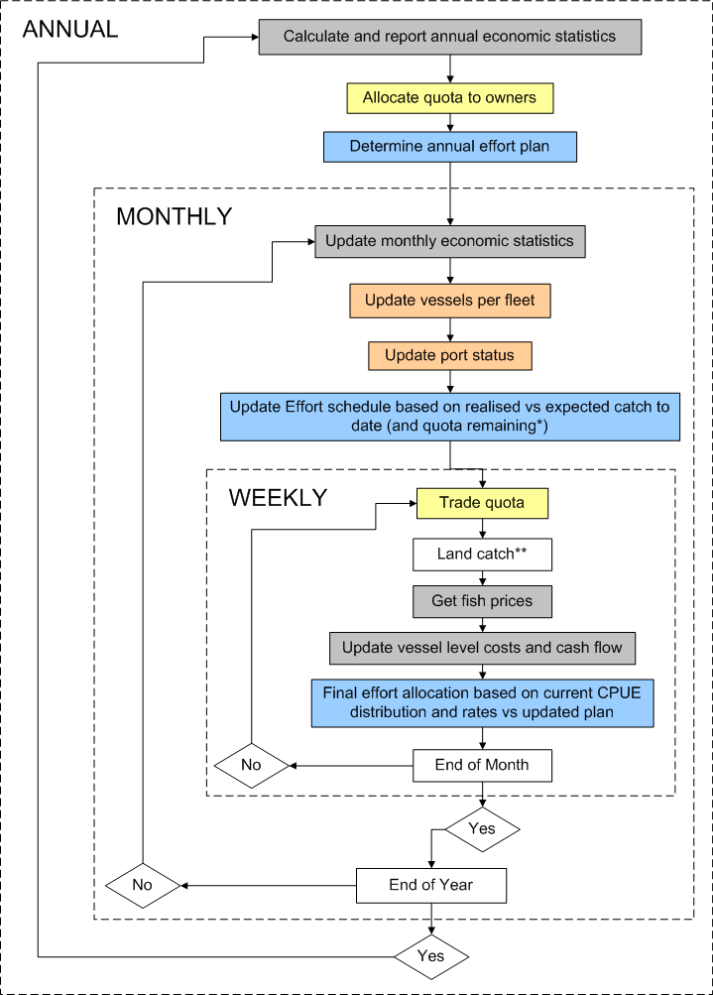
Effort Allocation

Slide 8
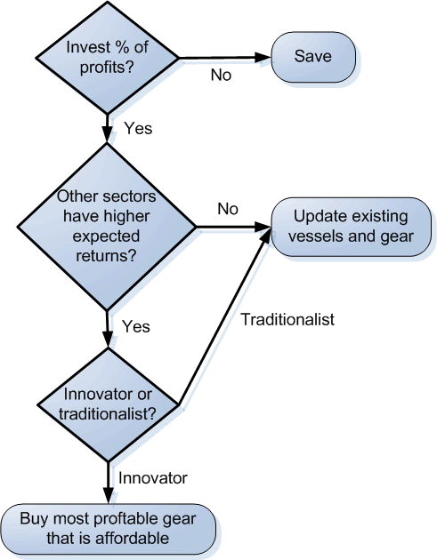
Economics – Investment
  Or can get further in debt (optional)

Slide 9
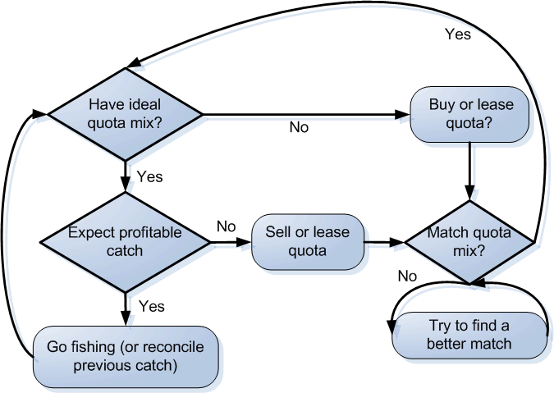
Trading Model
  How decide buy vs lease?

Slide 10
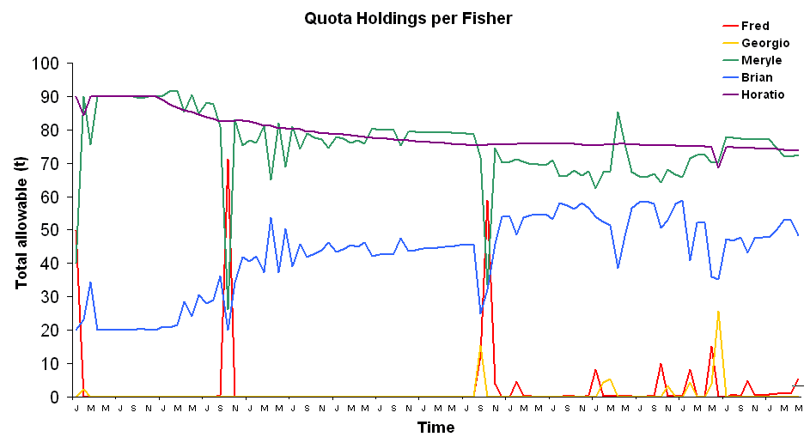
Trading Model
  Rich Little prototype (AMS = extension)

Slide 11
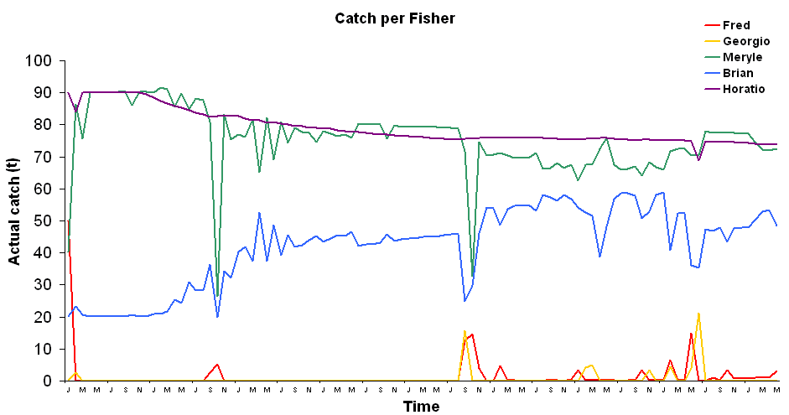
Trading Model

Slide 12
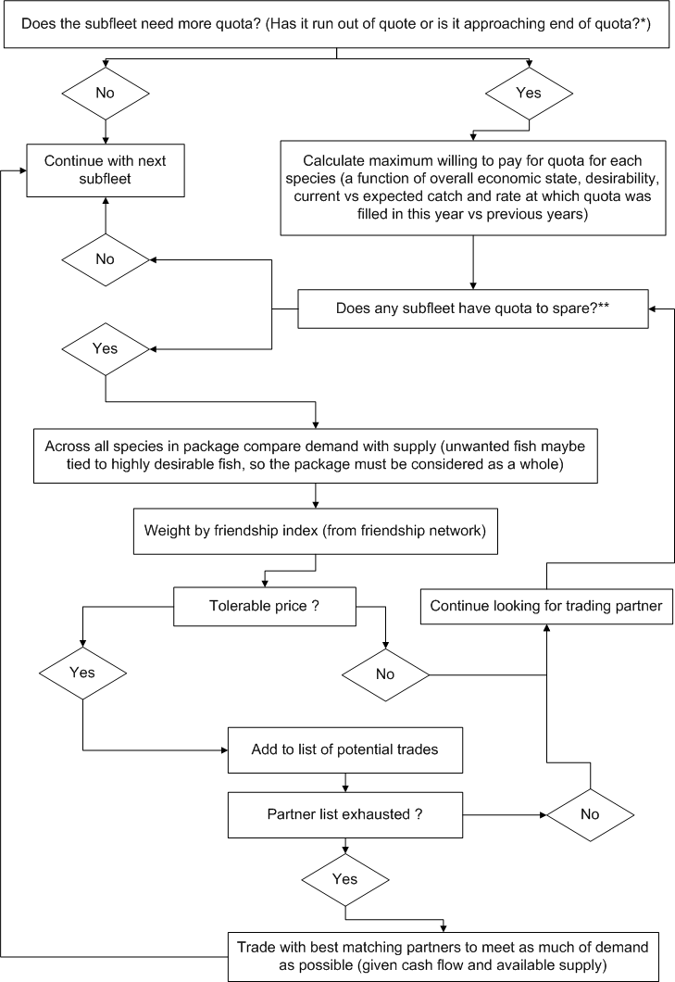
Trading Model
  Trading model details

Slide 13
Quota Price Models
  NZ model
  Value and costs
  Previous quota fill
  General economic state
  General stock state
  Current progress of quota fill (relative to same point previously)
  Newell et al 2005

Slide 14
Investment
  French model
    considers immediate costs (or value) of buying new boat (or selling old boat or switching between fleets) vs horizon $ return of staying put
    takes into account crew costs etc
    modifications
      land-based costs (so don’t always just fish hard and then tie up and coast through until next year)
      exhaustion of credit (and boats dropping out of fishery)
  Thebaud et al 2006 and Guyader 2002

