Slide 1
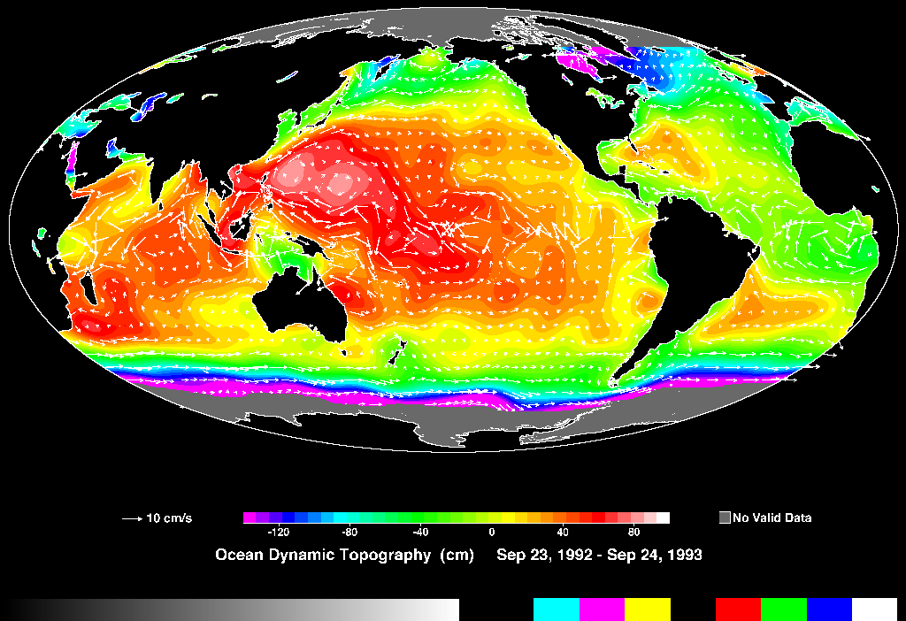


PHYSICS
Beth Fulton
CSIRO Marine and Atmospheric Research

Slide 2












Atlantis Structure

Slide 3
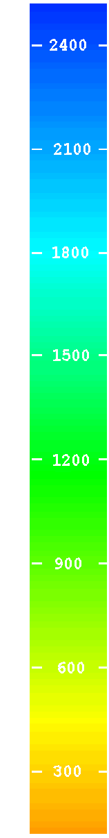
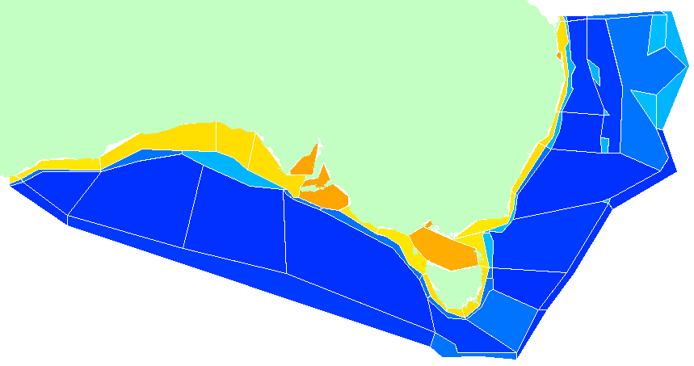
Atlantis - Geography
0
50
150
250
750+
Pelagic
flows
upwelling (to surface or at depth)
Epibenthic
Sediment

Slide 4
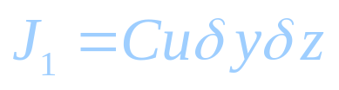
Physical processes
  Advection
  Flux = rate . concentration
  δz
  δy
  δx

Slide 5
Physical processes
  Advection
  Sum over faces of volume:
  is fluid velocity with components u,v,w in x,y,z
  For incompressible fluids advection transport is:
  Flux = rate . concentration

Slide 6
Physical processes
  Bulk diffusion coefficient (reflect magnitude of mixing at boundary)
  Diffusion
  Diffusive transport across boundary
  Flux proportional to particles near the interface ► Fick’s Laws, which give diffusive transport as

Slide 7
Physical processes
  Turbulence treated as variation in diffusion
    D can vary in each dimension (depending on direction of flow)
    turbulent diffusion = scale dependent
    varies with ⁴/₃ power of the length scale of the phenomenon
  Diffusion coefficient = 0.005 . grid_size^{4/3}

Slide 8
Physical processes
  Diffusion coefficient
  10⁶
  Horizontal Eddy Diffusion
  Vertical Eddy Diffusion
  Molecular Diffusion
  (salts, proteins and gases)
  Thermal Diffusion
  10⁻¹⁰

Slide 9
Physical processes
  Dispersion
    combine diffusion (including mass conservation assumptions) and advection

Slide 10
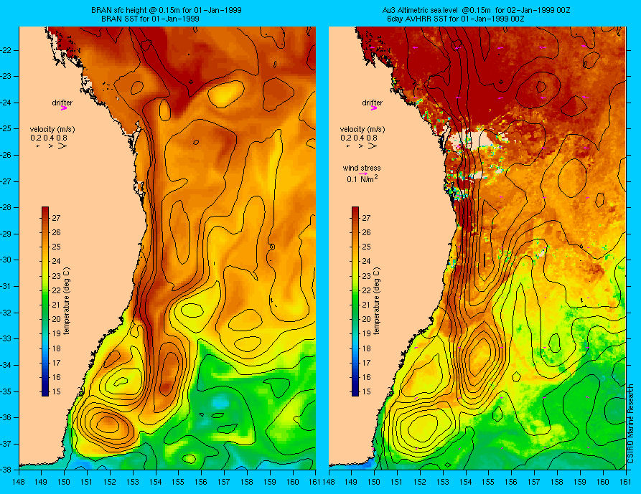
Physical forcing
  Advection & (most) horizontal diffusion is forced
    transport vectors from altimetry data or fine-scale 3D resolved hydrodynamic models

Slide 11
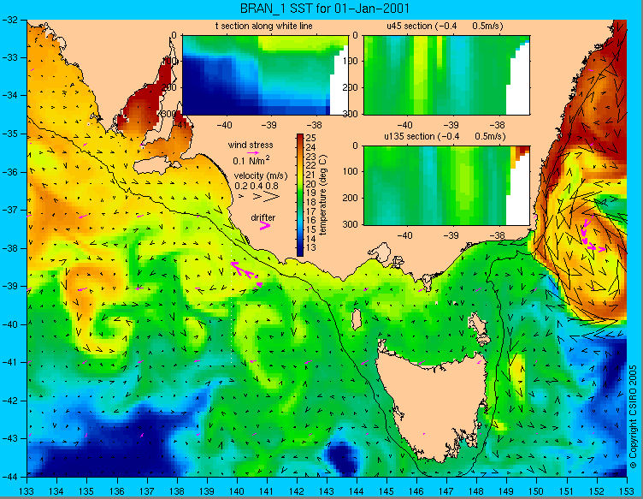
Physical forcing
  Most realistic fluxes (including vertically)
  Better seasonal and interannual variation representation

Slide 12
Hyperdiffusion
  In cell once over one edge available everywhere
    transport effectively too high
    correct to regain correct transport
      inverse methods
      “area” correct and then tune scalar

Slide 13
Transport
  Vectors from forcing file applied
  Forcing file contains ID of destination cell

Slide 14
Point Sources
  Forced time series
    can be scaled dynamically – series of linear increases and decreases through
    concentration coming from point source

Slide 15
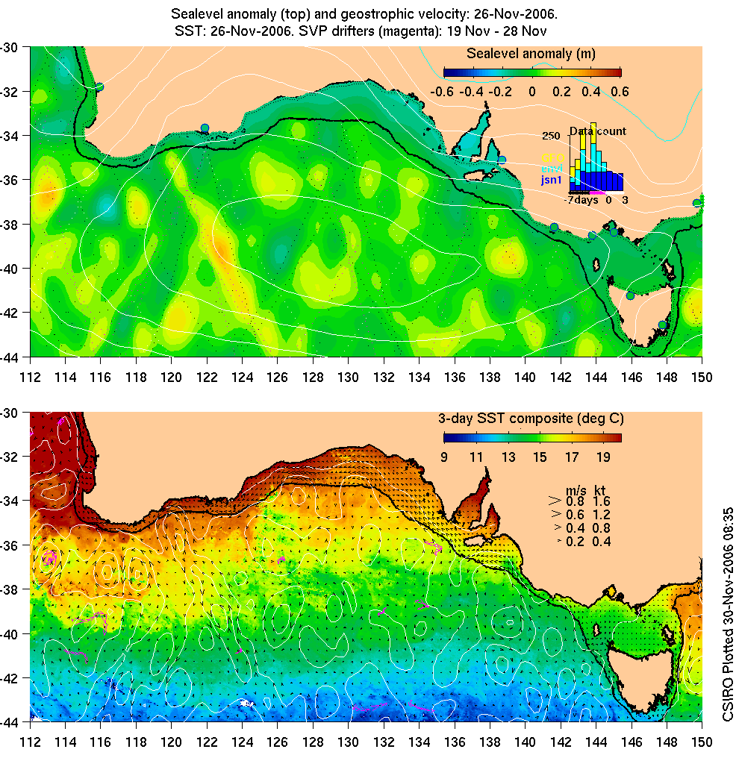
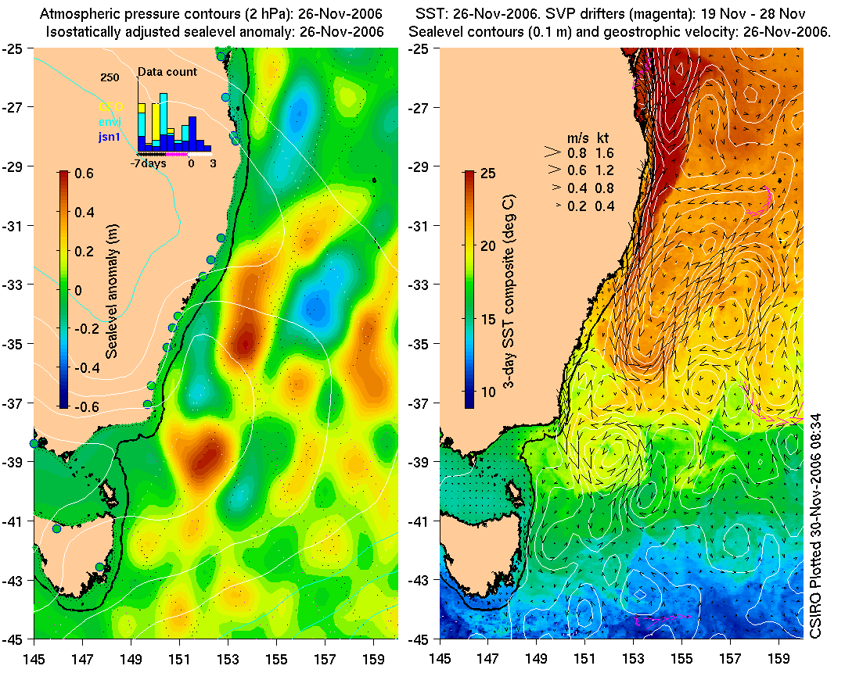
Environment
  Physical forcing and environmental variation
    e.g. temperature

Slide 16
Temperature Model
  Forced (data or BlueLink) OR CARS Regression
  different coefficient values coastal and oceanic

Slide 17
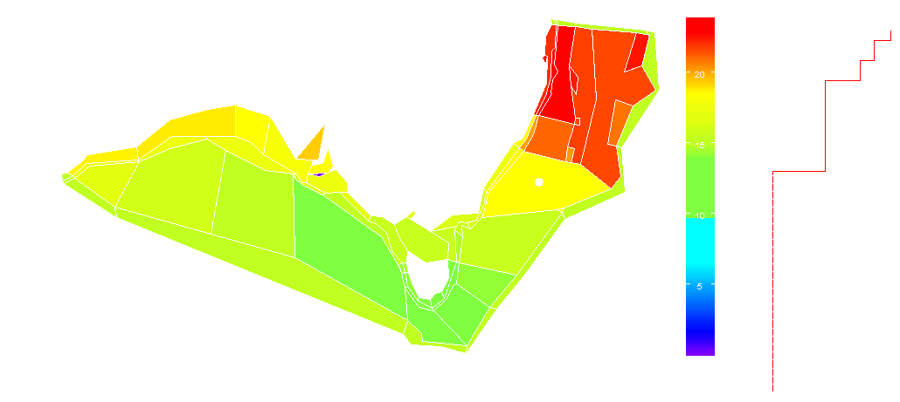
Temperature Model

Slide 18
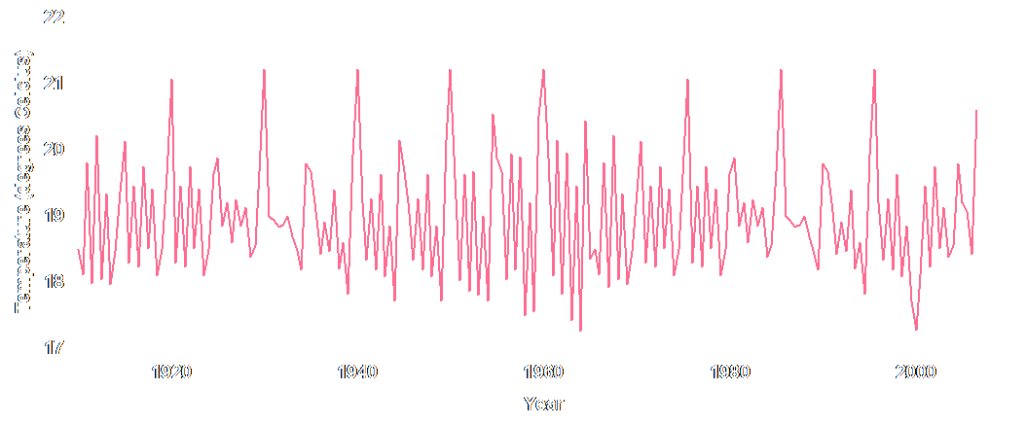
Temperature Model
  Salinity is similar
    forced OR dynamic calculation

Slide 19
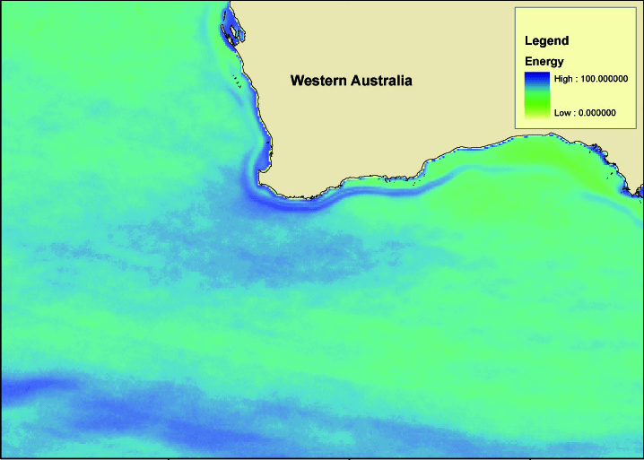
Eddies
  Forcing time series calculated from variation in surface height
    interpolate between quarterly values at site
    scale production accordingly

Slide 20
Gas exchange
  Exchange with infinite pool in atmosphere
    flux (F) at surface to pool in water (G)
  Diffusion (K) and saturation (S) coefficients are temperature dependent
  Stagnant layer thickness dz = wind and slick dependent
  Surface layer depth

Slide 21
Mixing
  Typical simplification

Slide 22
Settling
  Newton’s second law
  Simplification
  Temperature dependence, density and viscosity (Reynold’s number) may be included
  gravitational force F_{g}
  bouyancy
  friction
  Settling rate (ratio velocity and depth)

Slide 23
Resuspension
  Dependent on energy in water column due to wind, wave height, eddies, shear stress and sediment type
  Amount scoured
    typically α₀ = 0.008, t_{d} = 7, shear stress τ = 0.003u²
    cohesion and consolidation complicates everything (so easier for sands)

Slide 24
Decay (& Burial)
  Real decay (e.g. radionuclides) plus burial out of system

Slide 25
Bioturbation & Bioirrigation
  “Slab mixing”
  Bioturbation
    expulsion
    particulate diffusion
    intake
  Bioirrigation
    exchange
    dissolved diffusion
    injection

Slide 26
Physical Process Summary
  Vertical mixing, biorrigation, bioturbation, resuspension, settling, and atmospheric exchange
    slab or gradient exchanges
    largely variants of:
    elaboration = through calculation of λ (e.g. product of rates, dependent on biology etc)
    decay and diffusion functions used liberally too

