Slide 1
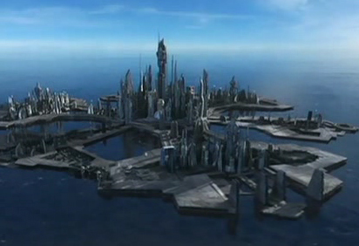


Atlantis
Beth Fulton
CSIRO Marine and Atmospheric Research

Slide 2
Outline
  Atlantis – the dog and pony
  Modelling terms
  Conceptual models of ecosystems
  Types of models

Slide 3
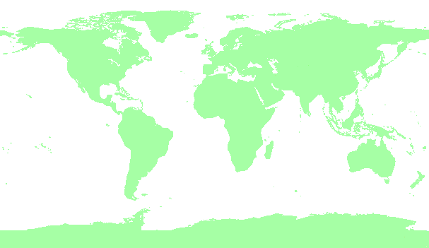
Atlantis - implementations
  14 systems simulated (+4 in proposal)
Notes:
Map of locations of Atlantis implementations to date
Port Phillip Bay
Gony area (southeast)
Westernport
Bass Strait (for Victorian MPA study)
NSW coast
Clarence River NSW
Torres Strait
Northeast US
California current
Coast of Tassie

Slide 4
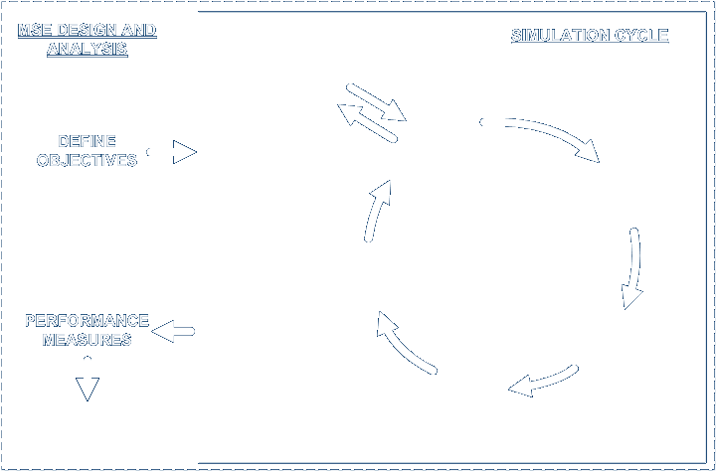


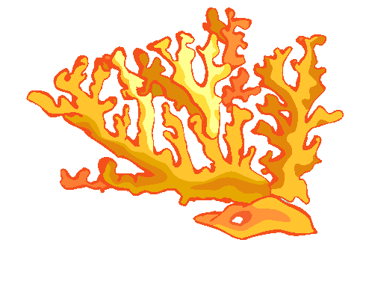



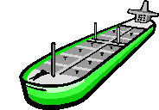

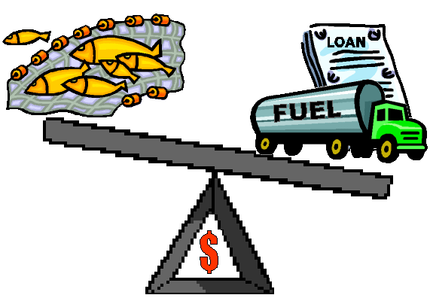


Atlantis – MSE framework

Slide 5
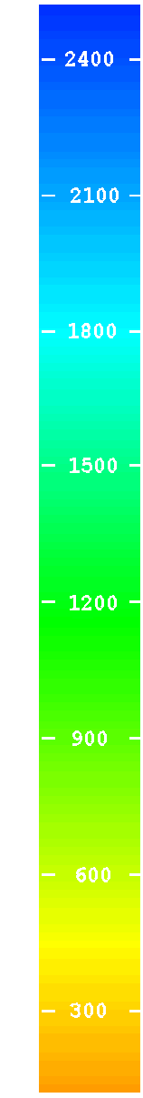
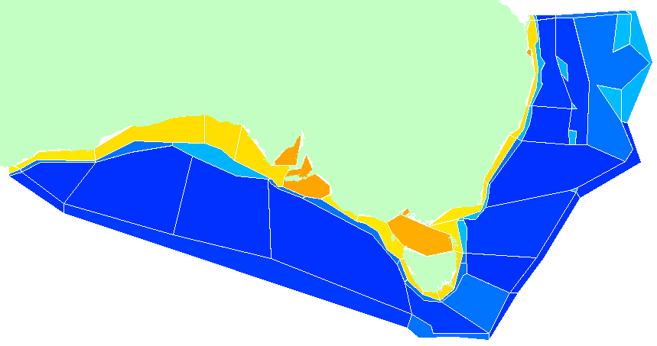
Atlantis - Geography
0
50
150
250
750+
Pelagic
flows
upwelling (to surface or at depth)
Epibenthic
Sediment

Slide 6
1910
toothed whales
pelagic fish
pelagic sharks
demersal fish
demersal sharks
birds
small pelagics
baleen whales
squid
filter feeders
zoobenthos
zooplankton
jellies
infauna
detritus
macrophytes
phytoplankton
Notes:
Process based (differential equations)
- movement, feeding, growth, reproduction, mortality, waste, nutrient regeneration (various representations)
- alternative representations of each (mix-n-match, evaluate model uncertainty)
- Functional groups and species of concern / interest
- Invertebrate (size and diet structured biomass pools)
- Vertebrate (condition of average individuals, age structured)
- Age-dependent changes (ontogenetic shifts)
“Polish” – Environmental forcing, multiple stocks
First up its good to have confidence in the plausibility of model behaviour when using it as a testbed.
Work as part of my Phd showed that Atlantis does reflect the dynamics of real ecosystems, but to give you an example…
This is the unfished foodweb for the southern shelf part of the big continental shelf ecosystem model
- Its too complicated with everything shown, so I’ve only shown the shelf parts from the southern section of the model and I’ve only shown the major flows
- bit over “rock” = benthic (rest = pelagic)
- rectangular boxes = invertebrates and detritus
- polygons are vertebrates showing relative proportion of group made up of juvenile and adults
- green = photosynthetic
- purple = bacteria
- grey = detritus
- yellow = zooplankton
- aqua = gelatinous zooplankton
- orange = benthos (light = infauna, dark = epifauna)
- black = cephalopds
- light blue = planktivores
- medium blue = piscivores
- deep blue = demersal fish
- red = sharks and rays
- pink = birds and mammals

Slide 7
1910

Slide 8
2000

Slide 10
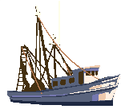
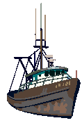
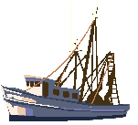
Atlantis - Sectors
river or major inputs ports currents
  Non-fishing nutrient/pollutants
  global climate
  habitat degradation
  Fishing (multiple fleets/subfleets, ports, effort allocation and exploration, targeting, gear, discarding, incidental impacts, technology creep, compliance, investment, quota- trading; socio-economic drivers)

Slide 11
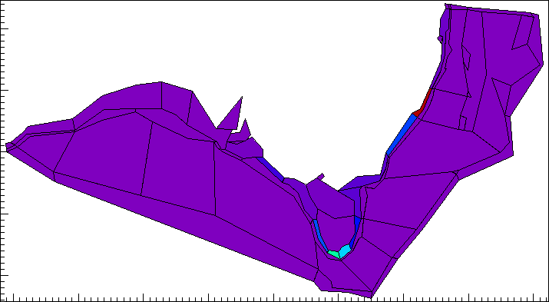

Fisheries – Timeseries
  Relative trawl effort time series
    shift in grounds through time (seasonal & annual)

Slide 12
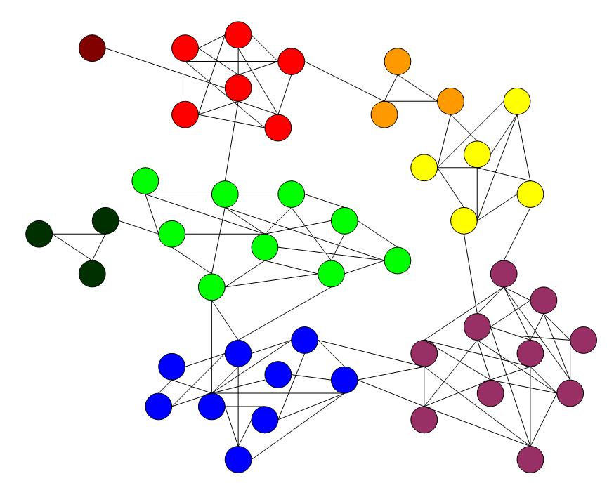
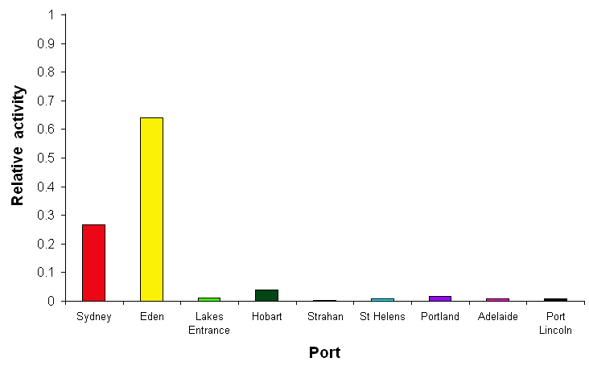
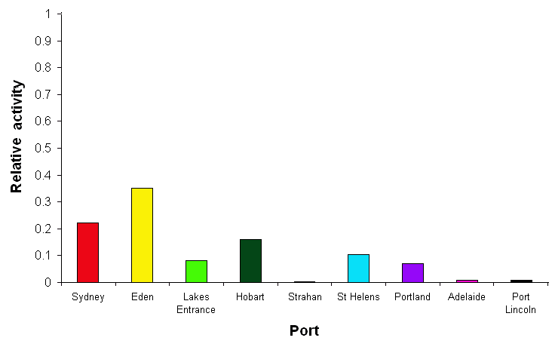
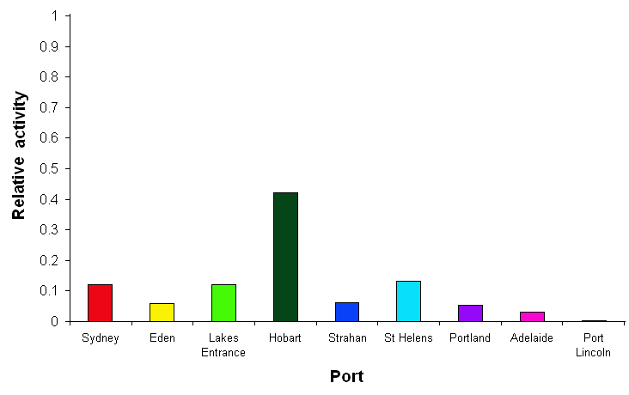
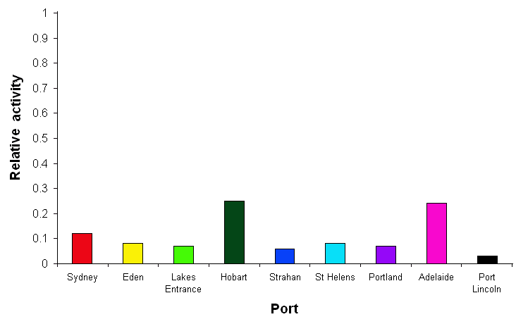
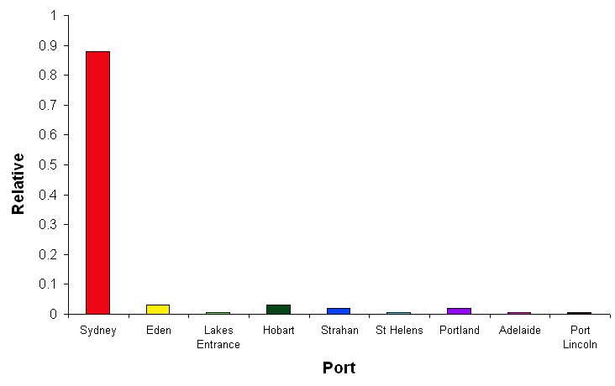
Ports and Networks
  Port activity levels varies through time

Slide 13
Notes:
Monitoring (observation sub-model)
- Industry dependent and independent data
- different types of data
- with error (and patchiness etc)
- multiple scales, mismatches, aggregations potentially
Assessment
- Simulate implementation of actual assessment models (catch curves, surplus production, VPA, integrated)
- Ecological indicators calculated

Slide 14
Atlantis – sampling
  Collects data from biophysical model at user set sampling step
    “data collection” reflects commercial and scientific sampling
      can be patchy & mis-matched, including lag effects and spatial sampling issues
      representing different methods (e.g. trawl surveys, acoustics)
  Aggregates data (if appropriate)
  Adds error (usually lognormal)
    includes aging errors and selectivity correction problems

Slide 15
Atlantis – assessment
  Uses “real world” assessment models
    Catch trends
    Schaefer production models
    Adapt-VPA
    MSVPA
    Integrated assessments (being added)

Slide 16
Notes:
Management activities
- Decision rules
- trigger points
- levers (regulations on gear / vessels / effort / discards / quotas / size / trip limits etc, spatial, temporal, implementation lag)
- Compliance
- tensions via counteracting industry responses (again maybe dependent on socio-economics)
- Detail facets of action of industry and management
- various alternative options formulated

Slide 17
Anthropogenic Control
  All major fisheries management drivers (scenario or dynamic)
    other sectors = scenario only
  Socio-economic drivers
    class categorisation (motivation, flexibility – e.g. vessel size, number crew, size, fuel expenditure, gear, held quota, efficiency etc)
    market, investment, trading, planning sub-models
    not optimisation but “moving equilibrium”
    social and economic factors directing hierarchy of “annual plan” / seasonal / daily trip decisions

Slide 18
Model Study – Stages
Ecology Alone
Forcing History
Match History
Predictions
  Each provides own kind of information even if don’t progress further
Notes:
Full MSEs still underway (though early results are getting positive responses from people like Mark Mangel who has had a look at the California current prototype)
Biggest use to date has been the ecological indicator work (results given here)
Need a suite of indicators which cover the types of groups listed here

Slide 19
BIGGEST issues
  General problems
    info intensive (no other way possible due to form of systems being represented)
    complexity issues (guidelines exist)
    structural sensitivity (can be checked for)
    uncertain (problem if for assessment, ok for MSE)
    difficult to interpret (coping methods exist)
  General pro
    give insights single and multispecies models can’t
    (e.g. alternative causation – declines direct from fisheries or from pollution killing prey?)

Slide 20
BIGGEST assumptions
  Homogeneous pools within habitats within boxes
  All individuals in group of same age = same size
  Single functional responses explain behaviour of entire populations (provide alternatives, but one at-a-time per group use)
  Genetic / micro-scale processes adequately incorporated by general representations (checked via IGBEM)
  Evolutionary change not important at these scales

Slide 21
Limitations
  Fine / very shallow scales under development
  Broad brush (lots of alternatives for major process representation, but NOT for assessment)
  Science software
  Dependent on pre-generated transports
  Omission of rare links (potentially)
  Parameter intensive

Slide 22
Strengths
  Heavily mix-n-match (multiple options for every implemented process)
  Sub-models and detail in each area (formulation focus is less skewed)
  Sub-grid scale processes means includes process across many scales (which are ignored in most other models were focus on set scales – mixotrophy, bacterial colonisation etc)

Slide 23
Modelling
Terms and Concepts

Slide 24
Models
  Model = synthesis of understanding with reference to particular issue
    vs statistical analyses = relationships in data only
  Useful for
    exploring system properties
    highlight data gaps (prioritise data collection)
    testbed for hypotheses (problem of double doubt)

Slide 25
Definitions
  State variable: Dynamic value describing system state (changes in the model)
  Diagnostic: Derived indicator (in output)
  Forcing function: External to dynamic system, but influence it
  Parameters: Mathematical coefficients, typically fixed in any run (weakest link)
  Universal constants: Universal (funnily enough)

Slide 26
Definitions
  Verification: Test model internal logic (check equations for consistency of units)

Slide 27
Definitions
  Calibration: Tune parameters to get accordance between model output and observations
    improving parameter estimates
    trial & error (often) or automated (own dangers)
    parameters not known exactly (often from literature) so refinement needed
    never spot on as
      lumping = averaging (parameters should not really be constant)
      models = simplifications (calibration = capturing influence of omitted components)

Slide 28
Definitions
  Sensitivity Analysis: Finding model’s most sensitive components (and impacts of changes in these on model dynamics)
    shows parameters need to know with certainty
    target field programs
  Validation: Objective test of model fit
    use data not used in calibration
    under multiple scenarios / forcing functions

Slide 29
Model Types
  Stochastic: stochastic processes and random variation modifies (to some degree) response
    not commonly used in ecosystem modelling (ABMs = exception)
  Deterministic: assume evolution of system completely described by differential equations
    common approach
      Atlantis

Slide 30
Model Types
  Reductionistic: all details included
  Holistic: include general principles only
  Atlantis intermediate
    includes more processes than some models (much less than others)
    core processes of each area only
      optional levels of detail

Slide 31
Model Types
  Black box: deals with input impacts on output only
  Causal: processes represented explicitly by equations in model
      Atlantis (mostly, empirical representations used in some spots where little is known)
  Atlantis = Biodemographic (follows numbers) and biogeochemical (follows pools)
Notes:
Map of locations of Atlantis implementations to date
Port Phillip Bay
Gony area (southeast)
Westernport
Bass Strait (for Victorian MPA study)
NSW coast
Clarence River NSW
Torres Strait
Northeast US
California current
Coast of Tassie

Slide 32
Why This Type?
Model type | Characteristics | Selection Criteria
Matrix | Linear | Age-structure; Linear
Static | Good for steady-state (average state) | Data poor; Short-term variation negligible
Fuzzy | Semi-quantitative (gives ranges) | Data poor; semi-quantitative sufficient
d.e. | Space-time and causal | Good data & understanding needed or desired
struct. dynamic | Parameters can vary (expert info, goal function) | Changing conditions; Good data over change
IBM | Individual properties | Average properties insufficient
  Technically DIFFICULT, not 100% requirement
  Plug-n-play trade-off = know much about little or little about much
Notes:
Not necessarily best quantitative prediction, but does off best balance of complexity and flexibility so can consider broad range of system-level questions

Slide 33
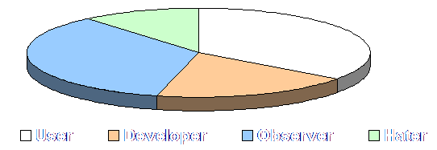
Side Note
  2002 survey of 350 US ecologists
Notes:
Map of locations of Atlantis implementations to date
Port Phillip Bay
Gony area (southeast)
Westernport
Bass Strait (for Victorian MPA study)
NSW coast
Clarence River NSW
Torres Strait
Northeast US
California current
Coast of Tassie

Slide 34
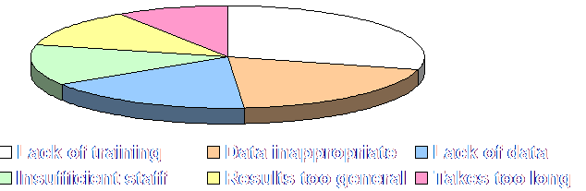
Side Note
  2002 survey of 350 US ecologists
Notes:
Map of locations of Atlantis implementations to date
Port Phillip Bay
Gony area (southeast)
Westernport
Bass Strait (for Victorian MPA study)
NSW coast
Clarence River NSW
Torres Strait
Northeast US
California current
Coast of Tassie

Slide 35
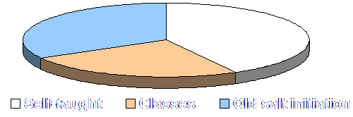
Side Note
  2002 survey of 350 US ecologists
  > 50% as grad students
Notes:
Map of locations of Atlantis implementations to date
Port Phillip Bay
Gony area (southeast)
Westernport
Bass Strait (for Victorian MPA study)
NSW coast
Clarence River NSW
Torres Strait
Northeast US
California current
Coast of Tassie

Slide 36
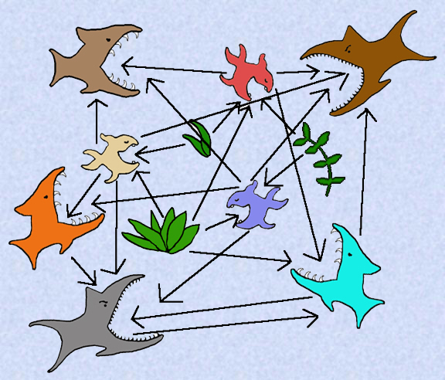
ECOSYSTEMS
Terms and Concepts

Slide 37
Ecosystems
  An ecosystem composes of physical-chemical-biological processes active within a space-time unit Lindeman (1942)
  Scales and inclusions usually actually based upon objectives of the study
  What do we know about ecosystems?
    Let’s draw a conceptual model of a reef system
Notes:
Map of locations of Atlantis implementations to date
Port Phillip Bay
Gony area (southeast)
Westernport
Bass Strait (for Victorian MPA study)
NSW coast
Clarence River NSW
Torres Strait
Northeast US
California current
Coast of Tassie

Slide 38

Lets Get Physical
Precipitation
Wind
Irradiance
Catchments
Currents
Eddies
Downwelling
Photic Zone
Turbulence, Mixing & Resuspension
Upwelling

Slide 39


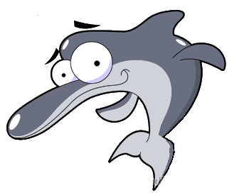





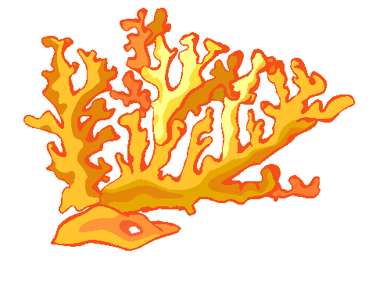








Now Ecological
Seabirds
Marine Mammals
Marine Reptiles
Nutrients
Phytoplankton
Zooplankton
Macrophytes
Detritus
Forage Fish
Benthos
Big Fish
Sharks
Chemical cycling

Slide 40




Socio-Economic
Defence
Commercial Fishing
Tourism
Recreational Fishing
Run-off
Development
Oil & Gas
Shipping
Pipelines

Slide 41
Processes
  Physical
    movement & mixing (& wind)
    light
  Nutrients
    supply & diagenesis
  Ecology
    production
    predation (& competition)
    reproduction
    waste
    habitat dependency
    migration (including vertical)
Atlantis
EwE
Notes:
Map of locations of Atlantis implementations to date
Port Phillip Bay
Gony area (southeast)
Westernport
Bass Strait (for Victorian MPA study)
NSW coast
Clarence River NSW
Torres Strait
Northeast US
California current
Coast of Tassie

Slide 42
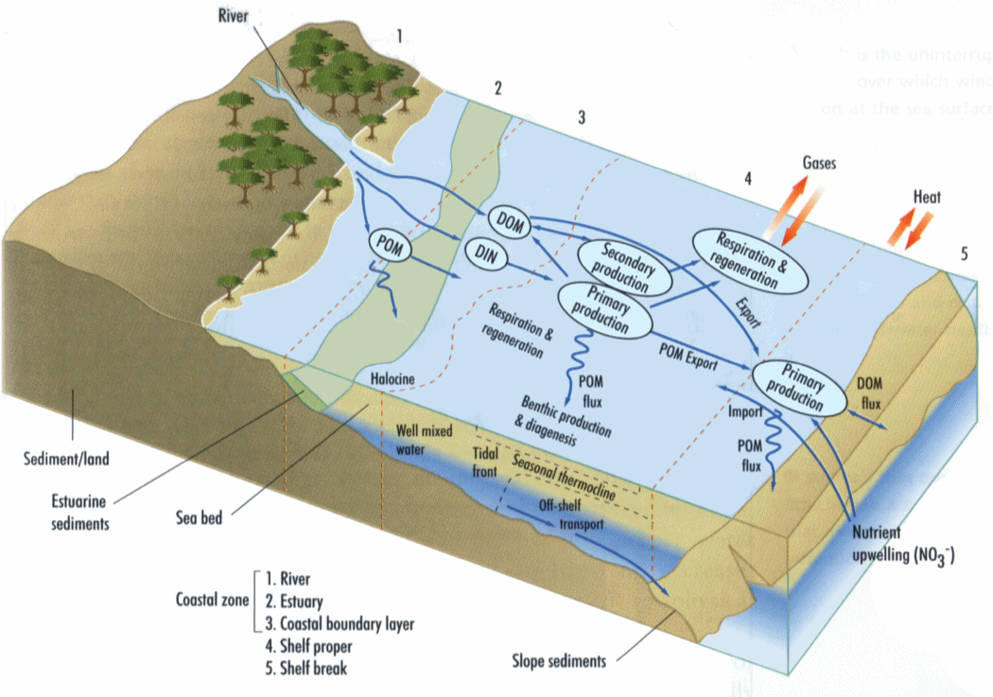
Process & Components
  The details come next…
Notes:
Map of locations of Atlantis implementations to date
Port Phillip Bay
Gony area (southeast)
Westernport
Bass Strait (for Victorian MPA study)
NSW coast
Clarence River NSW
Torres Strait
Northeast US
California current
Coast of Tassie

