Slide 1
Welcome to the Box Geometry Model
Mike Fuller
GIS bunny and data ferret
(pathologically)

Slide 2
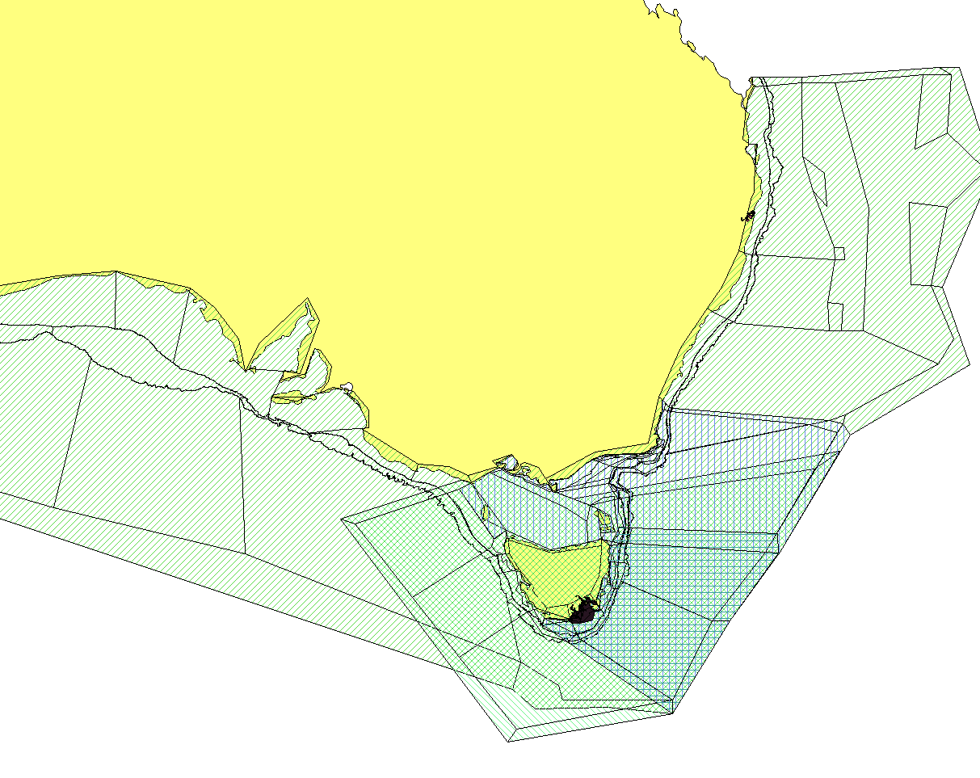
SE Aus Models

Slide 3
Outline
The Underbelly of the BGM file
How to get there
Model as cartoon (KISS)
Things to be aware of
Bgmeriser
  Other tools
Additional options
  Non-cartoon analysis version
Questions

Slide 4
The Underbelly of the BGM file
BGM file contains information about polygon and face relationships – topological
Source data from non-topological formats (e.g. shapefiles) has to be correct to build geometry
Internal format
  Header
  Projection information
  Boundary
  Box Definitions
    Geometry
    Attributes
  Face Definitions
    Geometry

Slide 5
Box Details
# Box number 1
box1.label Box1
box1.inside 146.9986146007499 -43.48157653831197
box1.nconn 2
box1.iface 4 2
box1.ibox 0 2
box1.botz NaN
box1.area 0.11298529097887133
box1.vert 147.11110167788928 -43.749813994537334
box1.vert 147.21098773967168 -43.50655099790789
box1.vert 147.00895426870437 -43.28163836910657
box1.vert 146.78624145758067 -43.34939823510481
box1.vert 146.88868506189317 -43.60854817595259
box1.vert 147.11110167788928 -43.749813994537334

Slide 6
Face Details
# Face number 1
face1.p1 147.00981045266124 -44.213919950710824
face1.p2 146.60300404861894 -43.873791043731146
face1.length 0.530263258894125
face1.cs 0.767178184079174 0.641434044834682
face1.lr 3 2

Slide 7
How to get there
Handronically …
Via Shapefile
GIS packages
  ESRI
  Open Source
    QGIS
    gvSIG
Snapping environment
  Arcs and vertices coincident
  Prevents topology errors

Slide 8
Model as cartoon (KISS)
Model is a simplified representation of the study area
  Cartoon not map
  Straight lines are OK
Faces and boxes must all be functional components of the ecosystem
Makes parameterisation easier
Less likelihood of geometry errors
Improves runtime

Slide 9
Things to be aware of - Topology
Topology
  arcs define boundaries (faces)
  Centroid within closed ring of arcs defines polygon (box.inside and box.verts)
Shapefile doesn’t understand topology
  Has to be maintained during editing
  Use snapping environment to ensure vertices fall on arcs, overlaps and undershoots don’t occur
Most common Errors
  Overshoots and undershoots
  Can be very small and difficult to find
Islands
  Must be connected to parent box
    Box geometry cannot differentiate between inside and outside the island – results in overlapping regions.

Slide 10
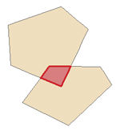
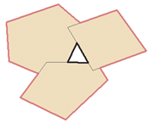
Topology Errors
Overshoots and undershoots
Slivers
  Narrow gaps between or overlapping polygons (often smaller than symbol width – zoom right in)
  Same error in bgmeriser
Clean shapefile
  Fuzzy tolerance
Other methods of handling topology from users?

Slide 11
Bgmeriser
Converts shapefile to BGM file
Clean shapefile = happy bgmeriser
Work in progress
java -jar bgmeriser.jar -as 4326 test3.shp
  You seem to have more than one box 0
  Boxes must be contiguously numbered from 0; expecting 1 but found 0
  You don't have the botz attribute set; every box must have its depth specified.
  You don't have the boundary attribute set; it should be set to 1 for every boundary box.

Slide 12
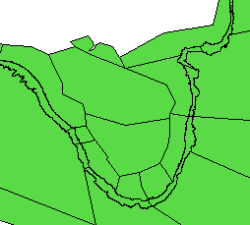
Additional options
Non-cartoon analysis version
  Create refined model for data processing
  Bathymetry bound regions use detailed data
  Not required to run through bgmeriser
  Use to process input data where spatial accuracy is required
    Allocating Fishing effort
    Processing SST data

Slide 13
Questions

