Slide 1


Output visualization
Cameron Ainsworth NWFSC-NOAA
cameron.ainsworth@noaa.gov
Atlantis training course Sept 8-10, 2009

Slide 2
Outline
Log.txt
R viewer
BGM mapper

Slide 3

Reporting options in Atlantis (Log.txt)

Slide 4
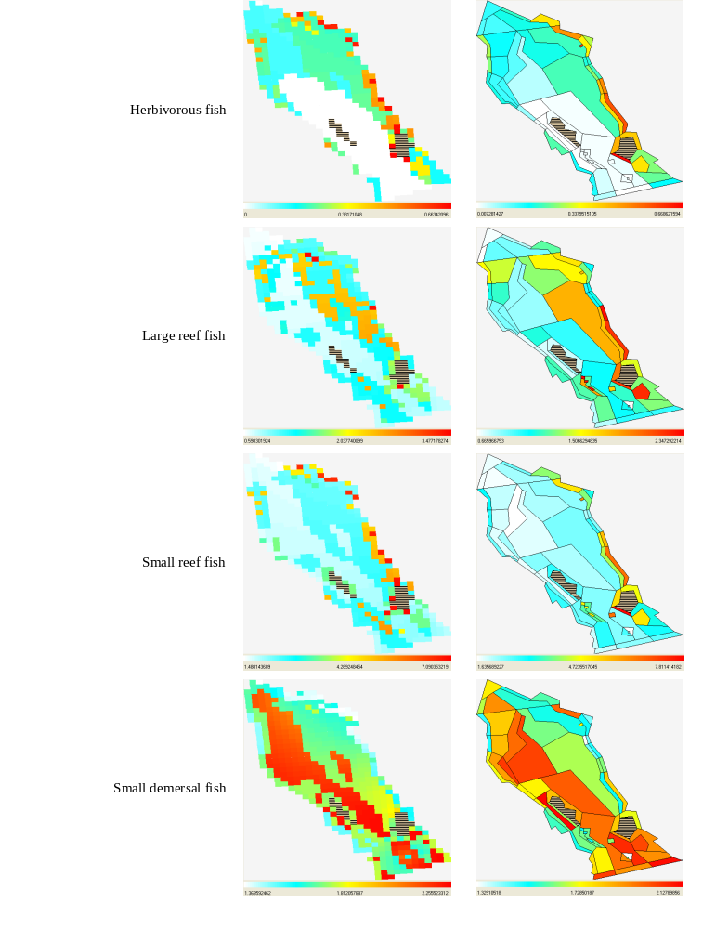
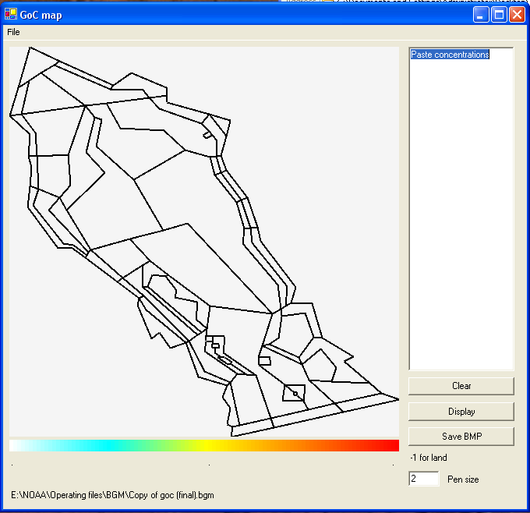
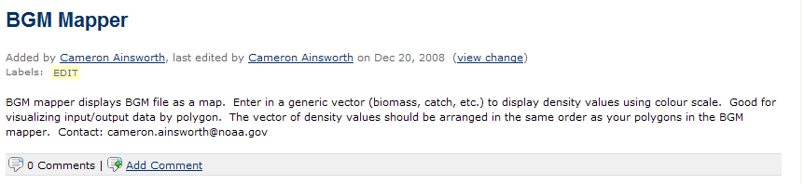
BGM mapper
BGM (box geometry file)
Download from website

Slide 5
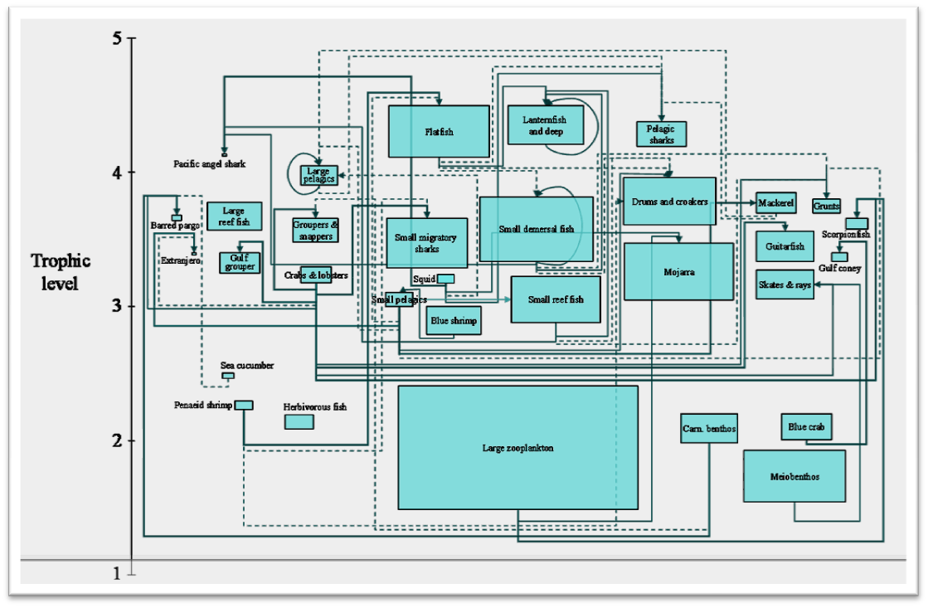
GoC food web
Semi-automated VB routine in powerpoint to create food web diagrams

Slide 6
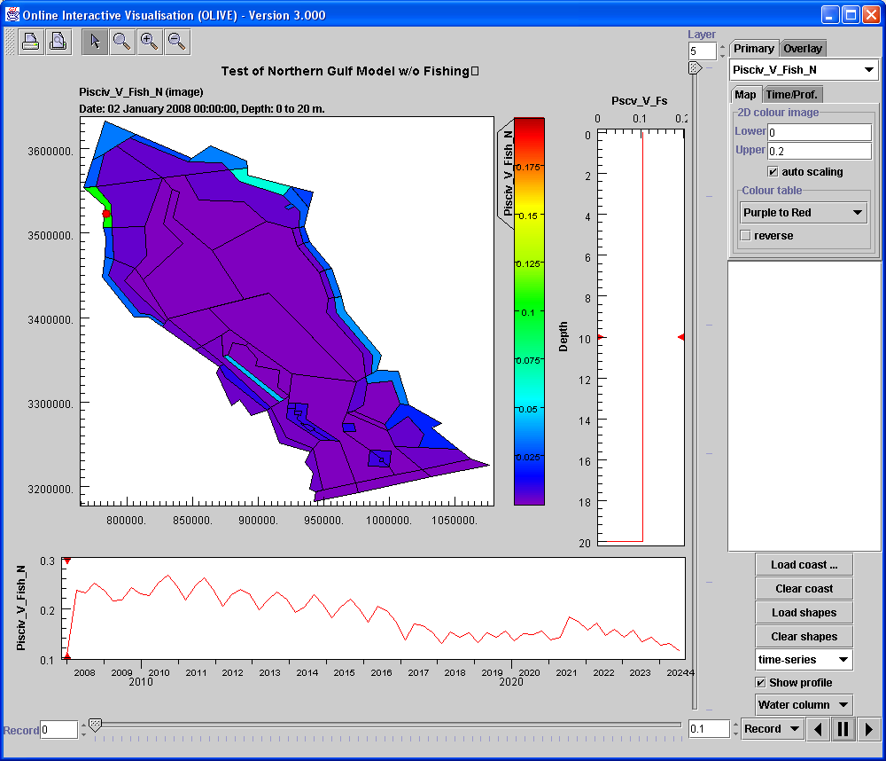
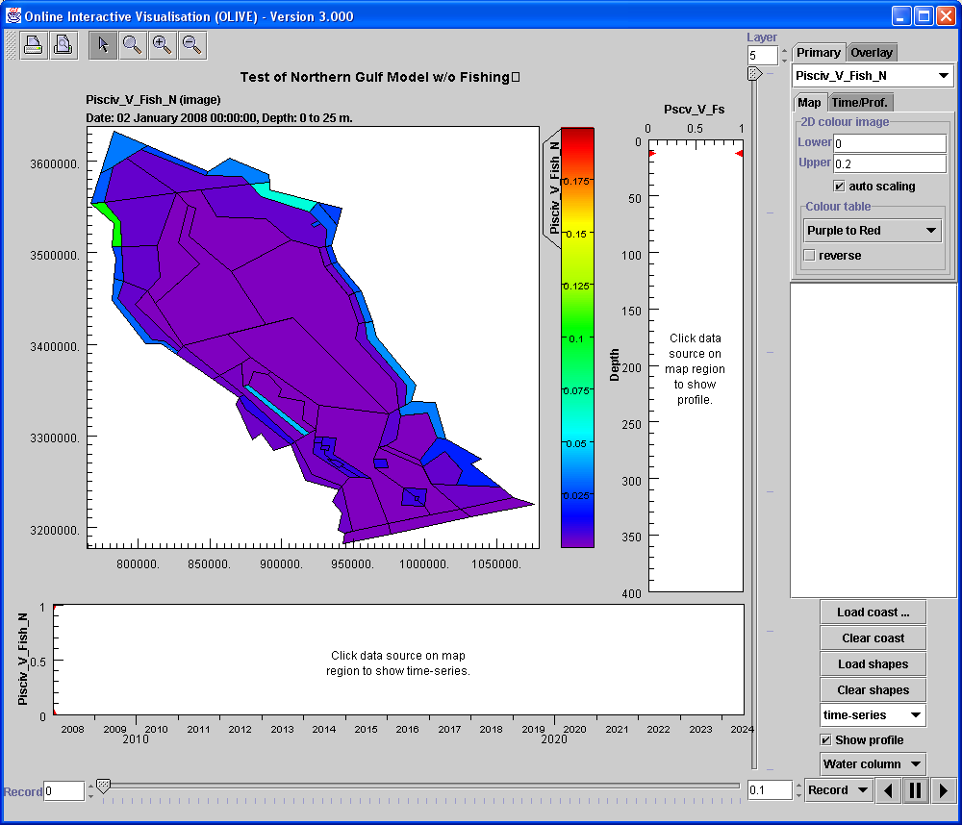
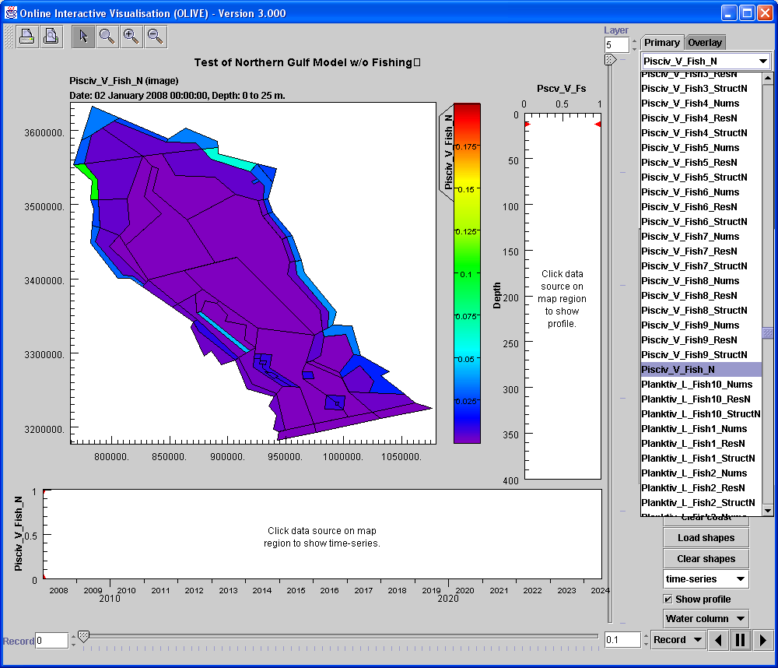
Olive
Interprets .nc files
3 dimensions
Time
Select group
XY
Z
Select a cell
TIME

