Slide 1

Atlantis –SE Australia
Beth Fulton
CSIRO Marine and Atmospheric Research

Slide 2
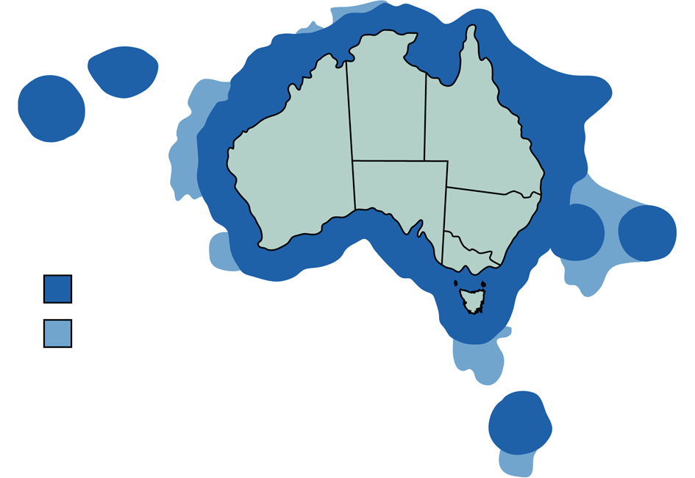
Alternative Management Strategies
3.7 million km² (tropical – subantarctic, inshore – oceanic)
Strongly seasonal
Highly diverse
Fisheries
  multiple gears
  multi-species
  overlapping jurisdictions
EEZ
Claimable shelf
Beth

Slide 3
Alternative Management Strategies
(AMS project)
Rethink management arrangements for SESSF
Strategic approach – bring stakeholders along
Two phases
    qualitative (expert judgement)
    quantitative (Atlantis model)
    Fulton, E.A., Smith, A.D.M., and D.C. Smith. 2007. Alternative Management Strategies for Southeast Australian Commonwealth Fisheries: Stage 2: Quantitative Management Strategy Evaluation. Australian Fisheries Management Authority, Fisheries Research and Development Corporation.

Slide 4



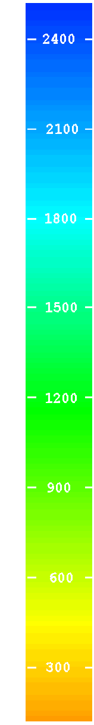
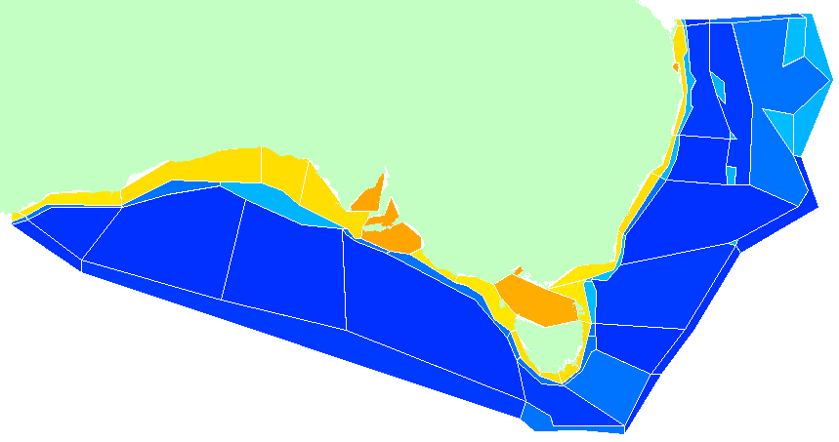
Atlantis SE - Physical
0
50
150
250
750+
Pelagic
flows
upwelling (to surface or at depth)
Epibenthic
Sediment

Slide 5
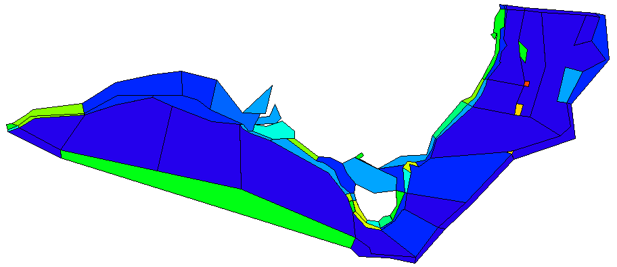
Atlantis SE - Geophysical
Bottom types (rough, flat, soft)
Canyons

Slide 6
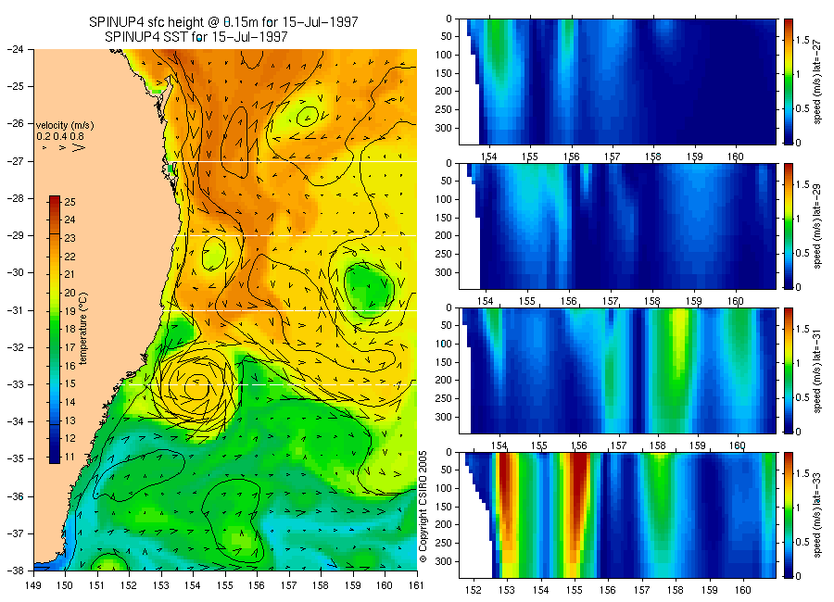
Atlantis SE - Bluelink
Currents
  horizontal
  vertical
Temperature
Salinity
Eddies

Slide 7
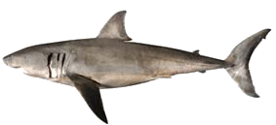
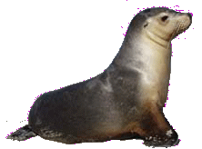
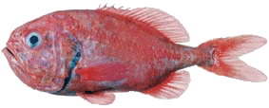


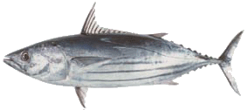
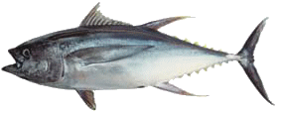

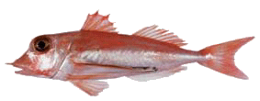

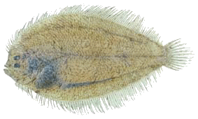
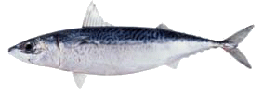
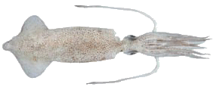
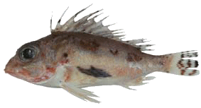
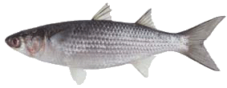

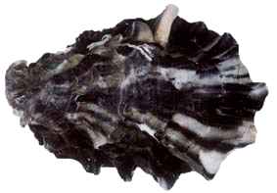
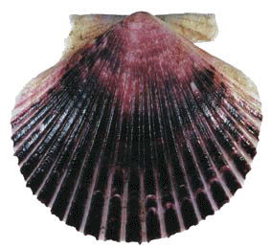
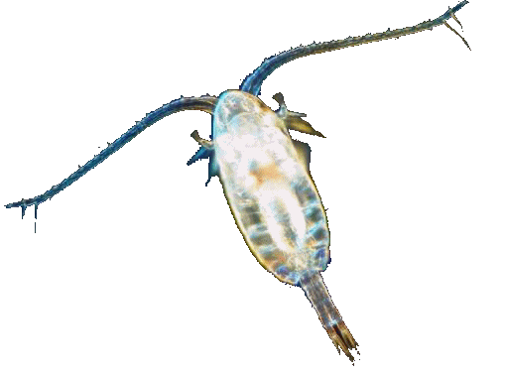

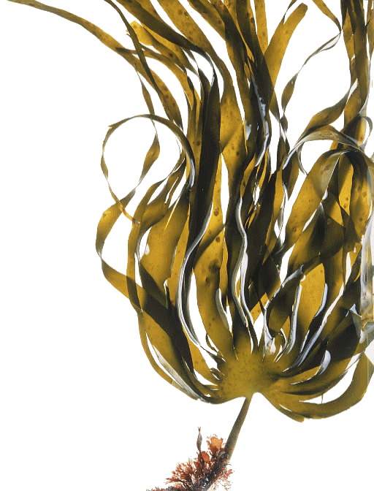
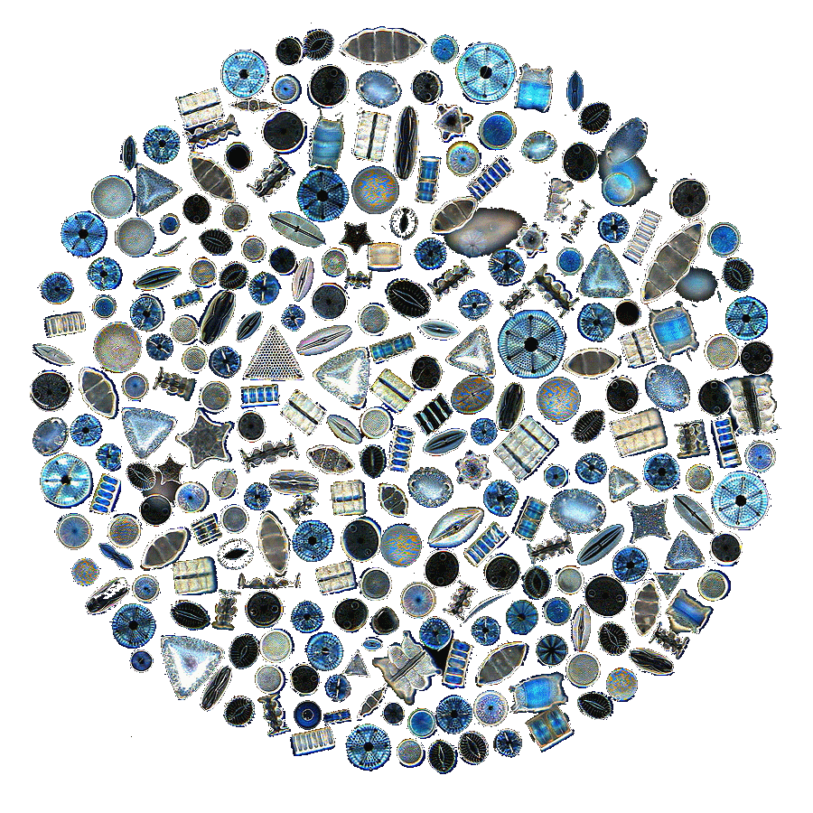
Atlantis SE - Ecological
Multiple options for major processes (e.g. feeding, movement, reproduction)
Notes:
Biological components
Differential equations
Major processes
Major groups (defined by user at start but generally cover size and guild structured representation of entire foodweb, pelagic and demersal from bacteria and phytoplankton up to top predators
Most invertebrates = aggregate pools, but vertebrates (and some inverts) have age structure so can catch ontogenetic change in behaviour and pressures

Slide 8
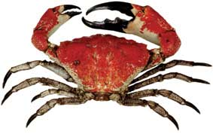
Atlantis SE - Invertebrates
2 phytoplankton
3 zooplankton
Jellies
Squid
Bacteria (pelagic, demersal)
Meiobenthos
Infauna
Deposit feeders
Filter feeders
Scallops
Grazers
Megazoobenthos
21 Invertebrates
Lobsters
Giant crab
Prawns
Seagrass
Macroalgae
Notes:
Human’s have used the oceans for thousands of years:
critical in cultural development
food – from algae to whales
materials – from corals and mangroves to salt and shells
transport – for trade, exploration and conquest
Recreation
inspiration (literature, art etc)

Slide 9
Atlantis SE - Vertebrates
Small pelagics
Red bait
Mackerel
Migratory mesopelagics
Non-migratory mesopelagics
School whiting
Shallow water piscivores
Blue warehou
Spotted warehou
Tuna and billfish
Gemfish
Shallow water demersal fish
Flathead
Redfish
Morwong
Ling
Blue grenadier
Blue-eye trevalla
Ribaldo
Orange roughy
Dories and oreos
Cardinalfish
Gummy shark
School shark
Demersal sharks
Pelagic sharks
Dogfish
Gulper sharks
Skates and rays
Seabirds
Seals
Sea lion
32 Vertebrates
Dolphins
Orcas
Baleen whales
Some species have multiple stocks
Notes:
Human’s have used the oceans for thousands of years:
critical in cultural development
food – from algae to whales
materials – from corals and mangroves to salt and shells
transport – for trade, exploration and conquest
Recreation
inspiration (literature, art etc)

Slide 10
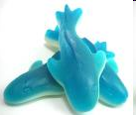
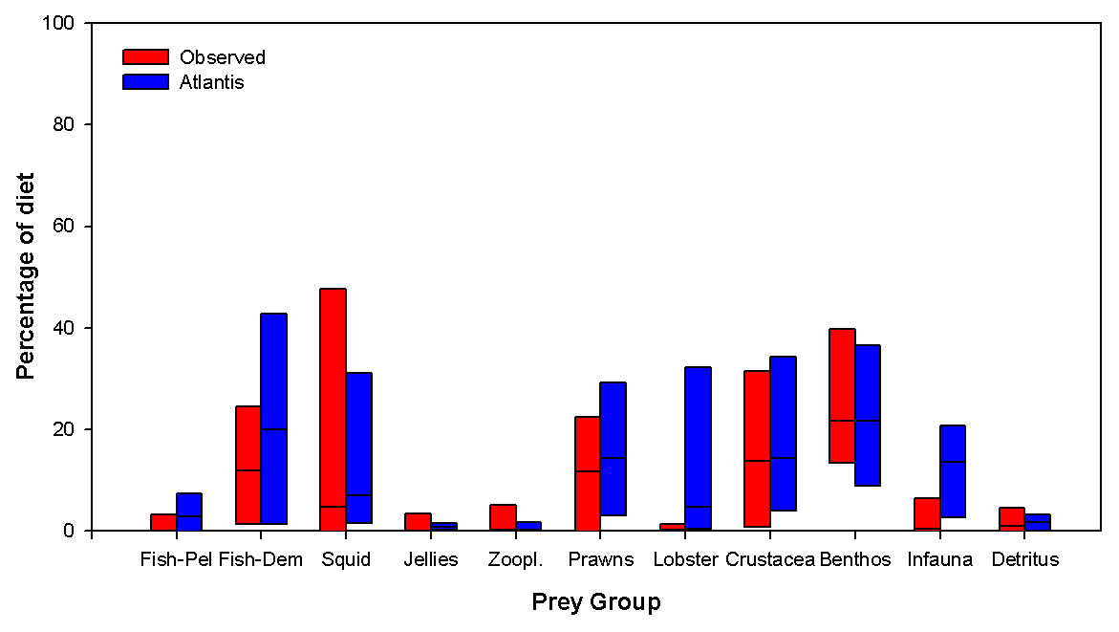
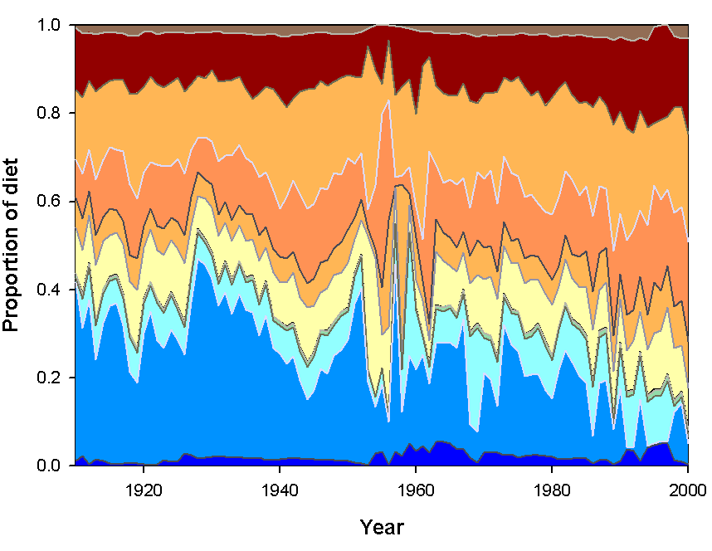
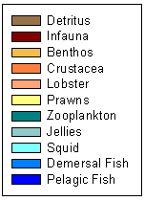
Atlantis SE – Diets
Ontogenetic shifts
Flexible in space and time
Example: gummy sharks
Notes:
Human’s have used the oceans for thousands of years:
critical in cultural development
food – from algae to whales
materials – from corals and mangroves to salt and shells
transport – for trade, exploration and conquest
Recreation
inspiration (literature, art etc)

Slide 11
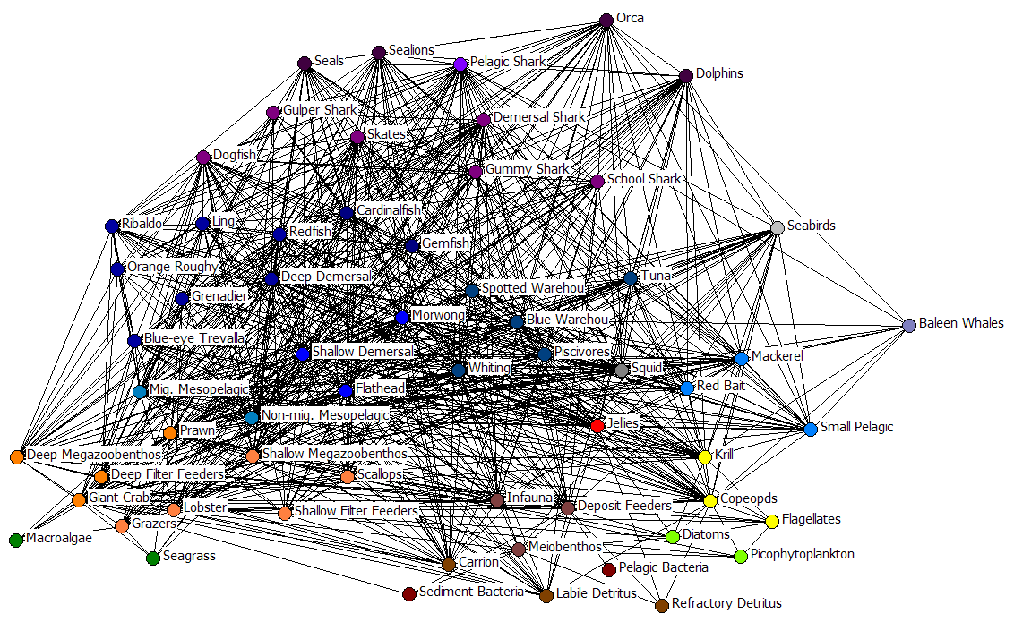
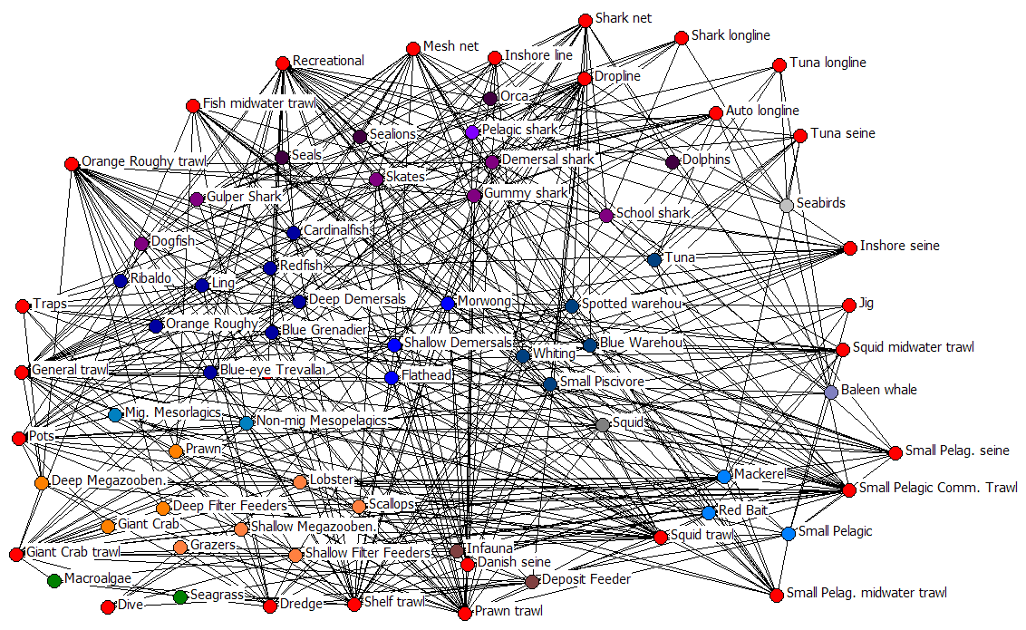
Atlantis SE – Webs
Notes:
Full MSEs still underway (though early results are getting positive responses from people like Mark Mangel who has had a look at the California current prototype)
Biggest use to date has been the ecological indicator work (results given here)
Need a suite of indicators which cover the types of groups listed here

Slide 12
Management Strategy Evaluation
Observations
Monitoring and Indicators
Observations
Ecology
and
1 yr
cycle
Assessments and
Fishing
1 year
Assessments and
1 year
cycle
Parameter
cycle
Parameter
Estimation
Estimation
Implementation
Management policies:
quotas, MPAs, nutrient and toxin reduction
Notes:
The main use of Atlantis is as a simulator, to test alternate ways of monitoring, assessing, or managing a marine ecosystem. We use the concept of Management Strategy Evaluation, which uses Atlantis as a ‘flight simulator’; we run it on annual incremements, applying some combination of monitoring/assessment/managment, and repeat this over many simulated years. We can evaluate how well our monitoring nad assessment and management perform relative to some objectives; we can try alternate scenarios for the ecology and fishing, such as scenarios with or without climate change.

Slide 13

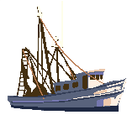
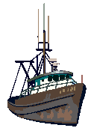
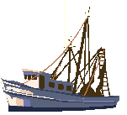
Atlantis SE - Sectors
river or major inputs ports currents
Non-fishing (nutrient/pollutants, global climate, habitat degradation)
Fishing (multiple fleets, gears, management rules)

Slide 14
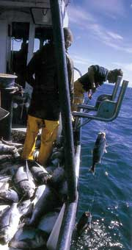
Atlantis SE - Fleets
Dive
Fin-fish auto-longline
Fin-fish drop line
Fin-fish mesh net
Fin-fish trap
Inshore line
Pots
Recreational
Scallop dredge
Shark net
Shark longline
Small pelagic state fisheries
Small pelagic Commonwealth fishery
Small pelagic purse seine
Squid jig
Tuna longline
SESSF dynamic
(rest forced)
Tuna purse seine
Trawl
  state, SET, GABT splits
  Cephalopod trawl
  Crustacean trawl
  Prawn trawl
  Fin-fish midwater trawl
  Squid midwater trawl
  Danish seine
  General demersal (slope) trawl
  Shelf demersal trawl
  Orange roughy trawl
Notes:
Human’s have used the oceans for thousands of years:
critical in cultural development
food – from algae to whales
materials – from corals and mangroves to salt and shells
transport – for trade, exploration and conquest
Recreation
inspiration (literature, art etc)

Slide 15
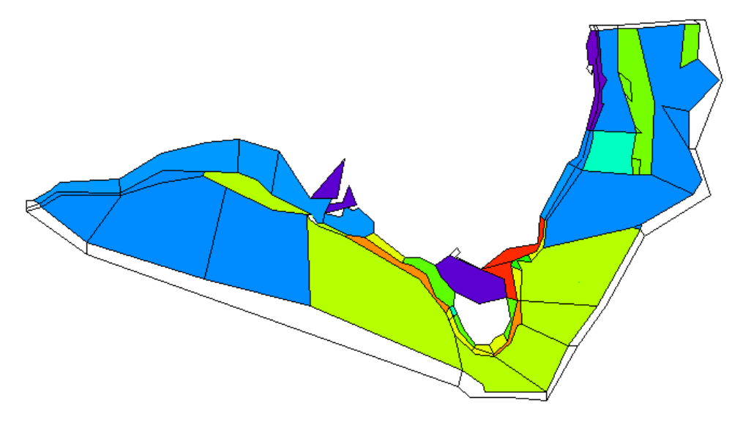
Fishing footprint – Longline fleet

Slide 16
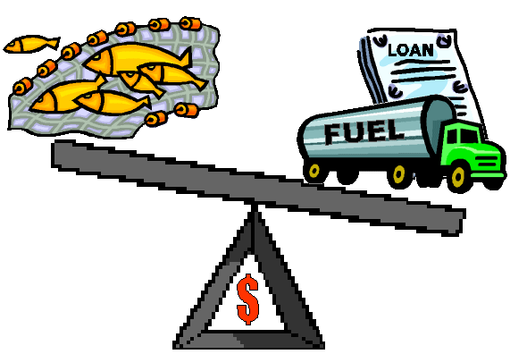
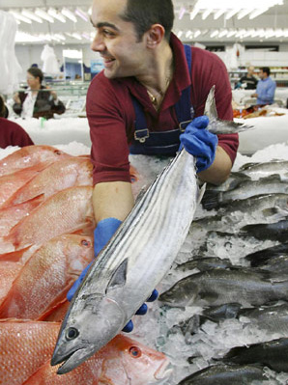
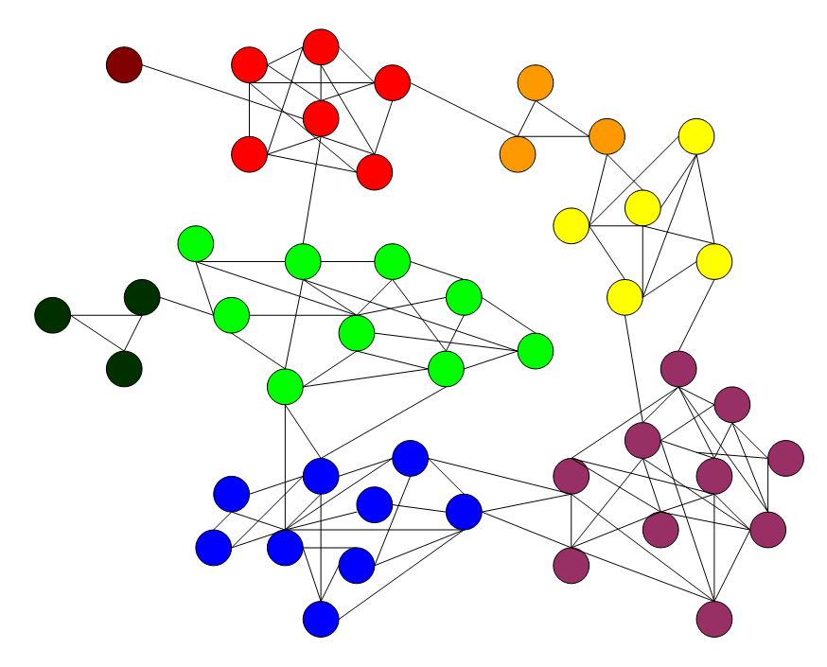
Atlantis SE - Socioeconomics
Effort allocation (by subfleet)
  Economic drivers
  Social drivers (in development)
Behavioural uncertainty
Notes:
Full MSEs still underway (though early results are getting positive responses from people like Mark Mangel who has had a look at the California current prototype)
Biggest use to date has been the ecological indicator work (results given here)
Need a suite of indicators which cover the types of groups listed here

Slide 17
Atlantis SE - Fishing Decisions
Tiered planning and effort allocation (annual, monthly, weekly)
Two markets
Multiple cost sources (fixed, variable, crew, gear, fuel)
Quota trading
Investment and disinvestment
Social and economic indicators
Costs of management (across compliance, research, infrastructure, monitoring)
  recovered costs
  per sector
Notes:
Full MSEs still underway (though early results are getting positive responses from people like Mark Mangel who has had a look at the California current prototype)
Biggest use to date has been the ecological indicator work (results given here)
Need a suite of indicators which cover the types of groups listed here

Slide 18
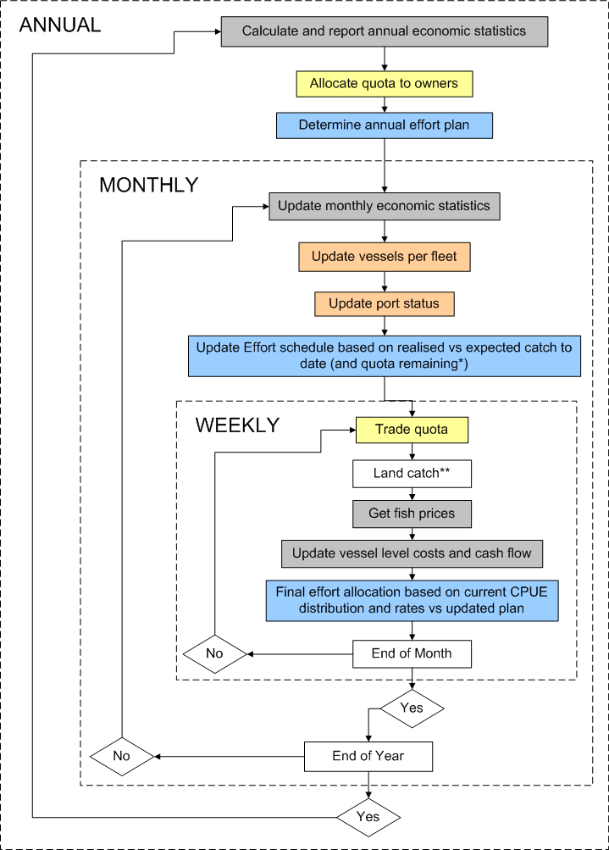
Atlantis SE - Fishing Decisions
Notes:
Full MSEs still underway (though early results are getting positive responses from people like Mark Mangel who has had a look at the California current prototype)
Biggest use to date has been the ecological indicator work (results given here)
Need a suite of indicators which cover the types of groups listed here

Slide 19
Management Strategy Evaluation
Observations
Monitoring and Indicators
Observations
Ecology
and
1 yr
cycle
Assessments and
Fishing
1 year
Assessments and
1 year
cycle
Parameter
cycle
Parameter
Estimation
Estimation
Implementation
Management policies:
quotas, MPAs, nutrient and toxin reduction
Notes:
The main use of Atlantis is as a simulator, to test alternate ways of monitoring, assessing, or managing a marine ecosystem. We use the concept of Management Strategy Evaluation, which uses Atlantis as a ‘flight simulator’; we run it on annual incremements, applying some combination of monitoring/assessment/managment, and repeat this over many simulated years. We can evaluate how well our monitoring nad assessment and management perform relative to some objectives; we can try alternate scenarios for the ecology and fishing, such as scenarios with or without climate change.

Slide 20


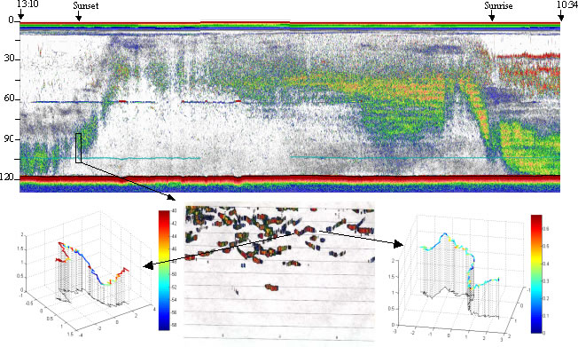
Atlantis SE – Reporting/Monitoring
Industry dependent reporting
  onboard observers
Fisheries independent data possible
  show costs and benefits of monitoring
Includes observation error
Notes:
Observation model includes fisheries records + option for independent surveys
Replicates data patchiness/error/design problems
Assessment models = range of ones typically used from simple trend analysis to highly sophisticated (complicated) assessment methods
- Also includes the calculation of ecological indicators (if want to think about what real EBFM might entail)

Slide 21
Management Strategy Evaluation
Observations
Monitoring and Indicators
Observations
Ecology
and
1 yr
cycle
Assessments and
Fishing
1 year
Assessments and
1 year
cycle
Parameter
cycle
Parameter
Estimation
Estimation
Implementation
Management policies:
quotas, MPAs, nutrient and toxin reduction
Notes:
The main use of Atlantis is as a simulator, to test alternate ways of monitoring, assessing, or managing a marine ecosystem. We use the concept of Management Strategy Evaluation, which uses Atlantis as a ‘flight simulator’; we run it on annual incremements, applying some combination of monitoring/assessment/managment, and repeat this over many simulated years. We can evaluate how well our monitoring nad assessment and management perform relative to some objectives; we can try alternate scenarios for the ecology and fishing, such as scenarios with or without climate change.

Slide 22
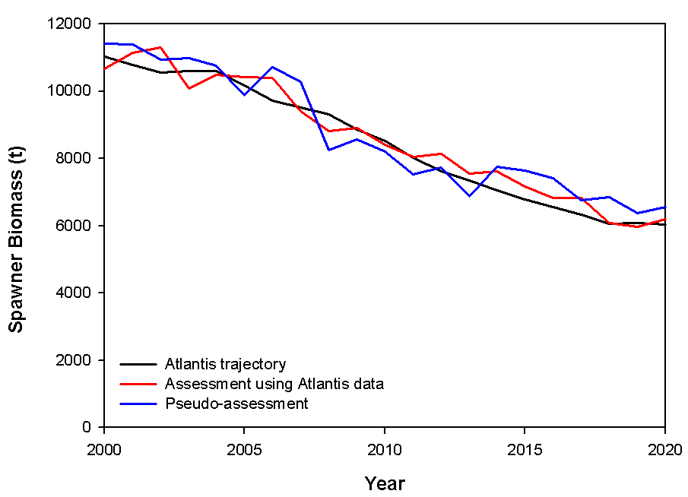
Atlantis SE - Assessment
One option: Simulate implementation of actual assessment models (catch curves, surplus production, VPA, integrated)
  Check robustness of system to assessment pitfalls.
This study instead used assessment ‘mimics’
  Computational time saver
Notes:
Observation model includes fisheries records + option for independent surveys
Replicates data patchiness/error/design problems
Assessment models = range of ones typically used from simple trend analysis to highly sophisticated (complicated) assessment methods
- Also includes the calculation of ecological indicators (if want to think about what real EBFM might entail)

Slide 23
Management Strategy Evaluation
Observations
Monitoring and Indicators
Observations
Ecology
and
1 yr
cycle
Assessments and
Fishing
1 year
Assessments and
1 year
cycle
Parameter
cycle
Parameter
Estimation
Estimation
Implementation
Management policies:
quotas, MPAs, nutrient and toxin reduction
Notes:
The main use of Atlantis is as a simulator, to test alternate ways of monitoring, assessing, or managing a marine ecosystem. We use the concept of Management Strategy Evaluation, which uses Atlantis as a ‘flight simulator’; we run it on annual incremements, applying some combination of monitoring/assessment/managment, and repeat this over many simulated years. We can evaluate how well our monitoring nad assessment and management perform relative to some objectives; we can try alternate scenarios for the ecology and fishing, such as scenarios with or without climate change.

Slide 24

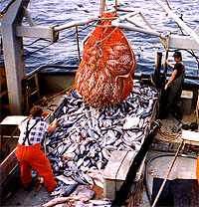
Atlantis SE – Management Levers
Quotas (overall, stock-based, regional, basket, companion, bi-monthly)
Spatial zoning (per sector through to closures, rolling)
Gear (size, selectivity, access to habitat types)
Swept area (or soak time)
Seasons
Discarding rules (BRD, size, per species, per area, limits)
Bag limits
Trip limits
Effort limits (days-at-sea)
Compliance
Notes:
Has all major management levers
Explicitly considers compliance issues (through expanding socio-economics submodels or simple scenario sketching depending on how deeply you want to think about it – this range of options is true of all submodels)

Slide 25
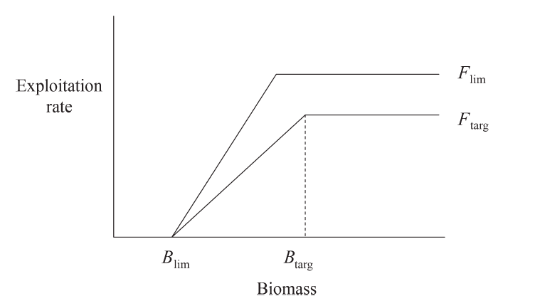
Atlantis SE – Decision Rules
Political process (with delays)
Harvest strategies (current rule: 40/20, F₄₈)
Tradeoffs (quota vs spatial management)
Smith et al. 2007. ICES J. Marine Sci., 64: 633–639.
Notes:
Has all major management levers
Explicitly considers compliance issues (through expanding socio-economics submodels or simple scenario sketching depending on how deeply you want to think about it – this range of options is true of all submodels)

Slide 26
Atlantis SE – Model Purpose
Management strategy evaluation (MSE), detailing actions of industry and management
  identify various alternative options
  highlight tradeoffs
  seek cost effective management
Observations
Monitoring and Indicators
Ecology
and
1 yr
Assessments and
1 year
Assessments
1 year
cycle
Parameter
Fishing
cycle
Implementation
Management policies
Notes:
Human’s have used the oceans for thousands of years:
critical in cultural development
food – from algae to whales
materials – from corals and mangroves to salt and shells
transport – for trade, exploration and conquest
Recreation
inspiration (literature, art etc)

Slide 27
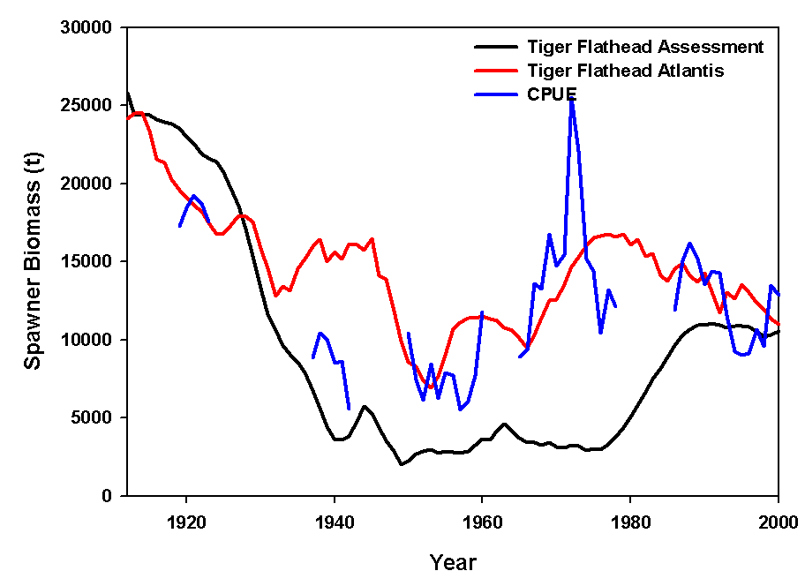
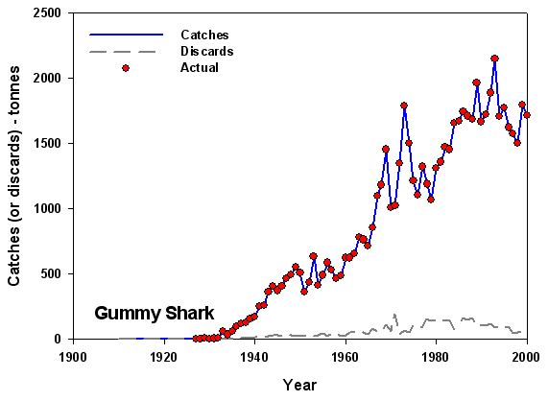
Atlantis SE - Historical Fitting
Stable system with no fishing (mammals increasing)
Forced historical catch (check can survive history)
Notes:
Human’s have used the oceans for thousands of years:
critical in cultural development
food – from algae to whales
materials – from corals and mangroves to salt and shells
transport – for trade, exploration and conquest
Recreation
inspiration (literature, art etc)

Slide 28
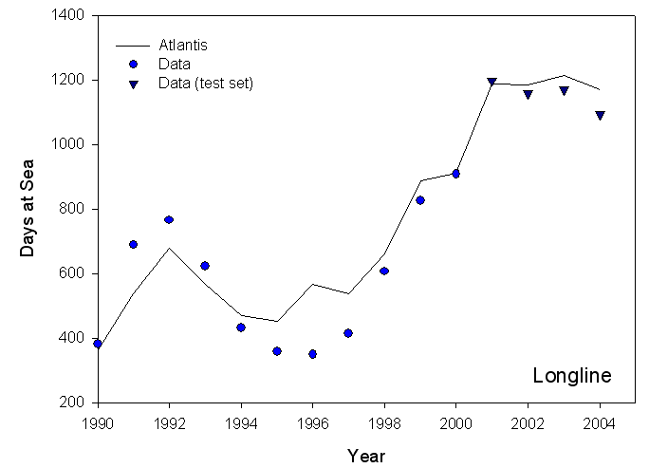
Atlantis SE - Dynamic Fitting
Training and test set
  general trends ok
  individual humans = HARD to predict
  aggregate behaviour predictable
Notes:
Human’s have used the oceans for thousands of years:
critical in cultural development
food – from algae to whales
materials – from corals and mangroves to salt and shells
transport – for trade, exploration and conquest
Recreation
inspiration (literature, art etc)

Slide 29
1910
pelagic sharks
toothed whales
demersal fish
pelagic fish
demersal sharks
birds
baleen whales
squid
small pelagics
zoobenthos
filter feeders
zooplankton
jellies
infauna
detritus
macrophytes
phytoplankton
Notes:
Process based (differential equations)
- movement, feeding, growth, reproduction, mortality, waste, nutrient regeneration (various representations)
- alternative representations of each (mix-n-match, evaluate model uncertainty)
- Functional groups and species of concern / interest
- Invertebrate (size and diet structured biomass pools)
- Vertebrate (condition of average individuals, age structured)
- Age-dependent changes (ontogenetic shifts)
“Polish” – Environmental forcing, multiple stocks
First up its good to have confidence in the plausibility of model behaviour when using it as a testbed.
Work as part of my Phd showed that Atlantis does reflect the dynamics of real ecosystems, but to give you an example…
This is the unfished foodweb for the southern shelf part of the big continental shelf ecosystem model
- Its too complicated with everything shown, so I’ve only shown the shelf parts from the southern section of the model and I’ve only shown the major flows
- bit over “rock” = benthic (rest = pelagic)
- rectangular boxes = invertebrates and detritus
- polygons are vertebrates showing relative proportion of group made up of juvenile and adults
- green = photosynthetic
- purple = bacteria
- grey = detritus
- yellow = zooplankton
- aqua = gelatinous zooplankton
- orange = benthos (light = infauna, dark = epifauna)
- black = cephalopds
- light blue = planktivores
- medium blue = piscivores
- deep blue = demersal fish
- red = sharks and rays
- pink = birds and mammals

Slide 30
1910

Slide 31
2000

Slide 33
Scenarios
Status quo (quota management & not that effective)
Quotas on everything of value
Integrated management (zoning; gear restrictions; quotas)
Conservation driven (open paddocks, closed world)
Pragmatic reality

Slide 34
Scenario Summary
  Status Quo 2000/2003 - effort high, longer trips, push into marginal areas until economic collapse; shift in targeting to extreme trophic levels, system and public opinion collapses
  Quota on Everything - effort high until fleet adjust (economically driven); fewer longer trips; deepwater unprofitable so shift to shelf; overcatch and discarding issues; shift to non-quota species (e.g. squid); trawl benefits most, high management costs

Slide 35
Scenario Summary
  Integrated Management – fleets readjust quickly; footprint concentrated on hot-spots; byproduct quota critical (e.g. gummy sharks); discarding issues; gear switching not common; good all-round
  NGO Defined - closures very restrictive; strong recovery; significant industry and human cost, buyback too late to matter.
  Pragmatic Reality 2006 - ban on discards has large implications (fishing grounds, constraining byproduct TAC, product quality, volume of trades); patchy success (small boats exit)

Slide 36
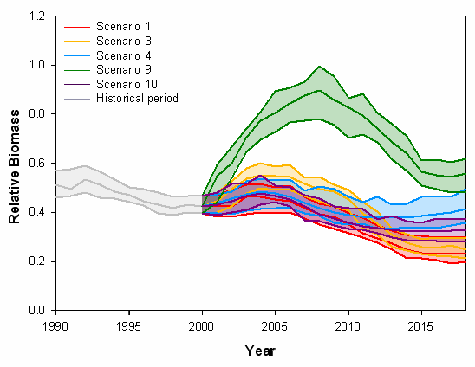
Example: Tiger flathead biomass

Slide 37
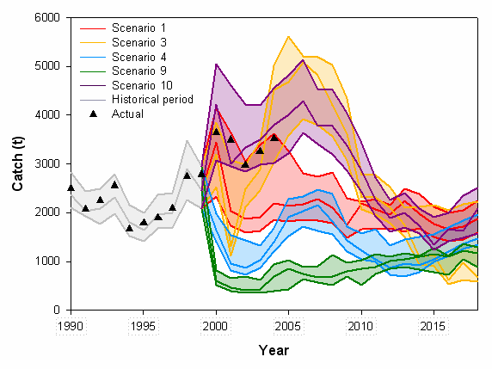
Example: Tiger flathead catch

Slide 38
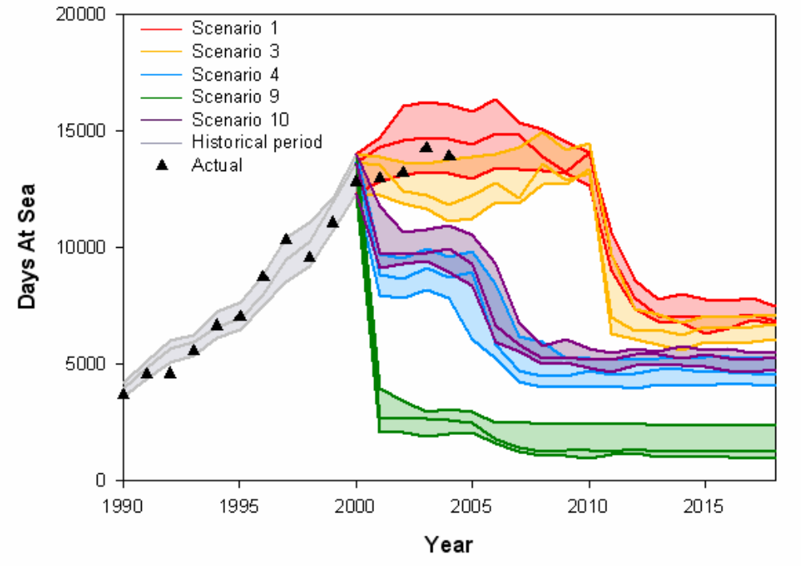
Example: Trawl effort

Slide 39
A few slides for our policy and management experts….

Slide 40
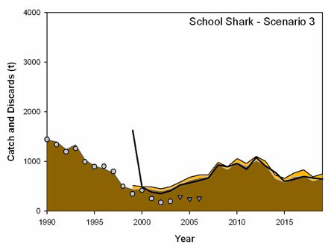
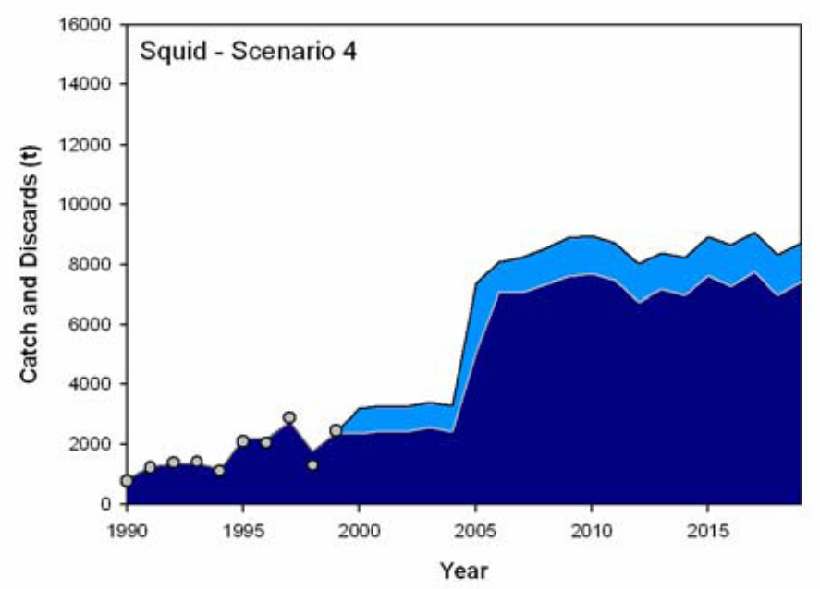
Shifts in Targeting to Squid and Sharks
Quota species ( but less restrictive quotas)
Non-quota species
Notes:
Scenarios 1 and 3 showed a lot of switching to sharks and pelagic species. This is temporary and disastrous for sharks.
For scenarios 4 and 9 there is less swtiching.
Scenario 10 shwoed some switch to small pelagics.

Slide 41
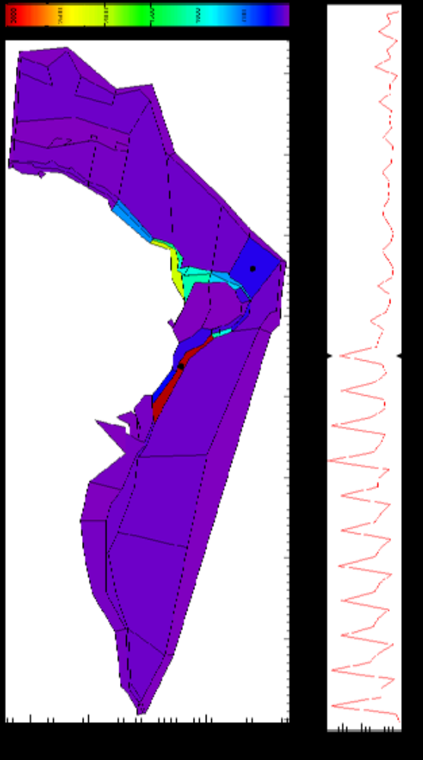

Effort, Scenario 1: Discards allowed
Effort
Effort
1990 Year 2020
Notes:
General demersal trawl effort

Slide 42


Effort, Scenario 10: Discards prohibited
Effort
Effort
1990 Year 2020

Slide 43

Monitoring and assessment costs
“Quota on everything” scenario

Slide 44

Quota trading costs
Pragmatic reality = no discards, and no fishing w/o quota

Slide 45

Gross Value of Landings– All fleets
2010: Scenario 1 and 3 fleet restructuring
NGO defined: Conservation scenario

Slide 46


Profit per day – SE trawl fishery

Slide 47
Back to the big picture…

Slide 48
Competing Objectives
Management = stability, access, trading
Management costs = overall, research, compliance, monitoring and assessment costs
Industry (non-economic facets, reflects work load and fishing pressure) = discards, habitat-impacts, total effort, CPUE, total landed catch, average size of the catch and catch composition
Economic = Gross Value of landed catch, revenue per tonne, revenue per effort, costs, profits
Social = Public image, gear conflict, port activity
Ecological = Habitat cover, pelagic:demersal biomass, piscivore:planktivore biomass, biomass of target, bycatch, TEP, microfauna and chondrichthyan biomass

Slide 49





Competing Objectives

Slide 50
Key Points
More variability between sectors & species than qualitative AMS suggested
None best over all, but integrated consistently “pretty good”
Tradeoffs
  conservation and economics
  short term costs vs long term pay-off
  as things “go bad” move shallower again

Slide 51
Key Points
Twists
  “getting around” quota system (so need integration)
  prohibiting discards changes distribution of effort
  long recovery times for some groups (gulper shark)
  multispecies (trophic etc) impacts (bigger on shelf)
  small boats = most heavily impacted (lack behavioural flexibility)

Slide 52
Usefulness
Management Strategy Evaluation
Strategic insights
  synthesise information
  identify key processes
  simulate possible ecosystem responses (e.g. climate change)
  set management reference points
NOT for tactical management
Notes:
Full MSEs still underway (though early results are getting positive responses from people like Mark Mangel who has had a look at the California current prototype)
Biggest use to date has been the ecological indicator work (results given here)
Need a suite of indicators which cover the types of groups listed here

Slide 54

Qualitative squiggle plots?
Notes:
Black = qualitativ.
Colored= Atlantis. Dashed are the range of scnearios run in Atlantis.

Slide 55

Discards and fishing without quota allowed
Model discard
True TAC
Model total allowable catch (TAC)
True catch
Model catch

Slide 56

Predicted Effort

