Slide 1


Ancillary tools
Cameron Ainsworth NWFSC-NOAA
cameron.ainsworth@noaa.gov
Atlantis training course Sept 8-10, 2009

Slide 2
Introduction
Atlantis Wiki
CSIRO SVN
Other tools

Slide 3
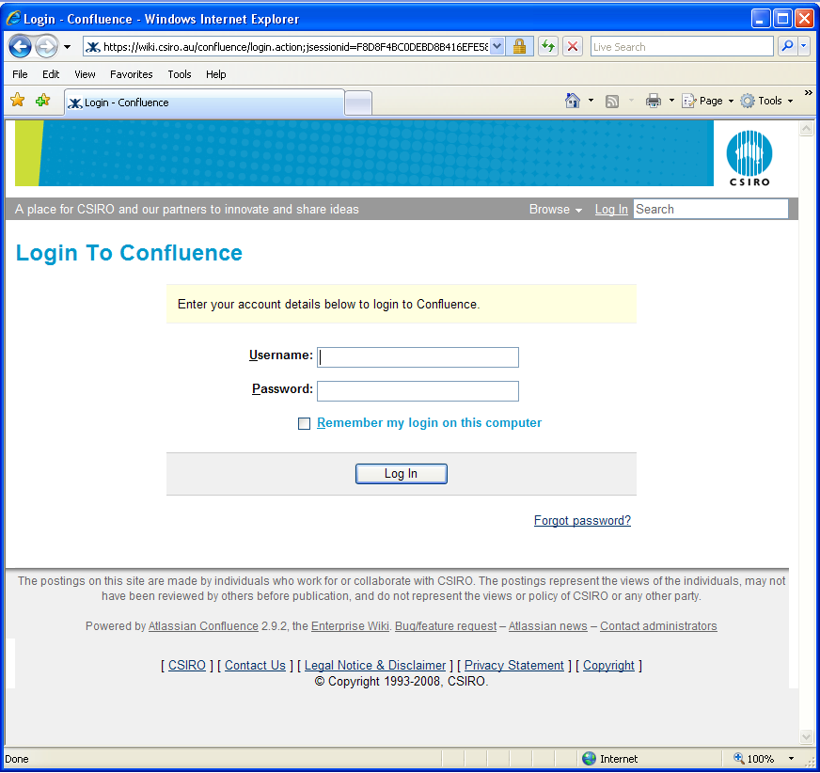
Atlantis wiki
http://atlantis.cmar.csiro.au/
Confluence
Register with Bec Gorton
(bec.Gorton@csiro.au)

Slide 4
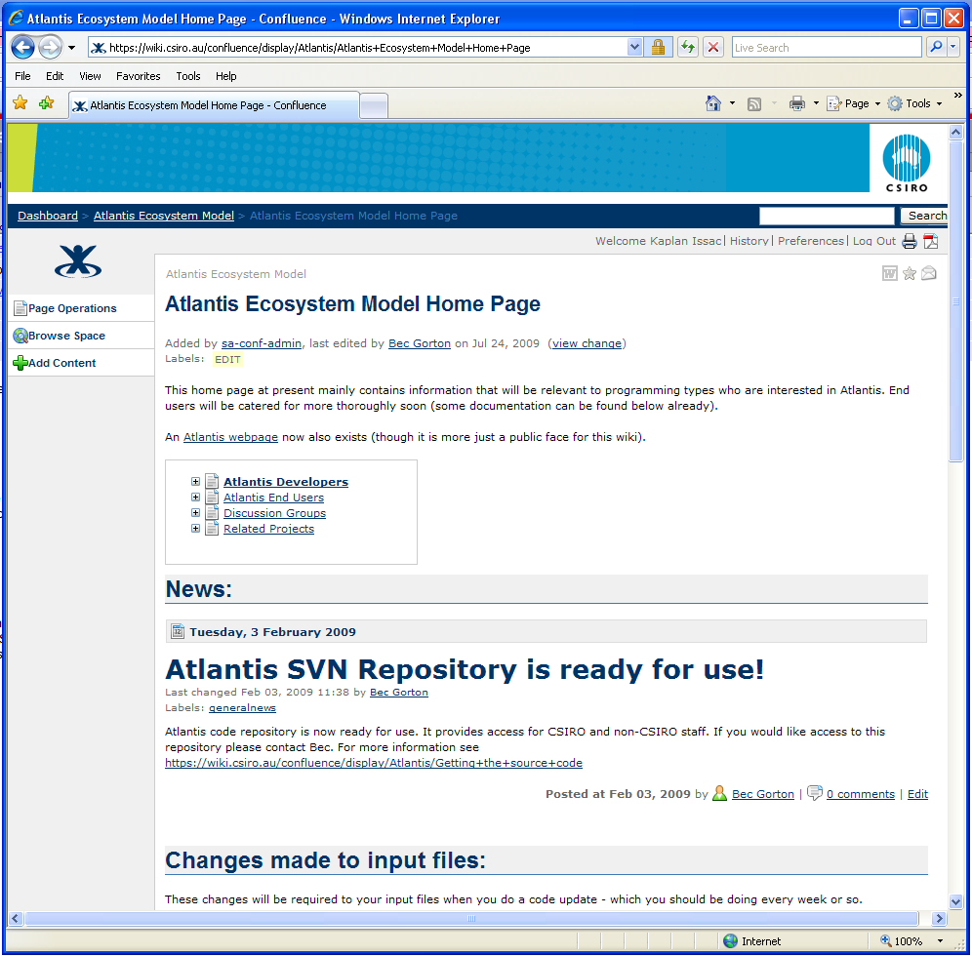
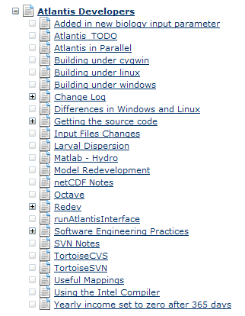
Atlantis wiki
Exciting updates
- development
- new release versions
- code sharing

Slide 5
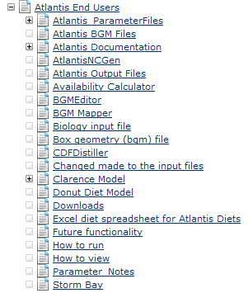
Atlantis wiki
Instructions and resources
- ancillary tools
- documentation

Slide 6
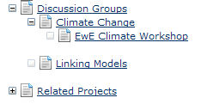
Atlantis wiki
Discussion groups
- troubleshooting
- modelling methodology
- software requests
Also, other CSIRO projects
- Invitro (IBM)
- Management strategy evaluation

Slide 7
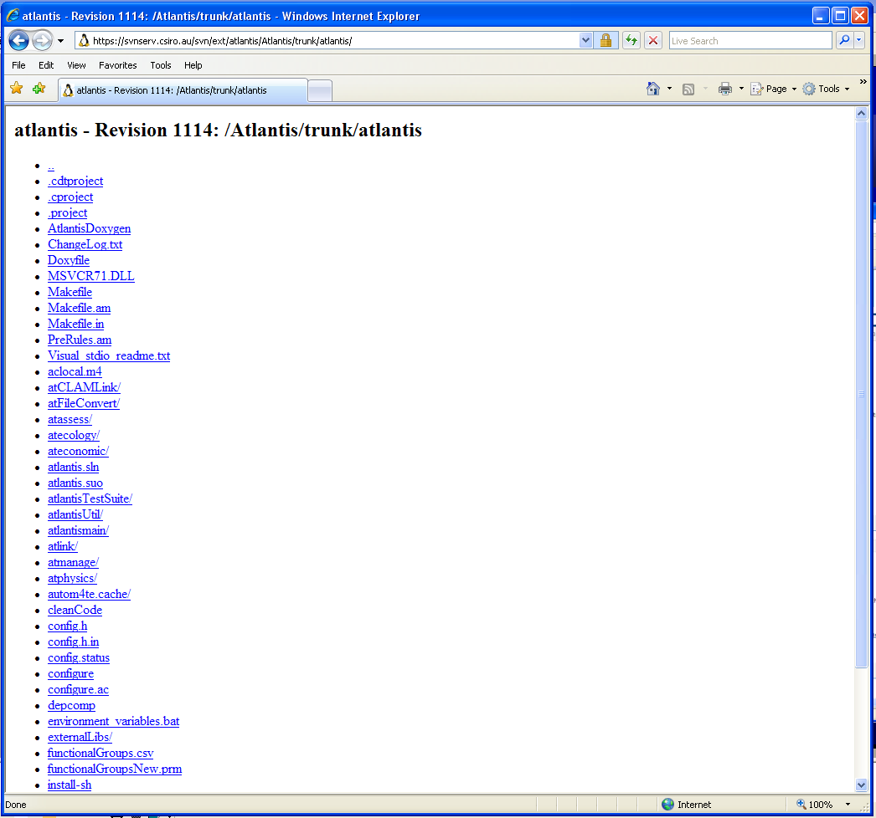
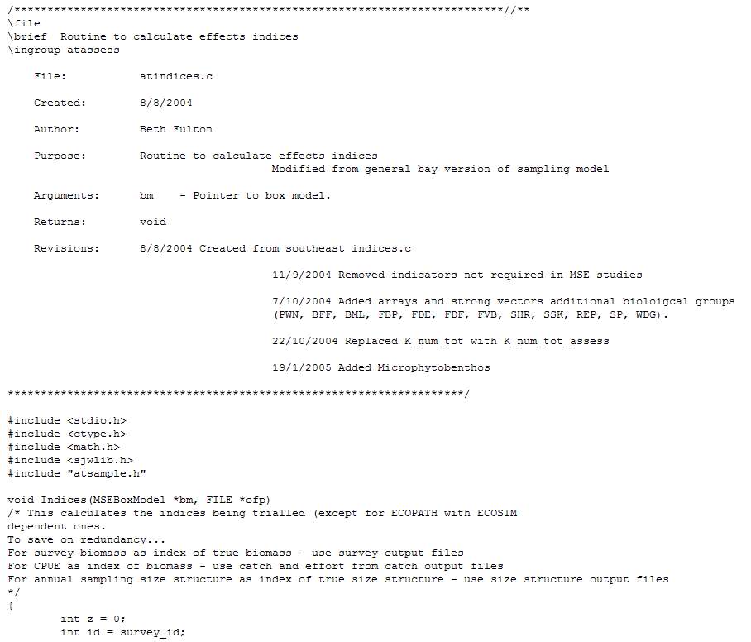
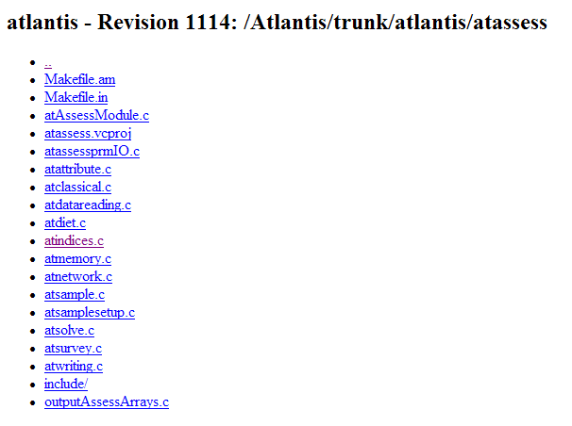
Code sharing
Code updates posted online

Slide 8
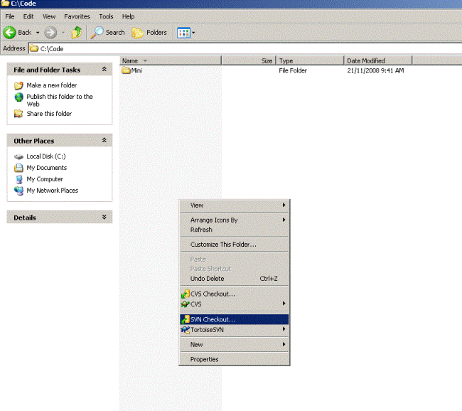

Code sharing
Sub-version control (SVN)
SVN will automatically update only the routines that have been changed
Visual Studio 6 is required to compile code
(C++)
Installing TortoiseSVN
http://tortoisesvn.tigris.org/

Slide 9
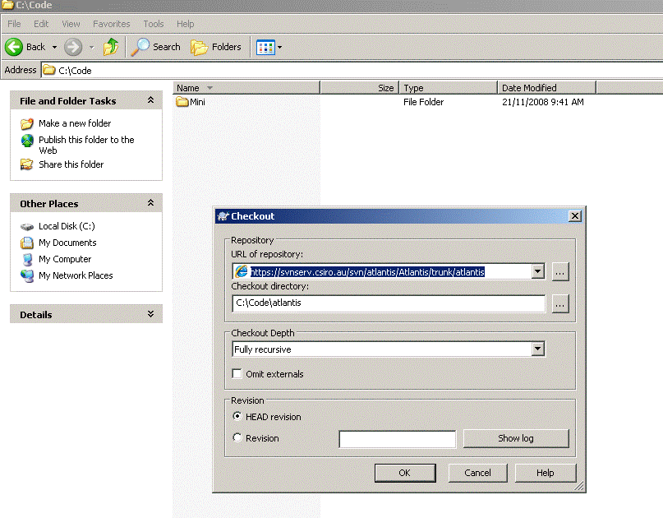
Code sharing
SVN will automatically update only the routines that have been changed

Slide 10
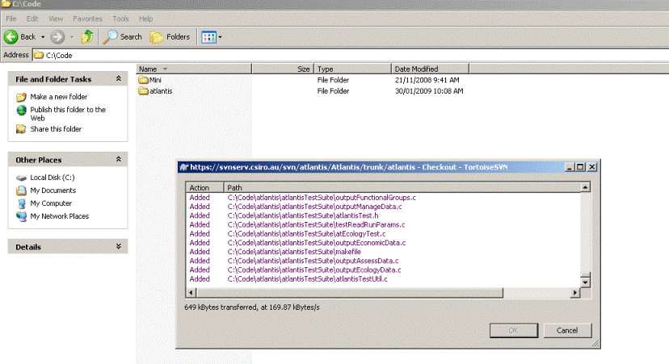
Code sharing
SVN will automatically update only the routines that have been changed

Slide 11
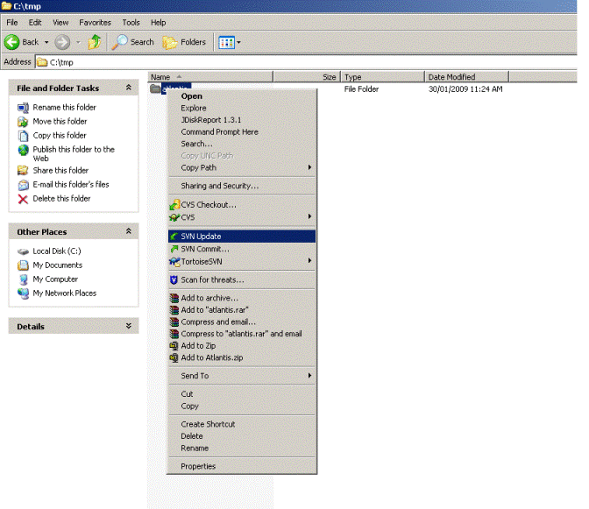
Code sharing
SVN will automatically update only the routines that have been changed
You will need Visual Studio to view / compile the code
Now one-click to update

Slide 12
Other tools available on wiki
CDF distiller
BGM editor
BGM mapper
Availability calculator
Excel diet spreadsheets
Documentation
Hydroconstruct
create new model (CDF file initialization state) from simulation end point
create new maps (BGM files) straight from ArcGIS shapefiles
display BGM data (input/output)
create availability matrix from diet compositions & other info
for building diets / gape restrictions
‘How-to’ guide, biology & physics equations
ROMS output into a .nc file read by Atlantis

