Slide 1
Calibration and Fitting to History
Can the model:
Support historical catches, without target species going extinct?
Recreate historical trends in abundance, as reported by surveys or assessments?
Respond reasonably to a variety of fishing mortality rates?

Slide 2
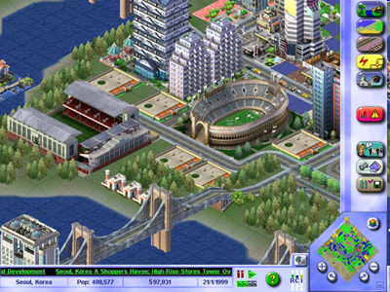
Calibration, not complete validation!
Goal is to simulate reasonable behavior of the ecosystem
Test that this reasonable behavior is consistent across a range of scenarios (historical and hypothetical fishing or climate)
Understand that the model is overparameterized –many more params than data
Evaluate uncertainty: try alternate parameterizations, structure, and scenarios

Slide 3
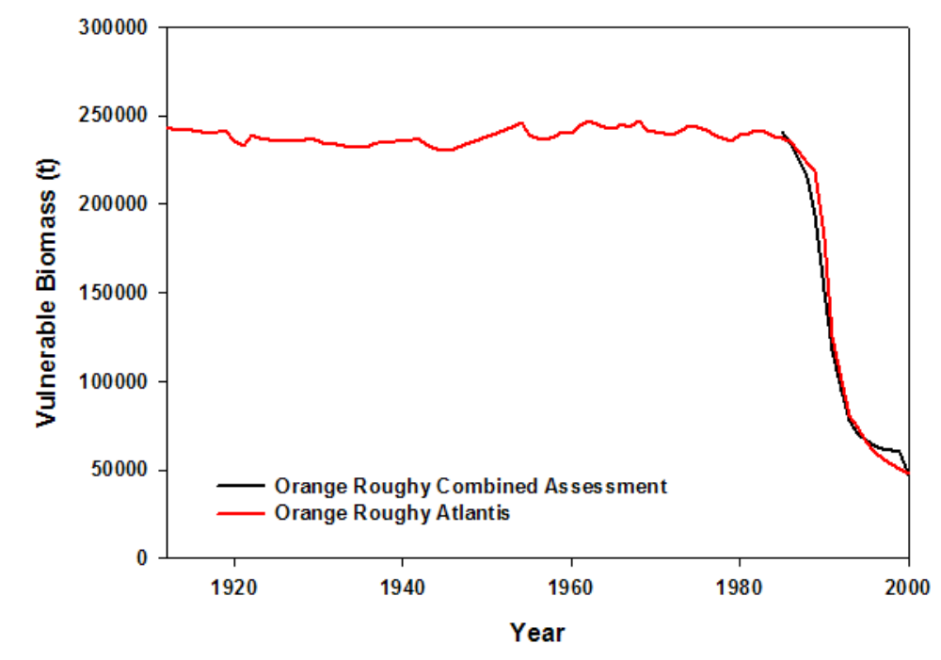
Close agreement between assessment and Atlantis
Notes:
Figure 3-47: Comparison of the historical biomass trajectories of jackass morwong predicted by a single
species assessment (Tuck and Smith 2004) and Atlantis.

Slide 4
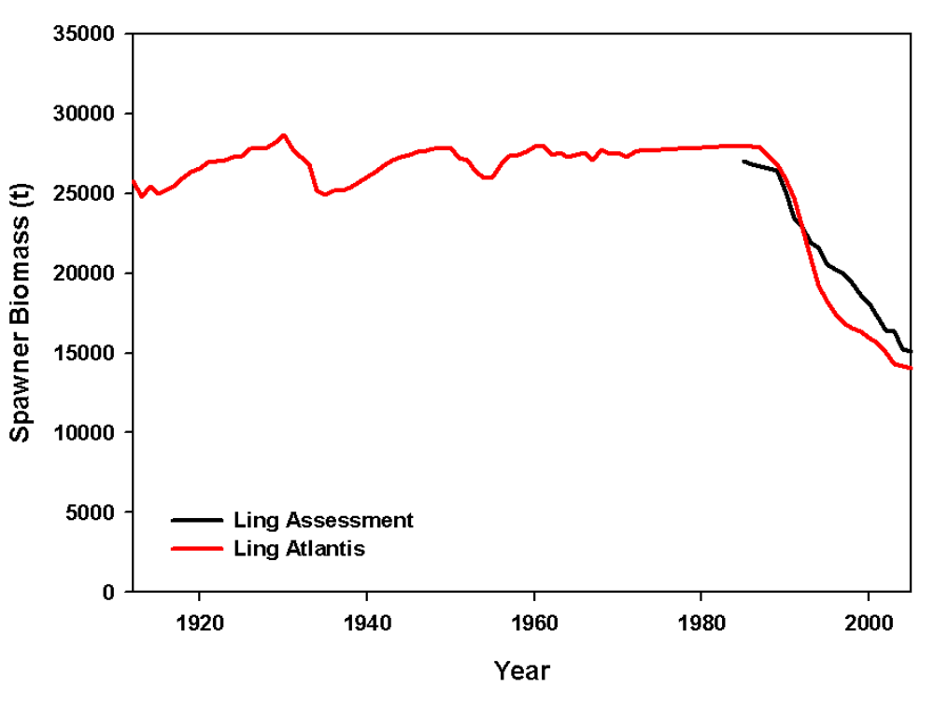
Close agreement between assessment and Atlantis
Notes:
Figure 3-47: Comparison of the historical biomass trajectories of jackass morwong predicted by a single
species assessment (Tuck and Smith 2004) and Atlantis.

Slide 5
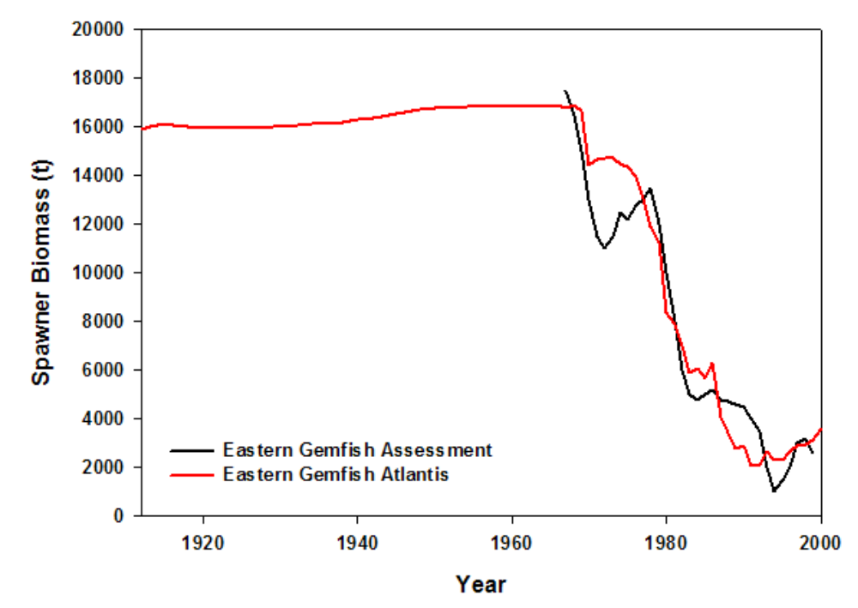
Close agreement between assessment and Atlantis
Notes:
Figure 3-47: Comparison of the historical biomass trajectories of jackass morwong predicted by a single
species assessment (Tuck and Smith 2004) and Atlantis.

Slide 6
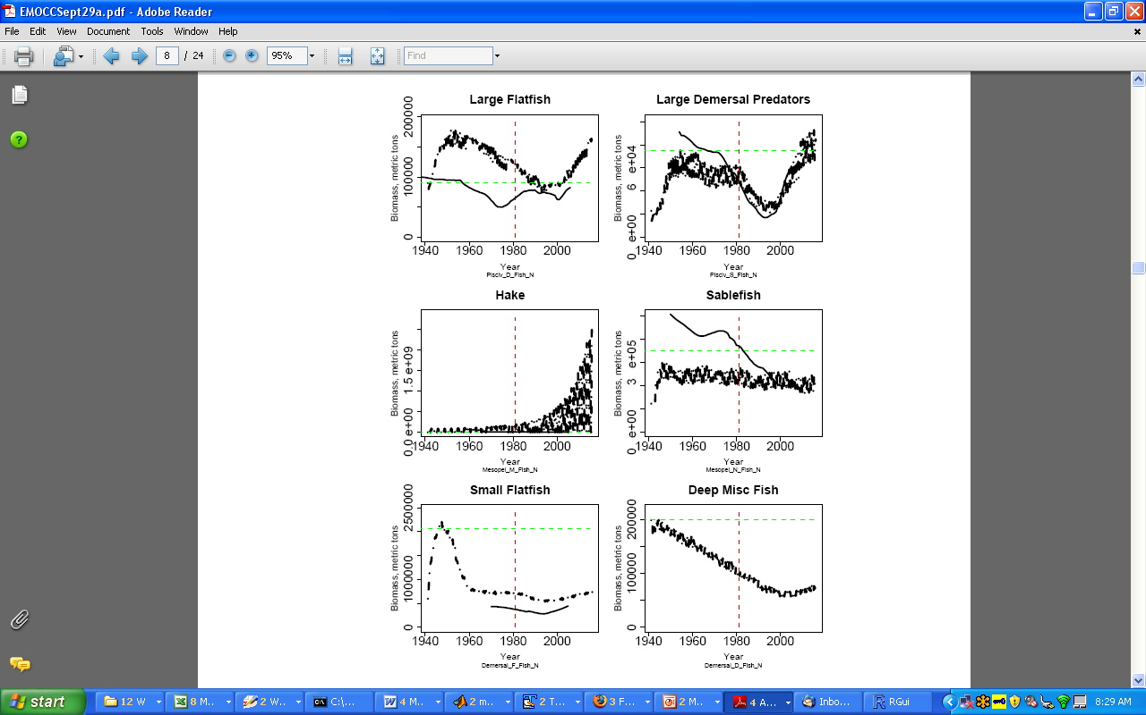
California Current
Begin hist. fishing
Bo, from assessment

Slide 7
Notes:
Figure 3-47: Comparison of the historical biomass trajectories of jackass morwong predicted by a single
species assessment (Tuck and Smith 2004) and Atlantis.

Slide 8
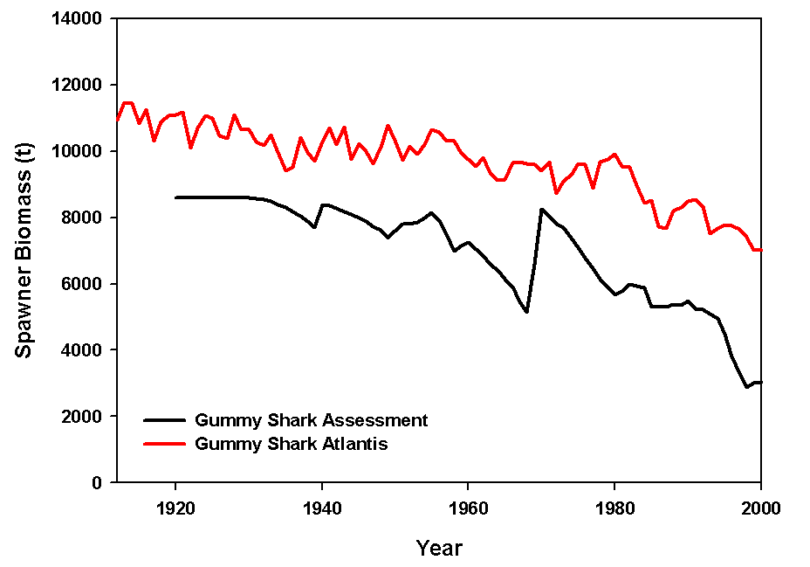
Atlantis: higher biomass is necessary to support predation + catches
Notes:
Figure 3-47: Comparison of the historical biomass trajectories of jackass morwong predicted by a single
species assessment (Tuck and Smith 2004) and Atlantis.

Slide 9
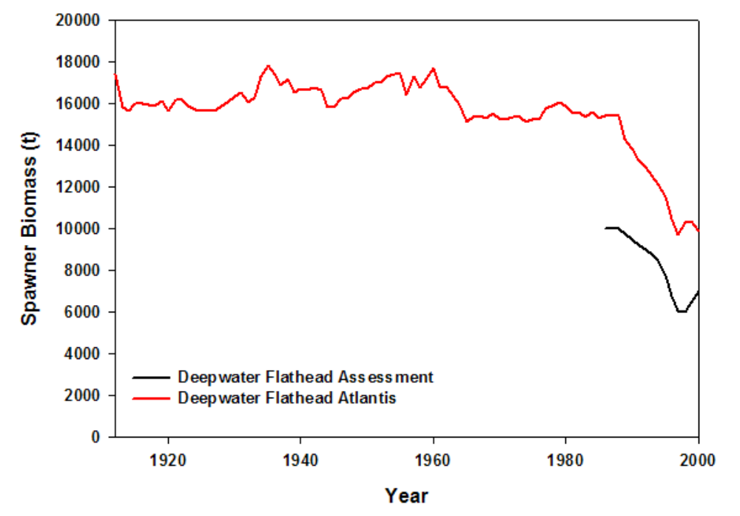
Atlantis: higher biomass is necessary to support predation + catches

Slide 10
And sometimes the assessments didn’t fit well anyway!
Notes:
Figure 3-47: Comparison of the historical biomass trajectories of jackass morwong predicted by a single
species assessment (Tuck and Smith 2004) and Atlantis.

Slide 11
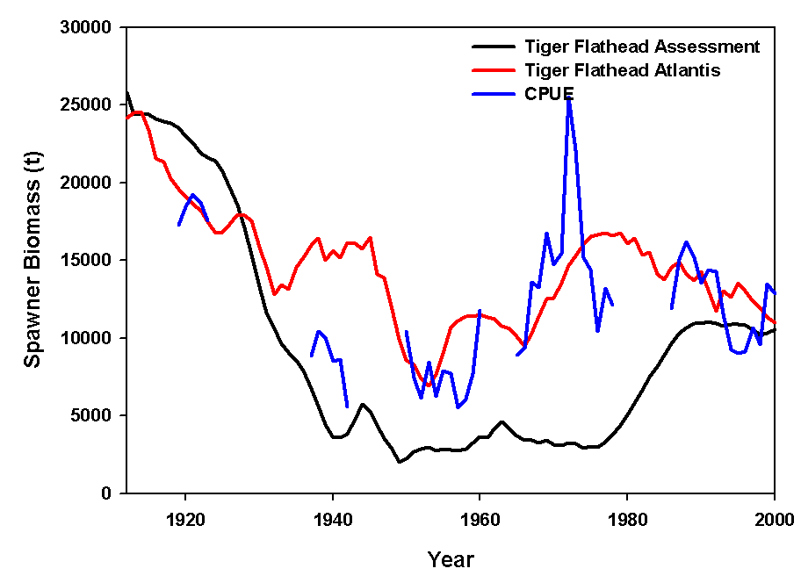

Slide 12
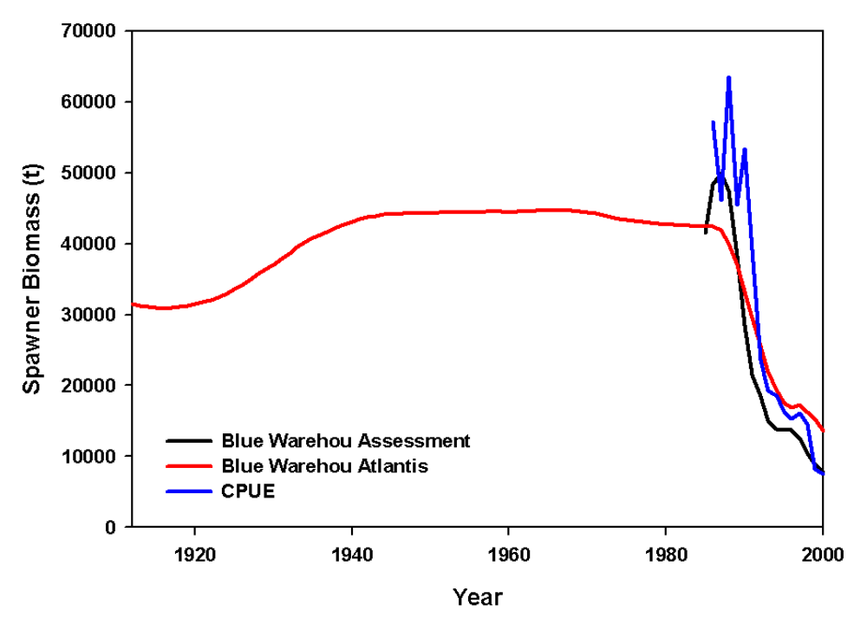

Slide 13
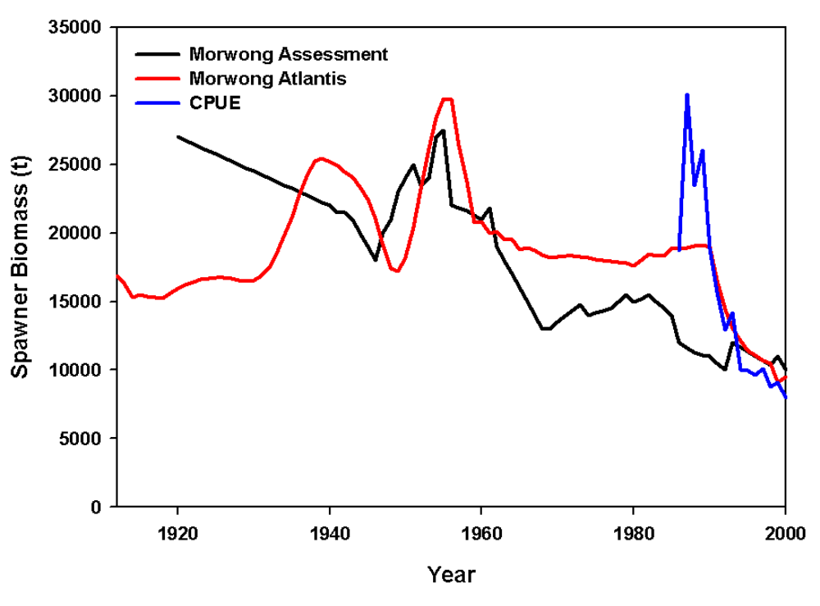
Notes:
Figure 3-47: Comparison of the historical biomass trajectories of jackass morwong predicted by a single
species assessment (Tuck and Smith 2004) and Atlantis.

Slide 14
If (when) the model fails, consider:
Are your biomass estimates reasonable? How did you derive them?
Are your catch data reasonable? Did you include discards? How did you combine data sources?
Is your biological parameterization reasonable? Are individuals growing too quickly? Is recruitment reasonable? How certain are you of your diet data?

Slide 15
Calibrating Dynamic Fisheries
Compare simulated vs. observed:
fishing effort (i.e. days at sea)
spatial distribution of effort
catch compositions

Slide 16
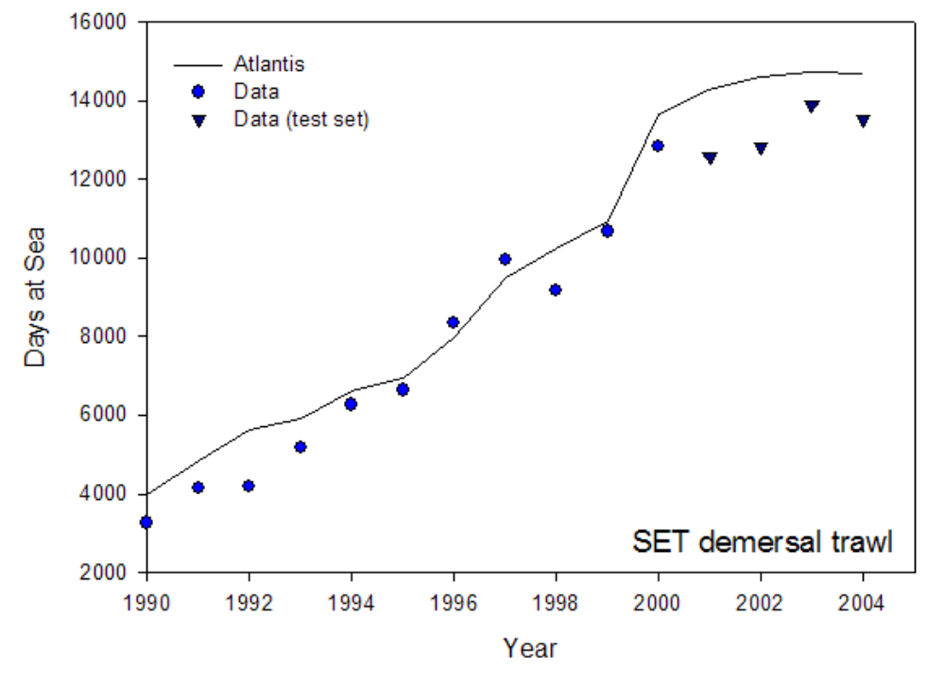
Notes:
Figure 3-47: Comparison of the historical biomass trajectories of jackass morwong predicted by a single
species assessment (Tuck and Smith 2004) and Atlantis.

Slide 17
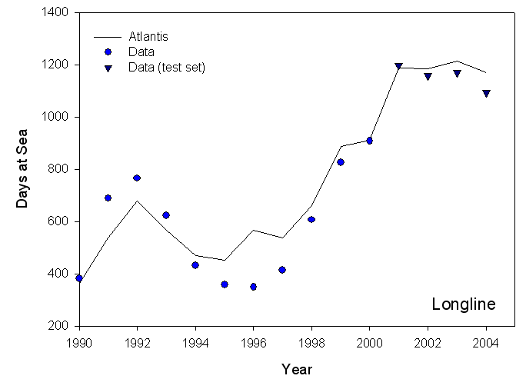
Notes:
Figure 3-47: Comparison of the historical biomass trajectories of jackass morwong predicted by a single
species assessment (Tuck and Smith 2004) and Atlantis.

Slide 18
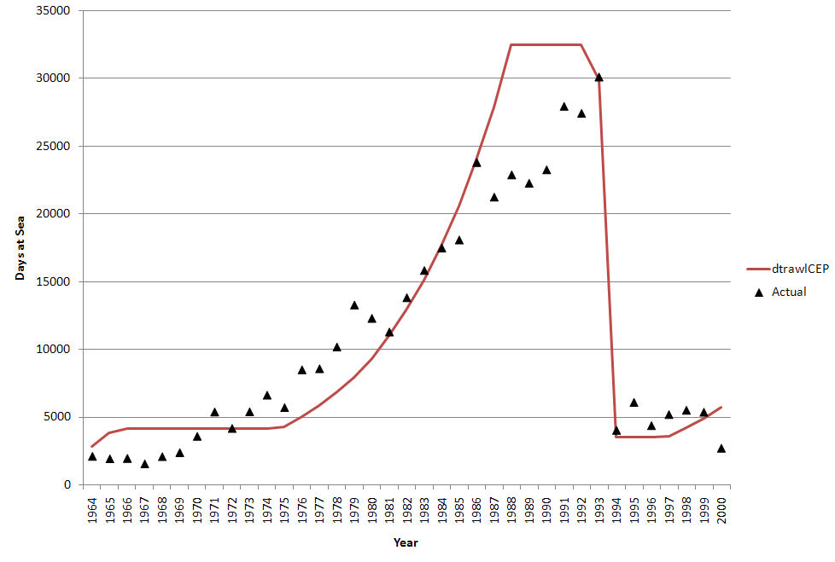
Northeast US squid trawl
Effort
1964
2000

Slide 19
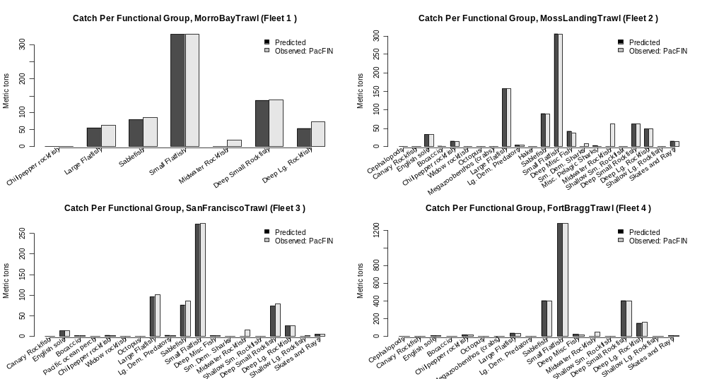
Status Quo
Atlantis catch
vs. Real World Catch

Slide 20
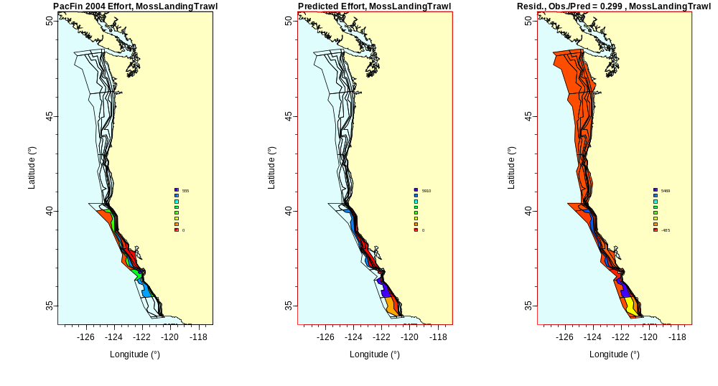

Slide 21
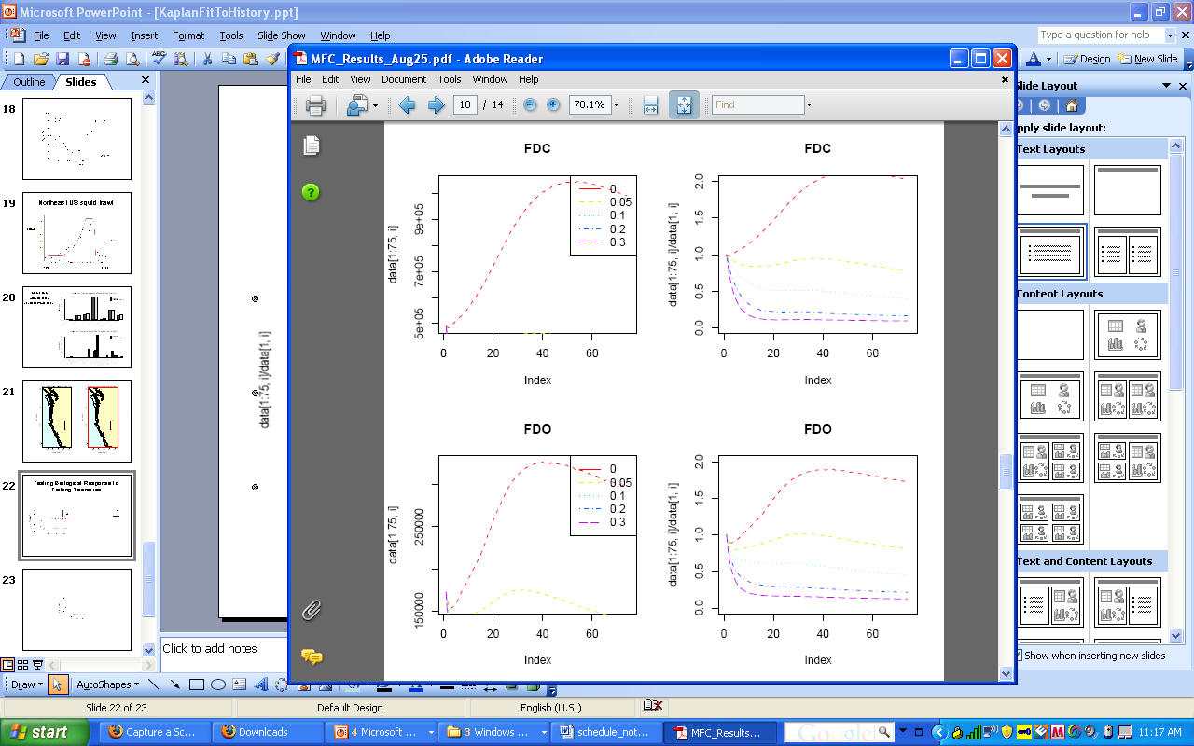
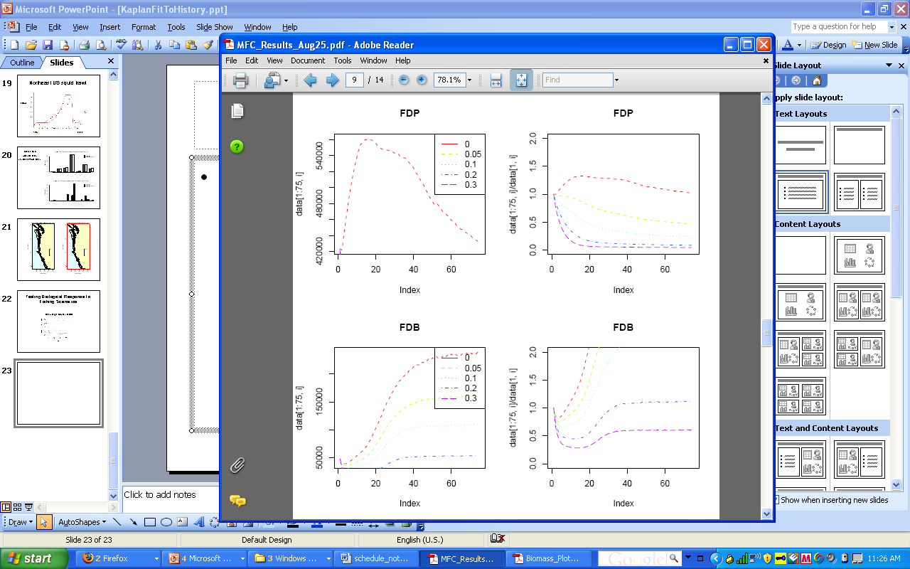
Testing Biological Response to Fishing Scenarios
Deep Large Rockfish (FDO)
Biomass / Initial Biomass
Year

