Slide 1
Running Atlantis
Wealth from Oceans Flagship
Beth Fulton

Slide 2
.bat file
atlantis -i input.nc -o Output.nc -r at_run.prm -f at_force.prm -p at_physics.prm -b at_biol.prm -h at_harvest.prm -a ams_assess.prm -e at_econ.prm -s functionalGroups.csv
  Also need
    exe installed
    forcing hydro, temp etc
    input time series
    bgm file
    fstatistic_blank.nc
    diagnostic_blank,nc
  con files auto-generated
Notes:
C:\Documents and Settings\kaplanis\My Documents\Atlantis\EMOCC_AtlantisWorkingCopy\run_emocc\RealNewellAug2009Hi0Free

Slide 3
Run File
atlantis -i input.nc -o Output.nc -r at_run.prm -f at_force.prm -p at_physics.prm -b at_biol.prm -h at_harvest.prm -a ams_assess.prm -e at_econ.prm -s functionalGroups.csv
Notes:
C:\Documents and Settings\kaplanis\My Documents\Atlantis\EMOCC_AtlantisWorkingCopy\run_emocc\RealNewellAug2009Hi0Free

Slide 4



Define run period
Build a present-day model, tune it, run it
Forward simulations
2009
Data model
Create past model, fit to data, create present model
Historic data fitting
Forward simulations
1950
2009
Data model
Derived model
Historic data fitting
1950
2009
Best of both worlds
(assumes stationarity)
Data model
Derived model
Transfer dynamic parameters (but not initialization state)
Forward simulations
2009
Data model

Slide 5

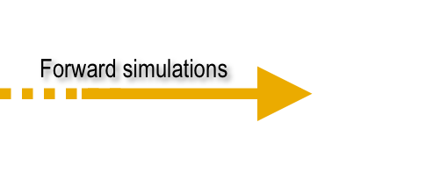

Spin-up period
Historic fishing
No fishing
Any
Virgin
2009
Data model
Derived model
Derived model
‘Spin up’ period
Can create new model
(or not)

Slide 6
Exploring the File
  Open VMPA_setas_run_fishing_F.prm…
  Atlantis stops when
    parameter is wrong type or missing (error message on what went wrong)
    delete delete_to_halt_run
    flux error (symptom that rates wrong, check params)
    program crash (rare, but not impossible.... when asking for help send ALL files)

Slide 7


Thank you
CSIRO Marine & Atmospheric Research
Dr Beth Fulton
CEO Fellow
Phone: +61 3 6232 5018
Email: beth.fulton@csiro.au
Web: www.csiro.au/wfo
www.cmar.csiro.au
Contact Us
Phone: 1300 363 400 or +61 3 9545 2176
Email: enquiries@csiro.au Web: www.csiro.au

