Slide 1
Making Models - Geometry
Wealth from Oceans Flagship
Beth Fulton

Slide 2
Scales
Scales (and distribution) of each process and component
  spatial
  temporal
  biological resolution
  process resolution

Slide 3
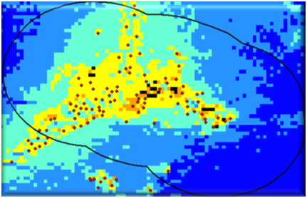
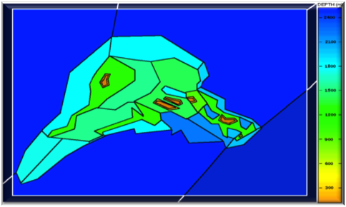
Spatial resolution
Scales
Homogeneous (grids)
  easier to handle conceptually (and easier to define cells)
  can be inefficient or “hard to fill”
Heterogeneous
  harder to handle conceptually (and harder to define cells)
  detail where needed
Mix-n-match (in one model some use homogeneous some use heterogeneous – e.g. in InVitro)

Slide 4









Spatial resolution
  High Low
  Lower variance shown through time and space
  Less heterogeneous environment and fewer refugia
  Increased self-simplification of trophic web
  Loss of spatial segregation of predator/prey
  Increased boundary condition effects
  Altered predictions of response to perturbation

Slide 5


















Temporal resolution
6, 12, 24 hours
Adaptive time-steps (for stability)
Mix-n-match
Biology (adaptive)
Physics
Biology (adaptive)
Physics

Slide 6
Bounds
What to include, what to leave out
  allow for transients?

Slide 7
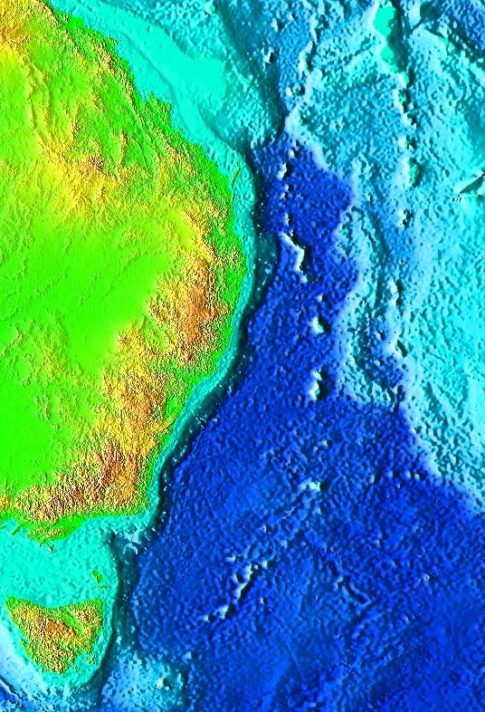
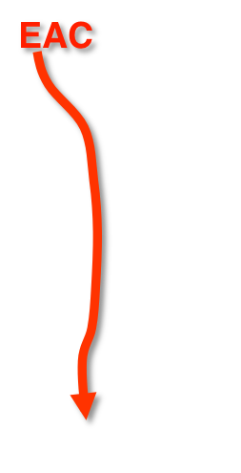

Bounds (example)
Oceanographic properties
  currents
  fronts
Tasman Front

Slide 8
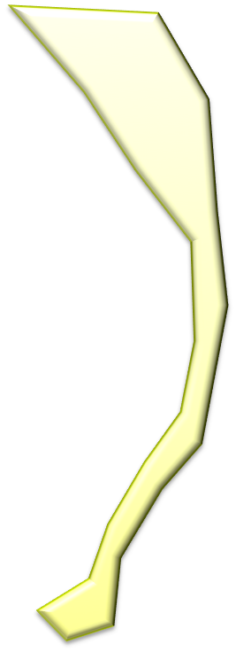



Bounds (example)
Biological distributions
  benthic
  pelagic
  at depth
  migratory
highly migratory

Slide 9

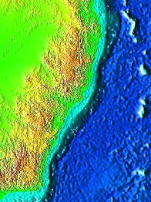
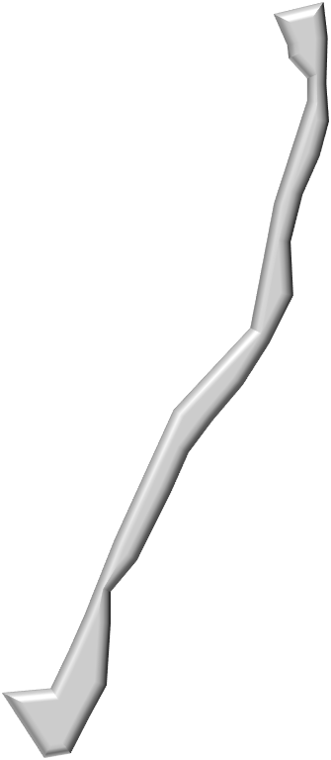
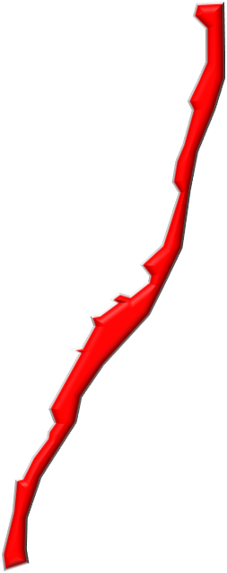
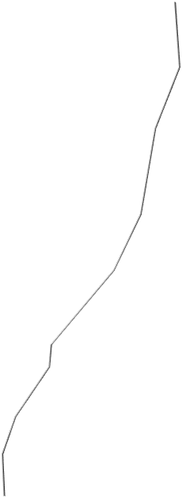
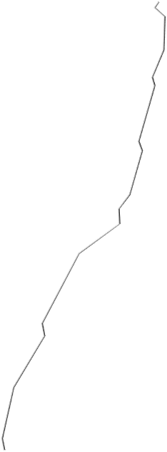



Bounds (example)
Combined
  constrictions
  major human input sites
  depth-structured (rivers/ inshore / shelf / break)
  boundary conditions
  migration boxes
LAYERS
0m
10m
50m
WATER COLUMN
100m
200m
EPIBENTHIC
< 1m
SEDIMENT

Slide 10
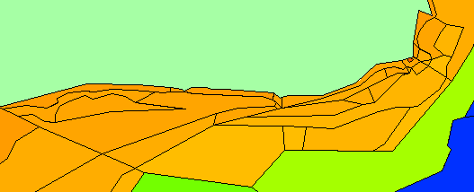
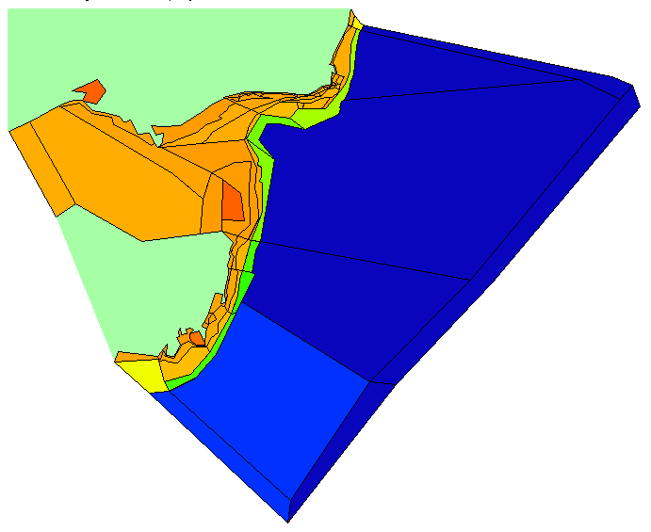

Telescoping

Slide 11
Exploring the File
  Hardwired rules
    Box 0 MUST be a boundary box
    Box 1 MUST be a dynamic box
  Open VMPA_setas.bgm…

Slide 12
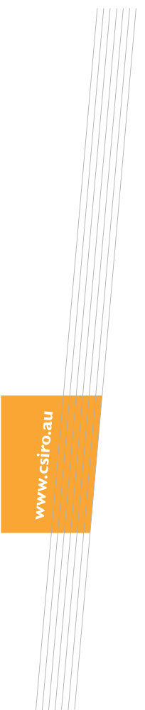

Thank you
CSIRO Marine & Atmospheric Research
Dr Beth Fulton
CEO Fellow
Phone: +61 3 6232 5018
Email: beth.fulton@csiro.au
Web: www.csiro.au/wfo
www.cmar.csiro.au
Contact Us
Phone: 1300 363 400 or +61 3 9545 2176
Email: enquiries@csiro.au Web: www.csiro.au

