Slide 1
Making Models – Physics
Wealth from Oceans Flagship
Beth Fulton

Slide 2
Atlantis Bits
  All components described elsewhere slotted together ► Atlantis
    physics = atphysics.lib
    ecological = atecology.lib
    assessment = atassess.lib
    fisheries and management = atmanage.lib
    socioeconomics = atecon.lib
    main loop = atlantismain.exe

Slide 3
Parameter files – For Each Bit
  Parameter files follow similar grouping
    physics = physics.prm and force.prm (+ ts files)
    ecological = biology.prm (+ functional.csv)
    assessment = assess.prm
    fisheries and management = harvest.prm
    socioeconomics = econ.prm
    run definition = run.prm
    initial conditions = in.nc (edit cdf version)

Slide 4

.bat file
Initial conditions
atlantis -i input.nc -o Output.nc -r at_run.prm -f at_force.prm -p at_physics.prm -b at_biol.prm -h at_harvest.prm -a ams_assess.prm -e at_econ.prm -s functionalGroups.csv
Output (basis of all output files)
forcing
ecological parameters
Can turn fisheries and economics off in run.prm (provide name but file can be empty)
Notes:
C:\Documents and Settings\kaplanis\My Documents\Atlantis\EMOCC_AtlantisWorkingCopy\run_emocc\RealNewellAug2009Hi0Free

Slide 5
Physic files
atlantis -i input.nc -o Output.nc -r at_run.prm -f at_force.prm -p at_physics.prm -b at_biol.prm -h at_harvest.prm -a ams_assess.prm -e at_econ.prm -s functionalGroups.csv
Notes:
C:\Documents and Settings\kaplanis\My Documents\Atlantis\EMOCC_AtlantisWorkingCopy\run_emocc\RealNewellAug2009Hi0Free

Slide 6


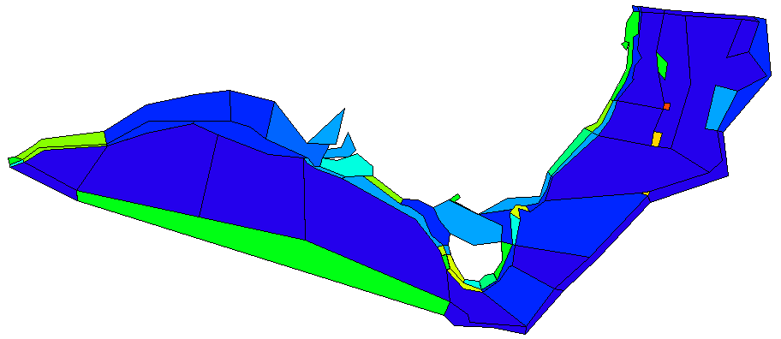
Geophysical
Bottom types (rough, flat, soft)
Canyons

Slide 7
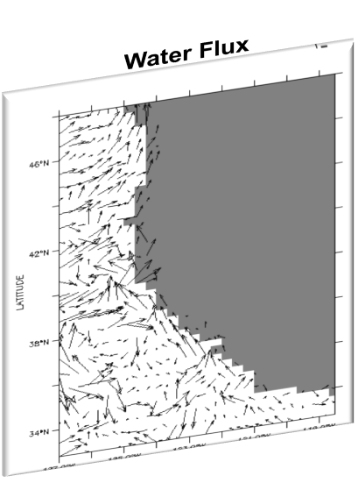
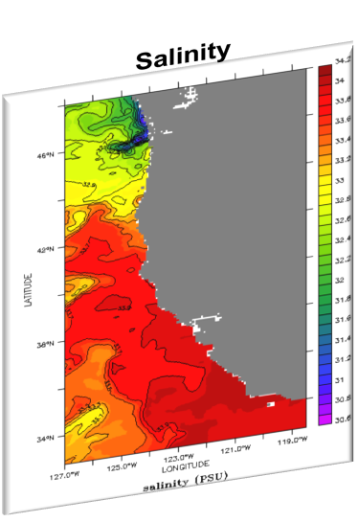
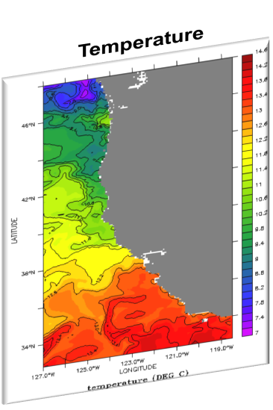
Oceanography

Slide 8
Dispersion
  Advection + diffusion

Slide 9
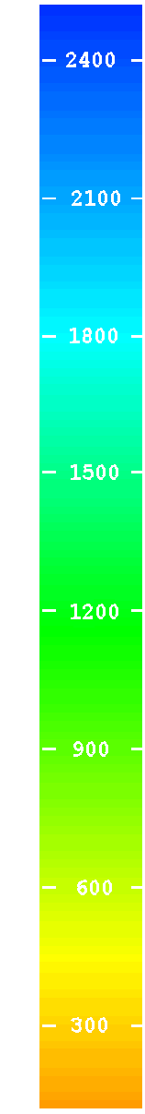
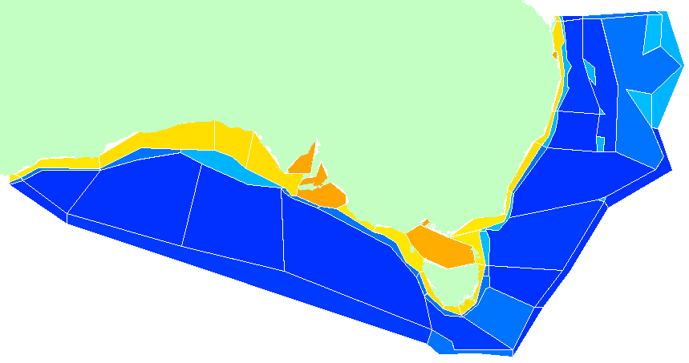
Hydrodynamic
0
50
150
250
750+
Pelagic
flows
upwelling (to surface or at depth)
Epibenthic
Sediment

Slide 10
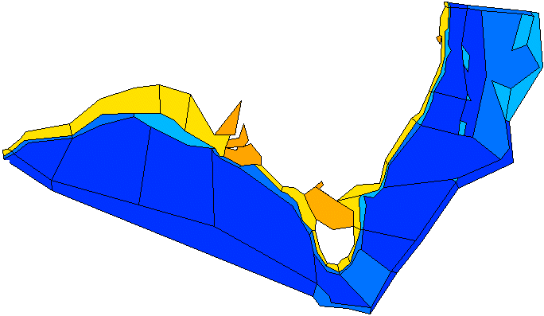
Depth structure
Each box contains:
  1+ sediment layer (oxic layer, but can become anoxic)
  multiple water column layers (≤5)
  dz based on bioregionalisation
0
50
150
250
700
1800

Slide 11
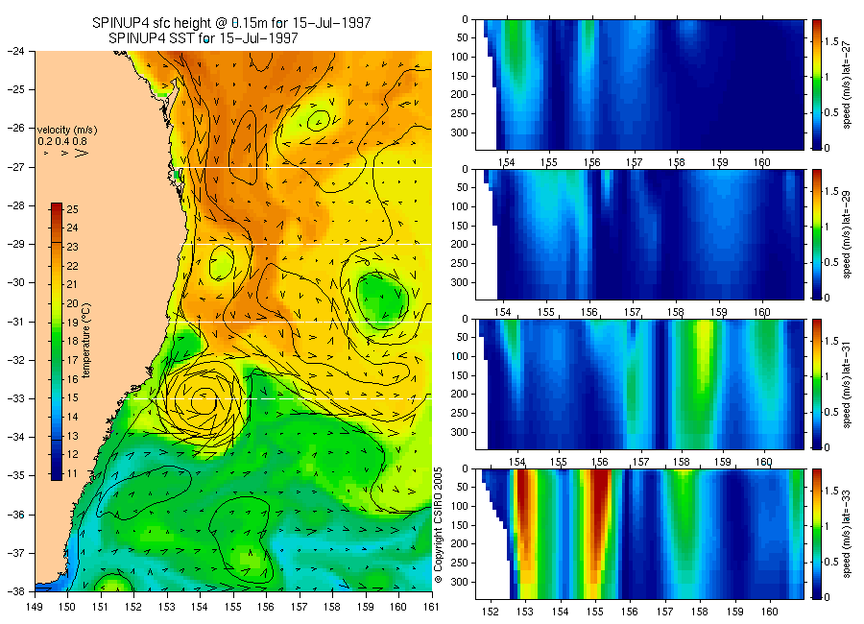
Bluelink
Currents
  horizontal
  vertical
Temperature
Salinity
Eddies

Slide 12
Transport
  Vectors from forcing file applied
  Forcing file contains ID of destination cell

Slide 13


Hyperdiffusion
  In cell once over one edge available everywhere
    transport effectively too high
    correct to regain correct transport
    inverse methods
    “area” correct and then tune scalar

Slide 14
Exploring the File
  Open VMPA_setas_force_fish.prm…

Slide 15
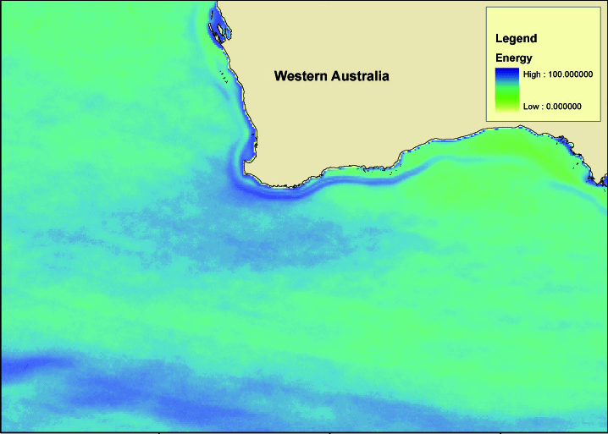
Eddies
  Forcing time series calculated from variation in surface height
    interpolate between quarterly values at site
    scale production accordingly

Slide 16
Decay (& Burial)
  Real decay (e.g. radionuclides) plus burial out of system
    rate set in in.nc

Slide 17

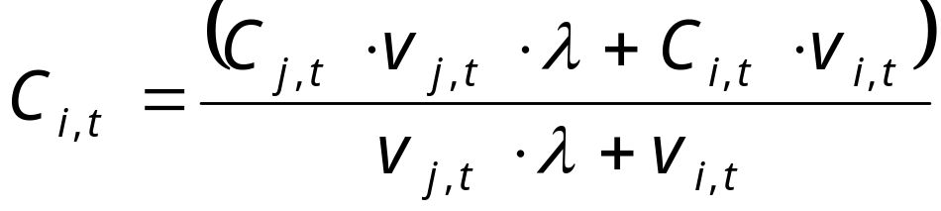

Physical processes
Vertical mixing, biorrigation, bioturbation, resuspension, settling, atmospheric exchange
  slab or gradient exchanges
  largely variants of:
  elaboration = through calculation of (e.g. product of rates, dependent on biology etc)
  decay and diffusion functions too

Slide 18
Exploring the File
  Open VMPA_setas_physics.prm…
  Common oops
    Trailing spaces if created in xls
    Be careful of “” from xls too
    If in linux (or mac) make sure have linux format files not Windows

Slide 19
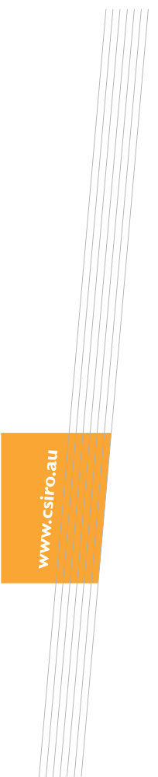

Thank you
CSIRO Marine & Atmospheric Research
Dr Beth Fulton
CEO Fellow
Phone: +61 3 6232 5018
Email: beth.fulton@csiro.au
Web: www.csiro.au/wfo
www.cmar.csiro.au
Contact Us
Phone: 1300 363 400 or +61 3 9545 2176
Email: enquiries@csiro.au Web: www.csiro.au

